Slide 1
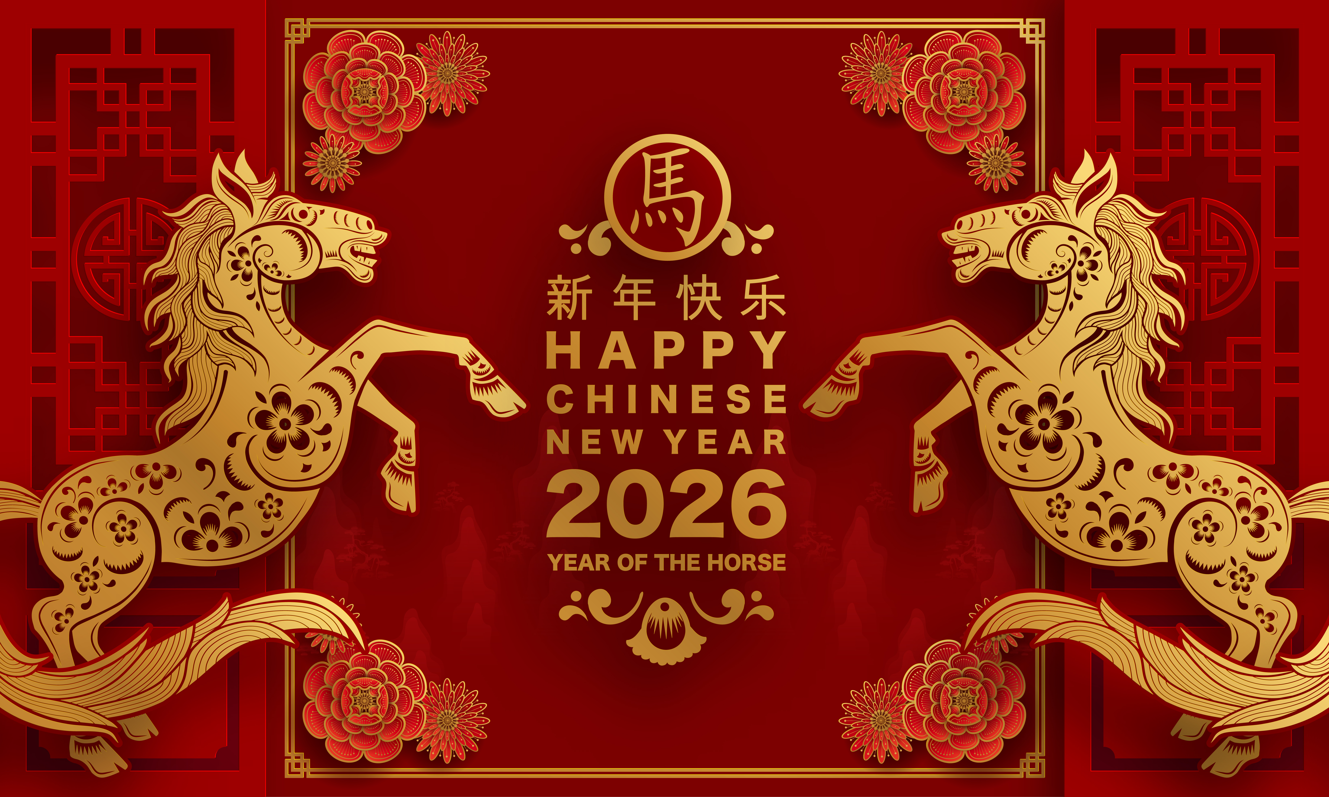

© Seomra Ranga 2026 www.seomraranga.com

Slide 2
Chinese New Year
Chinese New Year has a history going back more than 3,000 years. It originally started as a way to mark the end of winter and the beginning of spring. The festival is deeply rooted in Chinese mythology and folklore.
© Seomra Ranga 2026 www.seomraranga.com

Slide 3
Chinese New Year
Chinese New Year is sometimes known as Lunar New Year (“lunar” meaning “relating to the moon”) because the dates of the celebration are dictated by the phase of the moon. This means that the celebrations are on different dates each year.
© Seomra Ranga 2026 www.seomraranga.com

Slide 4
Chinese New Year
Chinese New Year 2026 falls on Tuesday February 17th and continues until the celebrations conclude with the Lantern Festival on Tuesday March 3rd.
© Seomra Ranga 2026 www.seomraranga.com

Slide 5
Chinese New Year
Each year, Chinese New Year is associated with one of the twelve animals from the zodiac:
rat | horse
ox | goat
tiger | monkey
rabbit | rooster
dragon | dog
snake | pig
© Seomra Ranga 2026 www.seomraranga.com

Slide 6
Chinese New Year
This year, 2026, has been designated the Year of the Horse. The Horse is considered a symbol of speed, energy, vitality and freedom. Legend has it that people born in the year of a certain animal, have similar traits to that animal.
© Seomra Ranga 2026 www.seomraranga.com

Slide 7
Chinese New Year
In China, people are given seven days off work for Chinese New Year. This break for celebration and relaxation is sometimes known as Spring Festival. During this time, many people have a feast and visit family.
© Seomra Ranga 2026 www.seomraranga.com

Slide 8
Chinese New Year
Chinese New Year marks saying goodbye to the old year and welcoming luck and prosperity for the new one. Celebrations include firecrackers, fireworks, wearing red clothes and putting up red decorations.
© Seomra Ranga 2026 www.seomraranga.com

Slide 9
Chinese New Year
Children traditionally wear red clothes for Chinese New Year and receive gifts of money in colourful red envelopes.
© Seomra Ranga 2026 www.seomraranga.com

Slide 10
Chinese New Year
Families prepare for Chinese New Year by thoroughly cleaning their homes to get rid of any bad luck. Special foods are prepared for certain days during the celebrations.
© Seomra Ranga 2026 www.seomraranga.com

Slide 11
Chinese New Year
People also prepare for Chinese New Year by giving themselves a thorough cleaning to wash away the bad luck before the new year. Children and adults change into new clothes and shoes to celebrate the new year.
© Seomra Ranga 2026 www.seomraranga.com

Slide 12
Chinese New Year
Families decorate their homes inside and outside with special festive decorations to mark the new year. Streets and public spaces are also decorated with banners, flags, flowerpots and orange trees.
© Seomra Ranga 2026 www.seomraranga.com

Slide 13
Chinese New Year
At midnight on New Year’s Eve, noisy firecrackers and fireworks are set off to welcome in the new year. On New Year’s Day and in the following days, people return to their family homes and visit friends to offer good wishes for the new year.
© Seomra Ranga 2026 www.seomraranga.com

Slide 14
Chinese New Year
On New Year’s Eve, families gather together and celebrate the most important meal of the year. Every effort is made to have the best food on the table. These special dishes vary from region to region throughout China.
© Seomra Ranga 2026 www.seomraranga.com

Slide 15
Chinese New Year
The final event of Chinese New Year is the Lantern Festival. People hang up glowing lanterns or carry them during a special nighttime parade. The parade is a colourful event with dance and long colourful dragons brought through the streets.
© Seomra Ranga 2026 www.seomraranga.com

Slide 16
Chinese New Year
Chinese New Year occurs on the new moon that falls between January 21st and February 20th. These are the dates for the forthcoming years:
Year | Date | Animal
2027 | Feb. 6th | Goat
2028 | Jan. 26th | Monkey
2029 | Feb. 13th | Rooster
2030 | Feb. 3rd | Dog
2031 | Jan. 23rd | Pig
2032 | Feb. 11th | Rat
© Seomra Ranga 2026 www.seomraranga.com

Slide 17
Can you remember?
What is another name for Chinese New Year?
On what date does Chinese New Year fall this year?
What event marks the end of the celebrations for Chinese New Year?
How many animals are in the Zodiac?
© Seomra Ranga 2026 www.seomraranga.com

Slide 18
Can you remember?
What animal marks the celebrations of Chinese New Year this year?
What preparations do families make in advance of Chinese New Year?
How do families celebrate Chinese New Year?
What happens during the Lantern Festival?
© Seomra Ranga 2026 www.seomraranga.com

Slide 19
For Your Information
Thank you for downloading this Seomra Ranga resource. We hope that you find it practical and useful in your classroom.
Please be aware of the following conditions before using this resource.
Please DO:
Print and copy this resource so that you can use it with your pupils.
Make this resource available to your pupils in a private enclosed online space eg. Google Classroom, Seesaw, Edublogs etc.
Tell others if you have found it useful.
Please DO NOT:
Copy or share this resource (in part or whole) with others who have not joined our website. By becoming a member for themselves, they will help the site develop into the future.
Make this resource available on your school website for anyone to download.
Share this resource with participants on any sort of course
Share this resource with other teachers in online groups eg. Facebook Groups, WhatsApp Groups etc.
Kind regards, Seomra Ranga
© Seomra Ranga 2026 www.seomraranga.com

Slide 20

Resources used in this file from:
https://depositphotos.com/
© Seomra Ranga 2026 www.seomraranga.com

