Slide 1
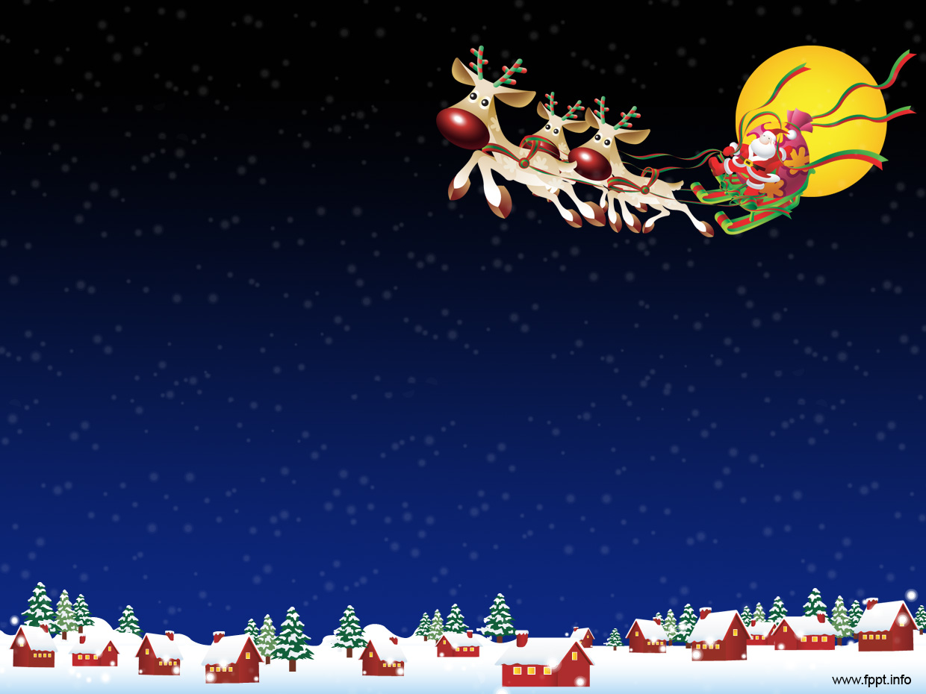

Santa Claus Around the World
© Seomra Ranga 2025 www.seomraranga.com

Slide 2
Santa Claus Around the World
Did you know that Santa Claus is called by countless names in many different countries? The names of Santa varies because of differences in cultures and Christmas traditions across the world. The following slides show the name given to Santa Claus throughout the world:
© Seomra Ranga 2025 www.seomraranga.com

Slide 3
Santa Claus Around the World
Joulupukki
Finland
© Seomra Ranga 2025 www.seomraranga.com

Slide 4
Santa Claus Around the World
Santa Claus
America
© Seomra Ranga 2025 www.seomraranga.com

Slide 5
Santa Claus Around the World
Papai Noel
Brazil
© Seomra Ranga 2025 www.seomraranga.com

Slide 6
Santa Claus Around the World
Shengdan Laoren
© Seomra Ranga 2025 www.seomraranga.com
China

Slide 7
Santa Claus Around the World
Viejo Pascuero
Chile
© Seomra Ranga 2025 www.seomraranga.com

Slide 8
Santa Claus Around the World
El Nino Jesus
Spain
© Seomra Ranga 2025 www.seomraranga.com

Slide 9
Santa Claus Around the World
Babbo Natale
Italy
© Seomra Ranga 2025 www.seomraranga.com

Slide 10
Santa Claus Around the World
Saint Nikolaus
Germany
© Seomra Ranga 2025 www.seomraranga.com

Slide 11
Santa Claus Around the World
San Nioclás
Ireland
© Seomra Ranga 2025 www.seomraranga.com

Slide 12
Santa Claus Around the World
De Kerstman
Netherlands
© Seomra Ranga 2025 www.seomraranga.com

Slide 13
Santa Claus Around the World
Hoteiosho
Japan
© Seomra Ranga 2025 www.seomraranga.com

Slide 14
Santa Claus Around the World
Black Peter
Morocco
© Seomra Ranga 2025 www.seomraranga.com

Slide 15
Santa Claus Around the World
Julenissen
Norway
© Seomra Ranga 2025 www.seomraranga.com

Slide 16
Santa Claus Around the World
Father Christmas
England
© Seomra Ranga 2025 www.seomraranga.com

Slide 17
Santa Claus Around the World
Pere Noel
France
© Seomra Ranga 2025 www.seomraranga.com

Slide 18
Santa Claus Around the World
Kaledu Senelis
Lithuania
© Seomra Ranga 2025 www.seomraranga.com

Slide 19
Santa Claus Around the World
Ded Moroz
Russia
© Seomra Ranga 2025 www.seomraranga.com

Slide 20
Santa Claus Around the World
Mikulas
Hungary
© Seomra Ranga 2025 www.seomraranga.com

Slide 21
Santa Claus Around the World
Kanakaloka
Hawaii
© Seomra Ranga 2025 www.seomraranga.com

Slide 22
Santa Claus Around the World
Papa Noel
Peru
© Seomra Ranga 2025 www.seomraranga.com

Slide 23
Santa Claus Around the World
Swiety Mikolaj
Poland
© Seomra Ranga 2025 www.seomraranga.com

Slide 24
Santa Claus Around the World
Jultomten
Sweden
© Seomra Ranga 2025 www.seomraranga.com

Slide 25
Santa Claus Around the World
Santa Claus
India
© Seomra Ranga 2025 www.seomraranga.com

Slide 26
For Your Information
Thank you for downloading this Seomra Ranga resource. We hope that you find it practical and useful in your classroom.
Please be aware of the following conditions before using this resource.
Please DO:
Print and copy this resource so that you can use it with your pupils.
Make this resource available to your pupils in a private enclosed online space eg. Google Classroom, Seesaw, Edublogs etc.
Tell others if you have found it useful.
Please DO NOT:
Copy or share this resource (in part or whole) with others who have not joined our website. By becoming a member for themselves, they will help the site develop into the future.
Make this resource available on your school website for anyone to download.
Share this resource with participants on any sort of course
Share this resource with other teachers in online groups eg. Facebook Groups, WhatsApp Groups etc.
Kind regards, Seomra Ranga
© Seomra Ranga 2025 www.seomraranga.com

Slide 27

Resources used in this file from:
https://www.free-power-point-templates.com/
© Seomra Ranga 2025 www.seomraranga.com

