Slide 1
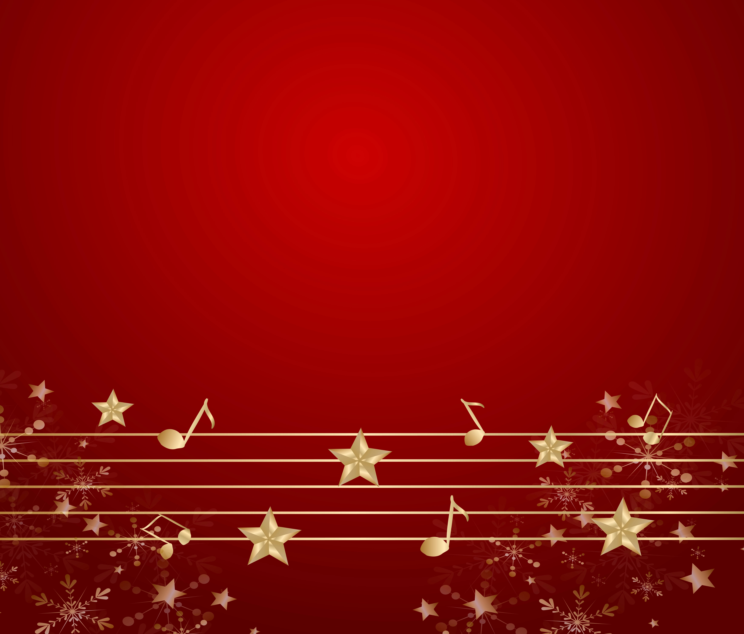

Finish the Christmas Lyrics
© Seomra Ranga 2025 www.seomraranga.com

Slide 2
Finish the Christmas lyric:
1
Last Christmas, I gave you my
* heart
* present
* money
* ring
© Seomra Ranga 2025 www.seomraranga.com

Slide 3
Finish the Christmas lyric:
2
Frosty the Snowman was a jolly, happy
* guy
* friend
* thing
* soul
© Seomra Ranga 2025 www.seomraranga.com

Slide 4
Finish the Christmas lyric:
3
When Santa got stuck up the
* tree
* roof
* chimney
* fire
© Seomra Ranga 2025 www.seomraranga.com

Slide 5
Finish the Christmas lyric:
4
I saw Mommy
Santa Claus
* hitting
* kissing
* feeding
* shaking
© Seomra Ranga 2025 www.seomraranga.com

Slide 6
Finish the Christmas lyric:
5
Good we bring to you and your kin
* wishes
* luck
* tidings
* cheer
© Seomra Ranga 2025 www.seomraranga.com

Slide 7
Finish the Christmas lyric:
6
All I want for Christmas is my two front
* teeth
* gates
* eyes
* lights
© Seomra Ranga 2025 www.seomraranga.com

Slide 8
Finish the Christmas lyric:
7
The first Noel, the
did say
* shepherds
* angels
* kings
* kids
© Seomra Ranga 2025 www.seomraranga.com

Slide 9
Finish the Christmas lyric:
8
We three kings of
are
* Nazareth
* Orient
* Egypt
* Ireland
© Seomra Ranga 2025 www.seomraranga.com

Slide 10
Finish the Christmas lyric:
9
Away in a manger, no
for a bed
* bunks
* stable
* crib
* cot
© Seomra Ranga 2025 www.seomraranga.com

Slide 11
Finish the Christmas lyric:
10
Silent night, holy night
All is all is bright
* cold
* dark
* noisy
* calm
© Seomra Ranga 2025 www.seomraranga.com

Slide 12
Finish the Christmas lyric:
11
Rudolph the red-nosed reindeer
Had a very nose
* shiny
* itchy
* flat
* runny
© Seomra Ranga 2025 www.seomraranga.com

Slide 13
Finish the Christmas lyric:
12
You better watch out, you better not
* fall
* cry
* laugh
* faint
© Seomra Ranga 2025 www.seomraranga.com

Slide 14
Finish the Christmas lyric:
13
O come all ye
* joyful
* followers
* faithful
* children
© Seomra Ranga 2025 www.seomraranga.com

Slide 15
Finish the Christmas lyric:
14
O the weather outside is
* lovely
* sunny
* awful
* frightful
© Seomra Ranga 2025 www.seomraranga.com

Slide 16
Finish the Christmas lyric:
15
Jolly old Saint
* Stephen
* Nicholas
* Mary
* Joan
© Seomra Ranga 2025 www.seomraranga.com

Slide 17
Finish the Christmas lyric:
16
we have heard on high
* Angels
* Elves
* Stars
* Snowmen
© Seomra Ranga 2025 www.seomraranga.com

Slide 18
Finish the Christmas lyric:
17
We’re walking in the
* park
* yard
* air
* town
© Seomra Ranga 2025 www.seomraranga.com

Slide 19
Finish the Christmas lyric:
18
It’s Christmas time,
and wine
* ivy
* mistletoe
* berries
* holly
© Seomra Ranga 2025 www.seomraranga.com

Slide 20
Finish the Christmas lyric:
19
Once in Royal David’s
* village
* town
* palace
* city
© Seomra Ranga 2025 www.seomraranga.com

Slide 21
Finish the Christmas lyric:
20
Jingle bell, jingle bell,
Jingle bell
* stone
* tree
* rock
* ring
© Seomra Ranga 2025 www.seomraranga.com

Slide 22
Finish the Christmas lyric:
21
I wanna wish you a Merry Christmas from the bottom of my
* foot
* heart
* stairs
* arm
© Seomra Ranga 2025 www.seomraranga.com

Slide 23
Finish the Christmas lyric:
22
The and the ivy
* holly
* mistletoe
* berries
* plant
© Seomra Ranga 2025 www.seomraranga.com

Slide 24
Finish the Christmas lyric:
23
Hark, the herald angels
* cry
* sing
* chant
* shout
© Seomra Ranga 2025 www.seomraranga.com

Slide 25
Finish the Christmas lyric:
24
O little town of
* Nazareth
* Bethlehem
* Tralee
* Jerusalem
© Seomra Ranga 2025 www.seomraranga.com

Slide 26
Finish the Christmas lyric:
25
God rest ye merry
* children
* singers
* angels
* gentlemen
© Seomra Ranga 2025 www.seomraranga.com

Slide 27
Finish the Christmas lyric:
26
In the bleak
* midautumn
* midspring
* midwinter
* midsummer
© Seomra Ranga 2025 www.seomraranga.com

Slide 28
Finish the Christmas lyric:
27
Ding dong merrily on
* high
* low
* wide
* sky
© Seomra Ranga 2025 www.seomraranga.com

Slide 29
Finish the Christmas lyric:
28
is fallin’, all around me
* leaves
* rain
* snow
* lights
© Seomra Ranga 2025 www.seomraranga.com

Slide 30
Finish the Christmas lyric:
29
Rockin’ around the Christmas
* cake
* tree
* angel
* pudding
© Seomra Ranga 2025 www.seomraranga.com

Slide 31
Finish the Christmas lyric:
30
roasting on an open fire
* almonds
* peanuts
* walnuts
* chestnuts
© Seomra Ranga 2025 www.seomraranga.com

Slide 32
Finish the Christmas lyric:
31
All I want for Christmas is
* her
* you
* him
* me
© Seomra Ranga 2025 www.seomraranga.com

Slide 33
Finish the Christmas lyric:
32
It’s beginning to look a lot like
* snow
* Easter
* presents
* Christmas
© Seomra Ranga 2025 www.seomraranga.com

Slide 34
Finish the Christmas lyric:
33
I’m dreaming of a
Christmas
* quiet
* happy
* white
* funny
© Seomra Ranga 2025 www.seomraranga.com

Slide 35
Finish the Christmas lyric:
34
So this is Christmas,
And what have you
* done
* bought
* seen
* heard
© Seomra Ranga 2025 www.seomraranga.com

Slide 36
Finish the Christmas lyric:
35
Little
On the dusty road
* sheep
* donkey
* camel
* cow
© Seomra Ranga 2025 www.seomraranga.com

Slide 37
Finish the Christmas lyric:
36
Long time ago in Bethlehem
So the holy said
* bible
* saint
* Mary
* baby
© Seomra Ranga 2025 www.seomraranga.com

Slide 38
Finish the Christmas lyric:
37
Good King Wenceslas looked out on the feast of
* New Year
* Joseph
* Stephen
* Christmas
© Seomra Ranga 2025 www.seomraranga.com

Slide 39
Finish the Christmas lyric:
38
On the first day of Christmas, my true love sent to me, a in a pear tree
* partridge
* dove
* wren
* owl
© Seomra Ranga 2025 www.seomraranga.com

Slide 40
Finish the Christmas lyric:
39
Deck the with boughs of holly
* roof
* halls
* house
* kitchen
© Seomra Ranga 2025 www.seomraranga.com

Slide 41
Finish the Christmas lyric:
40
While watched their flocks by night
* kings
* children
* shepherds
* angels
© Seomra Ranga 2025 www.seomraranga.com

Slide 42
Finish the Christmas lyric:
41
I’ll have a Christmas without you
* red
* white
* green
* blue
© Seomra Ranga 2025 www.seomraranga.com

Slide 43
Finish the Christmas lyric:
42
Here comes Santa Claus
Right down Santa Claus
* Street
* Town
* Lane
* Road
© Seomra Ranga 2025 www.seomraranga.com

Slide 44
Finish the Christmas lyric:
43
It’s the most
time of the year
* awful
* wonderful
* surprising
* stressful
© Seomra Ranga 2025 www.seomraranga.com

Slide 45
Finish the Christmas lyric:
44
I can’t really stay,
Baby it’s outside
* cold
* warm
* rainy
* windy
© Seomra Ranga 2025 www.seomraranga.com

Slide 46
Finish the Christmas lyric:
45
I’m home for Christmas
* walking
* driving
* running
* staying
© Seomra Ranga 2025 www.seomraranga.com

Slide 47
Finish the Christmas lyric:
46
Come on it’s lovely weather for a
ride together with you
* train
* car
* cart
* sleigh
© Seomra Ranga 2025 www.seomraranga.com

Slide 48
Finish the Christmas lyric:
47
Have yourself a little
Christmas
* merry
* happy
* jolly
* funny
© Seomra Ranga 2025 www.seomraranga.com

Slide 49
Finish the Christmas lyric:
48
I wish it could be Christmas
* again
* everyday
* non-stop
* tomorrow
© Seomra Ranga 2025 www.seomraranga.com

Slide 50
Finish the Christmas lyric:
49
It’ll be this Christmas
* funny
* happy
* lonely
* tiring
© Seomra Ranga 2025 www.seomraranga.com

Slide 51
Finish the Christmas lyric:
50
And there won’t be in Africa this Christmas time
* rain
* snow
* hail
* sunshine
© Seomra Ranga 2025 www.seomraranga.com

Slide 52
For Your Information
Thank you for downloading this Seomra Ranga resource. We hope that you find it practical and useful in your classroom.
Please be aware of the following conditions before using this resource.
Please DO:
Print and copy this resource so that you can use it with your pupils.
Make this resource available to your pupils in a private enclosed online space eg. Google Classroom, Seesaw, Edublogs etc.
Tell others if you have found it useful.
Please DO NOT:
Copy or share this resource (in part or whole) with others who have not joined our website. By becoming a member for themselves, they will help the site develop into the future.
Make this resource available on your school website for anyone to download.
Share this resource with participants on any sort of course
Share this resource with other teachers in online groups eg. Facebook Groups, WhatsApp Groups etc.
Kind regards, Seomra Ranga
© Seomra Ranga 2025 www.seomraranga.com

Slide 53


Resources used in this file from:
https://www.teacherspayteachers.com/Store/Hello-Literacy
https://depositphotos.com/
© Seomra Ranga 2025 www.seomraranga.com

