Slide 1
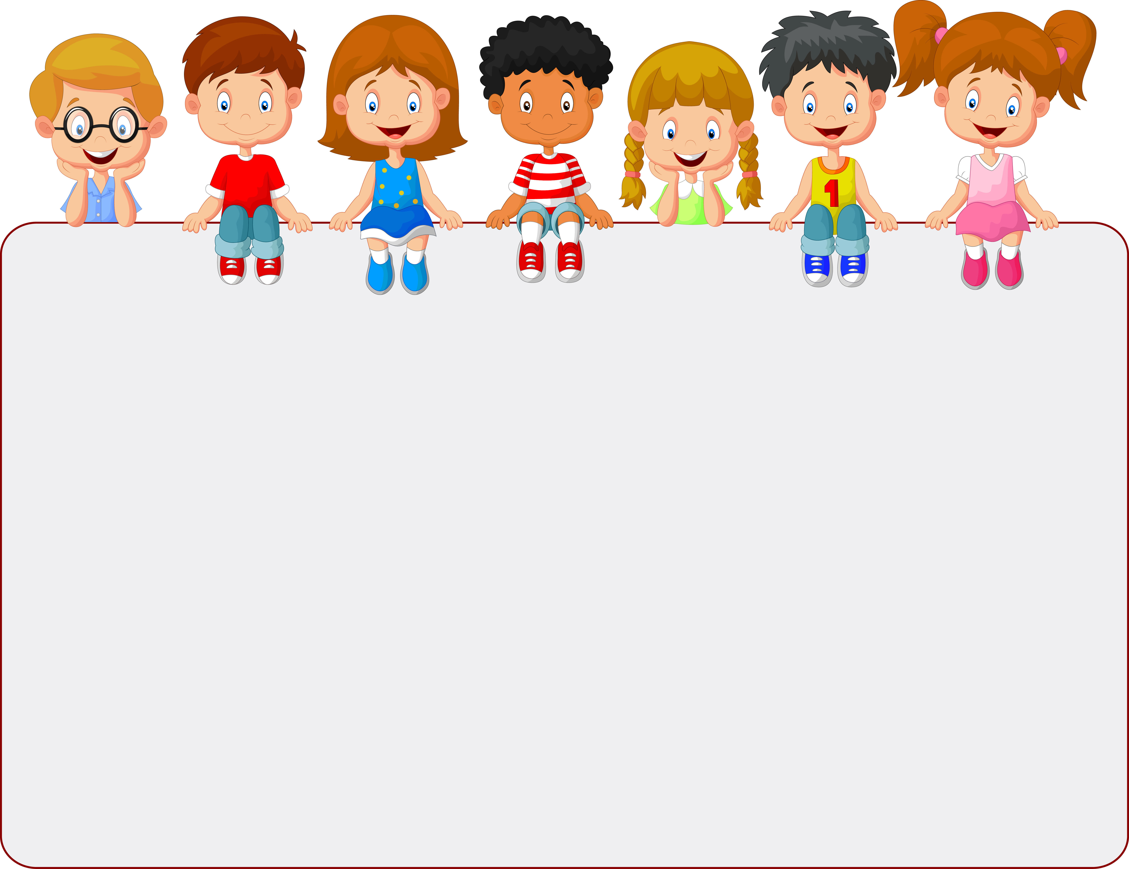



© Seomra Ranga 2025 www.seomraranga.com

Slide 2
Homonyms are words that sound the same, but they have a different spelling and have different meanings.
© Seomra Ranga 2025 www.seomraranga.com

Slide 3
Examples of these type of homonyms are:
to/two
here/hear
find/fined
© Seomra Ranga 2025 www.seomraranga.com

Slide 4
Homonyms could also be words that sound the same, are spelled the same but have different meanings.
© Seomra Ranga 2025 www.seomraranga.com

Slide 5
Examples of these type of homonyms are:
bark (the sound of a dog or a part of a tree)
nail (a part of a finger or for use with a hammer)
trunk (a part of an elephant or a part of a tree)
© Seomra Ranga 2025 www.seomraranga.com

Slide 6
The meaning of a sentence should help you to decide which spelling of a homonym to use.
© Seomra Ranga 2025 www.seomraranga.com

Slide 7
In the following slides there are sentences where you have to choose the correct spelling from the two homonyms given. Write the correct word on your whiteboard.
© Seomra Ranga 2025 www.seomraranga.com

Slide 8
For this activity you need:
a whiteboard
a marker
an eraser
© Seomra Ranga 2025 www.seomraranga.com

Slide 9
Ready to start ………
© Seomra Ranga 2025 www.seomraranga.com

Slide 10
Homonyms
Write the correct word on your whiteboard
I didn’t bring the (write/right) boots with me to the match.
1.
© Seomra Ranga 2025 www.seomraranga.com

Slide 11
Homonyms
Write the correct word on your whiteboard
I felt (week/weak) after a twisting ride at the fair.
2.
© Seomra Ranga 2025 www.seomraranga.com

Slide 12
Homonyms
Write the correct word on your whiteboard
(Would/Wood) you like some ice-cream for dessert?
3.
© Seomra Ranga 2025 www.seomraranga.com

Slide 13
Homonyms
Write the correct word on your whiteboard
The bride put on her wedding (veil/vale) on her wedding day.
4.
© Seomra Ranga 2025 www.seomraranga.com

Slide 14
Homonyms
Write the correct word on your whiteboard
(They’re/There) going to their granny’s house tomorrow.
5.
© Seomra Ranga 2025 www.seomraranga.com

Slide 15
Homonyms
Write the correct word on your whiteboard
The boy looked (pail/pale) after seeing the ghost.
6.
© Seomra Ranga 2025 www.seomraranga.com

Slide 16
Homonyms
Write the correct word on your whiteboard
The sailor (tide/tied) the boat to the ring on the harbour wall.
7.
© Seomra Ranga 2025 www.seomraranga.com

Slide 17
Homonyms
Write the correct word on your whiteboard
“Can I have a (peace/piece) of cake?” asked the girl.
8.
© Seomra Ranga 2025 www.seomraranga.com

Slide 18
Homonyms
Write the correct word on your whiteboard
The dog hurt its (pause/paws) when the door closed suddenly.
9.
© Seomra Ranga 2025 www.seomraranga.com

Slide 19
Homonyms
Write the correct word on your whiteboard
I (passed/past) the butcher shop on my way to the bank.
10.
© Seomra Ranga 2025 www.seomraranga.com

Slide 20
Homonyms
Write the correct word on your whiteboard
(It’s/Its) going to be sunny weather today.
11.
© Seomra Ranga 2025 www.seomraranga.com

Slide 21
Homonyms
Write the correct word on your whiteboard
My sister got a new (pair/pear) of runners in the shop.
12.
© Seomra Ranga 2025 www.seomraranga.com

Slide 22
Homonyms
Write the correct word on your whiteboard
I heard the (peel/peal) of bells coming from the church spire.
13.
© Seomra Ranga 2025 www.seomraranga.com

Slide 23
Homonyms
Write the correct word on your whiteboard
She broke the (pain/pane) of glass in the window with the ball.
14.
© Seomra Ranga 2025 www.seomraranga.com

Slide 24
Homonyms
Write the correct word on your whiteboard
The boy filled a (pale/pail) of water from the well.
15.
© Seomra Ranga 2025 www.seomraranga.com

Slide 25
Homonyms
Write the correct word on your whiteboard
(Their/There) class was going on a trip to the zoo.
16.
© Seomra Ranga 2025 www.seomraranga.com

Slide 26
Homonyms
Write the correct word on your whiteboard
They couldn’t (hear/here) the alarm because of the thunder.
17.
© Seomra Ranga 2025 www.seomraranga.com

Slide 27
Homonyms
Write the correct word on your whiteboard
He tried to (bore/boar) a hole in the wall with the drill.
18.
© Seomra Ranga 2025 www.seomraranga.com

Slide 28
Homonyms
Write the correct word on your whiteboard
The girl opened the (gait/gate) to let the dog out.
19.
© Seomra Ranga 2025 www.seomraranga.com

Slide 29
Homonyms
Write the correct word on your whiteboard
The (guest/guessed) arrived at the party an hour early.
20.
© Seomra Ranga 2025 www.seomraranga.com

Slide 30
Homonyms
Write the correct word on your whiteboard
The (hare/hair) was scared and ran across the field .
21.
© Seomra Ranga 2025 www.seomraranga.com

Slide 31
Homonyms
Write the correct word on your whiteboard
The children thought that the circus was (grate/great).
22.
© Seomra Ranga 2025 www.seomraranga.com

Slide 32
Homonyms
Write the correct word on your whiteboard
The children went to the summer (fare/fair) in the afternoon.
23.
© Seomra Ranga 2025 www.seomraranga.com

Slide 33
Homonyms
Write the correct word on your whiteboard
The hungry boy ate the (hole/whole) bar of chocolate.
24.
© Seomra Ranga 2025 www.seomraranga.com

Slide 34
Homonyms
Write the correct word on your whiteboard
The children were encouraged to do (acts/axe) of kindness.
25.
© Seomra Ranga 2025 www.seomraranga.com

Slide 35
Homonyms
Write the correct word on your whiteboard
The man walked along as he (beat/beet) the drum.
26.
© Seomra Ranga 2025 www.seomraranga.com

Slide 36
Homonyms
Write the correct word on your whiteboard
The boat was parked in the (berth/birth) nearest the shop.
27.
© Seomra Ranga 2025 www.seomraranga.com

Slide 37
Homonyms
Write the correct word on your whiteboard
The (copse/cops) arrested the man for burglary.
28.
© Seomra Ranga 2025 www.seomraranga.com

Slide 38
Homonyms
Write the correct word on your whiteboard
She wore a beautiful dress and was the (bell/belle) of the ball.
29.
© Seomra Ranga 2025 www.seomraranga.com

Slide 39
Homonyms
Write the correct word on your whiteboard
John was (dyeing/dying) to try out his new computer game.
30.
© Seomra Ranga 2025 www.seomraranga.com

Slide 40
Homonyms
Write the correct word on your whiteboard
I went to the shop to (bye/buy) some ice-cream.
31.
© Seomra Ranga 2025 www.seomraranga.com

Slide 41
Homonyms
Write the correct word on your whiteboard
I was scared as the door opened slowly with a (creek/creak).
32.
© Seomra Ranga 2025 www.seomraranga.com

Slide 42
Homonyms
Write the correct word on your whiteboard
She (new/knew) the answer but was afraid to speak.
33.
© Seomra Ranga 2025 www.seomraranga.com

Slide 43
Homonyms
Write the correct word on your whiteboard
The birds (flue/flew) to a hotter country for the winter.
34.
© Seomra Ranga 2025 www.seomraranga.com

Slide 44
Homonyms
Write the correct word on your whiteboard
The guide (lead/led) the pupils on a tour of the gallery.
35.
© Seomra Ranga 2025 www.seomraranga.com

Slide 45
Homonyms
Write the correct word on your whiteboard
The choir sang a (him/hymn) during the church service.
36.
© Seomra Ranga 2025 www.seomraranga.com

Slide 46
Homonyms
Write the correct word on your whiteboard
The (flower/flour) had a sweet scent that attracted the bees.
37.
© Seomra Ranga 2025 www.seomraranga.com

Slide 47
Homonyms
Write the correct word on your whiteboard
The girl had to (holed/hold) the ladder while her dad cleaned the window.
38.
© Seomra Ranga 2025 www.seomraranga.com

Slide 48
Homonyms
Write the correct word on your whiteboard
The lady wrote a (check/cheque) to pay for the meal.
39.
© Seomra Ranga 2025 www.seomraranga.com

Slide 49
Homonyms
Write the correct word on your whiteboard
The (sent/scent) of her perfume filled the air.
40.
© Seomra Ranga 2025 www.seomraranga.com

Slide 50
Homonyms
Write the correct word on your whiteboard
She fell off the path and twisted her (heel/heal).
41.
© Seomra Ranga 2025 www.seomraranga.com

Slide 51
Homonyms
Write the correct word on your whiteboard
The boy went on a donkey ride at the summer (fate/fete).
42.
© Seomra Ranga 2025 www.seomraranga.com

Slide 52
Homonyms
Write the correct word on your whiteboard
Dad had to (hire/higher) a skip when clearing out the garage.
43.
© Seomra Ranga 2025 www.seomraranga.com

Slide 53
Homonyms
Write the correct word on your whiteboard
My sister took a large (bite/byte) from the apple.
44.
© Seomra Ranga 2025 www.seomraranga.com

Slide 54
Homonyms
Write the correct word on your whiteboard
My brother finished the running (course/coarse) in fifth place.
45.
© Seomra Ranga 2025 www.seomraranga.com

Slide 55
Homonyms
Write the correct word on your whiteboard
I got my (feet/feat) measured for new boots.
46.
© Seomra Ranga 2025 www.seomraranga.com

Slide 56
Homonyms
Write the correct word on your whiteboard
The judge asked for the (fax/facts) of the case to be read out.
47.
© Seomra Ranga 2025 www.seomraranga.com

Slide 57
Homonyms
Write the correct word on your whiteboard
The baby could hear the bird (cheep/cheap) in the cage.
48.
© Seomra Ranga 2025 www.seomraranga.com

Slide 58
Homonyms
Write the correct word on your whiteboard
The player was (band/banned) for three matches.
49.
© Seomra Ranga 2025 www.seomraranga.com

Slide 59
Homonyms
Write the correct word on your whiteboard
The old man was suffering from a bad case of (flue/flu).
50.
© Seomra Ranga 2025 www.seomraranga.com

Slide 60
For Your Information
Thank you for downloading this Seomra Ranga resource. We hope that you find it practical and useful in your classroom.
Please be aware of the following conditions before using this resource.
Please DO:
Print and copy this resource so that you can use it with your pupils.
Make this resource available to your pupils in a private enclosed online space eg. Google Classroom, Seesaw, Edublogs etc.
Tell others if you have found it useful.
Please DO NOT:
Copy or share this resource (in part or whole) with others who have not joined our website. By becoming a member for themselves, they will help the site develop into the future.
Make this resource available on your school website for anyone to download.
Share this resource with participants on any sort of course
Share this resource with other teachers in online groups eg. Facebook Groups, WhatsApp Groups etc.
Kind regards, Seomra Ranga
© Seomra Ranga 2025 www.seomraranga.com

Slide 61



Resources used in this file from:
https://www.teacherspayteachers.com/Store/Hello-Literacy
https://depositphotos.com/
https://www.textgiraffe.com/
© Seomra Ranga 2025 www.seomraranga.com

