Slide 1

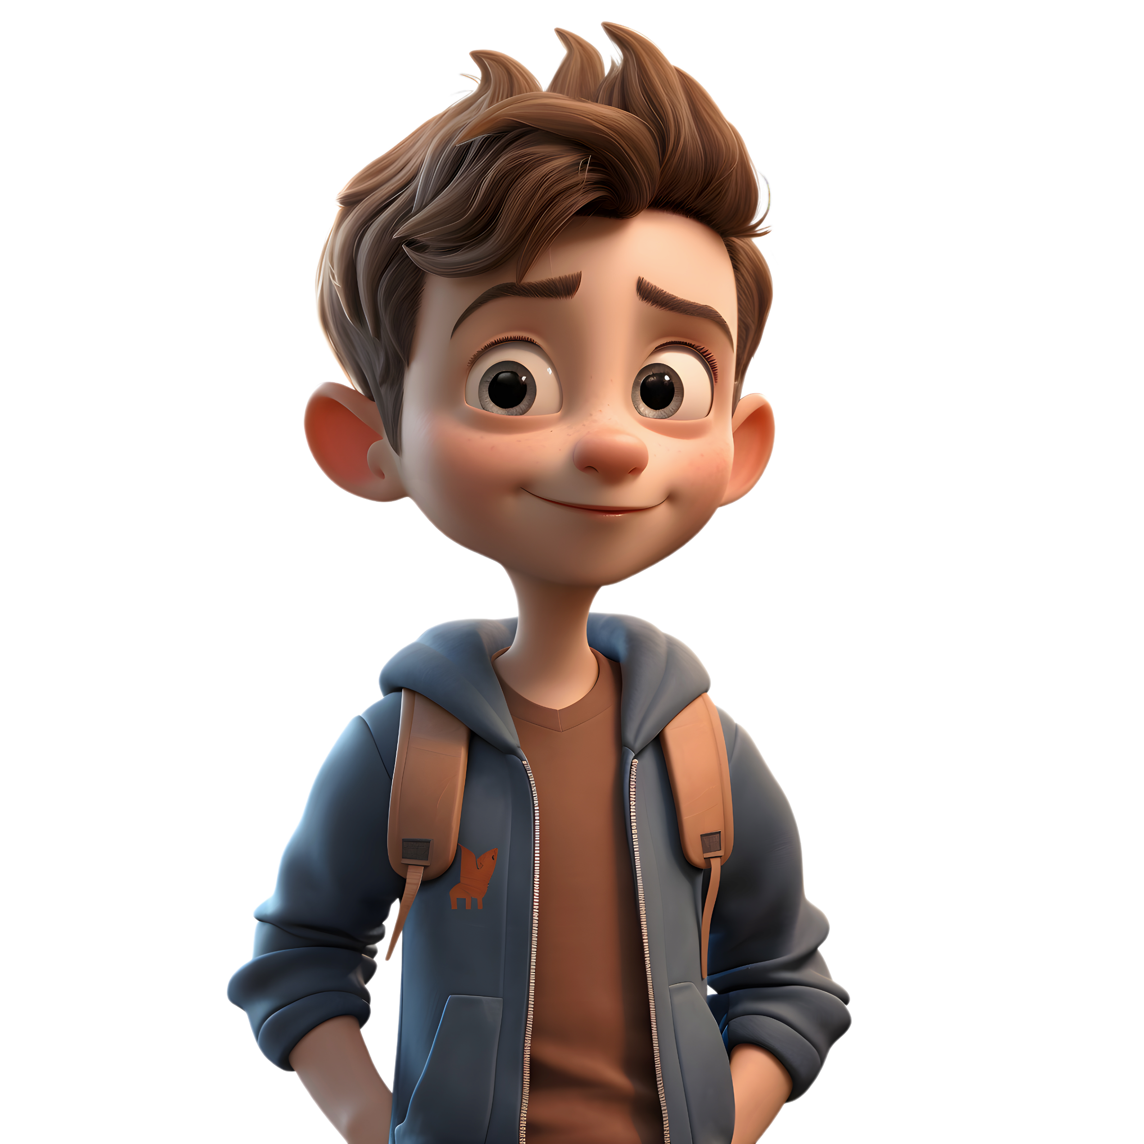


A Fun Oral
Language Game
© Seomra Ranga 2024 www.seomraranga.com

Slide 2
Hinky Pinkies is an activity based on having fun with language. Each slide gives you a clue. The answers to the clues all have two words, both of which rhyme. If both words have one syllable each, it’s called a Hink Pink. If both words have two syllables, it’s called a Hinky Pinky.
Examples:
Container for stones (Rocks Box)
Sugar on your toes (Sweet Feet)
Mickey Mouse’s thin wife (Skinny Minnie).
© Seomra Ranga 2024 www.seomraranga.com

Slide 3
Keep an eye out for these symbols on each slide – they give you a further clue if the answer is a Hink Pink or a Hinky Pinky:
HP1
This means it’s a Hink Pink with one syllable in each word in the answer
HP2
This means it’s a Hinkie Pinkie with two syllables in each word in the answer
© Seomra Ranga 2024 www.seomraranga.com

Slide 4
Ready to Start?
© Seomra Ranga 2024 www.seomraranga.com

Slide 5
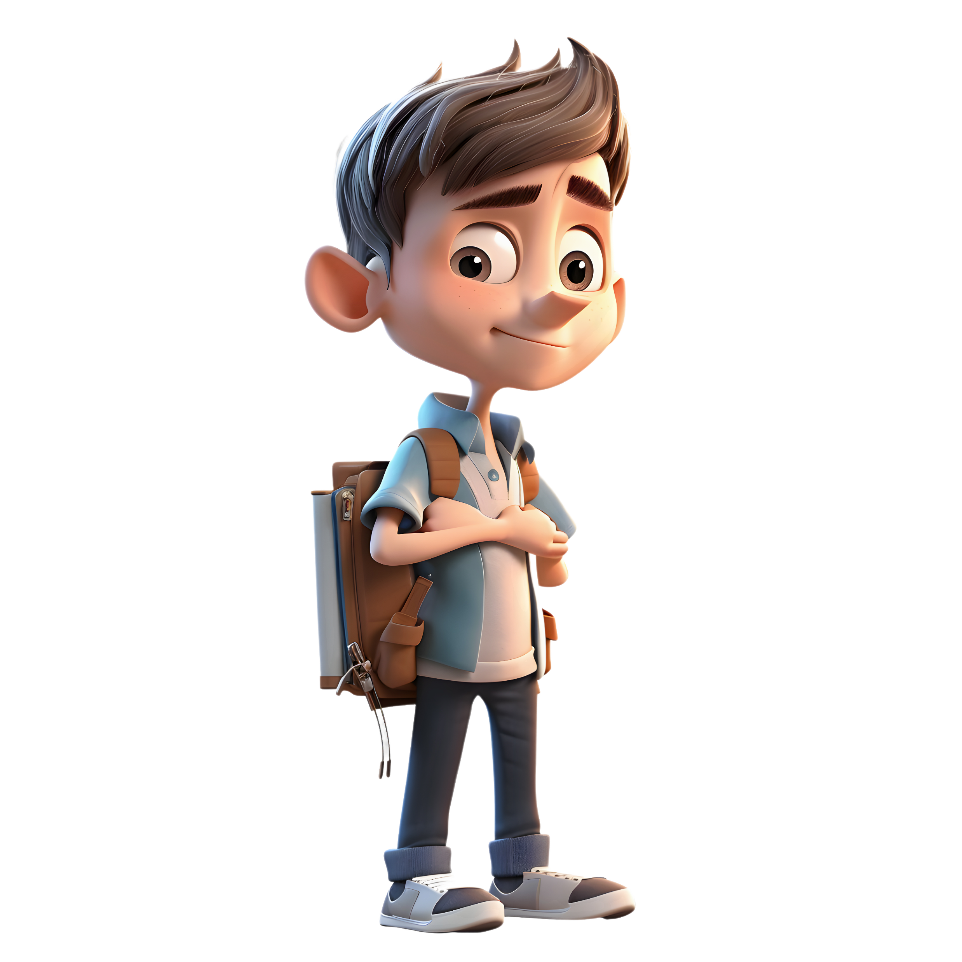
HP1
1
Jubilant Father
Glad Dad
© Seomra Ranga 2024 www.seomraranga.com

Slide 6
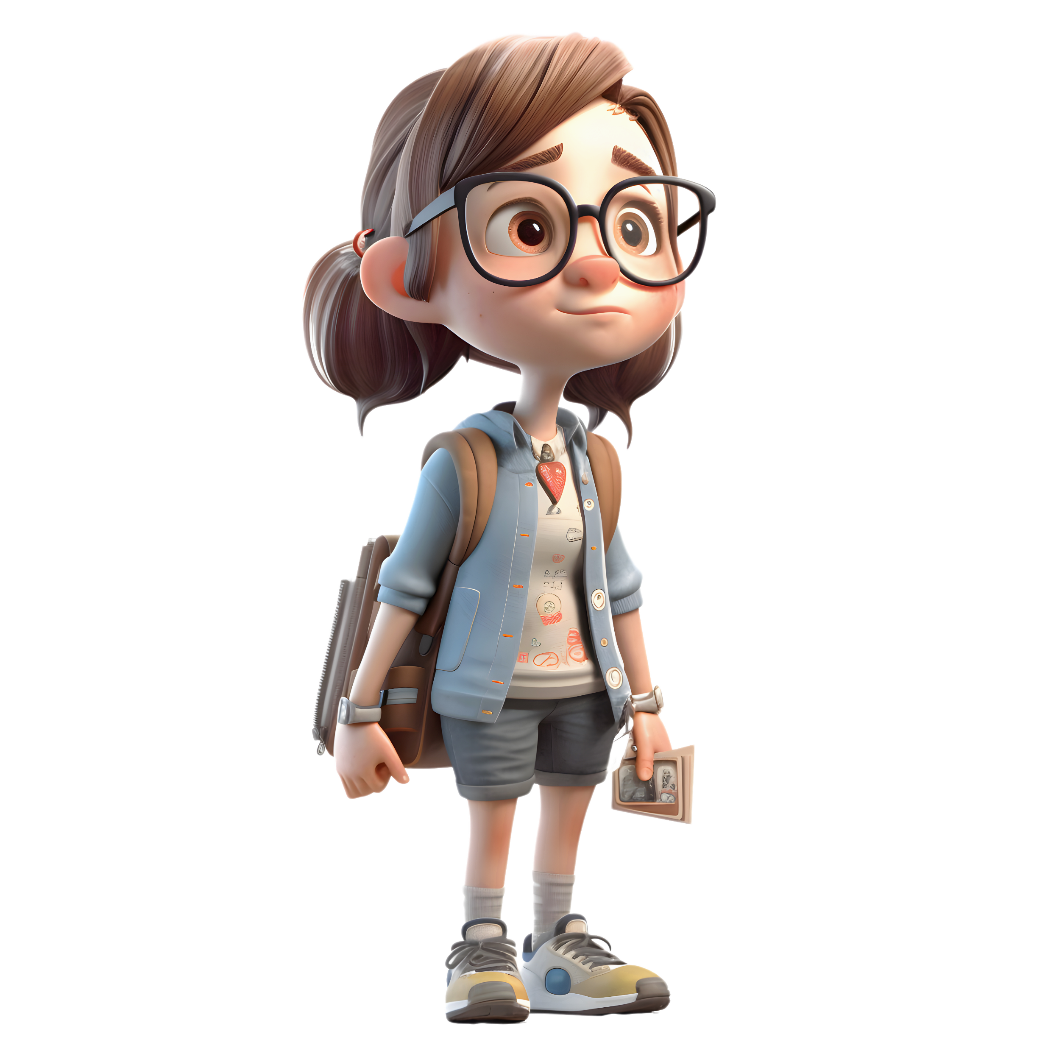
HP1
2
What an Insect Sees With
Flies Eyes
© Seomra Ranga 2024 www.seomraranga.com

Slide 7
HP2
3
Tired Flower
Lazy Daisy
© Seomra Ranga 2024 www.seomraranga.com

Slide 8
HP1
4
Jacket for a Ship
Boat Coat
© Seomra Ranga 2024 www.seomraranga.com

Slide 9
HP1
5
Orchestra at the Beach
Sand Band
© Seomra Ranga 2024 www.seomraranga.com

Slide 10
HP1
6
Plate of Salmon
Fish Dish
© Seomra Ranga 2024 www.seomraranga.com

Slide 11
HP1
7
Manual for a Chef
Cook Book
© Seomra Ranga 2024 www.seomraranga.com

Slide 12
HP1
8
First of the Fifth Month
May Day
© Seomra Ranga 2024 www.seomraranga.com

Slide 13
HP1
9
A Drenched Domestic Animal
Wet Pet
© Seomra Ranga 2024 www.seomraranga.com

Slide 14
HP1
10
A Really Great Group of Ships
Neat Fleet
© Seomra Ranga 2024 www.seomraranga.com

Slide 15
HP1
11
A Stupid Sea Bird
Dull Gull
© Seomra Ranga 2024 www.seomraranga.com

Slide 16
HP1
12
Bashful Insect
Shy Fly
© Seomra Ranga 2024 www.seomraranga.com

Slide 17
HP1
13
A Large Thing Made of Fake Hair
Big Wig
© Seomra Ranga 2024 www.seomraranga.com

Slide 18
HP2
14
A Humorous Rabbit
Funny Bunny
© Seomra Ranga 2024 www.seomraranga.com

Slide 19
HP1
15
A Rodent Could Wear This on its Head
Rat Hat
© Seomra Ranga 2024 www.seomraranga.com

Slide 20
HP1
16
Place Where a Small Rat-Like Animal Lives
Mole Hole
© Seomra Ranga 2024 www.seomraranga.com

Slide 21
HP2
17
A Smelly Little Finger
Stinky Pinkie
© Seomra Ranga 2024 www.seomraranga.com

Slide 22
HP1
18
Kind Rodents
Nice Mice
© Seomra Ranga 2024 www.seomraranga.com

Slide 23
HP2
19
A Small Violin
Little Fiddle
© Seomra Ranga 2024 www.seomraranga.com

Slide 24
HP2
20
Something Humorous that Bees Make
Funny Honey
© Seomra Ranga 2024 www.seomraranga.com

Slide 25
HP2
21
A Cow War
Cattle Battle
© Seomra Ranga 2024 www.seomraranga.com

Slide 26
HP2
22
A Strong Interest in Clothes
Fashion Passion
© Seomra Ranga 2024 www.seomraranga.com

Slide 27
HP1
23
A Really Nice Road
Neat Street
© Seomra Ranga 2024 www.seomraranga.com

Slide 28
HP1
24
Overweight Feline
Fat Cat
© Seomra Ranga 2024 www.seomraranga.com

Slide 29
HP2
25
Funny Female Horse
Silly Filly
© Seomra Ranga 2024 www.seomraranga.com

Slide 30
HP1
26
Shop Entrance
Store Door
© Seomra Ranga 2024 www.seomraranga.com

Slide 31
HP1
27
Large Truck
Big Rig
© Seomra Ranga 2024 www.seomraranga.com

Slide 32
HP2
28
When Numerals Sleep
Number Slumber
© Seomra Ranga 2024 www.seomraranga.com

Slide 33
HP2
29
Lawful Bird
Legal Eagle
© Seomra Ranga 2024 www.seomraranga.com

Slide 34
HP1
30
Intelligent Beginning
Smart Start
© Seomra Ranga 2024 www.seomraranga.com

Slide 35
HP1
31
Huge Hog
Big Pig
© Seomra Ranga 2024 www.seomraranga.com

Slide 36
HP2
32
One Who Lives in a Basement
Cellar Dweller
© Seomra Ranga 2024 www.seomraranga.com

Slide 37
HP1
33
Unhappy Father
Sad Dad
© Seomra Ranga 2024 www.seomraranga.com

Slide 38
HP1
34
Body of Water that is Not Real
Fake Lake
© Seomra Ranga 2024 www.seomraranga.com

Slide 39
HP1
35
Boiling Pan
Hot Pot
© Seomra Ranga 2024 www.seomraranga.com

Slide 40
HP2
36
Smarter Boxer
Brighter Fighter
© Seomra Ranga 2024 www.seomraranga.com

Slide 41
HP1
37
A Funky Spectre
Cool Ghoul
© Seomra Ranga 2024 www.seomraranga.com

Slide 42
HP2
38
Sibling of a Skin Sore
Sister Blister
© Seomra Ranga 2024 www.seomraranga.com

Slide 43
HP2
39
A Bloody Tale
Gory Story
© Seomra Ranga 2024 www.seomraranga.com

Slide 44
HP2
40
A Bunny Custom
Rabbit Habit
© Seomra Ranga 2024 www.seomraranga.com

Slide 45
HP2
41
Humorous Cash
Funny Money
© Seomra Ranga 2024 www.seomraranga.com

Slide 46
HP2
42
Lady Computer Letter
Female Email
© Seomra Ranga 2024 www.seomraranga.com

Slide 47
HP2
43
Not a Young Rock
Older Boulder
© Seomra Ranga 2024 www.seomraranga.com

Slide 48
HP2
44
Soft Shaky Stomach
Jelly Belly
© Seomra Ranga 2024 www.seomraranga.com

Slide 49
HP2
45
Young Cat in Love
Smitten Kitten
© Seomra Ranga 2024 www.seomraranga.com

Slide 50
HP2
46
Big Hill that Spouts Out Water
Mountain Fountain
© Seomra Ranga 2024 www.seomraranga.com

Slide 51
HP2
47
Blossoming Plant’s Energy
Flower Power
© Seomra Ranga 2024 www.seomraranga.com

Slide 52
HP2
48
Improved Written Communication
Better Letter
© Seomra Ranga 2024 www.seomraranga.com

Slide 53
HP2
49
Sea Cream
Ocean Lotion
© Seomra Ranga 2024 www.seomraranga.com

Slide 54
HP1
50
Large Group of People That is Noisy
Loud Crowd
© Seomra Ranga 2024 www.seomraranga.com

Slide 55
HP2
51
A Stinky Sandwich Shop
Smelly Deli
© Seomra Ranga 2024 www.seomraranga.com

Slide 56
HP1
52
A Skinny Refuse Container
Thin Bin
© Seomra Ranga 2024 www.seomraranga.com

Slide 57
HP2
53
A Play Featuring a South American Mammal
Llama Drama
© Seomra Ranga 2024 www.seomraranga.com

Slide 58
HP2
54
Sweets Left on the Beach
Sandy Candy
© Seomra Ranga 2024 www.seomraranga.com

Slide 59
HP1
55
Light Red Beverage
Pink Drink
© Seomra Ranga 2024 www.seomraranga.com

Slide 60
HP1
56
Closet to Keep a Sweeping Tool
Broom Room
© Seomra Ranga 2024 www.seomraranga.com

Slide 61
57
A Green Vegetable that Lives in Athens
Greek Leek
© Seomra Ranga 2024 www.seomraranga.com

Slide 62
HP1
58
A Black Bird that Doesn’t Fly Very Fast
Slow Crow
© Seomra Ranga 2024 www.seomraranga.com

Slide 63
HP1
59
A Paperback Thief
Book Crook
© Seomra Ranga 2024 www.seomraranga.com

Slide 64
HP1
60
A Lengthy Tune
Long Song
© Seomra Ranga 2024 www.seomraranga.com

Slide 65
Hope you enjoyed these
© Seomra Ranga 2024 www.seomraranga.com

Slide 66
For Your Information
Thank you for downloading this Seomra Ranga resource. We hope that you find it practical and useful in your classroom.
Please be aware of the following conditions before using this resource.
Please DO:
Print and copy this resource so that you can use it with your pupils.
Make this resource available to your pupils in a private enclosed online space eg. Google Classroom, Seesaw, Edublogs etc.
Tell others if you have found it useful.
Please DO NOT:
Copy or share this resource (in part or whole) with others who have not joined our website. By becoming a member for themselves, they will help the site develop into the future.
Make this resource available on your school website for anyone to download.
Share this resource with participants on any sort of course
Share this resource with other teachers in online groups eg. Facebook Groups, WhatsApp Groups etc.
Kind regards, Seomra Ranga
© Seomra Ranga 2024 www.seomraranga.com

Slide 67


Resources used in this file from:
https://www.teacherspayteachers.com/Store/Hello-Literacy
https://depositphotos.com/
© Seomra Ranga 2024 www.seomraranga.com

