Slide 1


© Seomra Ranga 2024 www.seomraranga.com

Slide 2
Can you work out the words/phrases from the clues given?
© Seomra Ranga 2024 www.seomraranga.com

Slide 3
DR.
DO
Doctor Dolittle
© Seomra Ranga 2024 www.seomraranga.com
No. 1

Slide 4
LE
G
Broken Leg
© Seomra Ranga 2024 www.seomraranga.com
No. 2

Slide 5
HEAD
HEELS
Head Over Heels
© Seomra Ranga 2024 www.seomraranga.com
No. 3

Slide 6
BEN
Big Ben
© Seomra Ranga 2024 www.seomraranga.com
No. 4

Slide 7
ever
ever
ever
ever
gether
gether
Together Forever
© Seomra Ranga 2024 www.seomraranga.com
No. 5

Slide 8
Mr. Green
Mr. Wilson
Mr. Grey
Mr. Daly
YYY
Three Wise Men
© Seomra Ranga 2024 www.seomraranga.com
No. 6

Slide 9
gegs
gseg
Scrambled Eggs
© Seomra Ranga 2024 www.seomraranga.com
No. 7

Slide 10
SILENCE
Silence is Golden
© Seomra Ranga 2024 www.seomraranga.com
No. 8

Slide 11
D
O
B
L
E
DOUBLE
Double Cross
© Seomra Ranga 2024 www.seomraranga.com
No. 9

Slide 12
PROM
ISE
Broken Promise
© Seomra Ranga 2024 www.seomraranga.com
No. 10

Slide 13
YOU
ME
JUST
Just Between You and Me
© Seomra Ranga 2024 www.seomraranga.com
No. 11

Slide 14
ATHLON
ATHLON
ATHLON
Triathlon
© Seomra Ranga 2024 www.seomraranga.com
No. 12

Slide 15
JACK
Jack in the Box
© Seomra Ranga 2024 www.seomraranga.com
No. 13

Slide 16
EGGS EGGS EGGS EGGS
EGGS EGGS EGGS EGGS
EGGS EGGS EGGS EGGS
A Dozen Eggs
© Seomra Ranga 2024 www.seomraranga.com
No. 14

Slide 17
IT
IT
IT
IT
NONEED
No Need For It
© Seomra Ranga 2024 www.seomraranga.com
No. 15

Slide 18
BUCHOLEKET
There’s a Hole in the Bucket
© Seomra Ranga 2024 www.seomraranga.com
No. 16

Slide 19
COVERS
READING
Reading Under the Covers
© Seomra Ranga 2024 www.seomraranga.com
No. 17

Slide 20
REDNESOT
Return to Sender
© Seomra Ranga 2024 www.seomraranga.com
No. 18

Slide 21
GROUND
Feet
Feet
Feet
Feet
Feet
Feet
Six Feet Under the Ground
© Seomra Ranga 2024 www.seomraranga.com
No. 19

Slide 22
WHITE
GREEN
ORANGE
Tricolour
© Seomra Ranga 2024 www.seomraranga.com
No. 20

Slide 23
E
MADE
Ready Made
© Seomra Ranga 2024 www.seomraranga.com
No. 21

Slide 24
An Eye
An Eye
An Eye
An Eye
An Eye
An Eye for an Eye
© Seomra Ranga 2024 www.seomraranga.com
No. 22

Slide 25

DAY
IT
Call It a Day
© Seomra Ranga 2024 www.seomraranga.com
No. 23

Slide 26
FIVE
High Five
© Seomra Ranga 2024 www.seomraranga.com
No. 24

Slide 27
CYCLE
CYCLE
CYCLE
Tricycle
© Seomra Ranga 2024 www.seomraranga.com
No. 25

Slide 28
DON’T
ANKOOLGER
Don’t Look Back in Anger
© Seomra Ranga 2024 www.seomraranga.com
No. 26

Slide 29
ABSENT
Leave
ABSENT
Absent Without Leave
© Seomra Ranga 2024 www.seomraranga.com
No. 27

Slide 30
“You’re such a pain!”
+
Broken
Ankle
Add Insult to Injury
© Seomra Ranga 2024 www.seomraranga.com
No. 28

Slide 31
B
E
BUSH
T
A
Beat Around the Bush
© Seomra Ranga 2024 www.seomraranga.com
No. 29

Slide 32
Q Q Q Q
X
ME
Excuse Me
© Seomra Ranga 2024 www.seomraranga.com
No. 30

Slide 33
CU L8R
See You Later
© Seomra Ranga 2024 www.seomraranga.com
No. 31

Slide 34
HICKEN
Headless Chicken
© Seomra Ranga 2024 www.seomraranga.com
No. 32

Slide 35

ON
On the Ball
© Seomra Ranga 2024 www.seomraranga.com
No. 33

Slide 36

DIRT
€0.03
It Was Dirt Cheap
© Seomra Ranga 2024 www.seomraranga.com
No. 34

Slide 37
CHILLY
It’s a Little Chilly
© Seomra Ranga 2024 www.seomraranga.com
No. 35

Slide 38
Z
Z
Z
DEAD
Z
Dead Tired
© Seomra Ranga 2024 www.seomraranga.com
No. 36

Slide 39

ONCE
Once in a Blue Moon
© Seomra Ranga 2024 www.seomraranga.com
No. 37

Slide 40
✓
MID
DLE
Right in the Middle
© Seomra Ranga 2024 www.seomraranga.com
No. 38

Slide 41
S
T
R
A
W
S
T
R
A
W
S
T
R
A
W
S
T
R
A
W
S
T
R
A
W
S
T
R
A
W
S
T
R
A
W
The Last Straw
© Seomra Ranga 2024 www.seomraranga.com
No. 39

Slide 42
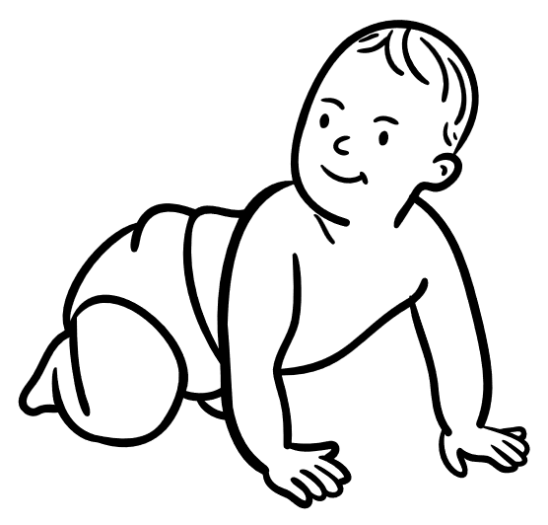
Looking
Looking After the Baby
© Seomra Ranga 2024 www.seomraranga.com
No. 40

Slide 43

PLAY IT
Play It By Ear
© Seomra Ranga 2024 www.seomraranga.com
No. 41

Slide 44
TOWN
ON
On the Right Side of Town
© Seomra Ranga 2024 www.seomraranga.com
No. 42

Slide 45
GET
IT
Get Over It
© Seomra Ranga 2024 www.seomraranga.com
No. 43

Slide 46
THING, THING, THING, THING, THING, THING, THING, THING, THING.
THING
One More Thing
© Seomra Ranga 2024 www.seomraranga.com
No. 44

Slide 47
BUN BUN BUN BUN
BUN BUN BUN BUN
BUN BUN BUN BUN BUN
A Baker’s Dozen
© Seomra Ranga 2024 www.seomraranga.com
No. 45

Slide 48

SIGHT
SIGHT
SIGHT
SIGHT
Love at First Sight
© Seomra Ranga 2024 www.seomraranga.com
No. 46

Slide 49
THEHANGRE
Hang in There
© Seomra Ranga 2024 www.seomraranga.com
No. 47

Slide 50
LONG STORY
LONG STORY
Make a Long Story Short
© Seomra Ranga 2024 www.seomraranga.com
No. 48

Slide 51
PAIN
GAIN
No Pain No Gain
© Seomra Ranga 2024 www.seomraranga.com
No. 49

Slide 52

UNDER
Under a Cloud
© Seomra Ranga 2024 www.seomraranga.com
No. 50

Slide 53
GARPADA
Father-in-Law
© Seomra Ranga 2024 www.seomraranga.com
No. 51

Slide 54
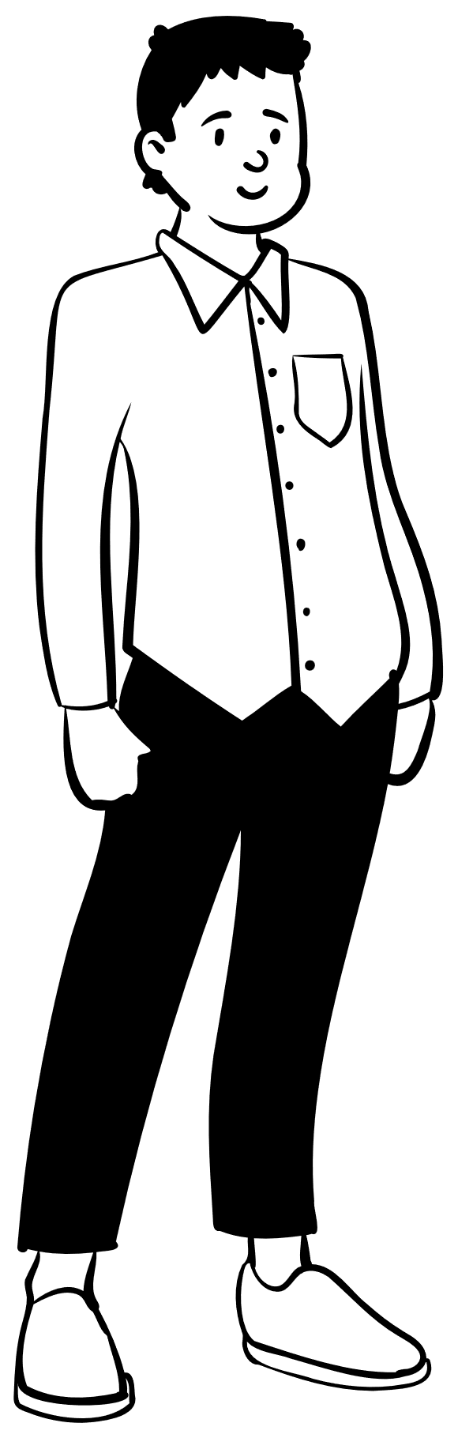
THAT
THAT
THAT
You Can Say That Again
© Seomra Ranga 2024 www.seomraranga.com
No. 52

Slide 55
DISBLESSINGGUISE
A Blessing in Disguise
© Seomra Ranga 2024 www.seomraranga.com
No. 53

Slide 56
Q
1st
First in the Queue
© Seomra Ranga 2024 www.seomraranga.com
No. 54

Slide 57
O
G
FLA MES
Go Up in Flames
© Seomra Ranga 2024 www.seomraranga.com
No. 55

Slide 58
OUT
OUT
OUT
OUT
1,2,3,4,5,6,7,8 …..
Out For the Count
© Seomra Ranga 2024 www.seomraranga.com
No. 56

Slide 59

IT
Sleep On It
© Seomra Ranga 2024 www.seomraranga.com
No. 57

Slide 60
EEEE E
PPPP E
Easy Peasy
© Seomra Ranga 2024 www.seomraranga.com
No. 58

Slide 61
URMO12”OUTH
Put a Foot in Your Mouth
© Seomra Ranga 2024 www.seomraranga.com
No. 59

Slide 62
K
E
E
R
C
PADDLE
Up the Creek Without a Paddle
© Seomra Ranga 2024 www.seomraranga.com
No. 60

Slide 63
For Your Information
Thank you for downloading this Seomra Ranga resource. We hope that you find it practical and useful in your classroom.
Please be aware of the following conditions before using this resource.
Please DO:
Print and copy this resource so that you can use it with your pupils.
Make this resource available to your pupils in a private enclosed online space eg. Google Classroom, Seesaw, Edublogs etc.
Tell others if you have found it useful.
Please DO NOT:
Copy or share this resource (in part or whole) with others who have not joined our website. By becoming a member for themselves, they will help the site develop into the future.
Make this resource available on your school website for anyone to download.
Share this resource with participants on any sort of course
Share this resource with other teachers in online groups eg. Facebook Groups, WhatsApp Groups etc.
Kind regards, Seomra Ranga
© Seomra Ranga 2024 www.seomraranga.com

Slide 64


Resources used in this file from:
https://www.teacherspayteachers.com/Store/Jax-And-Jake
https://www.textgiraffe.com/
© Seomra Ranga 2024 www.seomraranga.com

