Slide 1
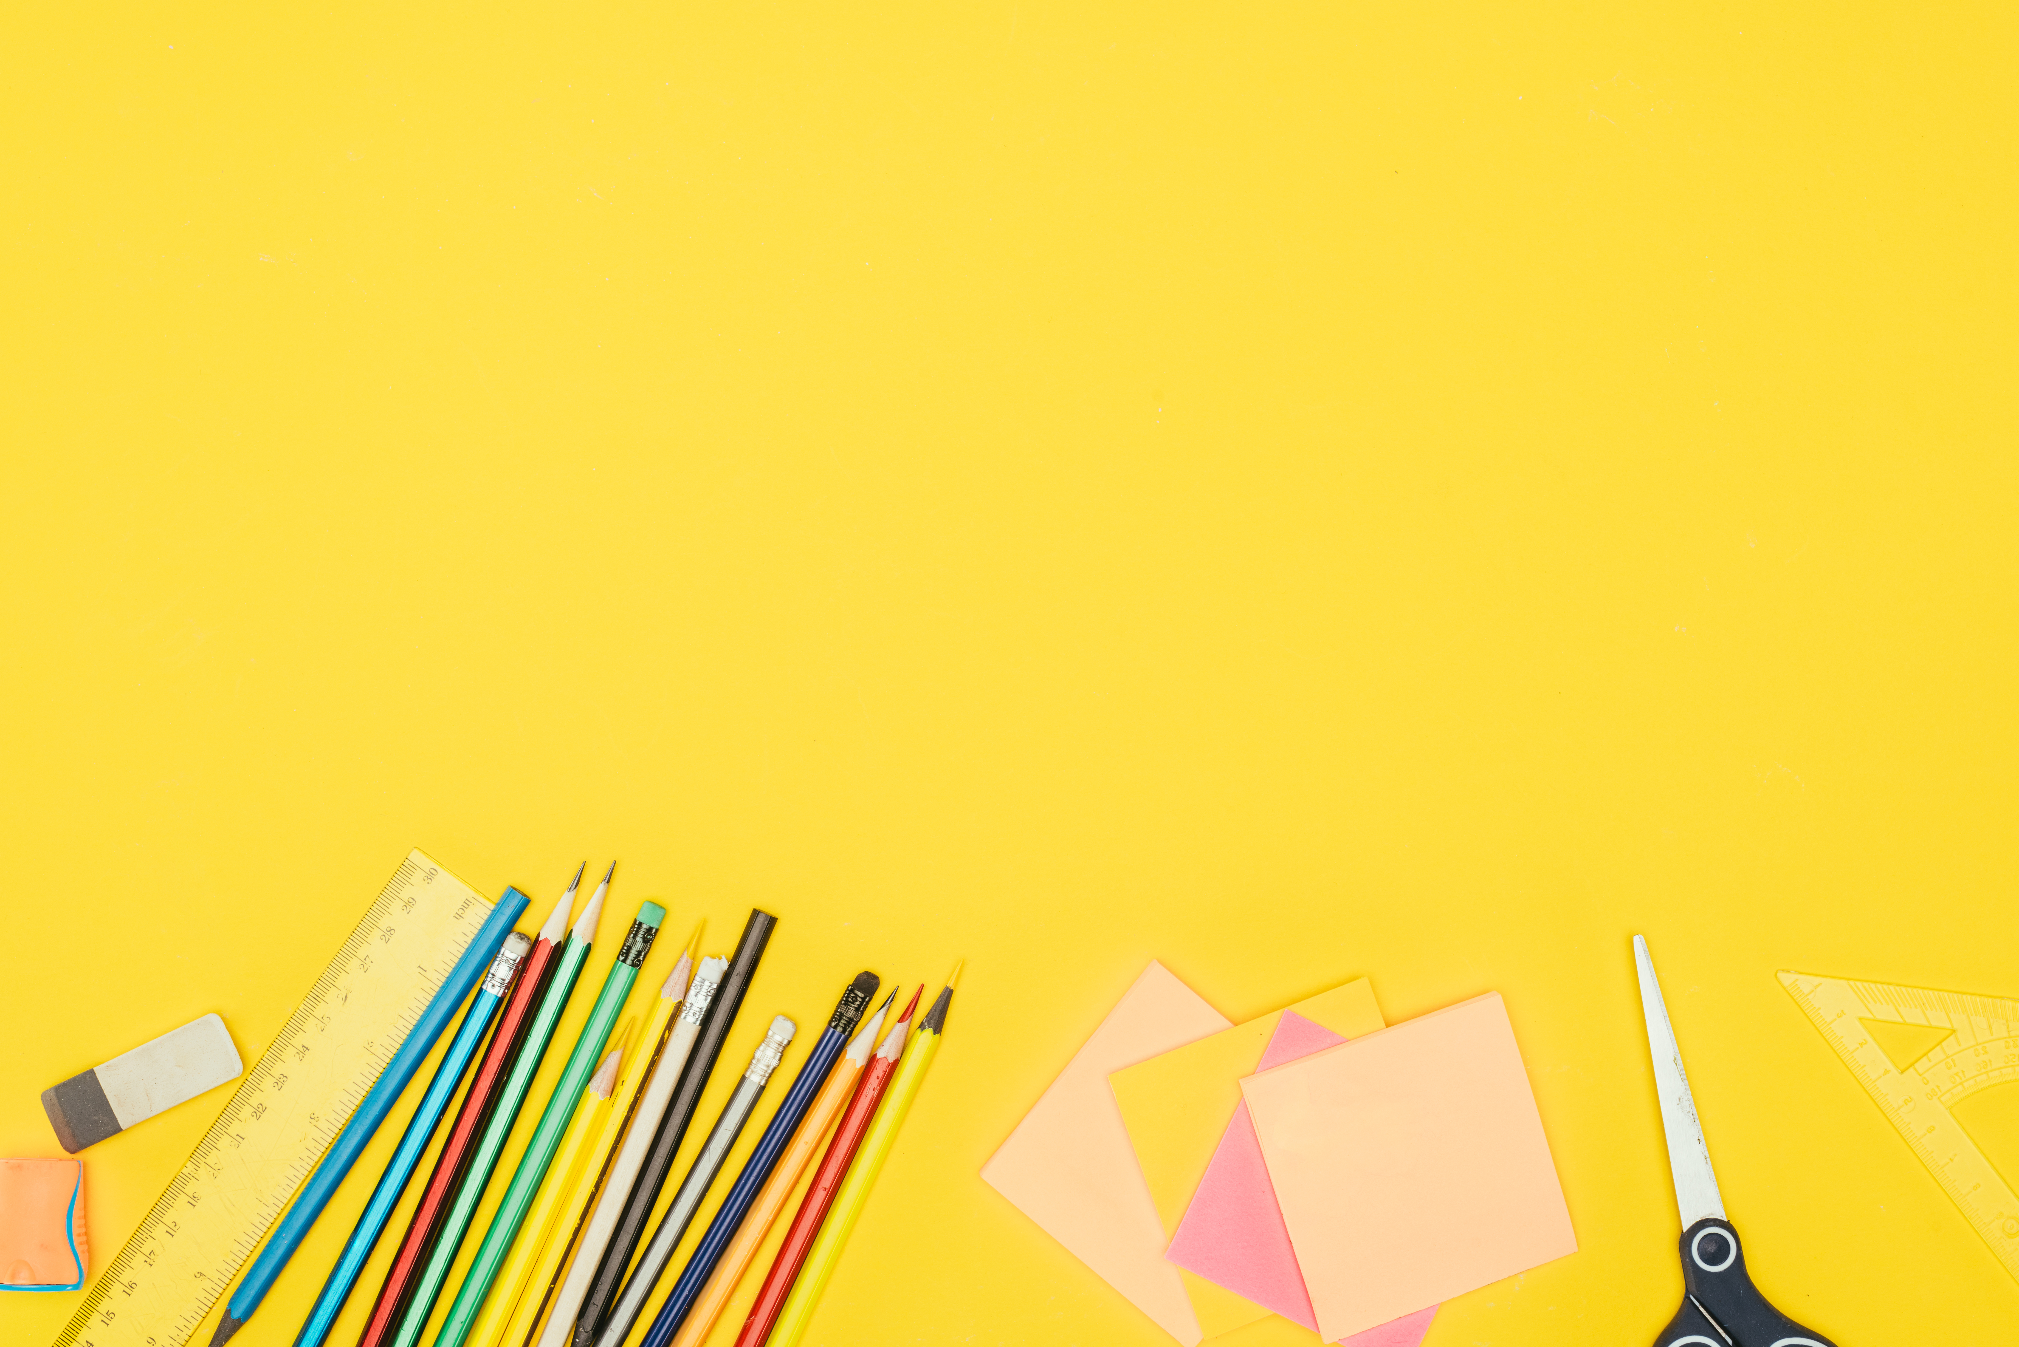

Unjumble the Sentences
There are six jumbled up words in each sentence. Write out the sentence in your copy in the correct order.
© Seomra Ranga 2023 www.seomraranga.com

Slide 2
Can you unjumble this sentence?
The
boy
ball.
blue
has
a
No. 1
© Seomra Ranga 2023 www.seomraranga.com

Slide 3
Did you get the sentence correct?
The
boy
has
a
blue
ball.
No. 1
© Seomra Ranga 2023 www.seomraranga.com

Slide 4
Can you unjumble this sentence?
red
girl
no
shoes.
has
The
No. 2
© Seomra Ranga 2023 www.seomraranga.com

Slide 5
Did you get the sentence correct?
The
girl
has
no
red
shoes.
No. 2
© Seomra Ranga 2023 www.seomraranga.com

Slide 6
Can you unjumble this sentence?
is
and
man
tall
thin.
The
No. 3
© Seomra Ranga 2023 www.seomraranga.com

Slide 7
Did you get the sentence correct?
The
man
is
tall
and
thin.
No. 3
© Seomra Ranga 2023 www.seomraranga.com

Slide 8
Can you unjumble this sentence?
The
curly
hair.
lady
brown
has
No. 4
© Seomra Ranga 2023 www.seomraranga.com

Slide 9
Did you get the sentence correct?
The
lady
has
curly
brown
hair.
No. 4
© Seomra Ranga 2023 www.seomraranga.com

Slide 10
Can you unjumble this sentence?
old
no
has
The
teeth.
man
No. 5
© Seomra Ranga 2023 www.seomraranga.com

Slide 11
Did you get the sentence correct?
The
old
man
has
no
teeth.
No. 5
© Seomra Ranga 2023 www.seomraranga.com

Slide 12
Can you unjumble this sentence?
My
years
is
old.
sister
five
No. 6
© Seomra Ranga 2023 www.seomraranga.com

Slide 13
Did you get the sentence correct?
My
sister
is
five
years
old.
No. 6
© Seomra Ranga 2023 www.seomraranga.com

Slide 14
Can you unjumble this sentence?
new
got
puppy.
black
a
We
No. 7
© Seomra Ranga 2023 www.seomraranga.com

Slide 15
Did you get the sentence correct?
We
got
a
new
black
puppy.
No. 7
© Seomra Ranga 2023 www.seomraranga.com

Slide 16
Can you unjumble this sentence?
off
the
fell
pole.
flag
Our
No. 8
© Seomra Ranga 2023 www.seomraranga.com

Slide 17
Did you get the sentence correct?
Our
flag
fell
off
the
pole.
No. 8
© Seomra Ranga 2023 www.seomraranga.com

Slide 18
Can you unjumble this sentence?
my
you
copy?
put
Where
did
No. 9
© Seomra Ranga 2023 www.seomraranga.com

Slide 19
Did you get the sentence correct?
Where
did
you
put
my
copy?
No. 9
© Seomra Ranga 2023 www.seomraranga.com

Slide 20
Can you unjumble this sentence?
Our
has
a
dog
paw.
sore
No. 10
© Seomra Ranga 2023 www.seomraranga.com

Slide 21
Did you get the sentence correct?
Our
dog
has
a
sore
paw.
No. 10
© Seomra Ranga 2023 www.seomraranga.com

Slide 22
Can you unjumble this sentence?
will
When
be
here?
cat
the
No. 11
© Seomra Ranga 2023 www.seomraranga.com

Slide 23
Did you get the sentence correct?
When
will
the
cat
be
here?
No. 11
© Seomra Ranga 2023 www.seomraranga.com

Slide 24
Can you unjumble this sentence?
This
copy.
new
maths
my
is
No. 12
© Seomra Ranga 2023 www.seomraranga.com

Slide 25
Did you get the sentence correct?
This
is
my
new
maths
copy.
No. 12
© Seomra Ranga 2023 www.seomraranga.com

Slide 26
Can you unjumble this sentence?
the
shop?
Are
going
to
you
No. 13
© Seomra Ranga 2023 www.seomraranga.com

Slide 27
Did you get the sentence correct?
Are
you
going
to
the
shop?
No. 13
© Seomra Ranga 2023 www.seomraranga.com

Slide 28
Can you unjumble this sentence?
use
the
pen
draw.
to
Don’t
No. 14
© Seomra Ranga 2023 www.seomraranga.com

Slide 29
Did you get the sentence correct?
Don’t
use
the
pen
to
draw.
No. 14
© Seomra Ranga 2023 www.seomraranga.com

Slide 30
Can you unjumble this sentence?
in
press.
Put
the
paint
the
No. 15
© Seomra Ranga 2023 www.seomraranga.com

Slide 31
Did you get the sentence correct?
Put
the
paint
in
the
press.
No. 15
© Seomra Ranga 2023 www.seomraranga.com

Slide 32
Can you unjumble this sentence?
boy
Tell
the
to
jumping.
stop
No. 16
© Seomra Ranga 2023 www.seomraranga.com

Slide 33
Did you get the sentence correct?
Tell
the
boy
to
stop
jumping.
No. 16
© Seomra Ranga 2023 www.seomraranga.com

Slide 34
Can you unjumble this sentence?
got
new
red
a
bike.
I
No. 17
© Seomra Ranga 2023 www.seomraranga.com

Slide 35
Did you get the sentence correct?
I
got
a
new
red
bike.
No. 17
© Seomra Ranga 2023 www.seomraranga.com

Slide 36
Can you unjumble this sentence?
can
some
buy
sweets?
Mum,
I
No. 18
© Seomra Ranga 2023 www.seomraranga.com

Slide 37
Did you get the sentence correct?
Mum,
can
I
buy
some
sweets?
No. 18
© Seomra Ranga 2023 www.seomraranga.com

Slide 38
Can you unjumble this sentence?
to
I
the
today.
circus
went
No. 19
© Seomra Ranga 2023 www.seomraranga.com

Slide 39
Did you get the sentence correct?
I
went
to
the
circus
today.
No. 19
© Seomra Ranga 2023 www.seomraranga.com

Slide 40
Can you unjumble this sentence?
from
leaves
the
trees.
The
fell
No. 20
© Seomra Ranga 2023 www.seomraranga.com

Slide 41
Did you get the sentence correct?
The
leaves
fell
from
the
trees.
No. 20
© Seomra Ranga 2023 www.seomraranga.com

Slide 42
Can you unjumble this sentence?
bus
went
school.
the
The
by
No. 21
© Seomra Ranga 2023 www.seomraranga.com

Slide 43
Did you get the sentence correct?
The
bus
went
by
the
school.
No. 21
© Seomra Ranga 2023 www.seomraranga.com

Slide 44
Can you unjumble this sentence?
to
went
family
Tom’s
zoo.
the
No. 22
© Seomra Ranga 2023 www.seomraranga.com

Slide 45
Did you get the sentence correct?
Tom’s
family
went
to
the
zoo.
No. 22
© Seomra Ranga 2023 www.seomraranga.com

Slide 46
Can you unjumble this sentence?
A
eat
monkey
likes
bananas.
to
No. 23
© Seomra Ranga 2023 www.seomraranga.com

Slide 47
Did you get the sentence correct?
A
monkey
likes
to
eat
bananas.
No. 23
© Seomra Ranga 2023 www.seomraranga.com

Slide 48
Can you unjumble this sentence?
sleeps
My
kennel.
his
in
dog
No. 24
© Seomra Ranga 2023 www.seomraranga.com

Slide 49
Did you get the sentence correct?
My
dog
sleeps
in
his
kennel.
No. 24
© Seomra Ranga 2023 www.seomraranga.com

Slide 50
Can you unjumble this sentence?
will
in
six
July.
Mary
be
No. 25
© Seomra Ranga 2023 www.seomraranga.com

Slide 51
Did you get the sentence correct?
Mary
will
be
six
in
July.
No. 25
© Seomra Ranga 2023 www.seomraranga.com

Slide 52
For Your Information
Thank you for downloading this Seomra Ranga resource. We hope that you find it practical and useful in your classroom.
Please be aware of the following conditions before using this resource.
Please DO:
Print and copy this resource so that you can use it with your pupils.
Make this resource available to your pupils in a private enclosed online space eg. Google Classroom, Seesaw, Edublogs etc.
Tell others if you have found it useful.
Please DO NOT:
Copy or share this resource (in part or whole) with others who have not joined our website. By becoming a member for themselves, they will help the site develop into the future.
Make this resource available on your school website for anyone to download.
Share this resource with participants on any sort of course
Share this resource with other teachers in online groups eg. Facebook Groups, WhatsApp Groups etc.
Kind regards, Seomra Ranga
© Seomra Ranga 2023 www.seomraranga.com

Slide 53

Resources used in this file from:
https://depositphotos.com/
© Seomra Ranga 2023 www.seomraranga.com

