Slide 1
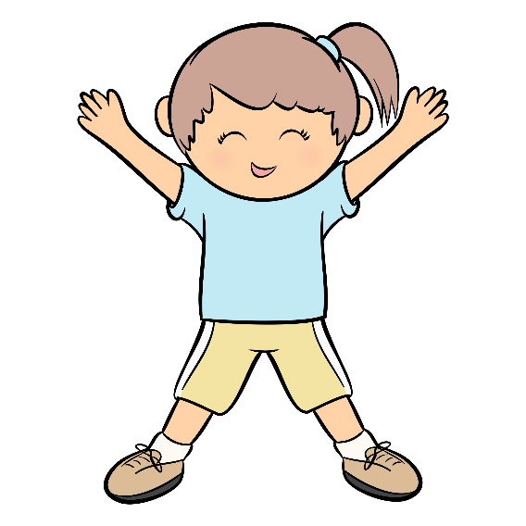
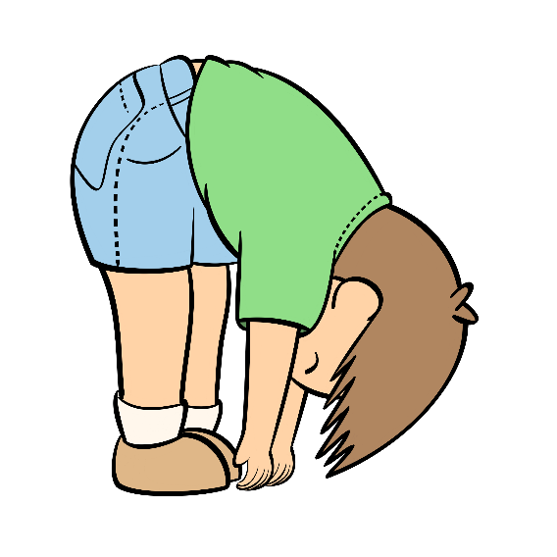
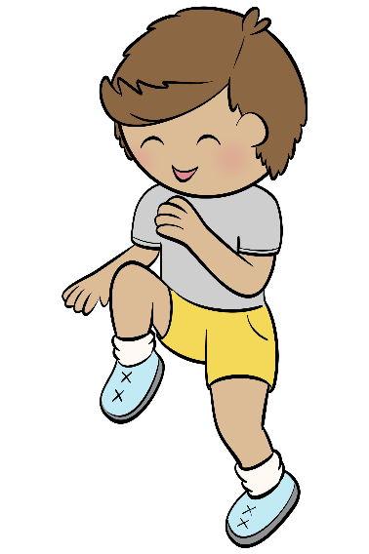
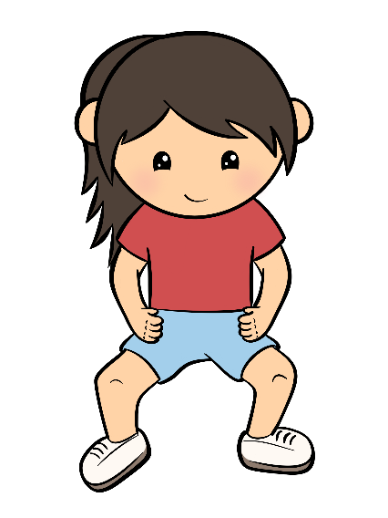

10 @ 10
10 simple exercises to do in the classroom at 10am every morning
© Seomra Ranga 2023 www.seomraranga.com

Slide 2

10 @ 10
10
Repeat
#1
High Knee Marching
© Seomra Ranga 2023 www.seomraranga.com

Slide 3
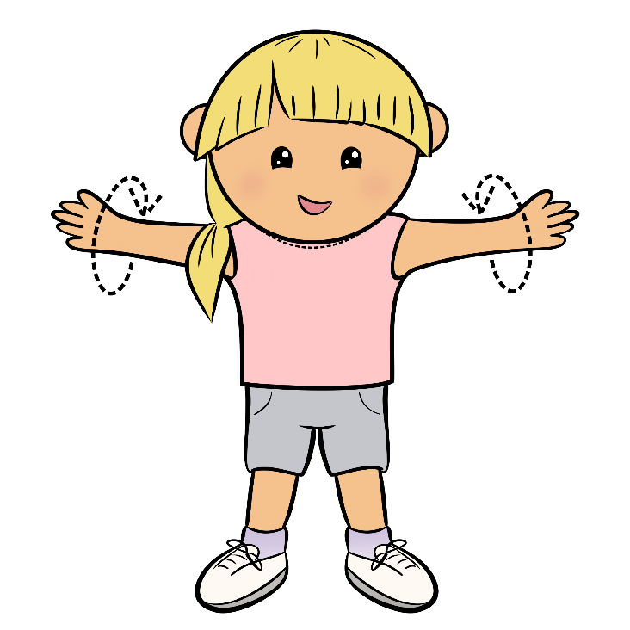
10 @ 10
10
Repeat
#2
Arm Circles
© Seomra Ranga 2023 www.seomraranga.com

Slide 4
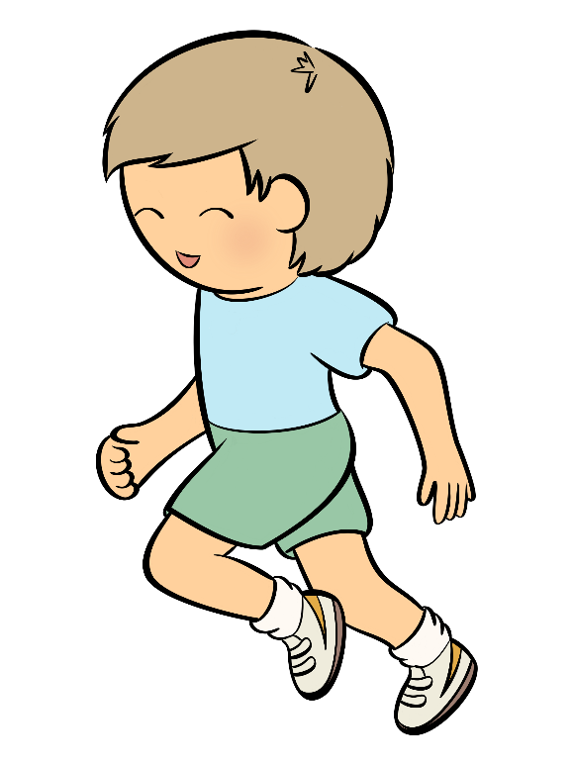
10 @ 10
10
Repeat
#3
Running on the Spot
© Seomra Ranga 2023 www.seomraranga.com

Slide 5

10 @ 10
10
Repeat
#4
Jumping Jacks
© Seomra Ranga 2023 www.seomraranga.com

Slide 6
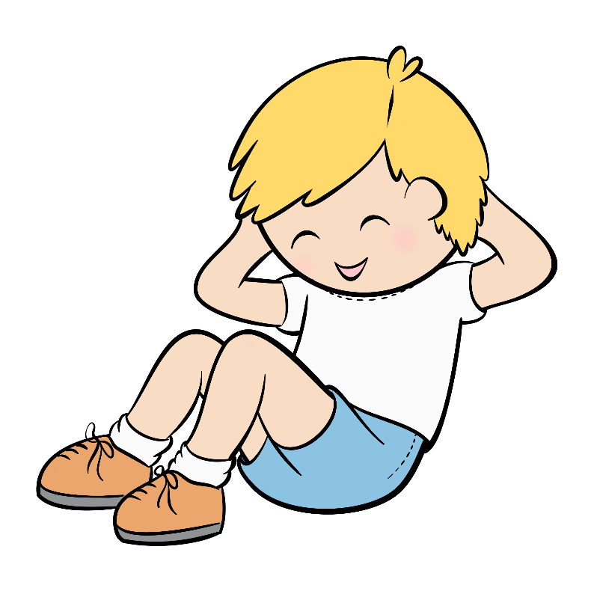
10 @ 10
10
Repeat
#5
Sit Ups
© Seomra Ranga 2023 www.seomraranga.com

Slide 7
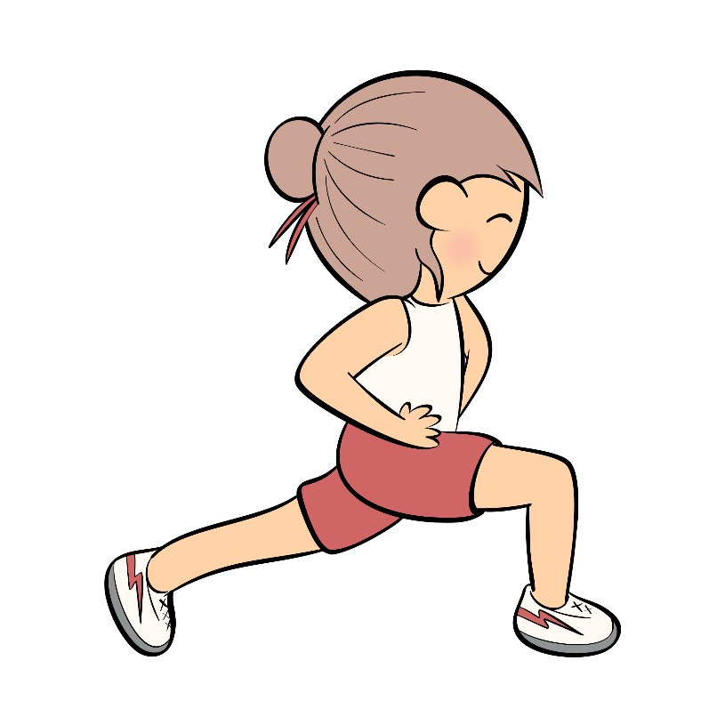
10 @ 10
10
Repeat
#6
Lunges
© Seomra Ranga 2023 www.seomraranga.com

Slide 8
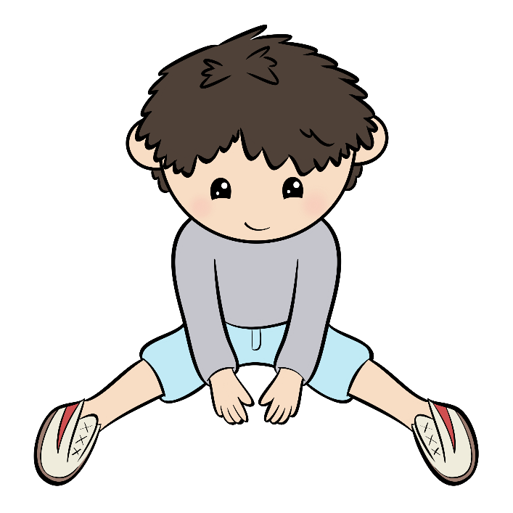
10 @ 10
10
Repeat
#7
Straddle Stretch
© Seomra Ranga 2023 www.seomraranga.com

Slide 9
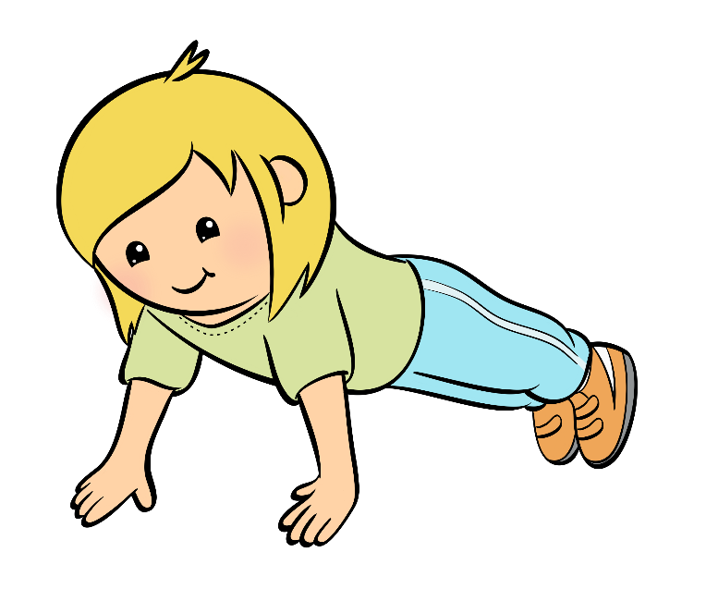
10 @ 10
10
Repeat
#8
Push-Ups
© Seomra Ranga 2023 www.seomraranga.com

Slide 10

10 @ 10
10
Repeat
#9
Touch Toes
© Seomra Ranga 2023 www.seomraranga.com

Slide 11

10 @ 10
10
Repeat
#10
Squats
© Seomra Ranga 2023 www.seomraranga.com

Slide 12
For Your Information
Thank you for downloading this Seomra Ranga resource. We hope that you find it practical and useful in your classroom.
Please be aware of the following conditions before using this resource.
Please DO:
Print and copy this resource so that you can use it with your pupils.
Make this resource available to your pupils in a private enclosed online space eg. Google Classroom, Seesaw, Edublogs etc.
Tell others if you have found it useful.
Please DO NOT:
Copy or share this resource (in part or whole) with others who have not joined our website. By becoming a member for themselves, they will help the site develop into the future.
Make this resource available on your school website for anyone to download.
Share this resource with other teachers in online groups eg. Facebook Groups, WhatsApp Groups etc.
Kind regards, Seomra Ranga
© Seomra Ranga 2023 www.seomraranga.com

Slide 13

10 @ 10
Resources used in this file from:
https://www.teacherspayteachers.com/Store/Scribblegarden
© Seomra Ranga 2023 www.seomraranga.com

