Slide 1
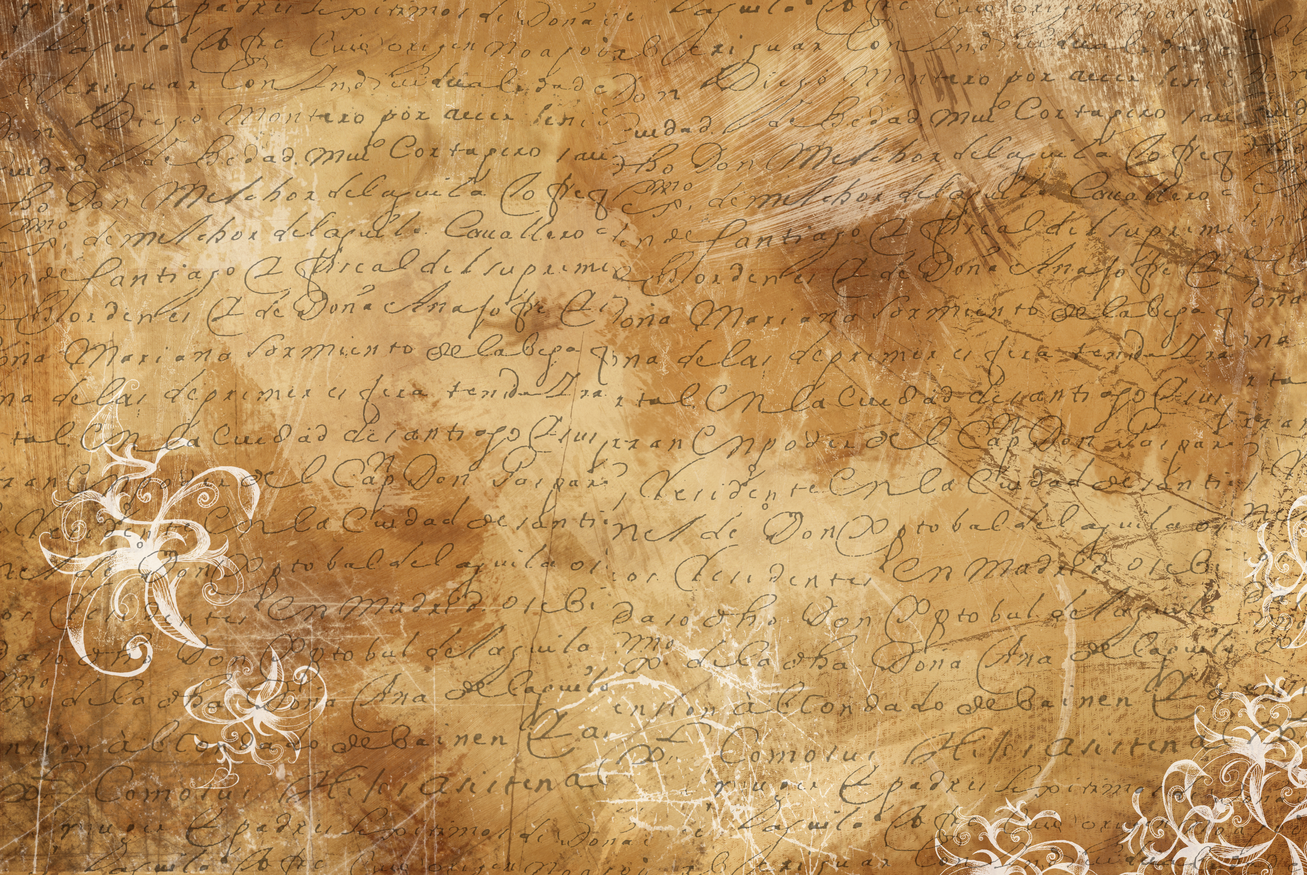

HANDWRITING PRACTICE
PART 2
© Seomra Ranga 2022 www.seomraranga.com

Slide 2
HANDWRITING PRACTICE
WEEK 11
© Seomra Ranga 2022 www.seomraranga.com

Slide 3
HANDWRITING PRACTICE
WEEK 11A
1998 was the year when the two hundredth anniversary of the rebellion in 1798 was commemorated. Most of the fighting in the rebellion took place around Wexford. Many events took place around the country to mark the anniversary.
© Seomra Ranga 2022 www.seomraranga.com

Slide 4
HANDWRITING PRACTICE
WEEK 11B
I rith na hoíche chuala an fear torann. Bhris na gadaithe an fhuinneog, chuaigh siad isteach sa teach agus ghoid siad an teilifís agus an ríomhaire glúine. Chuir an fear fios ar na Gardaí.
© Seomra Ranga 2022 www.seomraranga.com

Slide 5
HANDWRITING PRACTICE
WEEK 11C
In the Republic of Ireland children start school at around the age of four. They remain in primary school for about eight years after which time they transfer to a secondary school.
© Seomra Ranga 2022 www.seomraranga.com

Slide 6
HANDWRITING PRACTICE
WEEK 11D
February, March and April are the months of spring. During spring we look forward to the end of the cold and dark days of winter. One of the earliest signs of spring is the appearance of the daffodils.
© Seomra Ranga 2022 www.seomraranga.com

Slide 7
HANDWRITING PRACTICE
WEEK 11E
March 17th is St. Patrick’s Day. It is the National Holiday of Ireland and celebrates the life of St. Patrick who is believed to have been the first person to bring Christianity to Ireland.
© Seomra Ranga 2022 www.seomraranga.com

Slide 8
HANDWRITING PRACTICE
WEEK 12
© Seomra Ranga 2022 www.seomraranga.com

Slide 9
HANDWRITING PRACTICE
WEEK 12A
Pablo Picasso is regarded as one of the world’s greatest twentieth century artists. He was born in Spain and painted many paintings during his Blue Period and Rose Period. His most famous painting is called “La Guernica”.
© Seomra Ranga 2022 www.seomraranga.com

Slide 10
HANDWRITING PRACTICE
WEEK 12B
A historic peace agreement was reached between all the political parties in Northern Ireland and the Irish and British governments on Good Friday 1998. The Peace Agreement was voted on and accepted by all the people in Northern Ireland and the Republic of Ireland in a referendum.
© Seomra Ranga 2022 www.seomraranga.com

Slide 11
HANDWRITING PRACTICE
WEEK 12C
Gardening is a pastime which many people enjoy especially during the summer time. Grass grows more quickly during the summer months, so it has to be mown regularly. Flower beds have to be weeded and bedding plants and flowers have to be watered.
© Seomra Ranga 2022 www.seomraranga.com

Slide 12
HANDWRITING PRACTICE
WEEK 12D
Myths and legends are stories. They can sometimes be particular to a country. It is not known whether myths and legends are true, as they have more than likely been passed on by word of mouth from generation to generation.
© Seomra Ranga 2022 www.seomraranga.com

Slide 13
HANDWRITING PRACTICE
WEEK 12E
Good personal hygiene is very important. It is important to wash every day and to take a bath or shower a few times a week. It is also important to change clothes regularly, particularly underclothes.
© Seomra Ranga 2022 www.seomraranga.com

Slide 14
HANDWRITING PRACTICE
WEEK 13
© Seomra Ranga 2022 www.seomraranga.com

Slide 15
HANDWRITING PRACTICE
WEEK 13A
Good posture is very important. This means that people should be careful about the way they sit, stand and walk. Slouching when sitting, standing or walking is not good for the spine and weakens the back.
© Seomra Ranga 2022 www.seomraranga.com

Slide 16
HANDWRITING PRACTICE
WEEK 13B
Ken Doherty, from Ranelagh in Dublin, is a professional snooker player. He was the World Amateur Snooker Champion before he turned professional. He won the World Snooker Championship at the Crucible in Sheffield in 1997.
© Seomra Ranga 2022 www.seomraranga.com

Slide 17
HANDWRITING PRACTICE
WEEK 13C
Computer experts had to busily write new computer programmes to try to counter the Millennium Bug. This bug threatened to wipe out much of the data on computers on the first day of the year 2000. The bug was also known as Y2K.
© Seomra Ranga 2022 www.seomraranga.com

Slide 18
HANDWRITING PRACTICE
WEEK 13D
Traffic congestion has become a problem for many commuters, particularly during the peak time rush hours in the morning and in the afternoon. People are being encouraged to use public transport more and to try to share cars among fellow workers.
© Seomra Ranga 2022 www.seomraranga.com

Slide 19
HANDWRITING PRACTICE
WEEK 13E
Tarmacadam, or tarmac for short, is the name given to material used for roadmaking. It consists of layers of compacted broken stone laid on top of one another. It is named after a nineteenth century British surveyor J.L. McAdam.
© Seomra Ranga 2022 www.seomraranga.com

Slide 20
HANDWRITING PRACTICE
WEEK 14
© Seomra Ranga 2022 www.seomraranga.com

Slide 21
HANDWRITING PRACTICE
WEEK 14A
Seamus Heaney is a poet who was born in Derry. He taught poetry in Ireland, Great Britain and America. For many years he was recognised as Ireland’s greatest living poet. In 1997 he was awarded the Nobel Prize for Literature in recognition for his work as a poet. He died in 2013.
© Seomra Ranga 2022 www.seomraranga.com

Slide 22
HANDWRITING PRACTICE
WEEK 14B
W.B. Yeats is a world renowned poet and he is particularly associated with Sligo. As a child he spent many summers holidaying in Sligo with his relations. One of his most famous poems is called “The Lake Isle of Innisfree”.
© Seomra Ranga 2022 www.seomraranga.com

Slide 23
HANDWRITING PRACTICE
WEEK 14C
Litter is a problem that we all have to tackle every day. Litter is unsightly and is damaging to the environment. The problem can be solved if people use bins to place their litter in. Recycling of waste could also help to reduce the amount of waste that has to be dumped.
© Seomra Ranga 2022 www.seomraranga.com

Slide 24
HANDWRITING PRACTICE
WEEK 14D
It was his son’s birthday and his father was baking a special birthday cake for him. He looked at the recipe, got the ingredients and prepared the cake. When the cake mixture was ready, he placed the cake carefully in the pre-heated oven. After forty minutes the cake was cooked perfectly.
© Seomra Ranga 2022 www.seomraranga.com

Slide 25
HANDWRITING PRACTICE
WEEK 14E
A new family moved into the last house on the road. When they arrived at the house, the neighbours were there to greet them and to welcome them to the area. The family were very pleased that the neighbours were so considerate.
© Seomra Ranga 2022 www.seomraranga.com

Slide 26
HANDWRITING PRACTICE
WEEK 15
© Seomra Ranga 2022 www.seomraranga.com

Slide 27
HANDWRITING PRACTICE
WEEK 15A
It is important when cooking chips at home that they are never left unattended. Hot cooking oil is very dangerous and highly flammable. If cooking oil catches fire it is important that you should never throw water onto the flames. This only makes the fire worse.
© Seomra Ranga 2022 www.seomraranga.com

Slide 28
HANDWRITING PRACTICE
WEEK 15B
Advertising can sometimes be used by large companies in order to entice people into buying goods that they really do not want or need. Bright colours, nice background music and persuasive voices are used to tell the consumer that they should go out and buy a particular product.
© Seomra Ranga 2022 www.seomraranga.com

Slide 29
HANDWRITING PRACTICE
WEEK 15C
The people stood in an orderly queue at the bus stop, waiting for the number forty-seven bus to arrive. When the two teenagers joined the back of the queue, they started to push and jostle and the other passengers began to get very annoyed.
© Seomra Ranga 2022 www.seomraranga.com

Slide 30
HANDWRITING PRACTICE
WEEK 15D
The girl arrived home from school at five o’ clock, two hours late! Her mother was furious and demanded an explanation. The girl informed her mother that she had been playing with her friends outside the school and that she had lost track of the time.
© Seomra Ranga 2022 www.seomraranga.com

Slide 31
HANDWRITING PRACTICE
WEEK 15E
The newsreader announced the headlines of the day’s news. She was reading the news from an auto-cue, which is a small television in front of her in the studio. During the news she introduced some reports which were read by “on - the - spot” reporters.
© Seomra Ranga 2022 www.seomraranga.com

Slide 32
HANDWRITING PRACTICE
WEEK 16
© Seomra Ranga 2022 www.seomraranga.com

Slide 33
HANDWRITING PRACTICE
WEEK 16A
The family had booked their summer holiday to Spain in December. However, during the month of June the travel agent told them that their flights had to be re-arranged due to what they called “unforeseen circumstances”.
© Seomra Ranga 2022 www.seomraranga.com

Slide 34
HANDWRITING PRACTICE
WEEK 16B
The lady connected her new computer and placed it carefully on her workstation in the corner of the room. She connected the modem to her telephone line, contacted her Internet Service Provider (ISP) and quickly gained access to the Internet and the World Wide Web.
© Seomra Ranga 2022 www.seomraranga.com

Slide 35
HANDWRITING PRACTICE
WEEK 16C
The Italian man purchased his new restaurant in the centre of the busy town and quickly established a reputation as having the best restaurant in the region. People came from far and near to sample his authentic Italian cuisine.
© Seomra Ranga 2022 www.seomraranga.com

Slide 36
HANDWRITING PRACTICE
WEEK 16D
The author sat staring at the screen of her personal computer in dismay. She could not think of anything to write about and she feared that she might be suffering from “writers’ block”. Suddenly an idea flashed into her mind and she began to furiously tap the keys.
© Seomra Ranga 2022 www.seomraranga.com

Slide 37
HANDWRITING PRACTICE
WEEK 16E
The teenagers queued all night in the rain so that they would be the first to purchase the concert tickets. When the shop opened, the teenagers raced to the counter and succeeded in getting seats in the front row of the auditorium for the concert.
© Seomra Ranga 2022 www.seomraranga.com

Slide 38
HANDWRITING PRACTICE
WEEK 17
© Seomra Ranga 2022 www.seomraranga.com

Slide 39
HANDWRITING PRACTICE
WEEK 17A
The artist opened his box of different coloured chalks and carefully arranged them on the pavement. He placed the postcard on the ground and proceeded to copy the picture with the chalks onto the pavement. Passers-by tossed coins into his hat beside the picture.
© Seomra Ranga 2022 www.seomraranga.com

Slide 40
HANDWRITING PRACTICE
WEEK 17B
The architect assessed the space in the attic of the house and advised the couple that there was ample room to fit an attic conversion. The couple were delighted as they hoped to build a playroom there for their three children.
© Seomra Ranga 2022 www.seomraranga.com

Slide 41
HANDWRITING PRACTICE
WEEK 17C
After typing out her letter on her word processor, the lady checked the print preview to make sure that the letter looked well. Unfortunately, when she clicked on the print icon the printer failed to print the letter and she had to take the printer into the shop to be fixed.
© Seomra Ranga 2022 www.seomraranga.com

Slide 42
HANDWRITING PRACTICE
WEEK 17D
The gallery organised an exhibition of paintings and 3-D objects in the largest room of the gallery. The artist selected the pieces of art that he wished to be exhibited and the gallery staff arranged them around the room so that the public could view them with ease.
© Seomra Ranga 2022 www.seomraranga.com

Slide 43
HANDWRITING PRACTICE
WEEK 17E
D’fhág mé an teach go moch ar maidin. Nuair a shroich mé an scoil, ní raibh aon duine ann. Cheap mé go raibh sé sin ait ach ansin bhí a fhios agam – an Satharn a bhí ann!
© Seomra Ranga 2022 www.seomraranga.com

Slide 44
HANDWRITING PRACTICE
WEEK 18
© Seomra Ranga 2022 www.seomraranga.com

Slide 45
HANDWRITING PRACTICE
WEEK 18A
“The trees are in their autumn beauty, the woodland paths are dry. Under the October twilight, the water mirrors a still sky”. This is from the W.B. Yeats poem “The Wild Swans at Coole”.
© Seomra Ranga 2022 www.seomraranga.com

Slide 46
HANDWRITING PRACTICE
WEEK 18B
The leaders of the Easter Rising in 1916 took over many buildings around the city in Dublin including the General Post Office (GPO) on O’ Connell Street, which was bombed by the British forces.
© Seomra Ranga 2022 www.seomraranga.com

Slide 47
HANDWRITING PRACTICE
WEEK 18C
The Celts were a race of people who lived in Europe and became a powerful force in certain countries from about 800 BC to AD 100. They became powerful because they discovered how to use iron.
© Seomra Ranga 2022 www.seomraranga.com

Slide 48
HANDWRITING PRACTICE
WEEK 18D
Rivers are an important feature in our landscape. From earliest times, people have made their homes near rivers, where they could get fresh water. Major cities of the world are now located near rivers.
© Seomra Ranga 2022 www.seomraranga.com

Slide 49
HANDWRITING PRACTICE
WEEK 18E
The source of the Ganges River is in the Himalayan Mountains. It enters the sea in the Bay of Bengal. Hindu people consider the Ganges to be a sacred river and people from all over the world travel to bathe in its waters.
© Seomra Ranga 2022 www.seomraranga.com

Slide 50
HANDWRITING PRACTICE
WEEK 19
© Seomra Ranga 2022 www.seomraranga.com

Slide 51
HANDWRITING PRACTICE
WEEK 19A
The Great Famine of 1845-1850 is considered by most people to have been the worst tragedy in Irish History. It was a time of great suffering, poverty, misery, eviction, disease, fever, starvation, emigration and death.
© Seomra Ranga 2022 www.seomraranga.com

Slide 52
HANDWRITING PRACTICE
WEEK 19B
On November 1st 1884, a meeting took place in Hayes’ Hotel in Thurles, Co. Tipperary. At that meeting the Gaelic Athletic Association (GAA) was established. Maurice Davin was the first president and Michael Cusack was the first secretary.
© Seomra Ranga 2022 www.seomraranga.com

Slide 53
HANDWRITING PRACTICE
WEEK 19C
W.B. Yeats was one of a number of important writers who began to write in the English language at the end of the 19th and beginning of the 20th century. He wrote poems and plays about ancient Irish heroes. In 1923, he was awarded the Nobel Prize for Literature.
© Seomra Ranga 2022 www.seomraranga.com

Slide 54
HANDWRITING PRACTICE
WEEK 19D
In 1904, Lady Gregory, W.B. Yeats and John Millington Synge established the Abbey Theatre in Dublin. The Abbey quickly became famous throughout the world because of the number of excellent new plays, written by Irish playwrights, which were performed there.
© Seomra Ranga 2022 www.seomraranga.com

Slide 55
HANDWRITING PRACTICE
WEEK 19E
Marie Curie was one of the most famous women of the twentieth century. She discovered the mysterious scientific element called radium. This provided important new medical knowledge and the successful treatment of diseases, especially cancer.
© Seomra Ranga 2022 www.seomraranga.com

Slide 56
HANDWRITING PRACTICE
WEEK 20
© Seomra Ranga 2022 www.seomraranga.com

Slide 57
HANDWRITING PRACTICE
WEEK 20A
To remain healthy, people need to eat a good variety of food. Our bodies require certain nutrients to be healthy, such as protein, carbohydrates, minerals and vitamins. These are part of what is called a “balanced diet”.
© Seomra Ranga 2022 www.seomraranga.com

Slide 58
HANDWRITING PRACTICE
WEEK 20B
The countries touching the Mediterranean Sea are steeped in history. Great civilisations, such as the Romans, the Greeks, the Egyptians and the Moors, come from this area. They have had a huge influence on the architecture, art and culture of Europe.
© Seomra Ranga 2022 www.seomraranga.com

Slide 59
HANDWRITING PRACTICE
WEEK 20C
The Burren in north-west County Clare takes its name from the Irish word for the area, “boireann”, which means a bare rocky place. It is one of Ireland’s most unusual, and also most beautiful, limestone landscapes.
© Seomra Ranga 2022 www.seomraranga.com

Slide 60
HANDWRITING PRACTICE
WEEK 20D
Some of the countries in Africa are underdeveloped and poverty is widespread. Famine is a serious problem in many parts of the continent and millions of men, women and children have died as a result.
© Seomra Ranga 2022 www.seomraranga.com

Slide 61
HANDWRITING PRACTICE
WEEK 20E
A clean, healthy environment depends upon clean air. When we breathe in air, we also breathe in everything in it. This is the same for other life forms. Air pollution is harmful and it affects humans, animals and plants.
© Seomra Ranga 2022 www.seomraranga.com

Slide 62
For Your Information
Thank you for downloading this Seomra Ranga resource. We hope that you find it practical and useful in your classroom.
Please be aware of the following conditions before using this resource.
Please DO:
Print and copy this resource so that you can use it with your pupils.
Make this resource available to your pupils in a private enclosed online space eg. Google Classroom, Seesaw, Edublogs etc.
Tell others if you have found it useful.
Please DO NOT:
Copy or share this resource (in part or whole) with others who have not joined our website. By becoming a member for themselves, they will help the site develop into the future.
Make this resource available on your school website for anyone to download.
Share this resource with other teachers in online groups eg. Facebook Groups, WhatsApp Groups etc.
Kind regards, Seomra Ranga
© Seomra Ranga 2022 www.seomraranga.com

Slide 63

Resources used in this file from:
https://depositphotos.com/
© Seomra Ranga 2022 www.seomraranga.com

