Slide 1
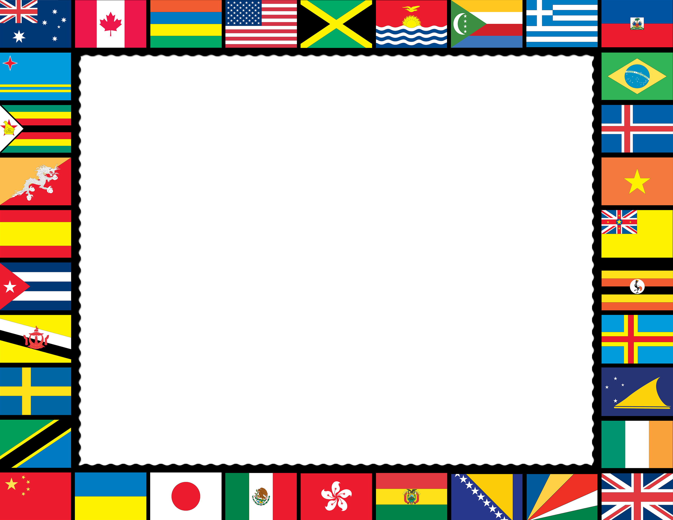



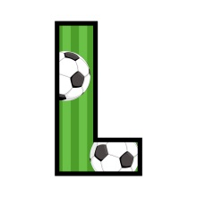




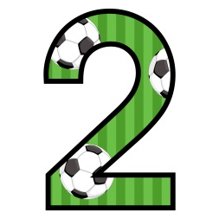
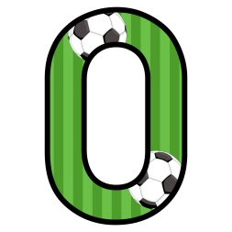





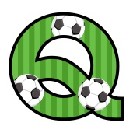




© Seomra Ranga 2022 www.seomraranga.com

Slide 2
Before You Start
There are eight rounds in this Table Quiz, with six questions in each round
The questions in each round relate to World Cup 2022 and to World Cup history
If there is a tie at the end, there is a Tie-Break Round to decide the winners
© Seomra Ranga 2022 www.seomraranga.com

Slide 3
Before You Start
Make sure you have written your table/group number on every answer sheet
Write the Round number 1-8 on each answer sheet
Try not to shout out answers
Don’t worry about spellings – do your best
Good luck and enjoy the quiz
© Seomra Ranga 2022 www.seomraranga.com

Slide 4
Good Luck!
Enjoy the
Quiz!
© Seomra Ranga 2022 www.seomraranga.com

Slide 5






© Seomra Ranga 2022 www.seomraranga.com

Slide 6
Round 1
Question 1
How many teams are participating in World Cup 2022?
© Seomra Ranga 2022 www.seomraranga.com

Slide 7
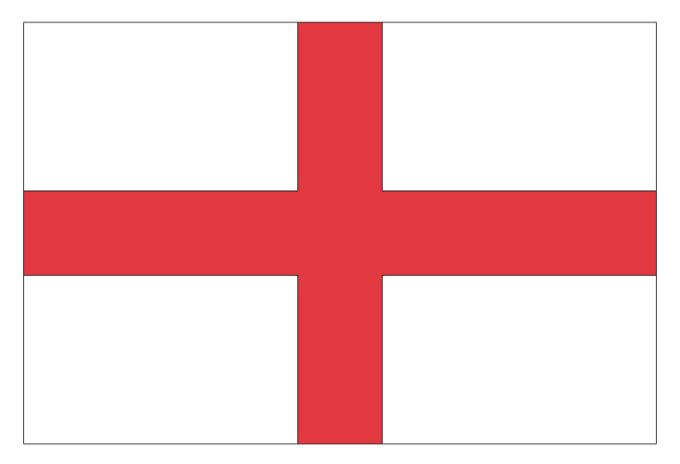
Round 1
Question 2
Which country is this participating in World Cup 2022?
© Seomra Ranga 2022 www.seomraranga.com

Slide 8
Round 1
Question 3
True or False: Ireland have played at two World Cups?
© Seomra Ranga 2022 www.seomraranga.com

Slide 9
Round 1
Question 4
If a=1, b=2, c=3 etc., which team is this, participating in World Cup 2022?
1-21-19-20-18-1-12-9-1
© Seomra Ranga 2022 www.seomraranga.com

Slide 10
Round 1
Question 5
For what country will Lionel Messi play at World Cup 2022?
© Seomra Ranga 2022 www.seomraranga.com

Slide 11
Round 1
Question 6
Who won the last World Cup in 2018?
© Seomra Ranga 2022 www.seomraranga.com

Slide 12
World Cup Joke #1
What do you call someone who stands inside goalposts and stops the ball from rolling away?
Annette
© Seomra Ranga 2022 www.seomraranga.com

Slide 13

© Seomra Ranga 2022 www.seomraranga.com

Slide 14
Round 2
Question 1
Who is the host nation for World Cup 2022?
© Seomra Ranga 2022 www.seomraranga.com

Slide 15
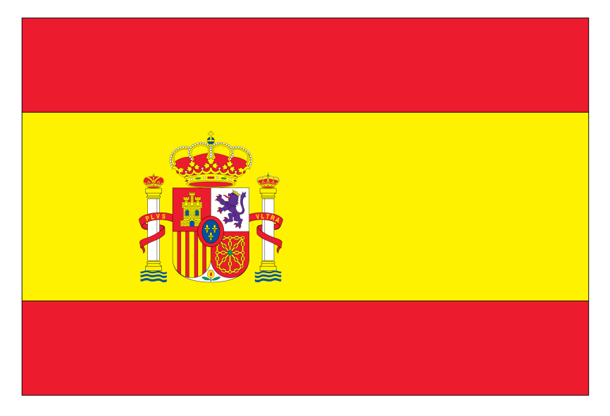
Round 2
Question 2
Which country is this participating in World Cup 2022?
© Seomra Ranga 2022 www.seomraranga.com

Slide 16
Round 2
Question 3
True or False: The World Cup is held every four years?
© Seomra Ranga 2022 www.seomraranga.com

Slide 17
Round 2
Question 4
Tehran is the capital of what country participating at World Cup 2022?
© Seomra Ranga 2022 www.seomraranga.com

Slide 18
Round 2
Question 5
Which team will miss the World Cup this year for the second time in a row since 1958: Holland, Ireland or Italy?
© Seomra Ranga 2022 www.seomraranga.com

Slide 19
Round 2
Question 6
Which Gabriel plays for Arsenal and will appear for Brazil at World Cup 2022: Jesus, Moses or Abraham?
© Seomra Ranga 2022 www.seomraranga.com

Slide 20
World Cup Joke #2
Where’s the best place in America to shop for a football kit?
New Jersey
© Seomra Ranga 2022 www.seomraranga.com

Slide 21






© Seomra Ranga 2022 www.seomraranga.com

Slide 22
Round 1 Answers
Question 1
How many teams are participating in World Cup 2022?
32
© Seomra Ranga 2022 www.seomraranga.com

Slide 23
Round 1 Answers
Question 2
Which country is this participating in World Cup 2022?
England
© Seomra Ranga 2022 www.seomraranga.com

Slide 24
Round 1 Answers
Question 3
True or False: Ireland have played at two World Cups?
False(1990, 1994 & 2002)
© Seomra Ranga 2022 www.seomraranga.com

Slide 25
Round 1 Answers
Question 4
If a=1, b=2, c=3 etc., which team is this, participating in World Cup 2022?
1-21-19-20-18-19-12-9-1
Australia
© Seomra Ranga 2022 www.seomraranga.com

Slide 26
Round 1 Answers
Question 5
For what country will Lionel Messi play at World Cup 2022?
Argentina
© Seomra Ranga 2022 www.seomraranga.com

Slide 27
Round 1 Answers
Question 6
Who won the last World Cup in 2018?
France
© Seomra Ranga 2022 www.seomraranga.com

Slide 28
World Cup Joke #3
How will the players stay cool during a World Cup game?
Stand Near the Fans
© Seomra Ranga 2022 www.seomraranga.com

Slide 29
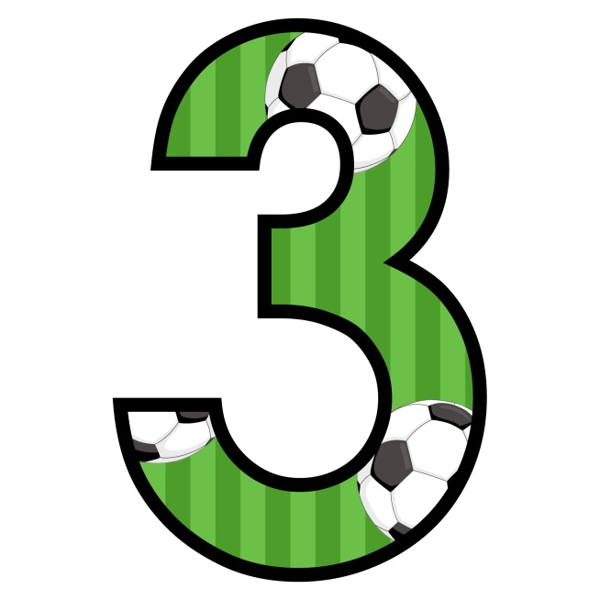
© Seomra Ranga 2022 www.seomraranga.com

Slide 30
Round 3
Question 1
How many groups are there in World Cup 2022?
© Seomra Ranga 2022 www.seomraranga.com

Slide 31
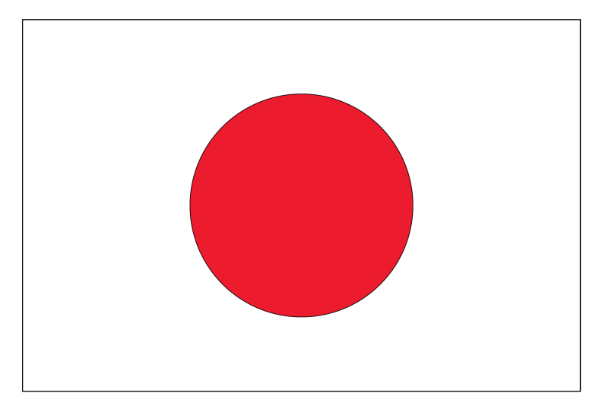
Round 3
Question 2
Which country is this participating in World Cup 2022?
© Seomra Ranga 2022 www.seomraranga.com

Slide 32
Round 3
Question 3
True or False: the Netherlands has reached three World Cup Finals and lost all three?
© Seomra Ranga 2022 www.seomraranga.com

Slide 33
Round 3
Question 4
Son Heung-min, the Spurs player, will play for what country in World Cup 2022?
© Seomra Ranga 2022 www.seomraranga.com

Slide 34
Round 3
Question 5
How many national teams tried to qualify for World Cup 2022: 201, 206, 218 or 222?
© Seomra Ranga 2022 www.seomraranga.com

Slide 35
Round 3
Question 6
In what country was the World Cup held in 2018?
© Seomra Ranga 2022 www.seomraranga.com

Slide 36
World Cup Joke #4
Why was the best footballer in the world asked to tidy up their room?
Because it was Messi
© Seomra Ranga 2022 www.seomraranga.com

Slide 37
© Seomra Ranga 2022 www.seomraranga.com

Slide 38
Round 2 Answers
Question 1
Who is the host nation for World Cup 2022?
Qatar
© Seomra Ranga 2022 www.seomraranga.com

Slide 39

Round 2 Answers
Question 2
Which country is this participating in World Cup 2022?
Spain
© Seomra Ranga 2022 www.seomraranga.com

Slide 40
Round 2 Answers
Question 3
True or False: The World Cup is held every four years?
True
© Seomra Ranga 2022 www.seomraranga.com

Slide 41
Round 2 Answers
Question 4
Tehran is the capital of what country participating at World Cup 2022?
Iran
© Seomra Ranga 2022 www.seomraranga.com

Slide 42
Round 2 Answers
Question 5
Which team will miss the World Cup this year for the second time since 1958: Holland, Ireland or Italy?
Italy
© Seomra Ranga 2022 www.seomraranga.com

Slide 43
Round 2 Answers
Question 6
Which Gabriel plays for Arsenal and will appear for Brazil at World Cup 2022: Jesus, Moses or Abraham?
Gabriel Jesus
© Seomra Ranga 2022 www.seomraranga.com

Slide 44
World Cup Joke #5
Why are soccer players like babies?
They both Dribble
© Seomra Ranga 2022 www.seomraranga.com

Slide 45
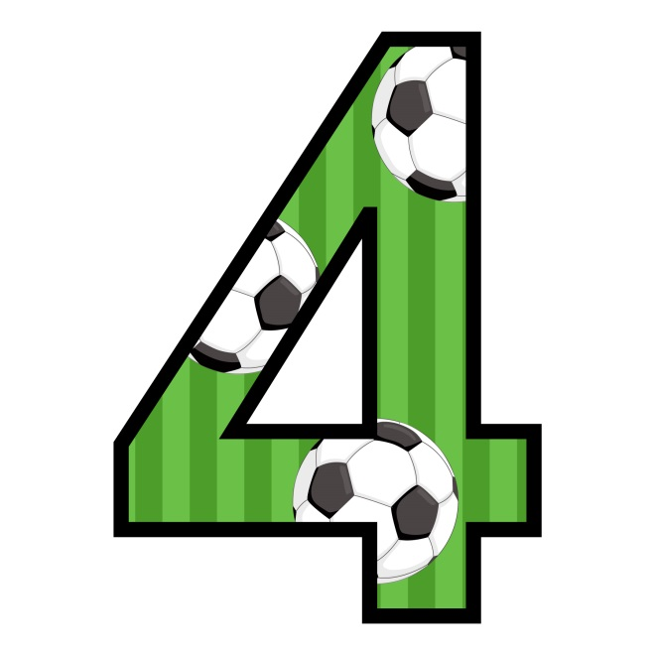
© Seomra Ranga 2022 www.seomraranga.com

Slide 46
Round 4
Question 1
Two countries playing in World Cup 2022 have a Z in their name. Brazil is one, name the other?
© Seomra Ranga 2022 www.seomraranga.com

Slide 47
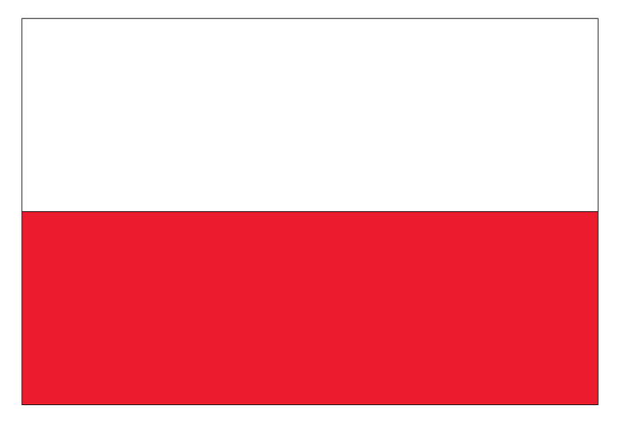
Round 4
Question 2
Which country is this participating in World Cup 2022?
© Seomra Ranga 2022 www.seomraranga.com

Slide 48
Round 4
Question 3
True or False: Pele holds the record for scoring the most goals (16) at World Cups?
© Seomra Ranga 2022 www.seomraranga.com

Slide 49
Round 4
Question 4
Unscramble the letters to find a team playing in Group A in World Cup 2022?
GASENEL
© Seomra Ranga 2022 www.seomraranga.com

Slide 50
Round 4
Question 5
Which former Ireland manager won a World Cup medal playing for England in 1966: Tommy, Bobby or Jack Charlton?
© Seomra Ranga 2022 www.seomraranga.com

Slide 51
Round 4
Question 6
Name the former Real Madrid Manager who was sent off in the 2006 World Cup Final while playing for France?
© Seomra Ranga 2022 www.seomraranga.com

Slide 52
World Cup Joke #6
What runs along the edge of the pitch but never moves?
The Sideline
© Seomra Ranga 2022 www.seomraranga.com

Slide 53
© Seomra Ranga 2022 www.seomraranga.com

Slide 54
Round 3 Answers
Question 1
How many groups are there in World Cup 2022?
8
© Seomra Ranga 2022 www.seomraranga.com

Slide 55
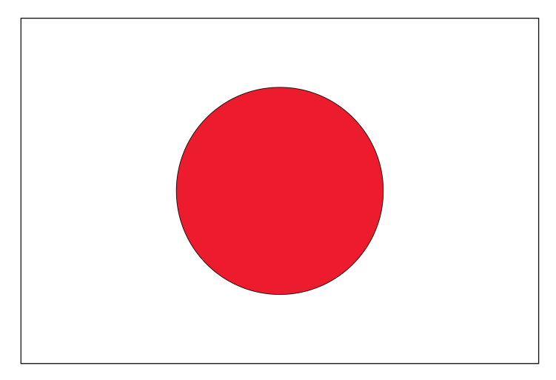
Round 3 Answers
Question 2
Which country is this participating in World Cup 2022?
Japan
© Seomra Ranga 2022 www.seomraranga.com

Slide 56
Round 3 Answers
Question 3
True or False: Holland have reached three World Cup Finals and lost all three?
True
© Seomra Ranga 2022 www.seomraranga.com

Slide 57
Round 3 Answers
Question 4
Son Heung-min, the Spurs player, will play for what country in World Cup 2022?
Korea Rep.
© Seomra Ranga 2022 www.seomraranga.com

Slide 58
Round 3 Answers
Question 5
How many national teams tried to qualify for World Cup 2022: 201, 206, 218 or 222?
206
© Seomra Ranga 2022 www.seomraranga.com

Slide 59
Round 3 Answers
Question 6
In what country was the World Cup held in 2018?
Russia
© Seomra Ranga 2022 www.seomraranga.com

Slide 60
World Cup Joke #7
Why did the soccer player bring string to her game?
She wanted to tie the score
© Seomra Ranga 2022 www.seomraranga.com

Slide 61
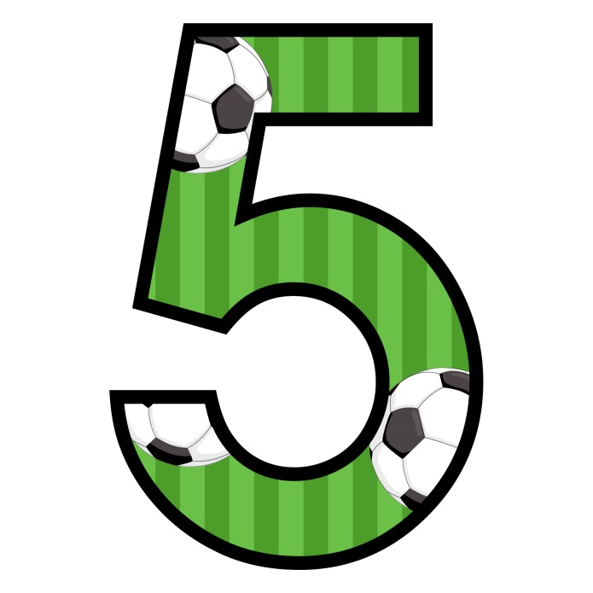
© Seomra Ranga 2022 www.seomraranga.com

Slide 62
Round 5
Question 1
Three countries playing at World Cup 2022 have two words in their name. Two of them are Korea Republic and Saudi Arabia. Name the third.
© Seomra Ranga 2022 www.seomraranga.com

Slide 63
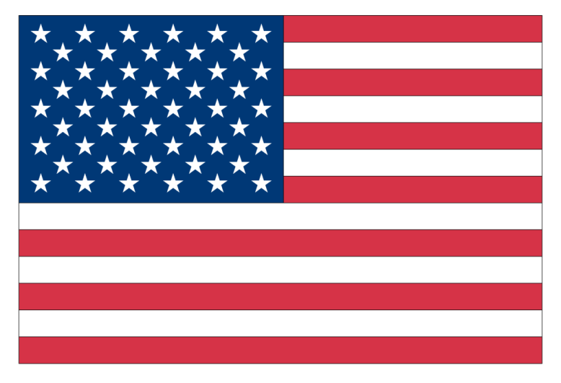
Round 5
Question 2
Which country is this participating in World Cup 2022?
© Seomra Ranga 2022 www.seomraranga.com

Slide 64
Round 5
Question 3
True or False: Italy has won the World Cup four times?
© Seomra Ranga 2022 www.seomraranga.com

Slide 65
Round 5
Question 4
How many host cities are there for World Cup 2022: 5, 8 or 10?
© Seomra Ranga 2022 www.seomraranga.com

Slide 66
Round 5
Question 5
Didier Deschamps is the manager of which country playing at World Cup 2022: France, Belgium or Spain?
© Seomra Ranga 2022 www.seomraranga.com

Slide 67
Round 5
Question 6
How many soccer World Cups have been held this century (including WC22)?
© Seomra Ranga 2022 www.seomraranga.com

Slide 68
World Cup Joke #8
What do Lionel Messi and a Magician have in common?
They both do Hat-Tricks
© Seomra Ranga 2022 www.seomraranga.com

Slide 69
© Seomra Ranga 2022 www.seomraranga.com

Slide 70
Round 4 Answers
Question 1
Two countries playing in World Cup 2022 have a Z in their name. Brazil is one, name the other?
Switzerland
© Seomra Ranga 2022 www.seomraranga.com

Slide 71
Round 4 Answers
Question 2
Which country is this participating in World Cup 2022?
Poland
© Seomra Ranga 2022 www.seomraranga.com

Slide 72
Round 4 Answers
Question 3
True or False: Pele holds the record for scoring the most goals (16) at World Cups?
False
(Miroslav Klose holds the record with 16 goals)
© Seomra Ranga 2022 www.seomraranga.com

Slide 73
Round 4 Answers
Question 4
Unscramble the letters to find a team playing in Group A in World Cup 2022?
GASENEL
Senegal
© Seomra Ranga 2022 www.seomraranga.com

Slide 74
Round 4 Answers
Question 5
Which former Ireland manager won a World Cup medal playing for England in 1966: Tommy, Bobby or Jack Charlton?
Jack Charlton
© Seomra Ranga 2022 www.seomraranga.com

Slide 75
Round 4 Answers
Question 6
Name the former Real Madrid Manager who was sent off in the 2006 World Cup Final while playing for France?
Zinedine Zidane
© Seomra Ranga 2022 www.seomraranga.com

Slide 76
World Cup Joke #9
Why did the manager bring pencils and sketchbooks into the dressing room before the game?
He was hoping for a draw
© Seomra Ranga 2022 www.seomraranga.com

Slide 77
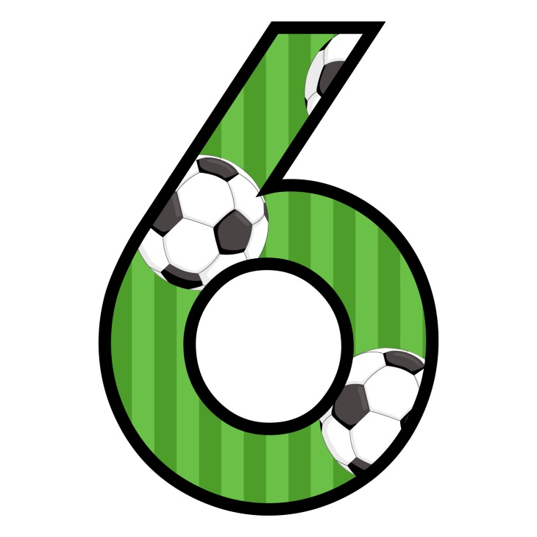
© Seomra Ranga 2022 www.seomraranga.com

Slide 78
Round 6
Question 1
Which is the only country at World Cup 2022 with an X in its name?
© Seomra Ranga 2022 www.seomraranga.com

Slide 79
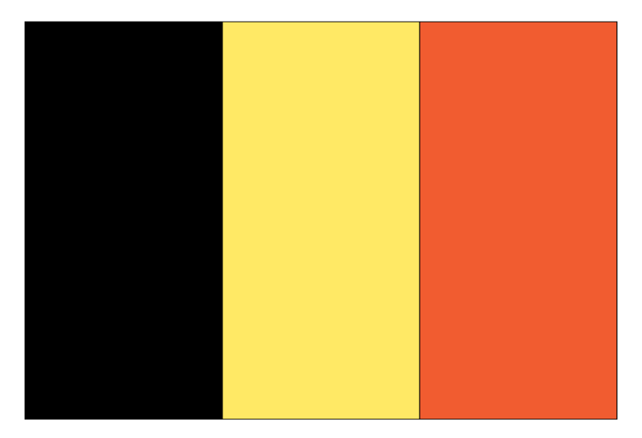
Round 6
Question 2
Which country is this participating in World Cup 2022?
© Seomra Ranga 2022 www.seomraranga.com

Slide 80
Round 6
Question 3
True or False: Germany hosted the first World Cup in 1930?
© Seomra Ranga 2022 www.seomraranga.com

Slide 81
Round 6
Question 4
What is the prize money for the winner of World Cup 2022: $20m, $25m, $33m or $42m?
© Seomra Ranga 2022 www.seomraranga.com

Slide 82
Round 6
Question 5
True or False: England has not won the World Cup since 1966?
© Seomra Ranga 2022 www.seomraranga.com

Slide 83
Round 6
Question 6
Which Manchester City player played for Ireland at U-21 level but is now in the England squad for World Cup 2022?
© Seomra Ranga 2022 www.seomraranga.com

Slide 84
World Cup Joke #10
What did the manager do when the pitch became flooded?
He sent on the subs
© Seomra Ranga 2022 www.seomraranga.com

Slide 85

© Seomra Ranga 2022 www.seomraranga.com

Slide 86
Round 5 Answers
Question 1
Three countries playing at World Cup 2022 have two words in their name. Two of them are Korea Republic and Saudi Arabia. Name the third.
Costa Rica
© Seomra Ranga 2022 www.seomraranga.com

Slide 87

Round 5 Answers
Question 2
Which country is this participating in World Cup 2022?
USA
© Seomra Ranga 2022 www.seomraranga.com

Slide 88
Round 5 Answers
Question 3
True or False: Italy has won the World Cup four times?
True
© Seomra Ranga 2022 www.seomraranga.com

Slide 89
Round 5 Answers
Question 4
How many host cities are there for World Cup 2022: 5, 8 or 10?
5
© Seomra Ranga 2022 www.seomraranga.com

Slide 90
Round 5 Answers
Question 5
Didier Deschamps is the manager of which country playing at World Cup 2022: France, Belgium or Spain?
France
© Seomra Ranga 2022 www.seomraranga.com

Slide 91
Round 5 Answers
Question 6
How many soccer World Cups have been held this century (including WC22)?
6
© Seomra Ranga 2022 www.seomraranga.com

Slide 92
World Cup Joke #11
What will be used to light up a stadium at World Cup 2022?
A soccer match
© Seomra Ranga 2022 www.seomraranga.com

Slide 93

© Seomra Ranga 2022 www.seomraranga.com

Slide 94
Round 7
Question 1
Name the only country at World Cup 2022 with a “J” in its name.
© Seomra Ranga 2022 www.seomraranga.com

Slide 95
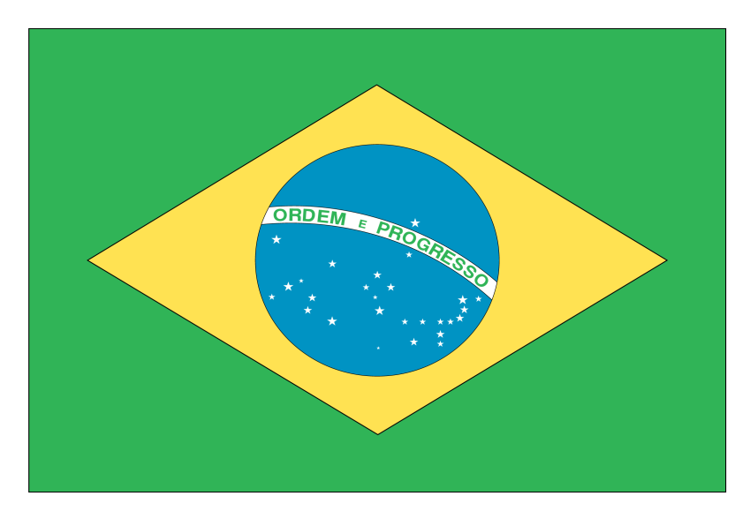
Round 7
Question 2
Which country is this participating in World Cup 2022?
© Seomra Ranga 2022 www.seomraranga.com

Slide 96
Round 7
Question 3
True or False: Norman Whiteside, playing for Northern Ireland at the 1982 World Cup, is the youngest player to ever appear at a World Cup?
© Seomra Ranga 2022 www.seomraranga.com

Slide 97
Round 7
Question 4
In which Group will England play at World Cup 2022: A, B or C?
© Seomra Ranga 2022 www.seomraranga.com

Slide 98
Round 7
Question 5
Ottawa is the capital of which country playing at World Cup 2022?
© Seomra Ranga 2022 www.seomraranga.com

Slide 99
Round 7
Question 6
Which country plays the host nation Qatar in the opening game of World Cup 2022?
© Seomra Ranga 2022 www.seomraranga.com

Slide 100
World Cup Joke #12
Which soccer player keeps the pitch neat and tidy?
The Sweeper
© Seomra Ranga 2022 www.seomraranga.com

Slide 101

© Seomra Ranga 2022 www.seomraranga.com

Slide 102
Round 6 Answers
Question 1
Which is the only country at World Cup 2022 with an X in its name?
Mexico
© Seomra Ranga 2022 www.seomraranga.com

Slide 103

Round 6 Answers
Question 2
Which country is this participating in World Cup 2022?
Belgium
© Seomra Ranga 2022 www.seomraranga.com

Slide 104
Round 6 Answers
Question 3
True or False: Germany hosted the first World Cup in 1930?
False (it was Uruguay)
© Seomra Ranga 2022 www.seomraranga.com

Slide 105
Round 6 Answers
Question 4
What is the prize money for the winner of World Cup 2022: $20m, $25m, $33m or $42m?
$42m
© Seomra Ranga 2022 www.seomraranga.com

Slide 106
Round 6 Answers
Question 5
True or False: England has not won the World Cup since 1966?
True
© Seomra Ranga 2022 www.seomraranga.com

Slide 107
Round 6 Answers
Question 6
Which Manchester City player played for Ireland at U-21 level but is now in the England squad for World Cup 2022?
Jack Grealish
© Seomra Ranga 2022 www.seomraranga.com

Slide 108
World Cup Joke #13
Why is the World cup not taking place in the jungle?
Because there are too many cheetahs
© Seomra Ranga 2022 www.seomraranga.com

Slide 109
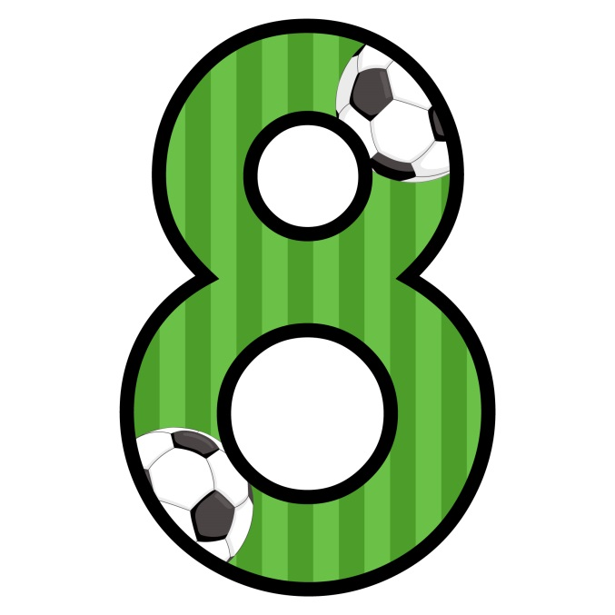
© Seomra Ranga 2022 www.seomraranga.com

Slide 110
Round 8
Question 1
Which European country playing at World Cup 2022 has Warsaw as its capital?
© Seomra Ranga 2022 www.seomraranga.com

Slide 111
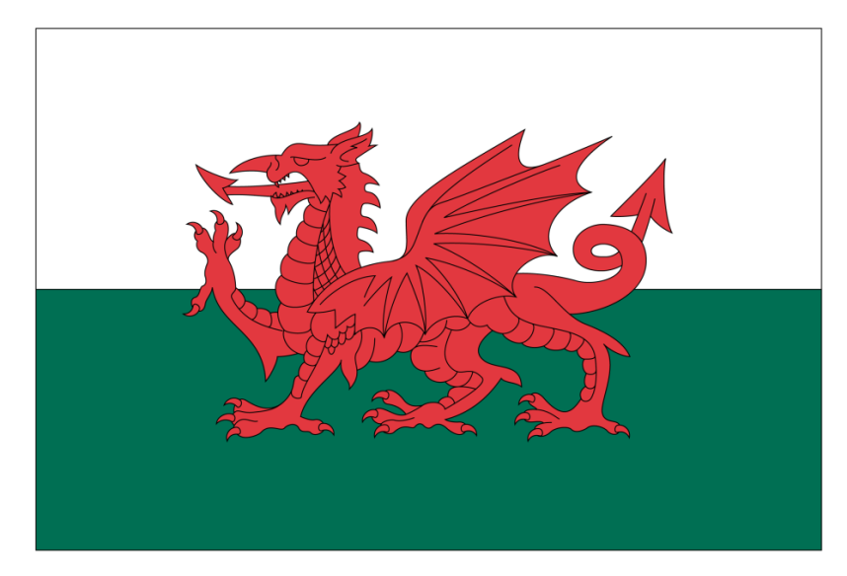
Round 8
Question 2
Which country is this participating in World Cup 2022?
© Seomra Ranga 2022 www.seomraranga.com

Slide 112
Round 8
Question 3
True or False: Brazil has won the most World Cups?
© Seomra Ranga 2022 www.seomraranga.com

Slide 113
Round 8
Question 4
Who is the youngest goal scorer at a World Cup: Ronaldo, Pele or Michael Owen?
© Seomra Ranga 2022 www.seomraranga.com

Slide 114
Round 8
Question 5
Unscramble the letters to find a Manchester United legend playing for Portugal in World Cup 2022?
DROONAL
© Seomra Ranga 2022 www.seomraranga.com

Slide 115
Round 8
Question 6
How many matches will be played at World Cup 2022: 48, 56 or 64?
© Seomra Ranga 2022 www.seomraranga.com

Slide 116
World Cup Joke #14
Why did the chicken get a red card from the referee?
For persistent fowl play
© Seomra Ranga 2022 www.seomraranga.com

Slide 117

© Seomra Ranga 2022 www.seomraranga.com

Slide 118
Round 7 Answers
Question 1
Name the only country at World Cup 2022 with a “J” in its name.
Japan
© Seomra Ranga 2022 www.seomraranga.com

Slide 119
Round 7 Answers
Question 2
Which country is this participating in World Cup 2022?
Brazil
© Seomra Ranga 2022 www.seomraranga.com

Slide 120
Round 7 Answers
Question 3
True or False: Norman Whiteside, playing for Northern Ireland at the 1982 World Cup, is the youngest player to ever appear at a World Cup?
True
© Seomra Ranga 2022 www.seomraranga.com

Slide 121
Round 7 Answers
Question 4
In which Group will England play at World Cup 2022: A, B or C?
Group B
© Seomra Ranga 2022 www.seomraranga.com

Slide 122
Round 7 Answers
Question 5
Ottawa is the capital of which country playing at World Cup 2022?
Canada
© Seomra Ranga 2022 www.seomraranga.com

Slide 123
Round 7 Answers
Question 6
Which country plays the host nation Qatar in the opening game of World Cup 2022?
Ecuador
© Seomra Ranga 2022 www.seomraranga.com

Slide 124
World Cup Joke #15
How did the soccer pitch get wet?
The players dribbled all over it
© Seomra Ranga 2022 www.seomraranga.com

Slide 125
© Seomra Ranga 2022 www.seomraranga.com

Slide 126
Round 8 Answers
Question 1
Which European country playing at World Cup 2022 has Warsaw as its capital?
Poland
© Seomra Ranga 2022 www.seomraranga.com

Slide 127

Round 8 Answers
Question 2
Which country is this participating in World Cup 2022?
Wales
© Seomra Ranga 2022 www.seomraranga.com

Slide 128
Round 8 Answers
Question 3
True or False: Brazil has won the most World Cups?
True
(It’s won it 5 times)
© Seomra Ranga 2022 www.seomraranga.com

Slide 129
Round 8 Answers
Question 4
Who is the youngest goal scorer at a World Cup: Ronaldo, Pele or Michael Owen?
Pele
(He was 17 in 1958)
© Seomra Ranga 2022 www.seomraranga.com

Slide 130
Round 8 Answers
Question 5
Unscramble the letters to find a Manchester United legend playing for Portugal in World Cup 2022?
DROONAL
Ronaldo
© Seomra Ranga 2022 www.seomraranga.com

Slide 131
Round 8 Answers
Question 6
How many matches will be played at World Cup 2022: 48, 56 or 64?
64
© Seomra Ranga 2022 www.seomraranga.com

Slide 132
World Cup Joke #16
When is a soccer player like a judge?
When he sits on the bench
© Seomra Ranga 2022 www.seomraranga.com

Slide 133








© Seomra Ranga 2022 www.seomraranga.com

Slide 134
Tie-Break Round
Question 1
Which country has made the most appearances at a World Cup without ever making it past the first round: Wales, Scotland or Ireland?
© Seomra Ranga 2022 www.seomraranga.com

Slide 135
Tie-Break Round
Question 2
What is the name of the official mascot for World Cup 2022. La’eeb, Ben’een, Su’veet?
© Seomra Ranga 2022 www.seomraranga.com

Slide 136
Tie-Break Round
Question 3
Which is the only country making its World Cup debut at World Cup 2022?
© Seomra Ranga 2022 www.seomraranga.com

Slide 137
Tie-Break Round
Question 4
Which single-word country playing at World Cup 2022 has the most letters in its name?
© Seomra Ranga 2022 www.seomraranga.com

Slide 138
Tie-Break Round
Question 5
Three countries will host the next World Cup in 2026. Two are Canada and USA. What is the third country?
© Seomra Ranga 2022 www.seomraranga.com

Slide 139
Tie-Break Round
Question 6
What club does the Brazilian player Neymar play for?
© Seomra Ranga 2022 www.seomraranga.com

Slide 140
World Cup Joke #17
How do we know that soccer referees are happy?
They whistle while they work
© Seomra Ranga 2022 www.seomraranga.com

Slide 141
© Seomra Ranga 2022 www.seomraranga.com

Slide 142
Tie-Break Round Answers
Question 1
Which country has made the most appearances at a World Cup without ever making it past the first round: Wales, Scotland or Ireland?
Scotland
© Seomra Ranga 2022 www.seomraranga.com

Slide 143
Tie-Break Round Answers
Question 2
What is the name of the official mascot for World Cup 2022. La’eeb, Ben’een, Su’veet?
La’eeb
© Seomra Ranga 2022 www.seomraranga.com

Slide 144
Tie-Break Round Answers
Question 3
Which is the only country making its World Cup debut at World Cup 2022?
Qatar
© Seomra Ranga 2022 www.seomraranga.com

Slide 145
Tie-Break Round Answers
Question 4
Which single-word country playing at World Cup 2022 has the most letters in its name?
Switzerland
© Seomra Ranga 2022 www.seomraranga.com

Slide 146
Tie-Break Round Answers
Question 5
Three countries will host the next World Cup in 2026. Two are Canada and USA. What is the third country?
Mexico
© Seomra Ranga 2022 www.seomraranga.com

Slide 147
Tie-Break Round Answers
Question 6
What club does the Brazilian player Neymar play for?
Paris Saint Germain
© Seomra Ranga 2022 www.seomraranga.com

Slide 148
World Cup Joke #18
Why wasn’t the nose on the soccer team?
It didn’t get picked
© Seomra Ranga 2022 www.seomraranga.com

Slide 149
“Some people think football is a matter of life and death. I assure you, it’s much more serious than that”.
Bill Shankly
(former Liverpool Manager)
© Seomra Ranga 2022 www.seomraranga.com

Slide 150
I hope you enjoyed the quiz and that your favourite team wins World Cup 2022
© Seomra Ranga 2022 www.seomraranga.com

Slide 151
For Your Information
Thank you for downloading this Seomra Ranga resource. We hope that you find it practical and useful in your classroom.
Please be aware of the following conditions before using this resource.
Please DO:
Print and copy this resource so that you can use it with your pupils.
Make this resource available to your pupils in a private enclosed online space eg. Google Classroom, Seesaw, Edublogs etc.
Tell others if you have found it useful.
Please DO NOT:
Copy or share this resource (in part or whole) with others who have not joined our website. By becoming a member for themselves, they will help the site develop into the future.
Make this resource available on your school website for anyone to download.
Share this resource with other teachers in online groups eg. Facebook Groups, WhatsApp Groups etc.
Kind regards, Seomra Ranga
© Seomra Ranga 2022 www.seomraranga.com

Slide 152


Resources used in this presentation from:
https://www.teacherspayteachers.com/Store/Best-Teacher-Tools
https://www.teacherspayteachers.com/Store/Dancing-Crayon-Designs
© Seomra Ranga 2022 www.seomraranga.com

