Slide 1
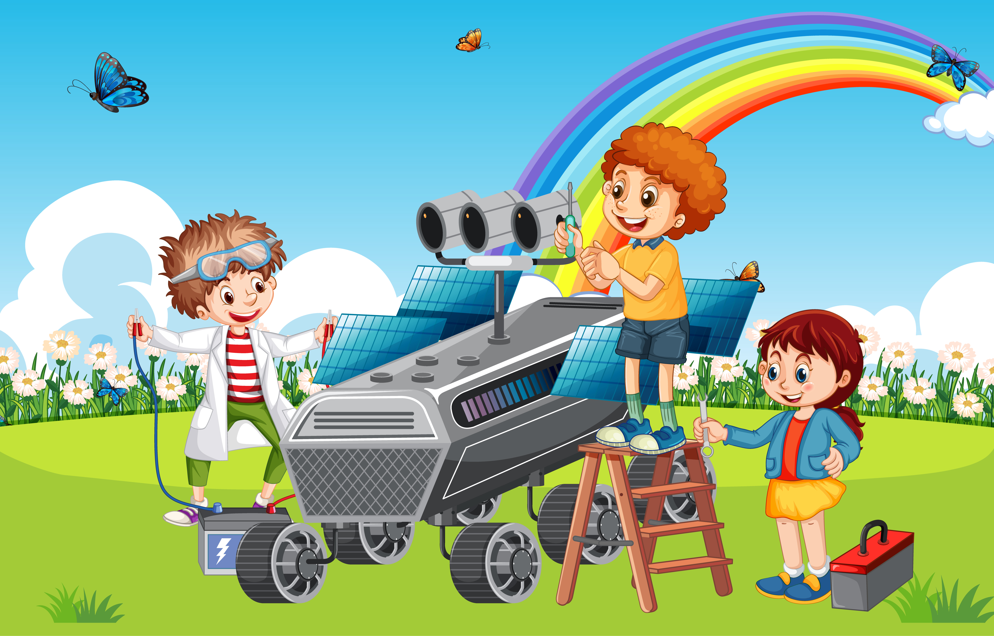

Science Week
2022
Table
Quiz
© Seomra Ranga 2022 www.seomraranga.com

Slide 2
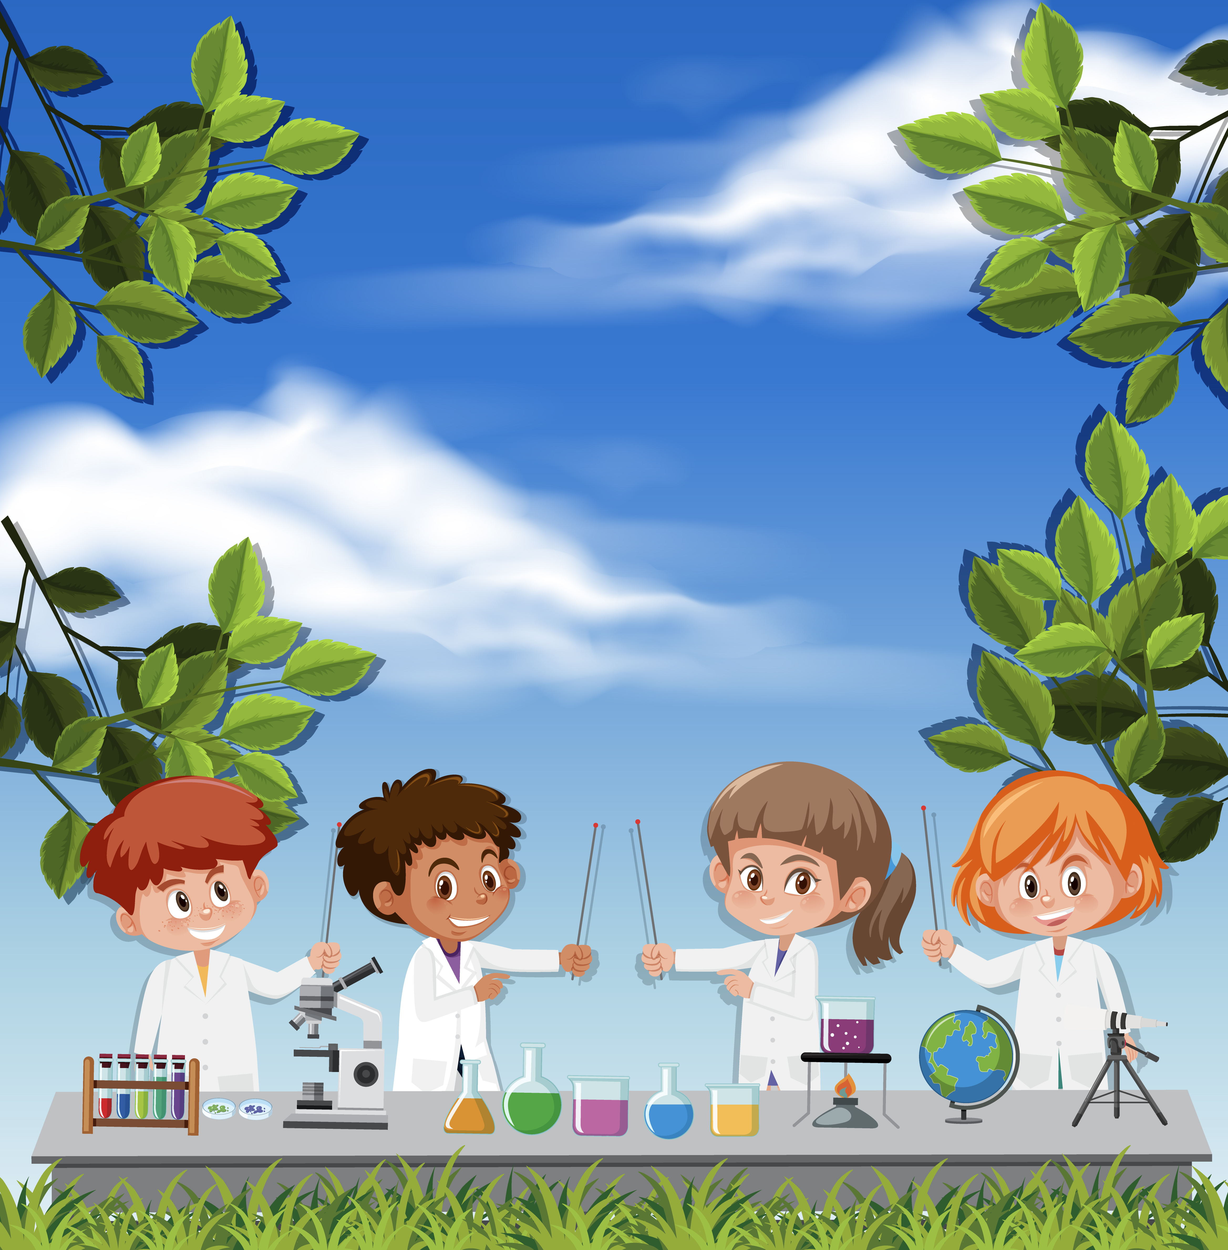
Before You Start
Make sure you have written your table/team number/letter on every answer sheet
Write the number of each round 1-8 on every answer sheet
Try not to shout out answers
© Seomra Ranga 2022 www.seomraranga.com

Slide 3
Before You Start
Check with your team mates and agree an answer before you write it down
Don’t worry about spellings – just do your best
If you’re not sure of the answer, make your best possible guess
© Seomra Ranga 2022 www.seomraranga.com

Slide 4
Remember:
There are eight rounds with six questions in each round
There are 48 questions in all to answer
You are not expected to be able to answer all questions, just do your best
© Seomra Ranga 2022 www.seomraranga.com

Slide 5
Good Luck!
Enjoy the Quiz!
© Seomra Ranga 2022 www.seomraranga.com

Slide 6
Round 1
© Seomra Ranga 2022 www.seomraranga.com

Slide 7
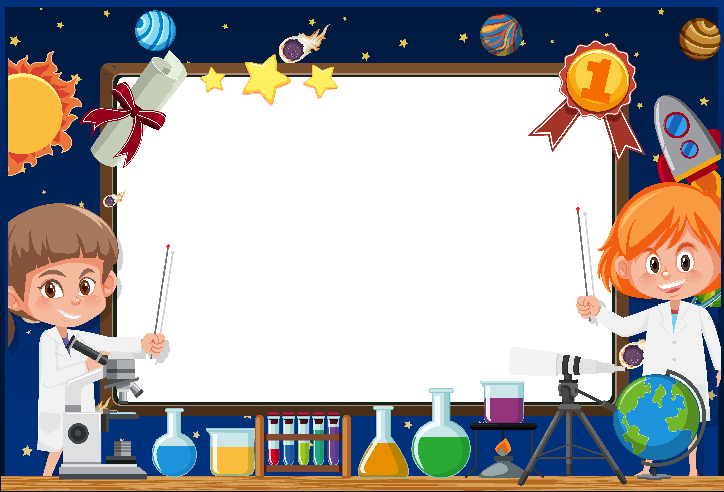
Round 1
Question 1:
What creature does a caterpillar grow into?
© Seomra Ranga 2022 www.seomraranga.com

Slide 8
Round 1
Question 2:
If you visit the optician, what part of your body would they examine?
© Seomra Ranga 2022 www.seomraranga.com

Slide 9
Round 1
Question 3:
What planet is also a Disney character?
© Seomra Ranga 2022 www.seomraranga.com

Slide 10
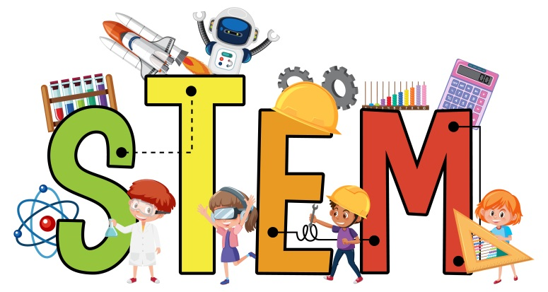
Round 1
Question 4:
What does the “T” in this word stand for?
© Seomra Ranga 2022 www.seomraranga.com

Slide 11
Round 1
Question 5:
Do carrots grow above or below the ground?
© Seomra Ranga 2022 www.seomraranga.com

Slide 12
Round 1
Question 6:
A Botanist is a type of scientist. What do they study?
© Seomra Ranga 2022 www.seomraranga.com

Slide 13
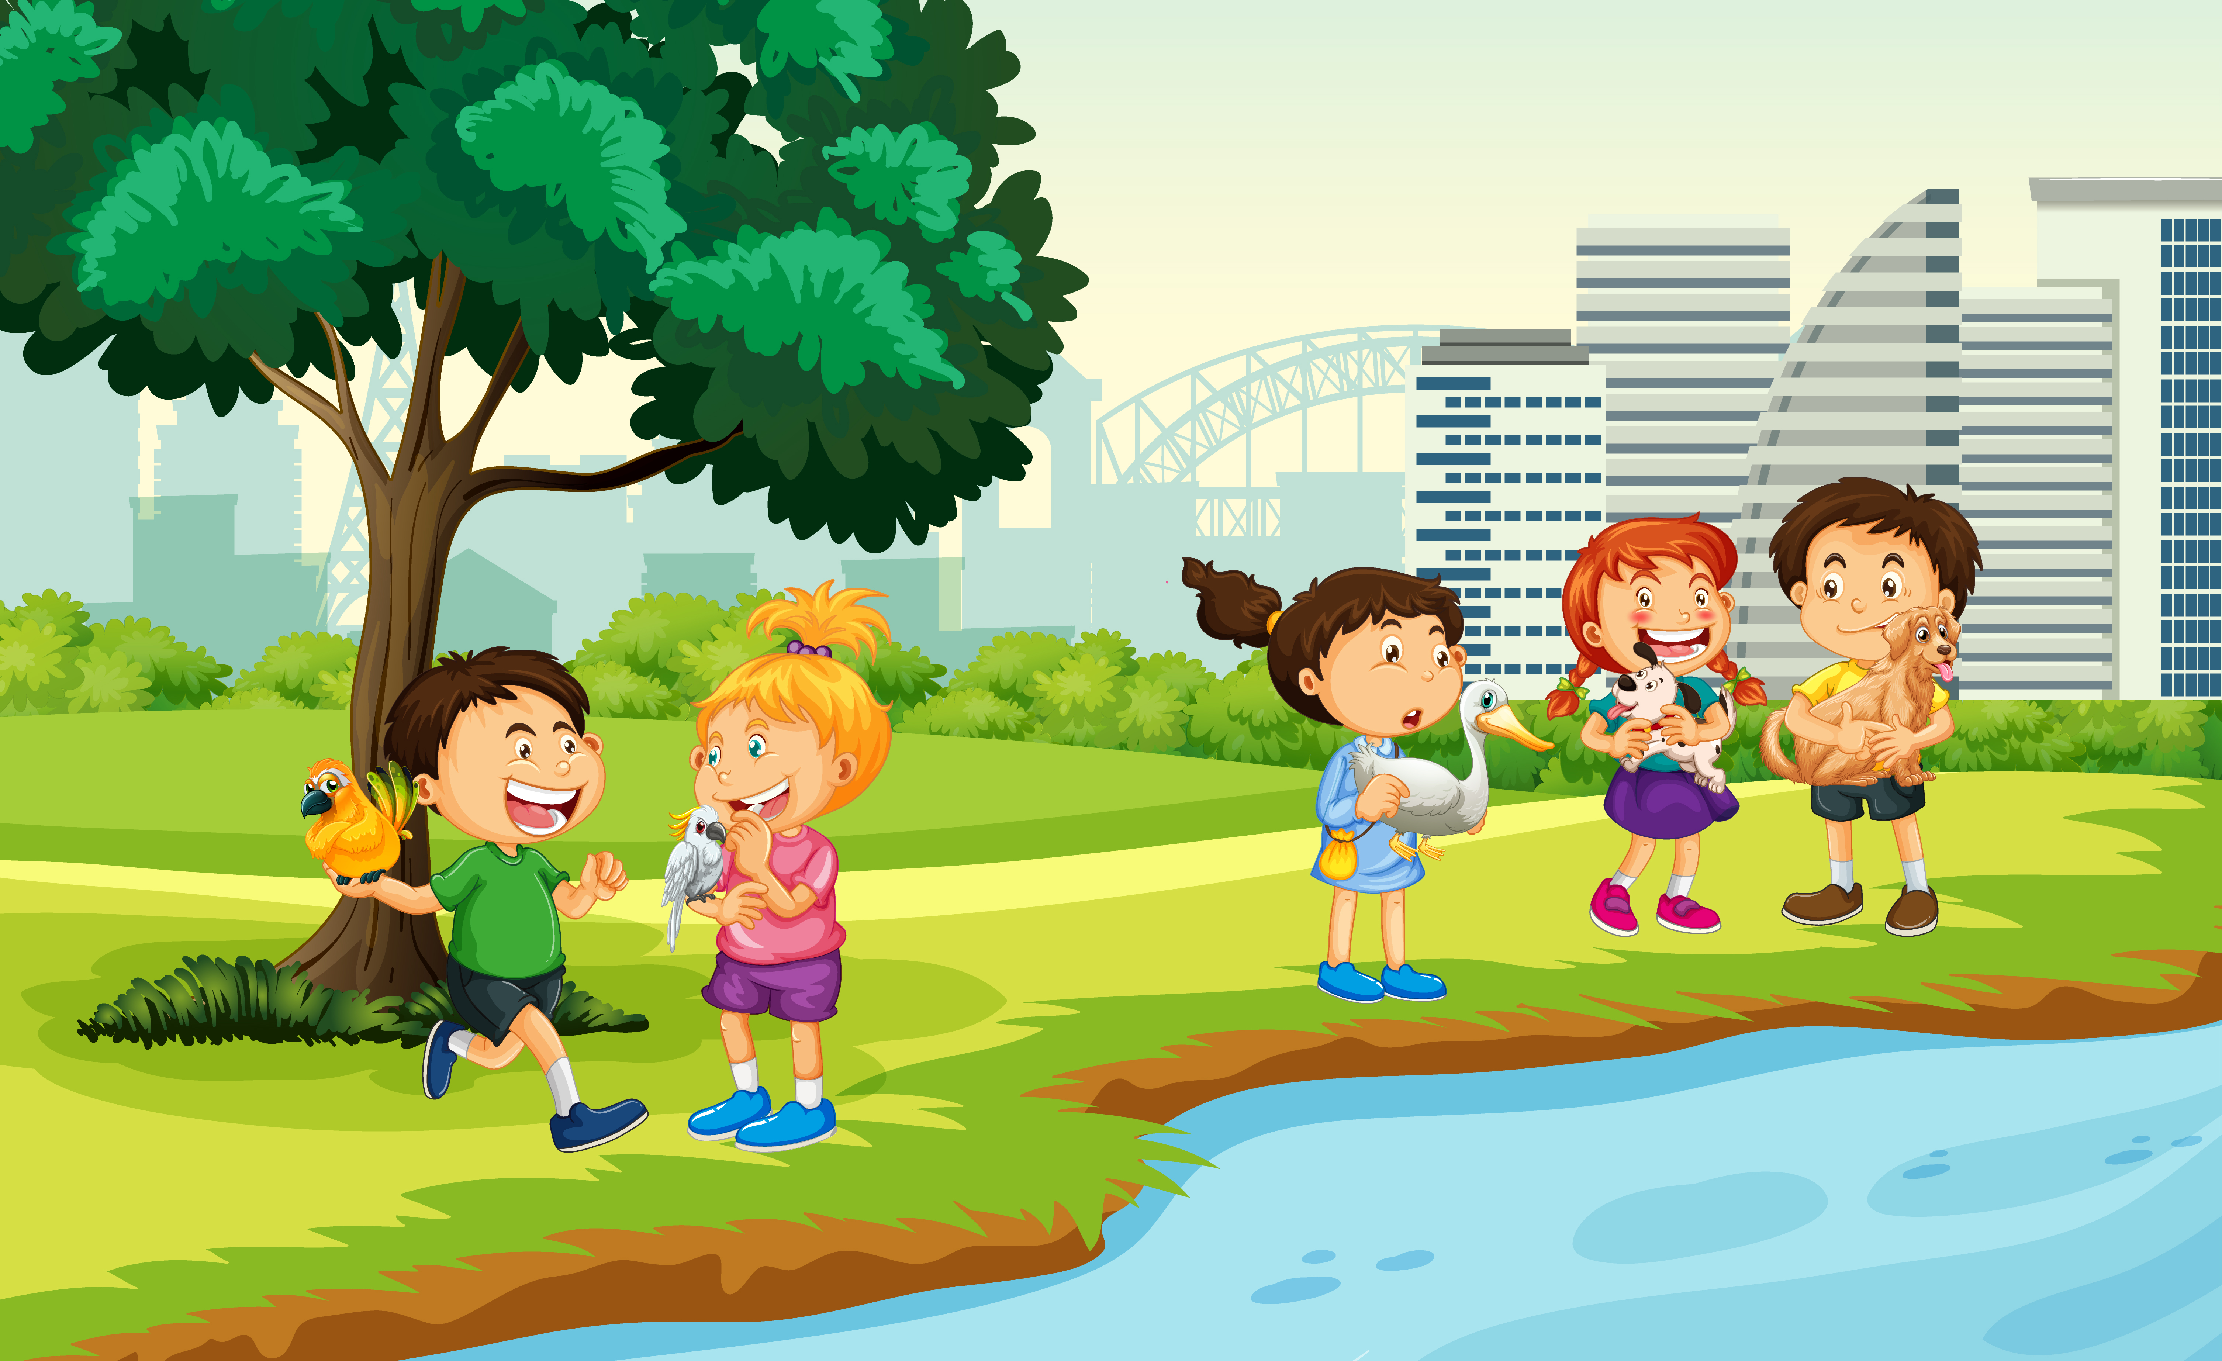
Science Joke
© Seomra Ranga 2022 www.seomraranga.com

Slide 14
Science Joke
What did the Science Book say to the Maths Book?
You’ve got problems!
© Seomra Ranga 2022 www.seomraranga.com

Slide 15
Round 2
© Seomra Ranga 2022 www.seomraranga.com

Slide 16
Round 2
Question 1:
True or false: plastic conducts electricity?
© Seomra Ranga 2022 www.seomraranga.com

Slide 17
Round 2
Question 2:
What is the longest river in the world?
© Seomra Ranga 2022 www.seomraranga.com

Slide 18
Round 2
Question 3:
Which would freeze first, saltwater or fresh water?
© Seomra Ranga 2022 www.seomraranga.com

Slide 19
Round 2
Question 4:
What is the name given to the two holes in the nose?
© Seomra Ranga 2022 www.seomraranga.com

Slide 20
Round 2
Question 5:
What animal is usually found in a byre?
© Seomra Ranga 2022 www.seomraranga.com

Slide 21
Round 2
Question 6:
The three states of matter are: solids, liquids and _____?
© Seomra Ranga 2022 www.seomraranga.com

Slide 22
Science Joke
© Seomra Ranga 2022 www.seomraranga.com

Slide 23
Science Joke
Why did the chemist read the book on Helium so fast?
He couldn’t put it down!
© Seomra Ranga 2022 www.seomraranga.com

Slide 24
Round 1 Answers
© Seomra Ranga 2022 www.seomraranga.com

Slide 25
Round 1 Answers
Question 1:
What creature does a caterpillar grow into?
Butterfly
© Seomra Ranga 2022 www.seomraranga.com

Slide 26
Round 1 Answers
Question 2:
If you visit the optician, what part of your body would they examine?
Eyes
© Seomra Ranga 2022 www.seomraranga.com

Slide 27
Round 1 Answers
Question 3:
What planet is also a Disney character?
Pluto
© Seomra Ranga 2022 www.seomraranga.com

Slide 28

Round 1 Answers
Question 4:
What does the “T” in this word stand for?
Technology
© Seomra Ranga 2022 www.seomraranga.com

Slide 29
Round 1 Answers
Question 5:
Do carrots grow above or below the ground?
Below
© Seomra Ranga 2022 www.seomraranga.com

Slide 30
Round 1 Answers
Question 6:
A Botanist is a type of scientist. What do they study?
Plants/Flowers
© Seomra Ranga 2022 www.seomraranga.com

Slide 31
Science Joke
© Seomra Ranga 2022 www.seomraranga.com

Slide 32
Science Joke
How do you throw a party in space?
You Planet!
© Seomra Ranga 2022 www.seomraranga.com

Slide 33
Round 3
© Seomra Ranga 2022 www.seomraranga.com

Slide 34
Round 3
Question 1:
Naan, pita and ciabatta are all types of what food?
© Seomra Ranga 2022 www.seomraranga.com

Slide 35
Round 3
Question 2:
What is the name given to four human babies born at the same time?
© Seomra Ranga 2022 www.seomraranga.com

Slide 36
Round 3
Question 3:
What is the famous scientist Isaac Newton said to have first discovered: magnetism, gravity or radiation?
© Seomra Ranga 2022 www.seomraranga.com

Slide 37
Round 3
Question 4:
What is the largest desert in the world?
© Seomra Ranga 2022 www.seomraranga.com

Slide 38
Round 3
Question 5:
Unscramble the letters to find a type of antelope: PLAIMA
© Seomra Ranga 2022 www.seomraranga.com

Slide 39
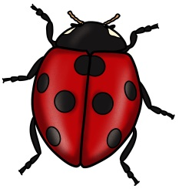

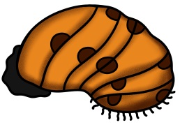
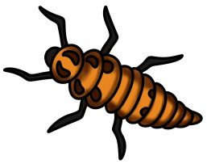
Round 3
Question 6:
Put these stages in the life cycle of a ladybird in order, starting with the earliest:
A
B
C
D
© Seomra Ranga 2022 www.seomraranga.com

Slide 40
Science Joke
© Seomra Ranga 2022 www.seomraranga.com

Slide 41
Science Joke
Did you hear about the two red blood cells that fell in love?
It was all in vein!
© Seomra Ranga 2022 www.seomraranga.com

Slide 42
Round 2 Answers
© Seomra Ranga 2022 www.seomraranga.com

Slide 43
Round 2 Answers
Question 1:
True or false: plastic conducts electricity?
False
© Seomra Ranga 2022 www.seomraranga.com

Slide 44
Round 2 Answers
Question 2:
What is the longest river in the world?
River Nile
© Seomra Ranga 2022 www.seomraranga.com

Slide 45
Round 2 Answers
Question 3:
Which would freeze first, saltwater or fresh water?
Saltwater
© Seomra Ranga 2022 www.seomraranga.com

Slide 46
Round 2 Answers
Question 4:
What is the name given to the two holes in the nose?
Nostrils
© Seomra Ranga 2022 www.seomraranga.com

Slide 47
Round 2 Answers
Question 5:
What animal is usually found in a byre?
Cow
© Seomra Ranga 2022 www.seomraranga.com

Slide 48
Round 2 Answers
Question 6:
The three states of matter are: solids, liquids and _____?
Gases
© Seomra Ranga 2022 www.seomraranga.com

Slide 49
Science Joke
© Seomra Ranga 2022 www.seomraranga.com

Slide 50
Science Joke
Why didn’t we have a bad cold season last year?
Because all the viruses flu away!
© Seomra Ranga 2022 www.seomraranga.com

Slide 51
Round 4
© Seomra Ranga 2022 www.seomraranga.com

Slide 52
Round 4
Question 1:
What type of bear is best known for living on bamboo?
© Seomra Ranga 2022 www.seomraranga.com

Slide 53
Round 4
Question 2:
What part of a plant absorbs water from the soil: leaves, stem or roots?
© Seomra Ranga 2022 www.seomraranga.com

Slide 54
Round 4
Question 3:
True or False: Tarantula spiders can eat birds, mice, frogs and even small snakes?
© Seomra Ranga 2022 www.seomraranga.com

Slide 55
Round 4
Question 4:
Which type of scientist studies the weather: a herpetologist or a meteorologist?
© Seomra Ranga 2022 www.seomraranga.com

Slide 56
Round 4
Question 5:
Steve Jobs was the co-founder of what well-known technology company?
© Seomra Ranga 2022 www.seomraranga.com

Slide 57
Round 4
Question 6:
In what country is this year’s COP27 Climate Conference being held?
© Seomra Ranga 2022 www.seomraranga.com

Slide 58
Science Joke
© Seomra Ranga 2022 www.seomraranga.com

Slide 59
Science Joke
What is a Tornado’s favourite game to play?
Twister!
© Seomra Ranga 2022 www.seomraranga.com

Slide 60
Round 3 Answers
© Seomra Ranga 2022 www.seomraranga.com

Slide 61
Round 3 Answers
Question 1:
Naan, pita and ciabatta are all types of what food?
Bread
© Seomra Ranga 2022 www.seomraranga.com

Slide 62
Round 3 Answers
Question 2:
What is the name given to four human babies born at the same time?
Quads/Quadruplets
© Seomra Ranga 2022 www.seomraranga.com

Slide 63
Round 3 Answers
Question 3:
What is the famous scientist Isaac Newton said to have first discovered: magnetism, gravity or radiation?
Gravity
© Seomra Ranga 2022 www.seomraranga.com

Slide 64
Round 3 Answers
Question 4:
What is the largest desert in the world?
Sahara
© Seomra Ranga 2022 www.seomraranga.com

Slide 65
Round 3 Answers
Question 5:
Unscramble the letters to find a type of antelope: PLAIMA
Impala
© Seomra Ranga 2022 www.seomraranga.com

Slide 66




Round 3 Answers
Question 6:
Put these stages in the life cycle of a ladybird in order, starting with the earliest:
A
B
C
D
B – D – C - A
© Seomra Ranga 2022 www.seomraranga.com

Slide 67
Science Joke
© Seomra Ranga 2022 www.seomraranga.com

Slide 68
Science Joke
What did the Limestone say to the geologist?
Don’t take me for Granite!
© Seomra Ranga 2022 www.seomraranga.com

Slide 69
Time to Check the Scores
© Seomra Ranga 2022 www.seomraranga.com

Slide 70
Round 5
© Seomra Ranga 2022 www.seomraranga.com

Slide 71
Round 5
Question 1:
Is a shark a fish or a mammal?
© Seomra Ranga 2022 www.seomraranga.com

Slide 72
Round 5
Question 2:
True or False: sound travels faster through water than air?
© Seomra Ranga 2022 www.seomraranga.com

Slide 73
Round 5
Question 3:
The coloured part of the human eye is also the name of a flower. Is it: (a) lupin (b) daisy (c) iris (d) tulip
© Seomra Ranga 2022 www.seomraranga.com

Slide 74
Round 5
Question 4:
What is the name given to molten rock that comes from a volcano after it has erupted?
© Seomra Ranga 2022 www.seomraranga.com

Slide 75
Round 5
Question 5:
True or false: the surface of the sun is 60 times hotter than boiling water?
© Seomra Ranga 2022 www.seomraranga.com

Slide 76
Round 5
Question 6:
Suspension, Arch, Cantilever and Truss are all types of what structure?
© Seomra Ranga 2022 www.seomraranga.com

Slide 77
Science Joke
© Seomra Ranga 2022 www.seomraranga.com

Slide 78
Science Joke
How do trees get on the internet?
They log in!
© Seomra Ranga 2022 www.seomraranga.com

Slide 79
Round 4 Answers
© Seomra Ranga 2022 www.seomraranga.com

Slide 80
Round 4 Answers
Question 1:
What type of bear is best known for living on bamboo?
Panda
© Seomra Ranga 2022 www.seomraranga.com

Slide 81
Round 4 Answers
Question 2:
What part of a plant absorbs water from the soil: leaves, stem or roots?
Roots
© Seomra Ranga 2022 www.seomraranga.com

Slide 82
Round 4 Answers
Question 3:
True or False: Tarantula spiders can eat birds, mice, frogs and even small snakes?
True
© Seomra Ranga 2022 www.seomraranga.com

Slide 83
Round 4 Answers
Question 4:
Which type of scientist studies the weather: a herpetologist or a meteorologist?
Meteorologist
© Seomra Ranga 2022 www.seomraranga.com

Slide 84
Round 4 Answers
Question 5:
Steve Jobs was the co-founder of what well-known technology company?
Apple
© Seomra Ranga 2022 www.seomraranga.com

Slide 85
Round 4 Answers
Question 6:
In what country is this year’s COP27 Climate Conference being held?
Egypt
© Seomra Ranga 2022 www.seomraranga.com

Slide 86
Science Joke
© Seomra Ranga 2022 www.seomraranga.com

Slide 87
Science Joke
Why was the bee’s hair sticky?
Because he used a honeycomb!
© Seomra Ranga 2022 www.seomraranga.com

Slide 88
Round 6
© Seomra Ranga 2022 www.seomraranga.com

Slide 89
Round 6
Question 1:
Is a sponge a plant or an animal?
© Seomra Ranga 2022 www.seomraranga.com

Slide 90
Round 6
Question 2:
To create electricity you have to complete a (a) round (b) lap (c) circuit?
© Seomra Ranga 2022 www.seomraranga.com

Slide 91
Round 6
Question 3:
A Sequoia is a type of (a) tree (b) mouse (c) mushroom (d) shellfish?
© Seomra Ranga 2022 www.seomraranga.com

Slide 92
Round 6
Question 4:
Which of the planets is known as the Red Planet?
© Seomra Ranga 2022 www.seomraranga.com

Slide 93
Round 6
Question 5:
Would you fish for salmon in a river or in the sea?
© Seomra Ranga 2022 www.seomraranga.com

Slide 94
Round 6
Question 6:
Unscramble the letters to find a term for when the moon blocks off light from the sun: SEEPILC
© Seomra Ranga 2022 www.seomraranga.com

Slide 95
Science Joke
© Seomra Ranga 2022 www.seomraranga.com

Slide 96
Science Joke
What did the tree wear to the beach?
Swimming trunks!
© Seomra Ranga 2022 www.seomraranga.com

Slide 97
Round 5 Answers
© Seomra Ranga 2022 www.seomraranga.com

Slide 98
Round 5 Answers
Question 1:
Is a shark a fish or a mammal?
Fish
© Seomra Ranga 2022 www.seomraranga.com

Slide 99
Round 5 Answers
Question 2:
True or False: sound travels faster through water than air?
True
© Seomra Ranga 2022 www.seomraranga.com

Slide 100
Round 5 Answers
Question 3:
The coloured part of the human eye is also the name of a flower. Is it: (a) lupin (b) daisy (c) iris (d) tulip
Iris
© Seomra Ranga 2022 www.seomraranga.com

Slide 101
Round 5 Answers
Question 4:
What is the name given to molten rock that comes from a volcano after it has erupted?
Lava
© Seomra Ranga 2022 www.seomraranga.com

Slide 102
Round 5 Answers
Question 5:
True or false: the surface of the sun is 60 times hotter than boiling water?
True
© Seomra Ranga 2022 www.seomraranga.com

Slide 103
Round 5 Answers
Question 6:
Suspension, Arch, Cantilever and Truss are all types of what structure?
Bridge
© Seomra Ranga 2022 www.seomraranga.com

Slide 104
Science Joke
© Seomra Ranga 2022 www.seomraranga.com

Slide 105
Science Joke
What’s worse than finding a worm in your apple?
Finding half a worm!
© Seomra Ranga 2022 www.seomraranga.com

Slide 106
Time to Check the Scores
© Seomra Ranga 2022 www.seomraranga.com

Slide 107
Round 7
© Seomra Ranga 2022 www.seomraranga.com

Slide 108
Round 7
Question 1:
What is the name of a scientist who can sell you medicines in a shop?
© Seomra Ranga 2022 www.seomraranga.com

Slide 109
Round 7
Question 2:
Sepals, Petals, Buds and a Stem are all parts of what?
© Seomra Ranga 2022 www.seomraranga.com

Slide 110
Round 7
Question 3:
What instrument, which contains a magnetic needle, tells you if you are pointing N, S, E or W?
© Seomra Ranga 2022 www.seomraranga.com

Slide 111
Round 7
Question 4:
What scientific instrument is used to view tiny organisms which the human eye cannot see?
HINT
© Seomra Ranga 2022 www.seomraranga.com

Slide 112
Round 7
Question 5:
Blood contains two colours of blood cells. One is red, what is the other colour?
© Seomra Ranga 2022 www.seomraranga.com

Slide 113
Round 7
Question 6:
Red, Sika and Fallow are all types of what animal found in Ireland: (a) hare (b) weasel (c) deer (d) beaver?
© Seomra Ranga 2022 www.seomraranga.com

Slide 114
Science Joke
© Seomra Ranga 2022 www.seomraranga.com

Slide 115
Science Joke
How do we know that Saturn was married more than once?
Because she has a lot of rings!
© Seomra Ranga 2022 www.seomraranga.com

Slide 116
Round 6 Answers
© Seomra Ranga 2022 www.seomraranga.com

Slide 117
Round 6 Answers
Question 1:
Is a sponge a plant or an animal?
Animal
© Seomra Ranga 2022 www.seomraranga.com

Slide 118
Round 6 Answers
Question 2:
To create electricity you have to complete a (a) round (b) lap (c) circuit?
Circuit
© Seomra Ranga 2022 www.seomraranga.com

Slide 119
Round 6 Answers
Question 3:
A Sequoia is a type of (a) tree (b) mouse (c) mushroom (d) shellfish?
Tree
© Seomra Ranga 2022 www.seomraranga.com

Slide 120
Round 6 Answers
Question 4:
Which of the planets is known as the Red Planet?
Mars
© Seomra Ranga 2022 www.seomraranga.com

Slide 121
Round 6 Answers
Question 5:
Would you fish for salmon in a river or in the sea?
River
© Seomra Ranga 2022 www.seomraranga.com

Slide 122
Round 6 Answers
Question 6:
Unscramble the letters to find a term for when the moon blocks off light from the sun: SEEPILC
Eclipse
© Seomra Ranga 2022 www.seomraranga.com

Slide 123
Science Joke
© Seomra Ranga 2022 www.seomraranga.com

Slide 124
Science Joke
How do you stop an astronaut’s baby from crying?
You rocket!
© Seomra Ranga 2022 www.seomraranga.com

Slide 125
Round 8
© Seomra Ranga 2022 www.seomraranga.com

Slide 126
Round 8
Question 1:
From what animal do we get pork meat?
© Seomra Ranga 2022 www.seomraranga.com

Slide 127
Round 8
Question 2:
Do moths, dragonflies, mayflies and butterflies have one or two pairs of wings?
© Seomra Ranga 2022 www.seomraranga.com

Slide 128
Round 8
Question 3:
Which brothers first discovered flight in 1903 in the USA?
© Seomra Ranga 2022 www.seomraranga.com

Slide 129
Round 8
Question 4:
What bird lays the largest eggs?
© Seomra Ranga 2022 www.seomraranga.com

Slide 130
Round 8
Question 5:
The dingo is a wild dog which is native to what country?
© Seomra Ranga 2022 www.seomraranga.com

Slide 131
Round 8
Question 6:
Covid 19 was a disease that affected people all over the world. Was this called (a) pandemic (b) epidemic (c) endemic?
© Seomra Ranga 2022 www.seomraranga.com

Slide 132
Science Joke
© Seomra Ranga 2022 www.seomraranga.com

Slide 133
Science Joke
What do you call a fish without an eye?
Fsh!
© Seomra Ranga 2022 www.seomraranga.com

Slide 134
Round 7 Answers
© Seomra Ranga 2022 www.seomraranga.com

Slide 135
Round 7 Answers
Question 1:
What is the name of a scientist who can sell you medicines in a shop?
Chemist/Pharmacist
© Seomra Ranga 2022 www.seomraranga.com

Slide 136
Round 7 Answers
Question 2:
Sepals, Petals, Buds and a Stem are all parts of what?
Flower
© Seomra Ranga 2022 www.seomraranga.com

Slide 137
Round 7 Answers
Question 3:
What instrument, which contains a magnetic needle, tells you if you are pointing N, S, E or W?
Compass
© Seomra Ranga 2022 www.seomraranga.com

Slide 138
Round 7 Answers
Question 4:
What scientific instrument is used to view tiny organisms which the human eye cannot see?
Microscope
© Seomra Ranga 2022 www.seomraranga.com

Slide 139
Round 7 Answers
Question 5:
Blood contains two colours of blood cells. One is red, what is the other colour?
White
© Seomra Ranga 2022 www.seomraranga.com

Slide 140
Round 7 Answers
Question 6:
Red, Sika and Fallow are all types of what animal found in Ireland: (a) hare (b) weasel (c) deer (d) beaver?
Deer
© Seomra Ranga 2022 www.seomraranga.com

Slide 141
Science Joke
© Seomra Ranga 2022 www.seomraranga.com

Slide 142
Science Joke
Why did the dinosaur cross the road?
Because the chicken hadn’t been invented yet!
© Seomra Ranga 2022 www.seomraranga.com

Slide 143
Round 8 Answers
© Seomra Ranga 2022 www.seomraranga.com

Slide 144
Round 8 Answers
Question 1:
From what animal do we get pork meat?
Pig
© Seomra Ranga 2022 www.seomraranga.com

Slide 145
Round 8 Answers
Question 2:
Do moths, dragonflies, mayflies and butterflies have one or two pairs of wings?
Two Pairs
© Seomra Ranga 2022 www.seomraranga.com

Slide 146
Round 8 Answers
Question 3:
Which brothers first discovered flight in 1903 in the USA?
Wright Brothers
© Seomra Ranga 2022 www.seomraranga.com

Slide 147
Round 8 Answers
Question 4:
What bird lays the largest eggs?
Ostrich
© Seomra Ranga 2022 www.seomraranga.com

Slide 148
Round 8 Answers
Question 5:
The dingo is a wild dog which is native to what country?
Australia
© Seomra Ranga 2022 www.seomraranga.com

Slide 149
Round 8 Answers
Question 6:
Covid 19 was a disease that affected people all over the world. Was this called (a) pandemic (b) epidemic (c) endemic?
Pandemic
© Seomra Ranga 2022 www.seomraranga.com

Slide 150
Science Joke
© Seomra Ranga 2022 www.seomraranga.com

Slide 151
Science Joke
What was the first animal to go into space?
The cow that jumped over the moon!
© Seomra Ranga 2022 www.seomraranga.com

Slide 152
Tie-Break Round
© Seomra Ranga 2022 www.seomraranga.com

Slide 153
Tie-Break
Question 1:
Australia’s national rugby team is nicknamed after what marsupial native to the country?
© Seomra Ranga 2022 www.seomraranga.com

Slide 154
Tie-Break
Question 2:
In centuries past, a bird’s feather was used to make a writing pen. What was this type of pen called?
© Seomra Ranga 2022 www.seomraranga.com

Slide 155
Tie-Break
Question 3:
Nuclear energy is derived from what metal: (a) uranium (b) aluminium (c) platinum?
© Seomra Ranga 2022 www.seomraranga.com

Slide 156
Tie-Break
Question 4:
What shellfish create pearls?
© Seomra Ranga 2022 www.seomraranga.com

Slide 157
Tie-Break
Question 5:
Put these data measurements in order, starting with the smallest: gigabyte (GB), terabyte (TB), megabyte (MB), kilobyte (KB)?
© Seomra Ranga 2022 www.seomraranga.com

Slide 158
Tie-Break
Question 6:
A magnifying glass contains what type of glass: convex or concave?
© Seomra Ranga 2022 www.seomraranga.com

Slide 159
Science Joke
© Seomra Ranga 2022 www.seomraranga.com

Slide 160
Science Joke
What is a snake’s favourite school subject?
Hiss-story!
© Seomra Ranga 2022 www.seomraranga.com

Slide 161
Tie-Break Answers
© Seomra Ranga 2022 www.seomraranga.com

Slide 162
Tie-Break Answers
Question 1:
Australia’s national rugby team is nicknamed after what marsupial native to the country?
Wallaby
© Seomra Ranga 2022 www.seomraranga.com

Slide 163
Tie-Break Answers
Question 2:
In centuries past, a bird’s feather was used to make a writing pen. What was this type of pen called?
Quill
© Seomra Ranga 2022 www.seomraranga.com

Slide 164
Tie-Break Answers
Question 3:
Nuclear energy is derived from what metal: (a) uranium (b) aluminium (c) platinum?
Uranium
© Seomra Ranga 2022 www.seomraranga.com

Slide 165
Tie-Break Answers
Question 4:
What shellfish create pearls?
Oysters
© Seomra Ranga 2022 www.seomraranga.com

Slide 166
Tie-Break Answers
Question 5:
Put these data measurements in order, starting with the smallest: gigabyte (GB), terabyte (TB), megabyte (MB), kilobyte (KB)?
KB, MB, GB, TB
© Seomra Ranga 2022 www.seomraranga.com

Slide 167
Tie-Break Answers
Question 6:
A magnifying glass contains what type of glass: convex or concave?
Convex
© Seomra Ranga 2022 www.seomraranga.com

Slide 168
Science Joke
© Seomra Ranga 2022 www.seomraranga.com

Slide 169
Science Joke
What does a skeleton say before it eats?
Bone Appetite!
© Seomra Ranga 2022 www.seomraranga.com

Slide 170
Hope you all enjoyed the quiz!
© Seomra Ranga 2022 www.seomraranga.com

Slide 171
For Your Information
Thank you for downloading this Seomra Ranga resource. We hope that you find it practical and useful in your classroom.
Please be aware of the following conditions before using this resource.
Please DO:
Print and copy this resource so that you can use it with your pupils.
Make this resource available to your pupils in a private enclosed online space eg. Google Classroom, Seesaw, Edublogs etc.
Tell others if you have found it useful.
Please DO NOT:
Copy or share this resource (in part or whole) with others who have not joined our website. By becoming a member for themselves, they will help the site develop into the future.
Make this resource available on your school website for anyone to download.
Share this resource with other teachers in online groups eg. Facebook Groups, WhatsApp Groups etc.
Kind regards, Seomra Ranga
© Seomra Ranga 2022 www.seomraranga.com

Slide 172


Resources used in this file from:
https://www.teacherspayteachers.com/Store/Clipartino
https://depositphotos.com/
© Seomra Ranga 2022 www.seomraranga.com

