Slide 1
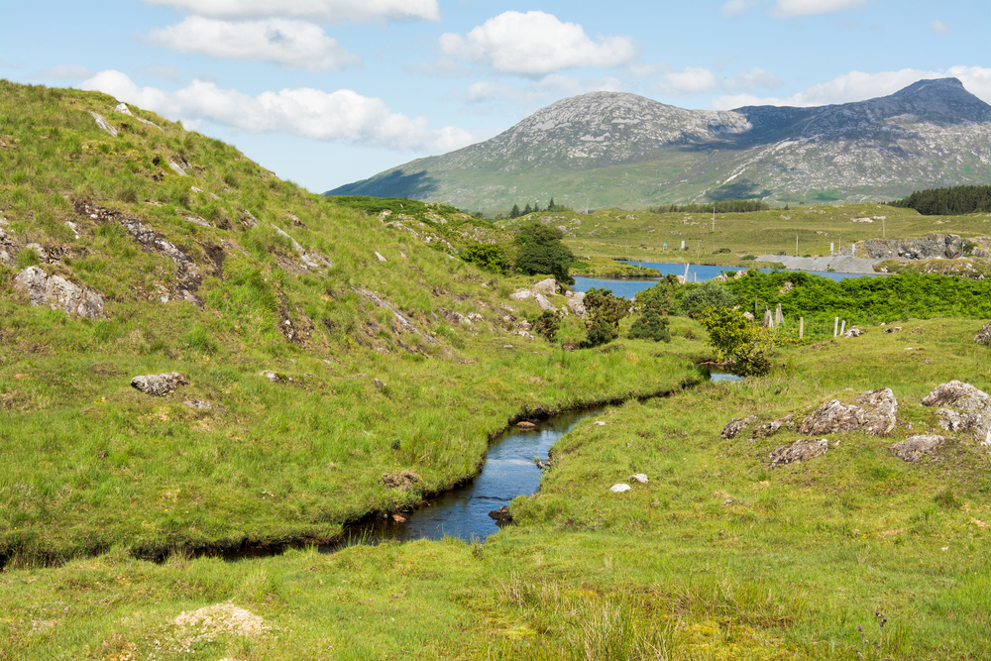

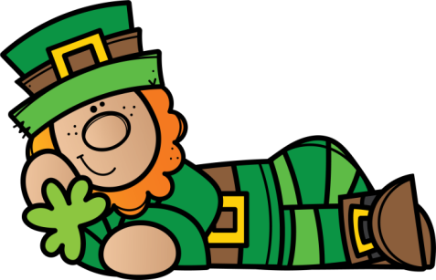



© Seomra Ranga 2022 www.seomraranga.com

Slide 2
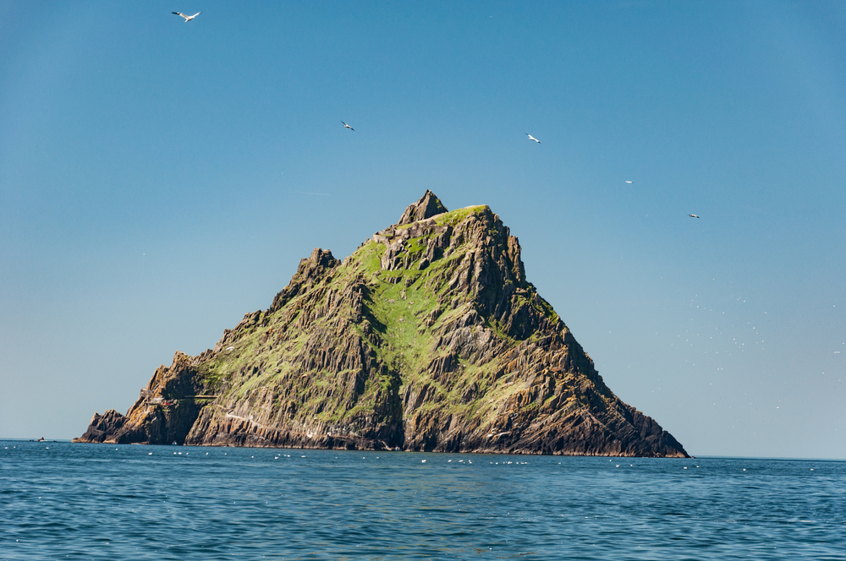

Scríobh uimhir d’fhoireann ar gach bileog freagartha
Scríobh uimhir gach babhta 1-8 ar gach bileog freagartha
Déan iarracht na freagraí a scríobh as Gaeilge
Ná scread amach na freagraí – bígí ciúin
Bainigí taitneamh as!
© Seomra Ranga 2022 www.seomraranga.com

Slide 3
Bígí réidh
anois …..
© Seomra Ranga 2022 www.seomraranga.com

Slide 4
Go n-éirí an t-ádh libh!
© Seomra Ranga 2022 www.seomraranga.com

Slide 5
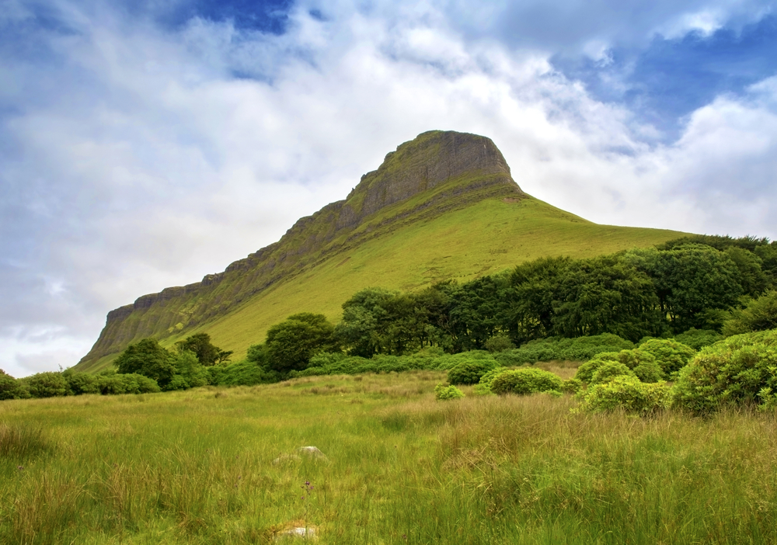


© Seomra Ranga 2022 www.seomraranga.com

Slide 6

Ceist 1:
Cén lá a thagann tar éis an Déardaoin?
© Seomra Ranga 2022 www.seomraranga.com

Slide 7
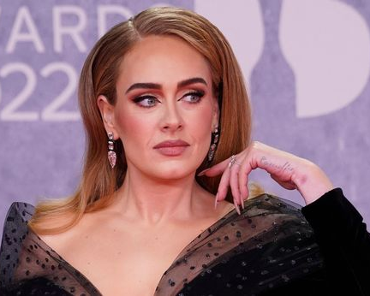
Ceist 2:
Ainmnigh an t-amhránaí seo:
© Seomra Ranga 2022 www.seomraranga.com

Slide 8
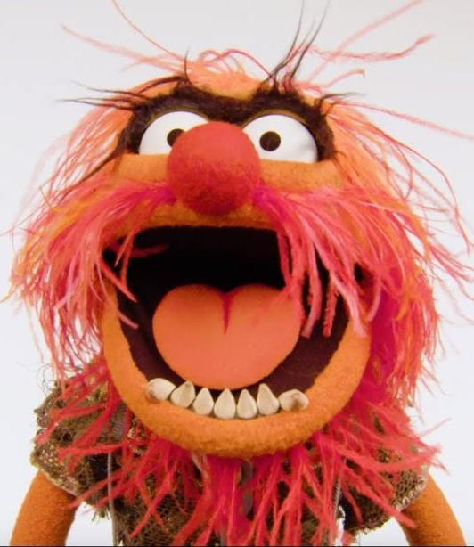
Ceist 3:
Ainmnigh an drumadóir ‘sna “Muppets”
© Seomra Ranga 2022 www.seomraranga.com

Slide 9

Ceist 4:
Cad í seo:
© Seomra Ranga 2022 www.seomraranga.com

Slide 10
Ceist 5:
Cé acu seo atá as ionad: peann, rialóir, capall, marcóir, peann luaidhe?
© Seomra Ranga 2022 www.seomraranga.com

Slide 11
Ceist 6:
Canann Elton John agus _____an t-amhrán “Cold Cold Heart”.
© Seomra Ranga 2022 www.seomraranga.com

Slide 12
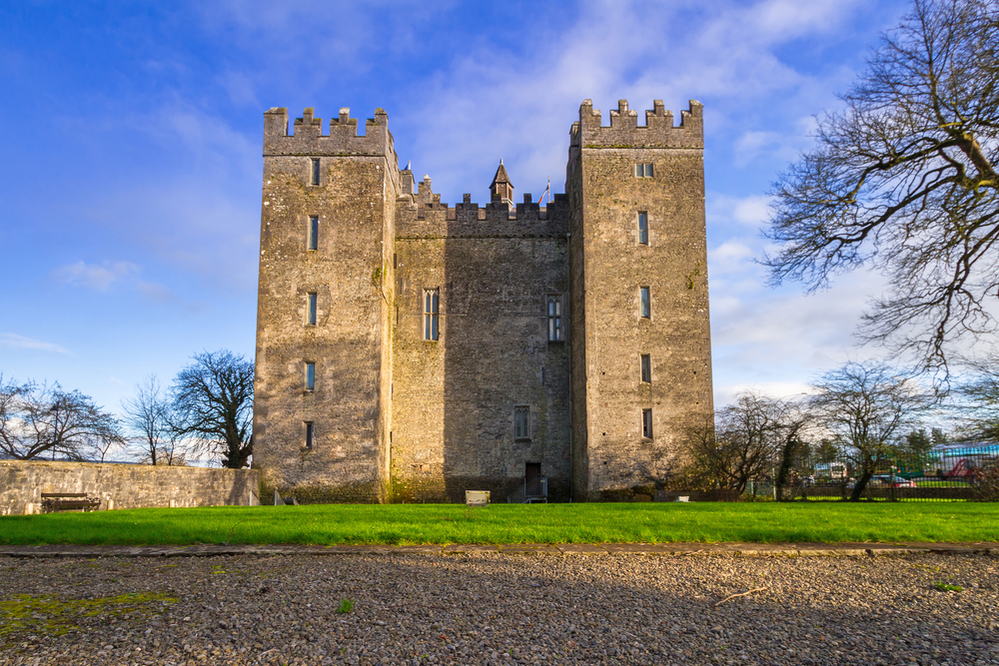

© Seomra Ranga 2022 www.seomraranga.com

Slide 13

Cén fath go mbíonn bogha báistí tinn go minic?
Mar tá sé ill-daite!
© Seomra Ranga 2022 www.seomraranga.com

Slide 14


© Seomra Ranga 2022 www.seomraranga.com

Slide 15

Ceist 1:
Ainmnigh an baile ina raibh an scéal “Pied Piper” suite.
© Seomra Ranga 2022 www.seomraranga.com

Slide 16
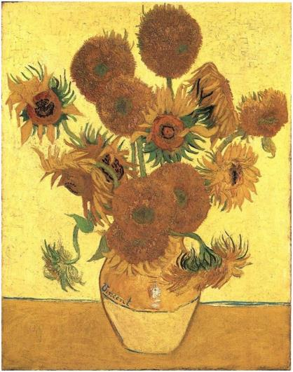
Ceist 2:
Ainmnigh an ealaíontóir a chruthaigh an pictiúr seo:
© Seomra Ranga 2022 www.seomraranga.com

Slide 17

Ceist 3:
Tá an buachaill seo ag ______?
© Seomra Ranga 2022 www.seomraranga.com

Slide 18
Ceist 4:
Críochnaigh an seanfhocal: “Aithníonn ciaróg ….”.
© Seomra Ranga 2022 www.seomraranga.com

Slide 19
Ceist 5:
I mbogha báistí, cén dath a thosaíonn le “B”?
© Seomra Ranga 2022 www.seomraranga.com

Slide 20
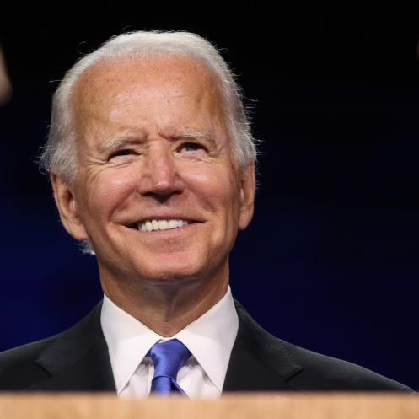
Ceist 6:
Cé hé Uachtarán na Stáit Aontaithe? (USA)
© Seomra Ranga 2022 www.seomraranga.com

Slide 21

© Seomra Ranga 2022 www.seomraranga.com

Slide 22

Cé mhéad duine a bhíonn i mbriogáid dóiteáin?
Naonúr! Naonúr!
© Seomra Ranga 2022 www.seomraranga.com

Slide 23


© Seomra Ranga 2022 www.seomraranga.com

Slide 24
Ceist 1:
Cén lá a thagann tar éis an Déardaoin?
An Aoine
© Seomra Ranga 2022 www.seomraranga.com

Slide 25
Ceist 2:
Ainmnigh an t-amhránaí seo:
Adele
© Seomra Ranga 2022 www.seomraranga.com

Slide 26
Ceist 3:
Ainmnigh an drumadóir ‘sna “Muppets”
Ainmhí
© Seomra Ranga 2022 www.seomraranga.com

Slide 27
Ceist 4:
Cad í seo:
Seamróg
© Seomra Ranga 2022 www.seomraranga.com

Slide 28
Ceist 5:
Cé acu seo atá as ionad: peann, rialóir, capall, marcóir, peann luaidhe?
Capall
© Seomra Ranga 2022 www.seomraranga.com

Slide 29
Ceist 6:
Canann Elton John agus _____an t-amhrán “Cold Cold Heart”.
Dua Lipa
© Seomra Ranga 2022 www.seomraranga.com

Slide 30

© Seomra Ranga 2022 www.seomraranga.com

Slide 31

Cad a thagann ort má itheann tú maisiúcháin Nollag?
Tinsilitis!
© Seomra Ranga 2022 www.seomraranga.com

Slide 32

© Seomra Ranga 2022 www.seomraranga.com

Slide 33

Ceist 1:
Cén mí a thagann roimh mí Iúil?
© Seomra Ranga 2022 www.seomraranga.com

Slide 34
Ceist 2:
Cé mhéad cos atá ag damhán alla?
© Seomra Ranga 2022 www.seomraranga.com

Slide 35
Ceist 3:
Tá mé i mo chónaí i bPáras. Labhraím Fraincís. Cén tír ina bhfuil mé?
© Seomra Ranga 2022 www.seomraranga.com

Slide 36

Ceist 4:
Ainmnigh an t-ainmhí seo:
© Seomra Ranga 2022 www.seomraranga.com

Slide 37
Ceist 5:
Deacair – Éasca
Bocht – Saibhir
Gearr - ?
© Seomra Ranga 2022 www.seomraranga.com

Slide 38
Ceist 6:
Cén áit sa teach a chuireann tú bainne – cuisneoir nó cithfholcadán?
© Seomra Ranga 2022 www.seomraranga.com

Slide 39

© Seomra Ranga 2022 www.seomraranga.com

Slide 40

Cén t-ainm atá ar an duine a oibríonn in Oifig na Scoile?
Ann Rooney!
(An rúnaí)
© Seomra Ranga 2022 www.seomraranga.com

Slide 41


© Seomra Ranga 2022 www.seomraranga.com

Slide 42
Ceist 1:
Ainmnigh an baile ina raibh an scéal “Pied Piper” suite.
Hamelin
© Seomra Ranga 2022 www.seomraranga.com

Slide 43
Ceist 2:
Ainmnigh an ealaíontóir a chruthaigh an pictiúr seo:
Vincent Van Gogh
© Seomra Ranga 2022 www.seomraranga.com

Slide 44
Ceist 3:
Tá an buachaill seo ag ______?
Ag Canadh
© Seomra Ranga 2022 www.seomraranga.com

Slide 45
Ceist 4:
Críochnaigh an seanfhocal: “Aithníonn ciaróg ….”.
Ciaróg Eile
© Seomra Ranga 2022 www.seomraranga.com

Slide 46
Ceist 5:
I mbogha báistí, cén dath a thosaíonn le “B”?
Buí
© Seomra Ranga 2022 www.seomraranga.com

Slide 47
Ceist 6:
Cé hé Uachtarán na Stáit Aontaithe? (USA)
Joe Biden
© Seomra Ranga 2022 www.seomraranga.com

Slide 48

© Seomra Ranga 2022 www.seomraranga.com

Slide 49

Cén Gaeilge atá ar “igloo”?
Choc Ice!
(Teach ice)
© Seomra Ranga 2022 www.seomraranga.com

Slide 50

© Seomra Ranga 2022 www.seomraranga.com

Slide 51

Ceist 1:
Orm, ort, air, ____, orainn, oraibh, orthu.
© Seomra Ranga 2022 www.seomraranga.com

Slide 52
Ceist 2:
Cén bia is fearr le luchóga – prátaí, cáis, pancóga?
© Seomra Ranga 2022 www.seomraranga.com

Slide 53
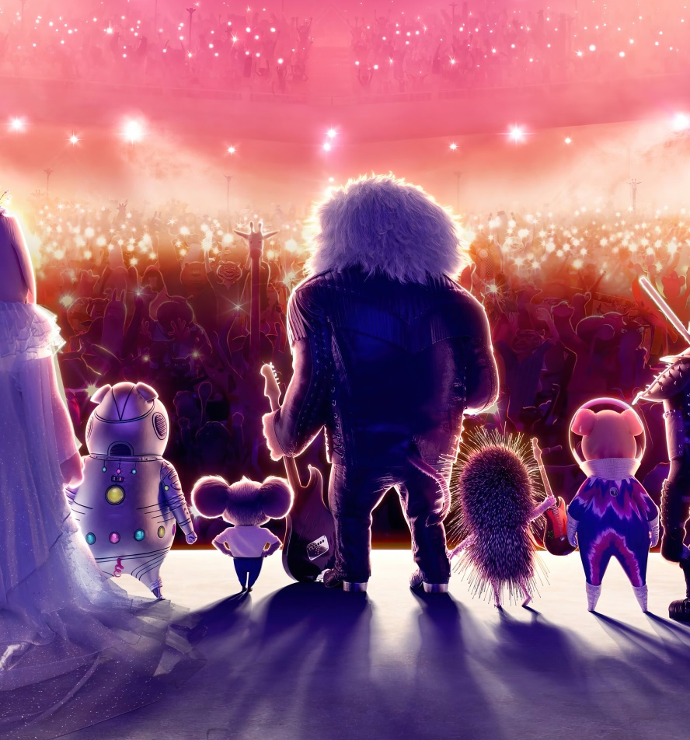
Ceist 3:
Ainmnigh an scannán seo:
© Seomra Ranga 2022 www.seomraranga.com

Slide 54

Ceist 4:
Cé hí seo:
© Seomra Ranga 2022 www.seomraranga.com

Slide 55
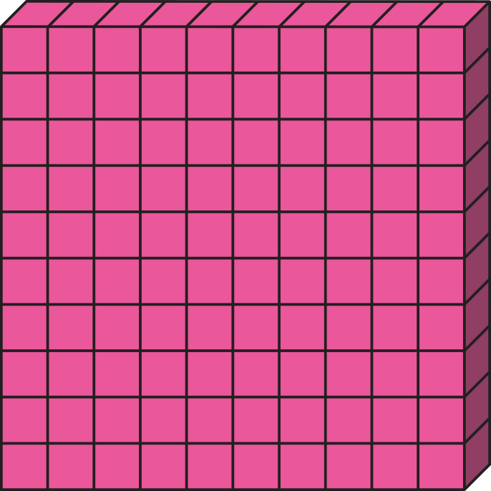

Ceist 5:
Scríobh an uimhir seo:
© Seomra Ranga 2022 www.seomraranga.com

Slide 56
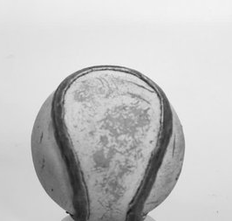
Ceist 6:
Cén t-ainm atá ar an liathróid a úsáidtear san iománaíocht?
© Seomra Ranga 2022 www.seomraranga.com

Slide 57

© Seomra Ranga 2022 www.seomraranga.com

Slide 58

Cén fath a d’ith an dalta a Obair Bhaile”?
Dúirt an múinteoir gur píosa cáca é!
© Seomra Ranga 2022 www.seomraranga.com

Slide 59

© Seomra Ranga 2022 www.seomraranga.com

Slide 60
Ceist 1:
Cén mí a thagann roimh mí Iúil?
Meitheamh
© Seomra Ranga 2022 www.seomraranga.com

Slide 61
Ceist 2:
Cé mhéad cos atá ag damhán alla?
Ocht (8)
© Seomra Ranga 2022 www.seomraranga.com

Slide 62
Ceist 3:
Tá mé i mo chónaí i bPáras. Labhraím Fraincís. Cén tír ina bhfuil mé?
An Fhrainc
© Seomra Ranga 2022 www.seomraranga.com

Slide 63
Ceist 4:
Ainmnigh an t-ainmhí seo:
Gráinneog
© Seomra Ranga 2022 www.seomraranga.com

Slide 64
Ceist 5:
Deacair – Éasca
Bocht – Saibhir
Gearr - ?
Fada
© Seomra Ranga 2022 www.seomraranga.com

Slide 65
Ceist 6:
Cén áit sa teach a chuireann tú bainne – cuisneoir nó cithfholcadán?
Cuisneoir
© Seomra Ranga 2022 www.seomraranga.com

Slide 66

© Seomra Ranga 2022 www.seomraranga.com

Slide 67

Cén Gaeilge atá ar “recurrent dermatitis”?
Ar ais arís!
© Seomra Ranga 2022 www.seomraranga.com

Slide 68

© Seomra Ranga 2022 www.seomraranga.com

Slide 69

Ceist 1:
Cén toradh a d’ith Snow White sular thit sí ina codladh?
© Seomra Ranga 2022 www.seomraranga.com

Slide 70
Ceist 2:
Críochnaigh an frása: “Chomh dubh le ____” – bóthar, lacha nó gual.
© Seomra Ranga 2022 www.seomraranga.com

Slide 71

Ceist 3:
Cad iad seo?
© Seomra Ranga 2022 www.seomraranga.com

Slide 72

Ceist 4:
Ainmnigh an imreoir gailf seo.
© Seomra Ranga 2022 www.seomraranga.com

Slide 73
Ceist 5:
Cén cathair ina bhfuil an dealbh (statue) Little Mermaid?
© Seomra Ranga 2022 www.seomraranga.com

Slide 74
Ceist 6:
Cé mhéad contae atá i gCúige Uladh?
© Seomra Ranga 2022 www.seomraranga.com

Slide 75

© Seomra Ranga 2022 www.seomraranga.com

Slide 76

Ar chuala tú faoin bhfear a bhris a lámh chlé?
Tá sé “alright” anois!
© Seomra Ranga 2022 www.seomraranga.com

Slide 77

© Seomra Ranga 2022 www.seomraranga.com

Slide 78
Ceist 1:
Orm, ort, air, ____, orainn, oraibh, orthu.
Uirthi
© Seomra Ranga 2022 www.seomraranga.com

Slide 79
Ceist 2:
Cén bia is fearr le luchóga – prátaí, cáis, pancóga?
Cáis
© Seomra Ranga 2022 www.seomraranga.com

Slide 80

Ceist 3:
Ainmnigh an scannán seo:
Sing 2
© Seomra Ranga 2022 www.seomraranga.com

Slide 81

Ceist 4:
Cé hí seo:
Mary Lou Mc Donald
© Seomra Ranga 2022 www.seomraranga.com

Slide 82
Ceist 5:
Scríobh an uimhir seo:
Céad is a deich
© Seomra Ranga 2022 www.seomraranga.com

Slide 83
Ceist 6:
Cén t-ainm atá ar an liathróid a úsáidtear san iománaíocht?
Sliotar
© Seomra Ranga 2022 www.seomraranga.com

Slide 84

© Seomra Ranga 2022 www.seomraranga.com

Slide 85

Cé hé rí an tseomra ranga?
An Rialóir!
© Seomra Ranga 2022 www.seomraranga.com

Slide 86

© Seomra Ranga 2022 www.seomraranga.com

Slide 87

Ceist 1:
Cén t-ainm atá ar mhadra Dennis the Menace?
© Seomra Ranga 2022 www.seomraranga.com

Slide 88
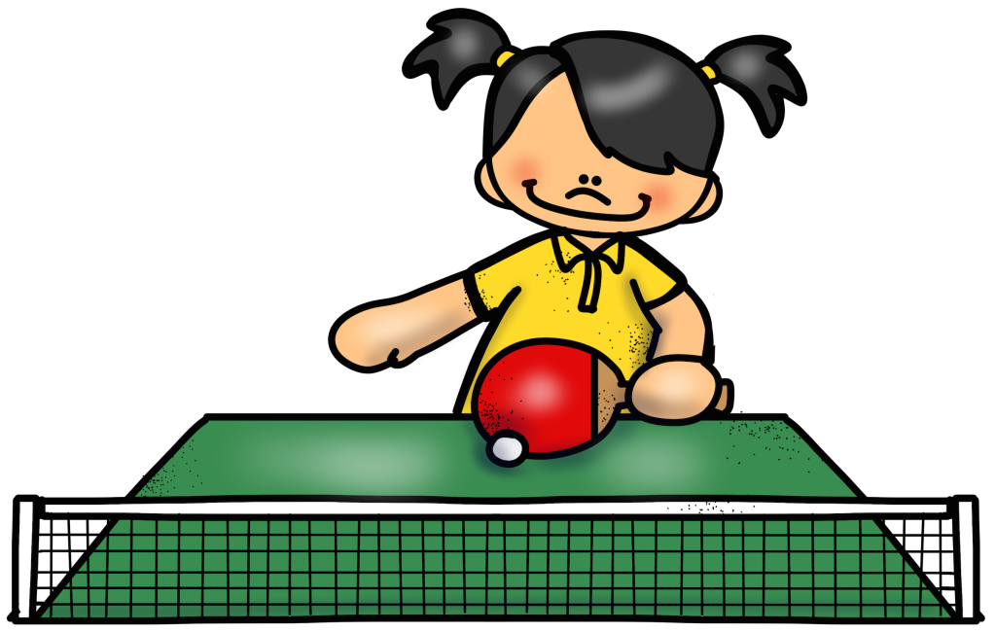
Ceist 2:
Cad atá á imirt ag an gcailín?
© Seomra Ranga 2022 www.seomraranga.com

Slide 89
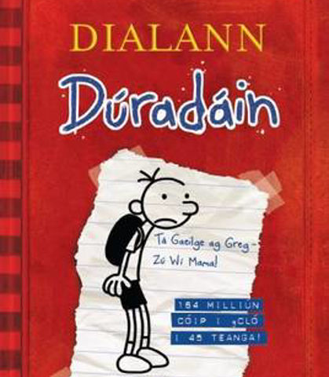
Ceist 3:
Cé a scríobh an leabhar seo:
© Seomra Ranga 2022 www.seomraranga.com

Slide 90
Ceist 4:
Cén mhí ina mbíonn Lá Fhéile Vailintín?
© Seomra Ranga 2022 www.seomraranga.com

Slide 91
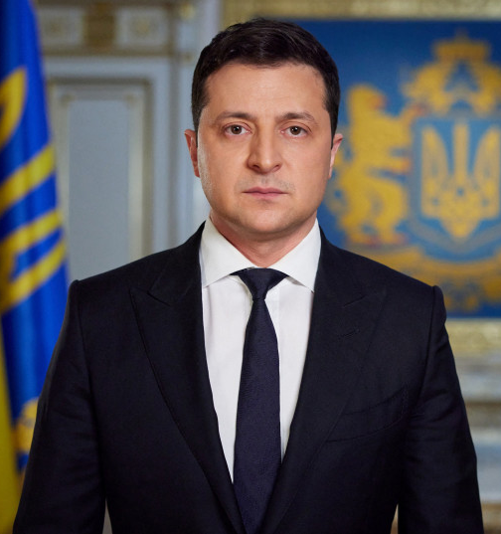
Ceist 5:
Cé hé seo:
© Seomra Ranga 2022 www.seomraranga.com

Slide 92
Ceist 6:
Cad iad na dathanna atá ar bhrat na hIodáile?
© Seomra Ranga 2022 www.seomraranga.com

Slide 93

© Seomra Ranga 2022 www.seomraranga.com

Slide 94

Fuair mé bronntanas lá breithe ó m’uncail. Bosca ríse a bhí ann.
Go raibh maith agat Uncail Ben!
© Seomra Ranga 2022 www.seomraranga.com

Slide 95
© Seomra Ranga 2022 www.seomraranga.com

Slide 96
Ceist 1:
Cén toradh a d’ith Snow White sular thit sí ina codladh?
Úll
© Seomra Ranga 2022 www.seomraranga.com

Slide 97
Ceist 2:
Críochnaigh an frása: “Chomh dubh le ____” – bóthar, lacha nó gual.
Gual
© Seomra Ranga 2022 www.seomraranga.com

Slide 98
Ceist 3:
Cad iad seo?
Fiacla
© Seomra Ranga 2022 www.seomraranga.com

Slide 99
Ceist 4:
Ainmnigh an imreoir gailf seo.
Leona Maguire
© Seomra Ranga 2022 www.seomraranga.com

Slide 100
Ceist 5:
Cén cathair ina bhfuil an dealbh (statue) Little Mermaid?
Copenhagen
© Seomra Ranga 2022 www.seomraranga.com

Slide 101
Ceist 6:
Cé mhéad contae atá i gCúige Uladh?
9 (naoi)
© Seomra Ranga 2022 www.seomraranga.com

Slide 102

© Seomra Ranga 2022 www.seomraranga.com

Slide 103

Cén fáth a mbíonn chuile dhuine ag ól caifé i gConamara?
Mar tá Bean an Tí ann!
© Seomra Ranga 2022 www.seomraranga.com

Slide 104

© Seomra Ranga 2022 www.seomraranga.com

Slide 105

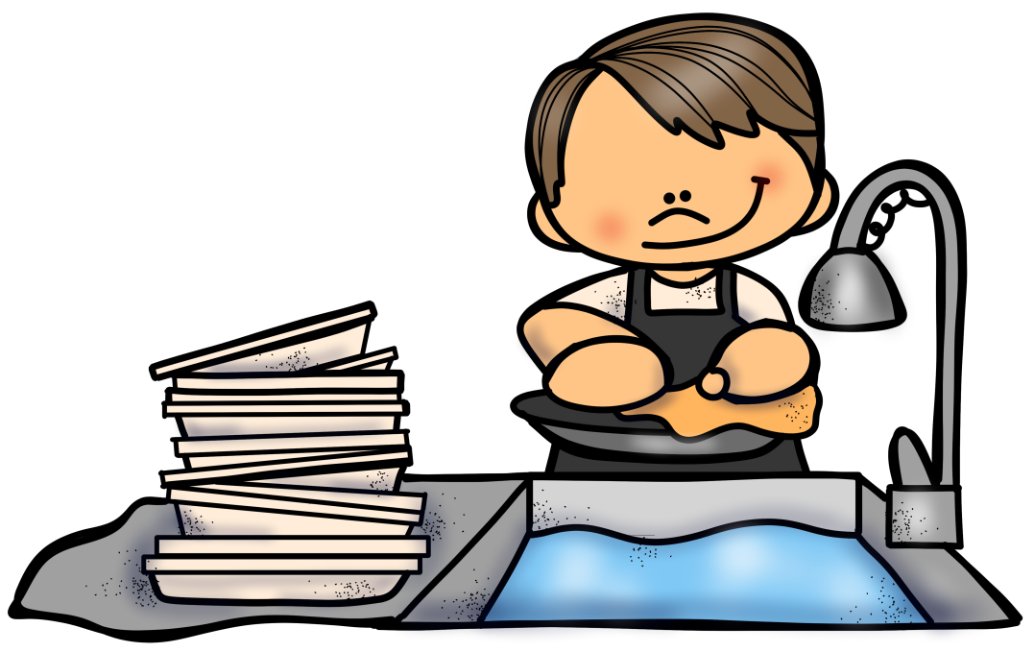
Ceist 1:
Cén áit sa teach a níonn tú na gréithe?
© Seomra Ranga 2022 www.seomraranga.com

Slide 106
Ceist 2:
Sa chartún, cén sórt ainmhí é Pluto?
© Seomra Ranga 2022 www.seomraranga.com

Slide 107
Ceist 3:
Cén cruth atá ar an ngrian?
© Seomra Ranga 2022 www.seomraranga.com

Slide 108
Ceist 4:
Cén contae ina bhfuil an Nás?
© Seomra Ranga 2022 www.seomraranga.com

Slide 109
Ceist 5:
Cé mhéad imreoir a bhíonn ar fhoireann haca?
© Seomra Ranga 2022 www.seomraranga.com

Slide 110

Ceist 6:
Ainmnigh an chlann sa scannán seo:
© Seomra Ranga 2022 www.seomraranga.com

Slide 111

© Seomra Ranga 2022 www.seomraranga.com

Slide 112

Cad a d’ith Jaws dá dhinnéar?
Duine … Duine… Duine!
© Seomra Ranga 2022 www.seomraranga.com

Slide 113
© Seomra Ranga 2022 www.seomraranga.com

Slide 114
Ceist 1:
Cén t-ainm atá ar mhadra Dennis the Menace?
Gnasher
© Seomra Ranga 2022 www.seomraranga.com

Slide 115
Ceist 2:
Cad atá á imirt ag an gcailín?
Leadóg Bhoird
© Seomra Ranga 2022 www.seomraranga.com

Slide 116
Ceist 3:
Cé a scríobh an leabhar seo:
Jeff Kinney
© Seomra Ranga 2022 www.seomraranga.com

Slide 117
Ceist 4:
Cén mhí ina mbíonn Lá Fhéile Vailintín?
Feabhra
© Seomra Ranga 2022 www.seomraranga.com

Slide 118
Ceist 5:
Cé hé seo:
Volodymyr Zelenskyy
(Uachtarán na hÚcráine)
© Seomra Ranga 2022 www.seomraranga.com

Slide 119
Ceist 6:
Cad iad na dathanna atá ar bhrat na hIodáile?
Glas, bán, dearg
© Seomra Ranga 2022 www.seomraranga.com

Slide 120

© Seomra Ranga 2022 www.seomraranga.com

Slide 121

Cad a ghlaonn tú ar chailín a bhíonn i gcónaí ag snámh?
Lynn!!
© Seomra Ranga 2022 www.seomraranga.com

Slide 122

© Seomra Ranga 2022 www.seomraranga.com

Slide 123

Ceist 1:
Fíor nó bréagach – is é Micheál Ó Máirtín Uachtarán na hÉireann?
© Seomra Ranga 2022 www.seomraranga.com

Slide 124




Ceist 2:
Cad iad seo:
© Seomra Ranga 2022 www.seomraranga.com

Slide 125
Ceist 3:
Cé mhéad lá atá i gcoicís?
© Seomra Ranga 2022 www.seomraranga.com

Slide 126
Ceist 4:
Cén chuid den chorp ar a gcaitear cuaráin?
© Seomra Ranga 2022 www.seomraranga.com

Slide 127
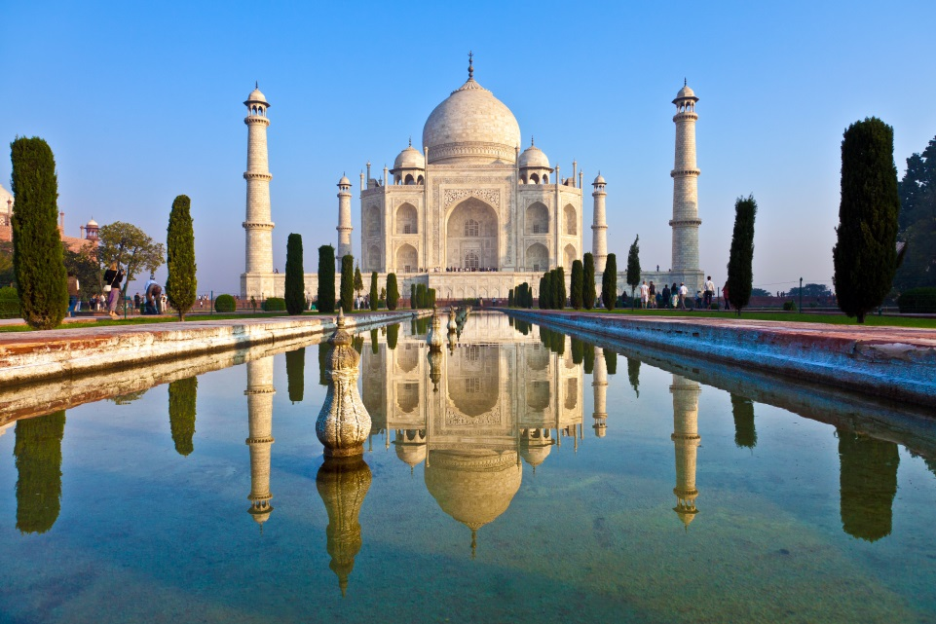
Ceist 5:
Cén tír ina bhfuil an foirgneamh seo:
© Seomra Ranga 2022 www.seomraranga.com

Slide 128
Ceist 6:
Ainmnigh an dara leabhar sa tsraith Harry Potter?
© Seomra Ranga 2022 www.seomraranga.com

Slide 129

© Seomra Ranga 2022 www.seomraranga.com

Slide 130

Cé a thógálann tithe sa ghaeltacht?
Dermot Bannon-Tí!!
© Seomra Ranga 2022 www.seomraranga.com

Slide 131

© Seomra Ranga 2022 www.seomraranga.com

Slide 132
Ceist 1:
Cén áit sa teach a níonn tú na gréithe?
An Chistin
© Seomra Ranga 2022 www.seomraranga.com

Slide 133
Ceist 2:
Sa chartún, cén sórt ainmhí é Pluto?
Madra
© Seomra Ranga 2022 www.seomraranga.com

Slide 134
Ceist 3:
Cén cruth atá ar an ngrian?
Ciorcal / Sféar
© Seomra Ranga 2022 www.seomraranga.com

Slide 135
Ceist 4:
Cén contae ina bhfuil an Nás?
Cill Dara
© Seomra Ranga 2022 www.seomraranga.com

Slide 136
Ceist 5:
Cé mhéad imreoir a bhíonn ar fhoireann haca?
11
© Seomra Ranga 2022 www.seomraranga.com

Slide 137
Ceist 6:
Ainmnigh an chlann sa scannán seo:
Clann Addams
© Seomra Ranga 2022 www.seomraranga.com

Slide 138

© Seomra Ranga 2022 www.seomraranga.com

Slide 139

Céard a thugann tú ar leaid Éireannach a bhíonn ag “sky-diveáil”?
Con-descending!
© Seomra Ranga 2022 www.seomraranga.com

Slide 140
© Seomra Ranga 2022 www.seomraranga.com

Slide 141
Ceist 1:
Fíor nó bréagach – is é Micheál Ó Máirtín Uachtarán na hÉireann?
Bréagach
© Seomra Ranga 2022 www.seomraranga.com

Slide 142




Ceist 2:
Cad iad seo:
Duilleoga
© Seomra Ranga 2022 www.seomraranga.com

Slide 143
Ceist 3:
Cé mhéad lá atá i gcoicís?
14
© Seomra Ranga 2022 www.seomraranga.com

Slide 144
Ceist 4:
Cén chuid den chorp ar a gcaitear cuaráin?
Cosa
© Seomra Ranga 2022 www.seomraranga.com

Slide 145
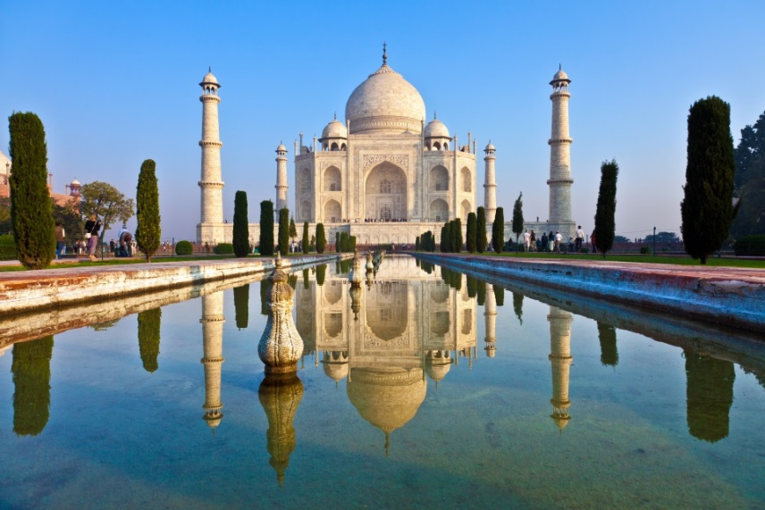
Ceist 5:
Cén tír ina bhfuil an foirgneamh seo:
An India
© Seomra Ranga 2022 www.seomraranga.com

Slide 146
Ceist 6:
Ainmnigh an dara leabhar sa tsraith Harry Potter?
HP agus an Seomra Diamhair
(HP & the Chamber of Secrets)
© Seomra Ranga 2022 www.seomraranga.com

Slide 147

© Seomra Ranga 2022 www.seomraranga.com

Slide 148

Cad a dúirt máthair Batman ag am dinnéir?
Dinnéar, dinnéar, dinnéar, dinnéar, dinnéar, dinnéar, dinnéar, dinnéar, Batman!
© Seomra Ranga 2022 www.seomraranga.com

Slide 149

© Seomra Ranga 2022 www.seomraranga.com

Slide 150

Ceist 1:
Cad is ainm don pháirc ina n-imríonn Liverpool a gcluichí baile?
© Seomra Ranga 2022 www.seomraranga.com

Slide 151
Ceist 2:
Cén luach atá ar an uimhir Rómhánach: MMCXXXIX?
© Seomra Ranga 2022 www.seomraranga.com

Slide 152
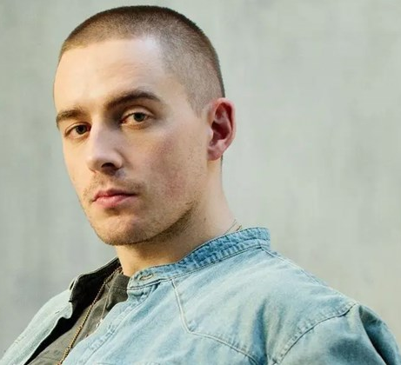
Ceist 3:
Ainmnigh an t-amhránaí Éireannach seo:
© Seomra Ranga 2022 www.seomraranga.com

Slide 153

Ceist 4:
Cad iad seo:
© Seomra Ranga 2022 www.seomraranga.com

Slide 154
Ceist 5:
Céard é an contae is lú in Éirinn?
© Seomra Ranga 2022 www.seomraranga.com

Slide 155
Ceist 6:
Cad í príomhchathair na hAstráile?
© Seomra Ranga 2022 www.seomraranga.com

Slide 156

© Seomra Ranga 2022 www.seomraranga.com

Slide 157

Chonaic mé mo chara Tom ar eitleán. “Haigh Tom”, a dúirt mé.
“Haigh Jack” a scread seisean!!
© Seomra Ranga 2022 www.seomraranga.com

Slide 158

© Seomra Ranga 2022 www.seomraranga.com

Slide 159
Ceist 1:
Cad is ainm don pháirc ina n-imríonn Liverpool a gcluichí baile?
Anfield
© Seomra Ranga 2022 www.seomraranga.com

Slide 160
Ceist 2:
Cén luach atá ar an uimhir Rómhánach: MMCXXXIX?
2139
© Seomra Ranga 2022 www.seomraranga.com

Slide 161
Ceist 3:
Ainmnigh an t-amhránaí Éireannach seo:
Dermot Kennedy
© Seomra Ranga 2022 www.seomraranga.com

Slide 162
Ceist 4:
Cad iad seo:
Bronntanais
© Seomra Ranga 2022 www.seomraranga.com

Slide 163
Ceist 5:
Céard é an contae is lú in Éirinn?
An Lú
© Seomra Ranga 2022 www.seomraranga.com

Slide 164
Ceist 6:
Cad í príomhchathair na hAstráile?
Canberra
© Seomra Ranga 2022 www.seomraranga.com

Slide 165

© Seomra Ranga 2022 www.seomraranga.com

Slide 166

Cén t-ainm atá ar chreatlach ghaelach?
Jimmy Mc Cracken
(D’imigh mo chraiceann!!)
© Seomra Ranga 2022 www.seomraranga.com

Slide 167

Sin an Deireadh
© Seomra Ranga 2022 www.seomraranga.com

Slide 168
Tá súil agam gur bhain sibh taitneamh as na ceisteanna.
© Seomra Ranga 2022 www.seomraranga.com

Slide 169
Slán agus beannacht
© Seomra Ranga 2022 www.seomraranga.com

Slide 170


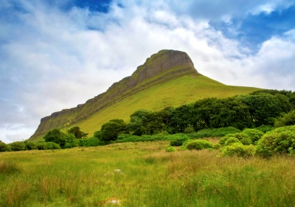


Grianghrafanna sa Chomhad
Connemara, Co. na Gaillimhe
Skellig Michael, Co. Ciarraí
Ben Bulben, Co. Shligigh
All images © Deposit Photos https://depositphotos.com/
Bunratty Castle, Co. an Chláir
© Seomra Ranga 2022 www.seomraranga.com

Slide 171
For Your Information
Thank you for downloading this Seomra Ranga resource. We hope that you find it practical and useful in your classroom.
Please be aware of the following conditions before using this resource.
Please DO:
* Print and copy this resource so that you can use it with your pupils.
* Make this resource available to your pupils in a private enclosed online space eg. Google Classroom, Seesaw, Edublogs etc.
* Tell others if you have found it useful.
Please DO NOT:
* Copy or share this resource (in part or whole) with others who have not joined our website. By becoming a member for themselves, they will help the site develop into the future.
* Make this resource available on your school website for anyone to download.
Kind regards, Seomra Ranga
© Seomra Ranga 2022 www.seomraranga.com

Slide 172








Úsáidtear íomhánna sa chomad seo ó:
https://www.teacherspayteachers.com/Store/Creating4-The-Classroom
https://www.teacherspayteachers.com/Store/Photo-Clipz
https://www.teacherspayteachers.com/Store/P4-Clips-Trioriginals
https://www.teacherspayteachers.com/Store/Educlips
https://www.teacherspayteachers.com/Store/Zip-a-dee-doo-dah-Designs
https://www.teacherspayteachers.com/Store/Whimsy-Clips
https://www.textgiraffe.com/
https://www.teacherspayteachers.com/Store/Krista-Wallden-Creative-Clips
https://depositphotos.com/
© Seomra Ranga 2022 www.seomraranga.com

