Slide 1
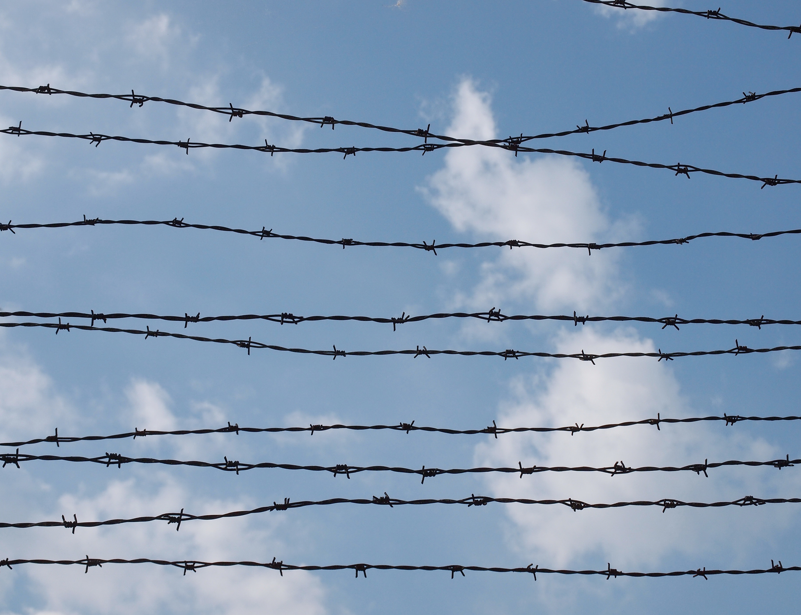

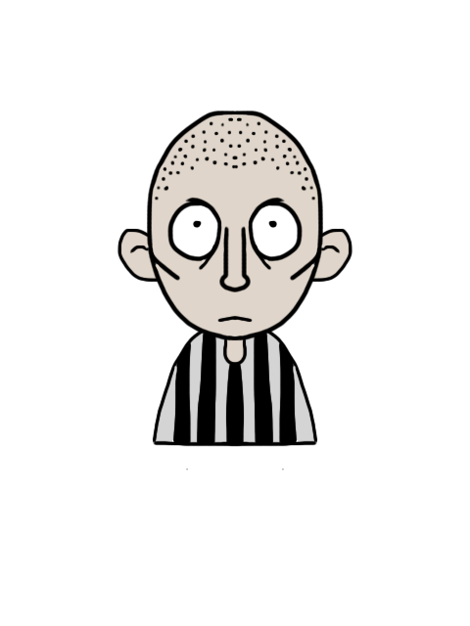



© Seomra Ranga 2022 www.seomraranga.com

Slide 2
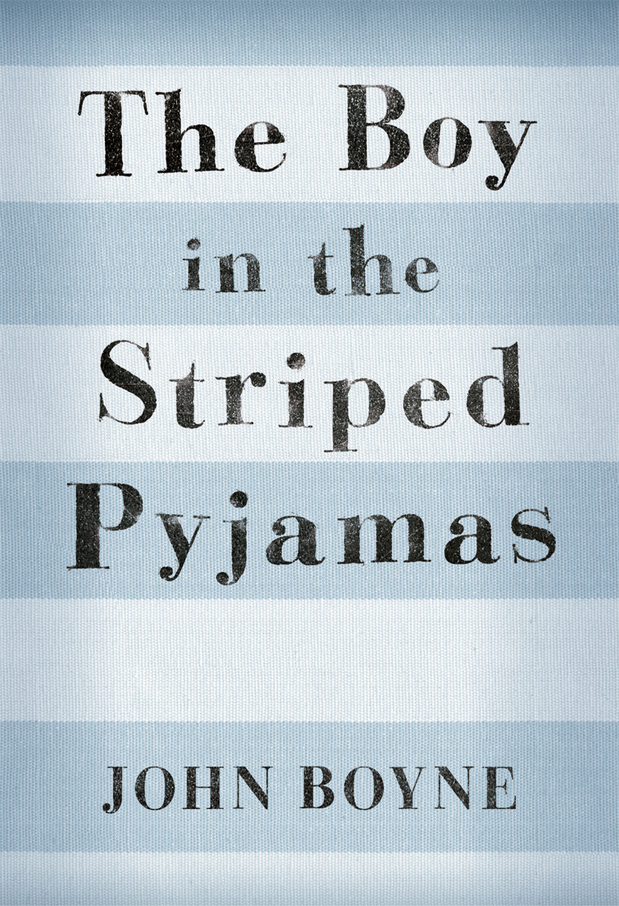
Based on the book by John Boyne
© Seomra Ranga 2022 www.seomraranga.com

Slide 3
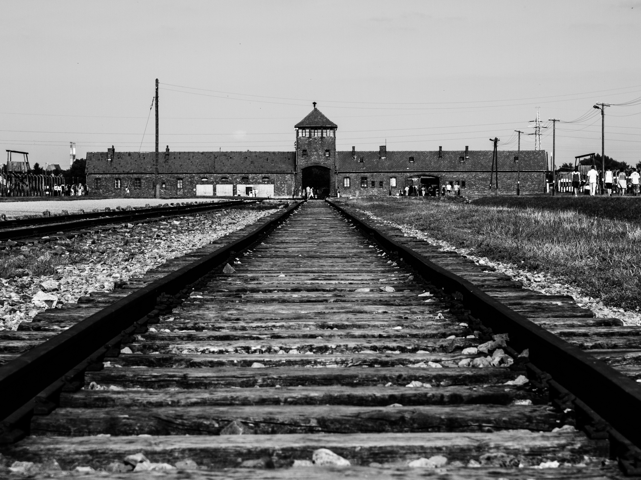


© Seomra Ranga 2022 www.seomraranga.com

Slide 4
Auschwitz was located near the industrial town of Oswiecim in southern Poland.
© Seomra Ranga 2022 www.seomraranga.com

Slide 5
Auschwitz was the largest concentration camp set up by Nazi Germany.
© Seomra Ranga 2022 www.seomraranga.com

Slide 6
Auschwitz was actually three camps in one – a prison camp, an extermination camp and a slave labour camp.
© Seomra Ranga 2022 www.seomraranga.com

Slide 7
The first transport of Polish political prisoners arrived in Auschwitz on June 14, 1940.
© Seomra Ranga 2022 www.seomraranga.com

Slide 8
Conditions in Auschwitz were harsh with poor shelter and sanitation. Prisoners had to work hard and were given little food.
© Seomra Ranga 2022 www.seomraranga.com

Slide 9
7,650 sick or starving prisoners were found by Soviet troops who eventually liberated the camp on January 27, 1945.
© Seomra Ranga 2022 www.seomraranga.com

Slide 10
Between 1.1 and 1.5 million people died at Auschwitz - 90 percent of them were Jewish.
© Seomra Ranga 2022 www.seomraranga.com

Slide 11
Approximately 83,000 Polish people died or were killed in the camp.
© Seomra Ranga 2022 www.seomraranga.com

Slide 12
Prison doctors carried out some medical experiments on prisoners in Auschwitz.
© Seomra Ranga 2022 www.seomraranga.com

Slide 13
Prisoner serial numbers were tattooed onto their bodies in the camp. Prisoners were known by their numbers, not their names.
© Seomra Ranga 2022 www.seomraranga.com

Slide 14
Jewish prisoners had to sew two yellow triangles onto their clothes in the shape of a Star of David.
© Seomra Ranga 2022 www.seomraranga.com

Slide 15
15% of those who worked at Auschwitz were convicted of war crimes after the war.
© Seomra Ranga 2022 www.seomraranga.com

Slide 16
Approximately 700 prisoners tried to escape from Auschwitz’s three camps – about 300 were successful.
© Seomra Ranga 2022 www.seomraranga.com

Slide 17
Some years after the war, Auschwitz was rebuilt as a museum and is visited by thousands of people every year.
© Seomra Ranga 2022 www.seomraranga.com

Slide 18
In 1979, the Polish Pope John Paul II celebrated mass in Auschwitz.
© Seomra Ranga 2022 www.seomraranga.com

Slide 19
In the 1980s, Pope John Paul II made two people who were killed in Auschwitz into Catholic Saints.
© Seomra Ranga 2022 www.seomraranga.com

Slide 20
In 2005, the United Nations declared January 27th International Holocaust Remembrance day, marking the day the camp was liberated.
© Seomra Ranga 2022 www.seomraranga.com

Slide 21
Auschwitz remains as a reminder to the world of the horrors of war.
© Seomra Ranga 2022 www.seomraranga.com

Slide 22



Resources used in this file from:
https://www.teacherspayteachers.com/Store/Thebookwrangler
https://www.textgiraffe.com/
https://depositphotos.com/
© Seomra Ranga 2022 www.seomraranga.com

