Slide 1


MATHS WEEK 2021
TABLE QUIZ
© Seomra Ranga 2021 www.seomraranga.com

Slide 2
Before You Start
Make sure you have written your table/team number/letter on every answer sheet
Write the number of each round 1-8 on every answer sheet
Try not to shout out answers
Check with your team mates and agree an answer before you write it down
© Seomra Ranga 2021 www.seomraranga.com

Slide 3
Before You Start
Don’t worry about spellings – just do your best
If you’re not sure of the answer, make your best possible guess
It might be a good idea to have a piece of paper to do some rough calculations for some questions
Good luck and enjoy the quiz!
© Seomra Ranga 2021 www.seomraranga.com

Slide 4
Round 1
© Seomra Ranga 2021 www.seomraranga.com

Slide 5
Round 1
Question 1
What number goes into the empty box:
9
+
=
17
© Seomra Ranga 2021 www.seomraranga.com

Slide 6
Round 1
Question 2
What comes next in this sequence:
2, 4, 6, 8, ____?
© Seomra Ranga 2021 www.seomraranga.com

Slide 7

Round 1
Question 3
Name this 2D shape:
© Seomra Ranga 2021 www.seomraranga.com

Slide 8
Round 1
Question 4
Make the largest number possible using these digits:
9
5
2
8
© Seomra Ranga 2021 www.seomraranga.com

Slide 9
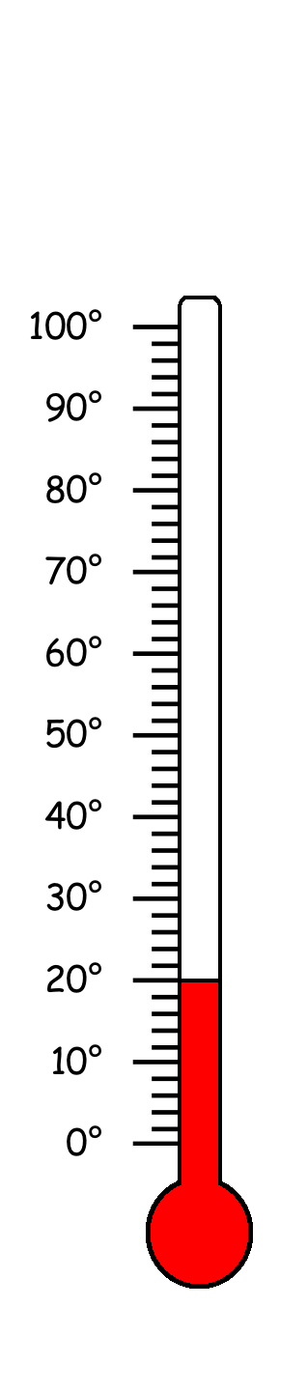
Round 1
Question 5
What is the temperature?
© Seomra Ranga 2021 www.seomraranga.com

Slide 10
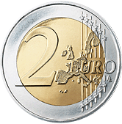

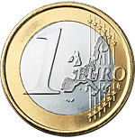
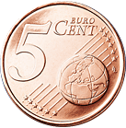

Round 1
Question 6
How much money is this:
© Seomra Ranga 2021 www.seomraranga.com

Slide 11
Maths Joke No. 1
What did one Maths Book say to the other?
Don’t bother me, I’ve got my own problems!
© Seomra Ranga 2021 www.seomraranga.com

Slide 12
Round 2
© Seomra Ranga 2021 www.seomraranga.com

Slide 13
Round 2
Question 1
What number is double 12?
© Seomra Ranga 2021 www.seomraranga.com

Slide 14
Round 2
Question 2
Write the following number: seventy nine.
© Seomra Ranga 2021 www.seomraranga.com

Slide 15
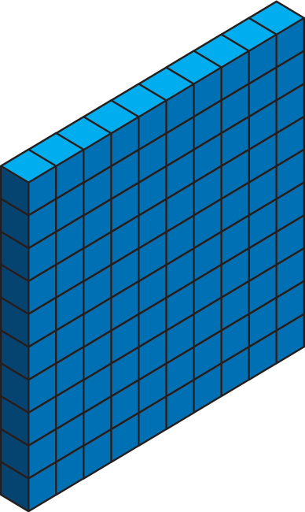


Round 2
Question 3
What is this number?
© Seomra Ranga 2021 www.seomraranga.com

Slide 16


Round 2
Question 4
Add these fractions:
+
© Seomra Ranga 2021 www.seomraranga.com

Slide 17
Round 2
Question 5
Which of these are odd numbers?
6
9
5
12
8
17
© Seomra Ranga 2021 www.seomraranga.com

Slide 18




Round 2
Question 6
Dad is 30 years older than John. Mum is 20 years older than Alva. What age are the four of them altogether?
John
Alva
Dad
Mum
Age 6
Age 10
Age ?
Age ?
© Seomra Ranga 2021 www.seomraranga.com

Slide 19
Maths Joke No. 2
Why did the girl wear glasses during maths class?
Because it improves di-vision!
© Seomra Ranga 2021 www.seomraranga.com

Slide 20
Round 1 Answers
© Seomra Ranga 2021 www.seomraranga.com

Slide 21
Round 1 Answers
Question 1
What number goes into the empty box:
9
+
=
17
8
© Seomra Ranga 2021 www.seomraranga.com

Slide 22
Round 1 Answers
Question 2
What comes next in this sequence:
2, 4, 6, 8, ____?
10
© Seomra Ranga 2021 www.seomraranga.com

Slide 23

Round 1 Answers
Question 3
Name this 2D shape:
semi-circle
© Seomra Ranga 2021 www.seomraranga.com

Slide 24
Round 1 Answers
Question 4
Make the largest number possible using these digits:
9
5
2
8
9852
© Seomra Ranga 2021 www.seomraranga.com

Slide 25
Round 1 Answers
Question 5
What is the temperature?
20⁰
© Seomra Ranga 2021 www.seomraranga.com

Slide 26
Round 1 Answers
Question 6
How much money is this:
€3.57
© Seomra Ranga 2021 www.seomraranga.com

Slide 27
Maths Joke No. 3
How do you keep warm in a cold room?
You go to the corner because it’s always 90⁰!
© Seomra Ranga 2021 www.seomraranga.com

Slide 28
Round 3
© Seomra Ranga 2021 www.seomraranga.com

Slide 29
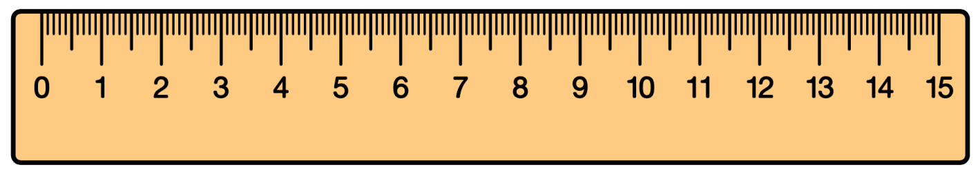
Round 3
Question 1
How many mm are there in 5cm?
© Seomra Ranga 2021 www.seomraranga.com

Slide 30
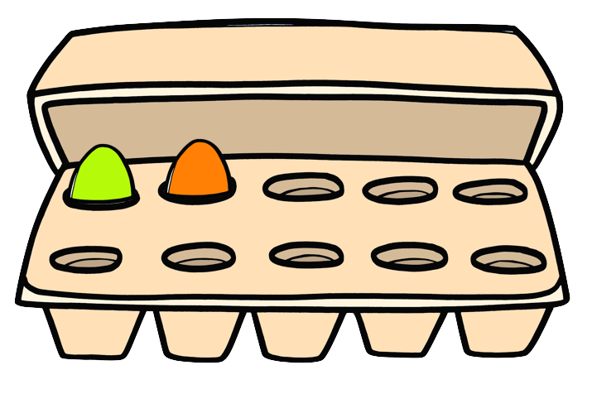
Round 3
Question 2
How many more eggs are needed to fill the egg box?
© Seomra Ranga 2021 www.seomraranga.com

Slide 31
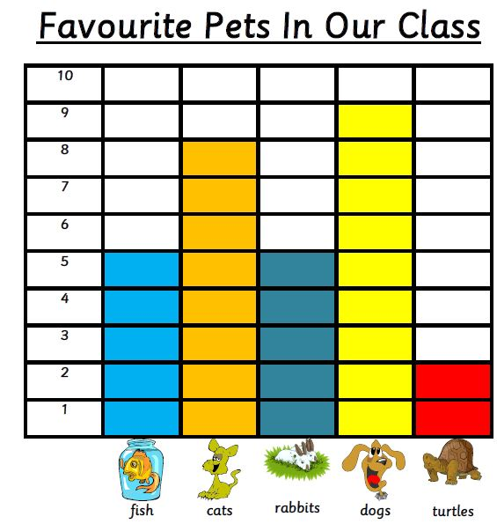
Round 3
Question 3
What is the most favourite pet in the class?
© Seomra Ranga 2021 www.seomraranga.com

Slide 32
Round 3
Question 4
What day comes three days before Saturday?
© Seomra Ranga 2021 www.seomraranga.com

Slide 33
Round 3
Question 5
My tens number is 7. My units number is 3. My hundreds number is 5. What number am I?
© Seomra Ranga 2021 www.seomraranga.com

Slide 34
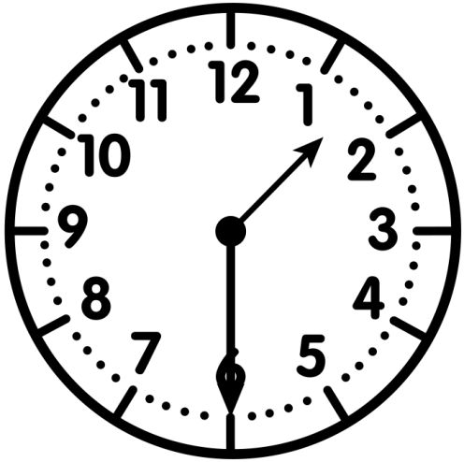
Round 3
Question 6
What time will it be 90 minutes later?
© Seomra Ranga 2021 www.seomraranga.com

Slide 35
Maths Joke No. 4
Why did the teacher write the maths problem on the window?
Because she wanted it to be very clear!
© Seomra Ranga 2021 www.seomraranga.com

Slide 36
Round 2 Answers
© Seomra Ranga 2021 www.seomraranga.com

Slide 37
Round 2 Answers
Question 1
What number is double 12?
24
© Seomra Ranga 2021 www.seomraranga.com

Slide 38
Round 2 Answers
Question 2
Write the following number: seventy nine.
79
© Seomra Ranga 2021 www.seomraranga.com

Slide 39
Round 2 Answers
Question 3
What is this number?
127
© Seomra Ranga 2021 www.seomraranga.com

Slide 40
Round 2 Answers
Question 4
Add these fractions:
+
¾
© Seomra Ranga 2021 www.seomraranga.com

Slide 41
Round 2 Answers
Question 5
Which of these are odd numbers?
6
9
5
12
8
17
9, 5, 17
© Seomra Ranga 2021 www.seomraranga.com

Slide 42
Round 2 Answers
Question 6
Dad is 30 years older than John. Mum is 20 years older than Alva. What age are the four of them altogether?
John
Alva
Dad
Mum
Age 6
Age 10
Age ?
Age ?
6 + 10 + 36 + 30 = 82
© Seomra Ranga 2021 www.seomraranga.com

Slide 43
Maths Joke No. 5
Why did the boy do addition problems on the floor?
Because his teacher told him not to use tables!
© Seomra Ranga 2021 www.seomraranga.com

Slide 44
Round 4
© Seomra Ranga 2021 www.seomraranga.com

Slide 45

Round 4
Question 1
What fraction of this shape is coloured?
© Seomra Ranga 2021 www.seomraranga.com

Slide 46
Round 4
Question 2
What would be best to use for measuring your maths copy: ruler, metre stick or trundle wheel?
© Seomra Ranga 2021 www.seomraranga.com

Slide 47
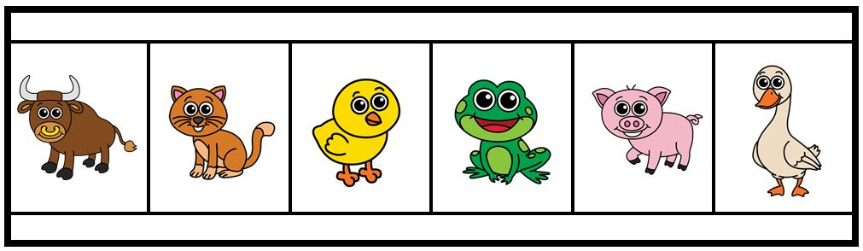
Round 4
Question 3
Which animal is fifth in line?
© Seomra Ranga 2021 www.seomraranga.com

Slide 48

Round 4
Question 4
      38
      +27
      55
© Seomra Ranga 2021 www.seomraranga.com

Slide 49
Round 4
Question 5
How many years in a decade: 10, 100, 1000?
© Seomra Ranga 2021 www.seomraranga.com

Slide 50
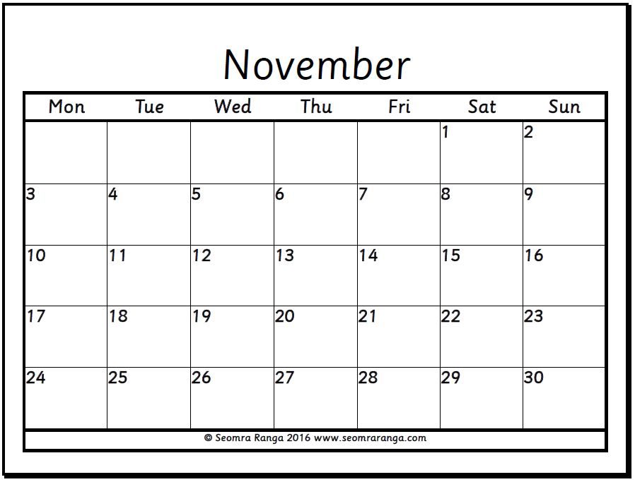
Round 4
Question 6
What day was October 28th?
© Seomra Ranga 2021 www.seomraranga.com

Slide 51
Maths Joke No. 6
What did the zero say to the eight?
Nice belt!
© Seomra Ranga 2021 www.seomraranga.com

Slide 52
Round 3 Answers
© Seomra Ranga 2021 www.seomraranga.com

Slide 53
Round 3 Answers
Question 1
How many mm are there in 5cm?
50mm
© Seomra Ranga 2021 www.seomraranga.com

Slide 54
Round 3 Answers
Question 2
How many more eggs are needed to fill the egg box?
8
© Seomra Ranga 2021 www.seomraranga.com

Slide 55
Round 3 Answers
Question 3
What is the most favourite pet in the class?
Dogs
© Seomra Ranga 2021 www.seomraranga.com

Slide 56
Round 3 Answers
Question 4
What day comes three days before Saturday?
Wednesday
© Seomra Ranga 2021 www.seomraranga.com

Slide 57
Round 3 Answers
Question 5
My tens number is 7. My units number is 3. My hundreds number is 5. What number am I?
573
© Seomra Ranga 2021 www.seomraranga.com

Slide 58
Round 3 Answers
Question 6
What time will it be 90 minutes later?
3 o’clock
© Seomra Ranga 2021 www.seomraranga.com

Slide 59
Maths Joke No. 7
What did the triangle say to the circle?
You’re pointless!
© Seomra Ranga 2021 www.seomraranga.com

Slide 60
Round 5
© Seomra Ranga 2021 www.seomraranga.com

Slide 61
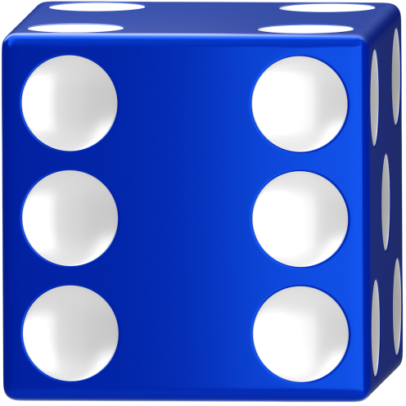

Round 5
Question 1
What score did I get when I threw the dice?
© Seomra Ranga 2021 www.seomraranga.com

Slide 62

Round 5
Question 2
Name this 3D shape:
© Seomra Ranga 2021 www.seomraranga.com

Slide 63
Round 5
Question 3
2 + 12 > 17 - 4
© Seomra Ranga 2021 www.seomraranga.com

Slide 64






Round 5
?
Question 4
Which of the following completes the sequence above?
A
B
C
© Seomra Ranga 2021 www.seomraranga.com

Slide 65

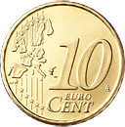
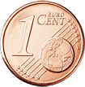
Round 5
Question 5
What two coins are missing to make up 50c?
© Seomra Ranga 2021 www.seomraranga.com

Slide 66

Round 5
Question 6
Write this time in words:
09
40
© Seomra Ranga 2021 www.seomraranga.com

Slide 67
Maths Joke No. 8
What did the Spelling Book say to the Maths Book?
You know I can always count on you!
© Seomra Ranga 2021 www.seomraranga.com

Slide 68
Round 4 Answers
© Seomra Ranga 2021 www.seomraranga.com

Slide 69
Round 4 Answers
Question 1
What fraction of this shape is coloured?
¾
© Seomra Ranga 2021 www.seomraranga.com

Slide 70
Round 4 Answers
Question 2
What would be best to use for measuring your maths copy: ruler, metre stick or trundle wheel?
Ruler
© Seomra Ranga 2021 www.seomraranga.com

Slide 71
Round 4 Answers
Question 3
Which animal is fifth in line?
Pig
© Seomra Ranga 2021 www.seomraranga.com

Slide 72
Round 4 Answers
Question 4
      38
      +27
      55
False
© Seomra Ranga 2021 www.seomraranga.com

Slide 73
Round 4 Answers
Question 5
How many years in a decade: 10, 100, 1000?
10
© Seomra Ranga 2021 www.seomraranga.com

Slide 74
Round 4 Answers
Question 6
What day was October 28th?
Tuesday
© Seomra Ranga 2021 www.seomraranga.com

Slide 75
Maths Joke No. 9
How can you make time fly?
Throw a clock out the window!
© Seomra Ranga 2021 www.seomraranga.com

Slide 76
Round 6
© Seomra Ranga 2021 www.seomraranga.com

Slide 77

Round 6
Question 1
Yes or no, is this teddy symmetrical?
© Seomra Ranga 2021 www.seomraranga.com

Slide 78



Round 6
Question 2
What shape comes next in this sequence?
?
© Seomra Ranga 2021 www.seomraranga.com

Slide 79
Round 6
Question 3
There are 100 years in a century?
© Seomra Ranga 2021 www.seomraranga.com

Slide 80
Round 6
Question 4
This is a cut-out from a 100 Square. What number goes in the bottom box?
 |  | 45
 | ?
© Seomra Ranga 2021 www.seomraranga.com

Slide 81
Round 6
Question 5
What is the number in the centre of this Magic Square?
6 |  | 7
 | ? | 8
4 |  | 5
© Seomra Ranga 2021 www.seomraranga.com

Slide 82
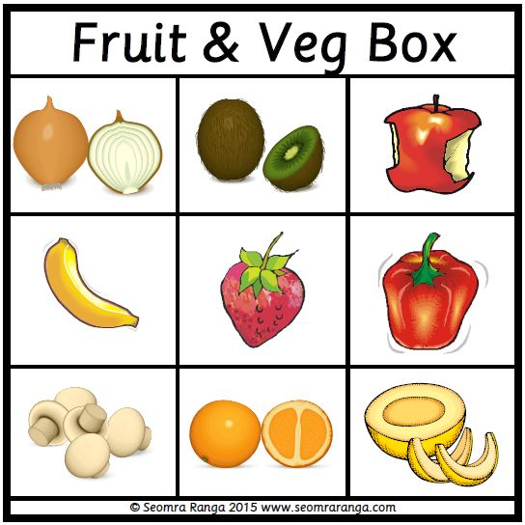
Round 6
Question 6
Starting with the pepper, move two squares left, one square up and two squares right. What fruit is this?
© Seomra Ranga 2021 www.seomraranga.com

Slide 83
Maths Joke No. 10
A farmer had a hen that could count her own eggs.
She was a mathemachicken!
© Seomra Ranga 2021 www.seomraranga.com

Slide 84
Round 5 Answers
© Seomra Ranga 2021 www.seomraranga.com

Slide 85
Round 5 Answers
Question 1
What score did I get when I threw the dice?
11
© Seomra Ranga 2021 www.seomraranga.com

Slide 86
Round 5 Answers
Question 2
Name this 3D shape:
Cylinder
© Seomra Ranga 2021 www.seomraranga.com

Slide 87
Round 5 Answers
Question 3
2 + 12 > 17 - 4
True
© Seomra Ranga 2021 www.seomraranga.com

Slide 88



Round 5 Answers
?
Question 4
Which of the following completes the sequence above?
A
B
C
B
© Seomra Ranga 2021 www.seomraranga.com

Slide 89
Round 5 Answers
Question 5
What two coins are missing to make up 50c?
5c and 2c
© Seomra Ranga 2021 www.seomraranga.com

Slide 90
Round 5 Answers
Question 6
Write this time in words:
09
40
Twenty to ten
© Seomra Ranga 2021 www.seomraranga.com

Slide 91
Maths Joke No. 11
Are monsters good at maths?
Not unless you Count Dracula!
© Seomra Ranga 2021 www.seomraranga.com

Slide 92
Round 6 Answers
© Seomra Ranga 2021 www.seomraranga.com

Slide 93
Round 6 Answers
Question 1
Yes or no, is this teddy symmetrical?
Yes
© Seomra Ranga 2021 www.seomraranga.com

Slide 94
Round 6 Answers
Question 2
What shape comes next in this sequence?
?
□ Square
© Seomra Ranga 2021 www.seomraranga.com

Slide 95
Round 6 Answers
Question 3
There are 100 years in a century?
True
© Seomra Ranga 2021 www.seomraranga.com

Slide 96
Round 6 Answers
Question 4
This is cut out from a 100 Square. What number goes in the bottom box?
 |  | 45
 | ?
64
© Seomra Ranga 2021 www.seomraranga.com

Slide 97
Round 6 Answers
Question 5
What is the number in the centre of this Magic Square?
6 |  | 7
 | ? | 8
4 |  | 5
2
© Seomra Ranga 2021 www.seomraranga.com

Slide 98
Round 6 Answers
Question 6
Starting with the pepper, move two squares left, one square up and two squares right. What fruit is this?
Apple
© Seomra Ranga 2021 www.seomraranga.com

Slide 99
Maths Joke No. 12
Why did the two 4s skip lunch?
Because they already 8!
© Seomra Ranga 2021 www.seomraranga.com

Slide 100
Tie-Break Round
© Seomra Ranga 2021 www.seomraranga.com

Slide 101
Tie-Break Round
Question 1
You have €20. You spend €2.99 in one shop and €3.99 in another. How much have you left?
© Seomra Ranga 2021 www.seomraranga.com

Slide 102

Tie-Break Round
Question 2
How many faces are there on this 3D shape? (Hint: not all faces can be seen)
© Seomra Ranga 2021 www.seomraranga.com

Slide 103
Tie-Break Round
Question 3
There are 38 hours in 1½ days?
© Seomra Ranga 2021 www.seomraranga.com

Slide 104
Tie-Break Round
Question 4
What is the value of this Roman Numeral:
XXXV
© Seomra Ranga 2021 www.seomraranga.com

Slide 105
Tie-Break Round
Question 5
What fraction of the garden is set in vegetables?
vegetables
flowers
paving
© Seomra Ranga 2021 www.seomraranga.com

Slide 106
Tie-Break Round
Question 6
Put these in order starting with the shortest:
year, fortnight, day, month, week.
© Seomra Ranga 2021 www.seomraranga.com

Slide 107
Maths Joke No. 13
Why did the boy eat his maths homework?
Because the teacher told him it was a piece of cake!
© Seomra Ranga 2021 www.seomraranga.com

Slide 108
Tie-Break Round Answers
© Seomra Ranga 2021 www.seomraranga.com

Slide 109
Tie-Break Answers
Question 1
You have €20. You spend €2.99 in one shop and €3.99 in another. How much have you left?
€13.02
© Seomra Ranga 2021 www.seomraranga.com

Slide 110
Tie-Break Answers
Question 2
How many faces are there on this 3D shape? (Hint: not all faces can be seen)
5
© Seomra Ranga 2021 www.seomraranga.com

Slide 111
Tie-Break Answers
Question 3
There are 38 hours in 1½ days?
False
© Seomra Ranga 2021 www.seomraranga.com

Slide 112
Tie-Break Answers
Question 4
What is the value of this Roman Numeral:
XXXV
35
© Seomra Ranga 2021 www.seomraranga.com

Slide 113
Tie-Break Answers
Question 5
What fraction of the garden is set in vegetables?
vegetables
flowers
½
paving
© Seomra Ranga 2021 www.seomraranga.com

Slide 114
Tie-Break Answers
Question 6
Put these in order starting with the shortest:
year, fortnight, day, month, week.
Day, week, fortnight, month, year
© Seomra Ranga 2021 www.seomraranga.com

Slide 115
Maths Joke No. 14
What did one decimal say to the other?
Do you get my point?!
© Seomra Ranga 2021 www.seomraranga.com

Slide 116
Hope you all enjoyed the quiz!
© Seomra Ranga 2021 www.seomraranga.com

Slide 117











Resources used in this file from:
© Seomra Ranga 2021 www.seomraranga.com

