Slide 1


MATHS WEEK 2021
TABLE QUIZ
© Seomra Ranga 2021 www.seomraranga.com

Slide 2
Before You Start
Make sure you have written your table/team number/letter on every answer sheet
Write the number of each round 1-8 on every answer sheet
Try not to shout out answers
Check with your team mates and agree an answer before you write it down
© Seomra Ranga 2021 www.seomraranga.com

Slide 3
Before You Start
Don’t worry about spellings – just do your best
If you’re not sure of the answer, make your best possible guess
It might be a good idea to have a piece of paper to do some rough calculations for some questions
Good luck and enjoy the quiz!
© Seomra Ranga 2021 www.seomraranga.com

Slide 4
Round 1
© Seomra Ranga 2021 www.seomraranga.com

Slide 5
Round 1
Question 1
Make the largest number possible using these digits:
4
9
5
2
8
3
© Seomra Ranga 2021 www.seomraranga.com

Slide 6
Round 1
Question 2
What is the value of the variable y in this equation:
3y + 4 = 28
© Seomra Ranga 2021 www.seomraranga.com

Slide 7
Round 1
Question 3
What is the next term in this sequence:
0.2, 0.6, 1, 1.4, ____?
© Seomra Ranga 2021 www.seomraranga.com

Slide 8
Round 1
Question 4
What type of angle is this:
© Seomra Ranga 2021 www.seomraranga.com

Slide 9

Round 1
Question 5
If a painter charges €5 per m² to paint a 7m X 2m wall, how much would it cost?
© Seomra Ranga 2021 www.seomraranga.com

Slide 10
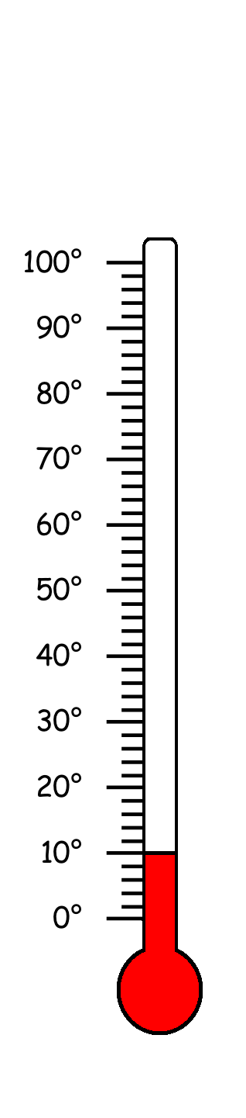
Round 1
Question 6
If the temperature drops by 15⁰, what is the temperature then?
© Seomra Ranga 2021 www.seomraranga.com

Slide 11
Maths Joke No. 1
What did one Maths Book say to the other?
Don’t bother me, I’ve got my own problems!
© Seomra Ranga 2021 www.seomraranga.com

Slide 12
Round 2
© Seomra Ranga 2021 www.seomraranga.com

Slide 13
Round 2
Question 1
What is double 0.85?
© Seomra Ranga 2021 www.seomraranga.com

Slide 14
Round 2
Question 2
Write the following number: one million one thousand one hundred and one.
© Seomra Ranga 2021 www.seomraranga.com

Slide 15
Round 2
Question 3
What number is half way between 12 and 38?
© Seomra Ranga 2021 www.seomraranga.com

Slide 16

Round 2
Question 4
How many 20c coins are there in €10.60?
© Seomra Ranga 2021 www.seomraranga.com

Slide 17
Round 2
Question 5
Sinéad ran 1½km on Monday, 2¼km on Tuesday, 1¾km on Thursday and 1.5km on Friday. How far did she run over the four days?
© Seomra Ranga 2021 www.seomraranga.com

Slide 18


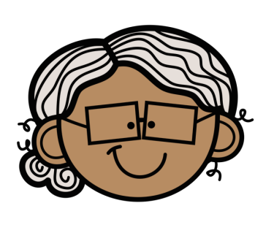

Round 2
Question 6
If grandad is ten times John’s age and granny is seven times Alva’s age, what age are the four of them altogether?
John
Alva
Grandad
Granny
Age 6
Age 10
Age ?
Age ?
© Seomra Ranga 2021 www.seomraranga.com

Slide 19
Maths Joke No. 2
Why did the girl wear glasses during maths class?
Because it improves di-vision!
© Seomra Ranga 2021 www.seomraranga.com

Slide 20
Round 1 Answers
© Seomra Ranga 2021 www.seomraranga.com

Slide 21
Round 1 Answers
Question 1
Make the largest number possible using these digits:
4
9
5
2
8
3
985,432
© Seomra Ranga 2021 www.seomraranga.com

Slide 22
Round 1 Answers
Question 2
What is the value of the variable y in this equation:
3y + 4 = 28
y = 8
© Seomra Ranga 2021 www.seomraranga.com

Slide 23
Round 1 Answers
Question 3
What is the next term in this sequence:
0.2, 0.6, 1, 1.4, ____?
1.8
© Seomra Ranga 2021 www.seomraranga.com

Slide 24
Round 1 Answers
Question 4
What type of angle is this:
right
angle
© Seomra Ranga 2021 www.seomraranga.com

Slide 25
Round 1 Answers
Question 5
If a painter charges €5 per m² to paint a 7m X 2m wall, how much would it cost?
€70
© Seomra Ranga 2021 www.seomraranga.com

Slide 26
Round 1 Answers
Question 6
If the temperature drops by 15⁰, what is the temperature then?
-5⁰
© Seomra Ranga 2021 www.seomraranga.com

Slide 27
Maths Joke No. 3
How do you keep warm in a cold room?
You go to the corner because it’s always 90⁰!
© Seomra Ranga 2021 www.seomraranga.com

Slide 28
Round 3
© Seomra Ranga 2021 www.seomraranga.com

Slide 29
Round 3
Question 1
Write 140mm as m?
© Seomra Ranga 2021 www.seomraranga.com

Slide 30
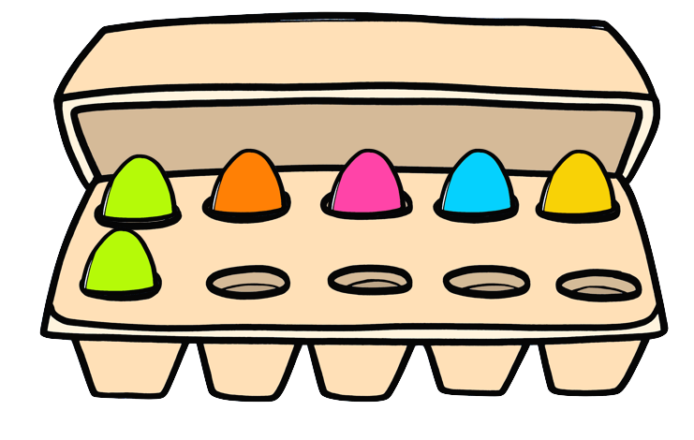
Round 3
Question 2
If six eggs cost €2.10, what is the cost of one egg?
© Seomra Ranga 2021 www.seomraranga.com

Slide 31

Round 3
Question 3
The number 549 be divided evenly by 3?
© Seomra Ranga 2021 www.seomraranga.com

Slide 32
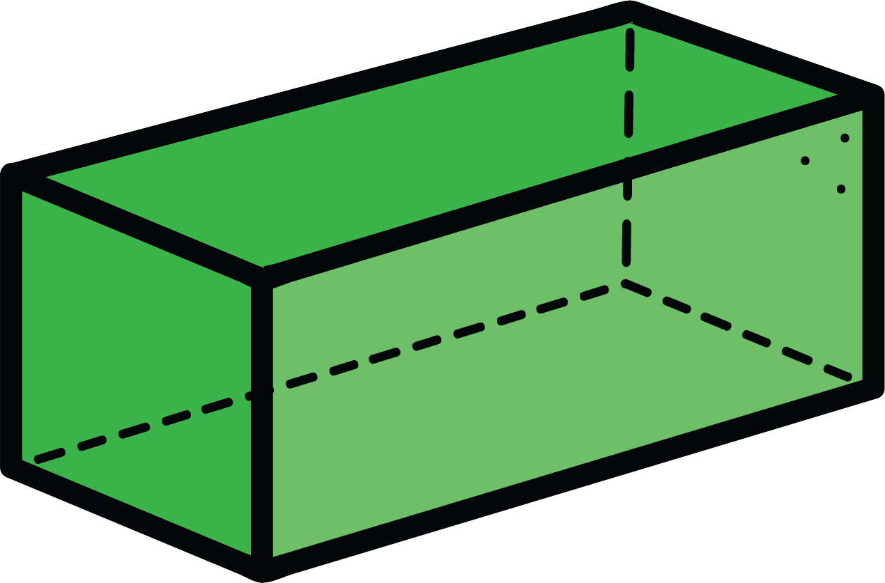
Round 3
Question 4
What is the volume of this cuboid in cm³?
2
6
4
© Seomra Ranga 2021 www.seomraranga.com

Slide 33
Round 3
Question 5
Which of these is the word for the number 10¹⁰⁰ : (a) Gaggel (b) Googol (c) Giggel?
© Seomra Ranga 2021 www.seomraranga.com

Slide 34

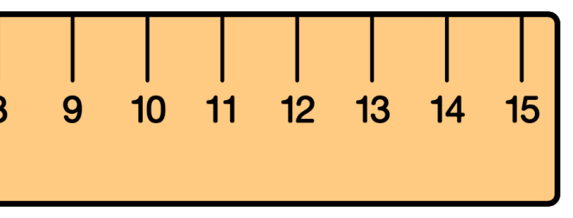
Round 3
Question 6
The end of the pencil is at the 25cm mark. How long is the pencil?
© Seomra Ranga 2021 www.seomraranga.com

Slide 35
Maths Joke No. 4
Why are obtuse angles always so upset?
Because they are never right!
© Seomra Ranga 2021 www.seomraranga.com

Slide 36
Round 2 Answers
© Seomra Ranga 2021 www.seomraranga.com

Slide 37
Round 2 Answers
Question 1
What is double 0.85?
1.70
© Seomra Ranga 2021 www.seomraranga.com

Slide 38
Round 2 Answers
Question 2
Write the following number: one million one thousand one hundred and one.
1,001,101
© Seomra Ranga 2021 www.seomraranga.com

Slide 39
Round 2 Answers
Question 3
What number is half way between 12 and 38?
25
© Seomra Ranga 2021 www.seomraranga.com

Slide 40
Round 2 Answers
Question 4
How many 20c coins are there in €10.60?
53
© Seomra Ranga 2021 www.seomraranga.com

Slide 41
Round 2 Answers
Question 5
Sinéad ran 1½km on Monday, 2¼km on Tuesday, 1¾km on Thursday and 1.5km on Friday. How far did she run over the four days?
7km
© Seomra Ranga 2021 www.seomraranga.com

Slide 42




Round 2 Answers
Question 6
If grandad is ten times John’s age and granny is seven times Alva’s age, what age are the four of them altogether?
John
Alva
Grandad
Granny
Age 6
Age 10
Age ?
Age ?
146
© Seomra Ranga 2021 www.seomraranga.com

Slide 43
Maths Joke No. 5
Why did the boy do multiplication problems on the floor?
Because his teacher told him not to use tables!
© Seomra Ranga 2021 www.seomraranga.com

Slide 44
Round 4
© Seomra Ranga 2021 www.seomraranga.com

Slide 45

Round 4
Question 1
What fraction of this shape is not coloured?
© Seomra Ranga 2021 www.seomraranga.com

Slide 46
Round 4
Question 2
Write the time twenty-five to nine at night in 24-hour time?
© Seomra Ranga 2021 www.seomraranga.com

Slide 47

Round 4
Question 3
111111111 X 111111111 = 12345678987654321?
© Seomra Ranga 2021 www.seomraranga.com

Slide 48
Round 4
Question 4
What is 20% of 1000?
© Seomra Ranga 2021 www.seomraranga.com

Slide 49
Round 4
Question 5
In digital storage, how many Megabytes in a Terabyte: (a) 10,000, (b) 100,000 (c) 1,000,000?
© Seomra Ranga 2021 www.seomraranga.com

Slide 50





Round 4
Question 6
Which of these shapes are congruent?
A
B
C
D
E
F
© Seomra Ranga 2021 www.seomraranga.com

Slide 51
Maths Joke No. 6
What did the zero say to the eight?
Nice belt!
© Seomra Ranga 2021 www.seomraranga.com

Slide 52
Round 3 Answers
© Seomra Ranga 2021 www.seomraranga.com

Slide 53
Round 3 Answers
Question 1
Write 140mm as m?
0.14m
© Seomra Ranga 2021 www.seomraranga.com

Slide 54
Round 3 Answers
Question 2
If six eggs cost €2.10, what is the cost of one egg?
35c
© Seomra Ranga 2021 www.seomraranga.com

Slide 55
Round 3 Answers
Question 3
The number 549 can be divided evenly by 3?
Yes
© Seomra Ranga 2021 www.seomraranga.com

Slide 56
Round 3 Answers
Question 4
What is the volume of this cuboid in cm³?
2
6
4
48cm³
© Seomra Ranga 2021 www.seomraranga.com

Slide 57
Round 3 Answers
Question 5
Which of these is the word for the number 10¹⁰⁰ : (a) Gaggel (b) Googol (c) Giggel?
Googol
© Seomra Ranga 2021 www.seomraranga.com

Slide 58
Round 3 Answers
Question 6
The end of the pencil is at the 25cm mark. How long is the pencil?
13cm
© Seomra Ranga 2021 www.seomraranga.com

Slide 59
Maths Joke No. 7
What did the triangle say to the circle?
You’re pointless!
© Seomra Ranga 2021 www.seomraranga.com

Slide 60
Round 5
© Seomra Ranga 2021 www.seomraranga.com

Slide 61
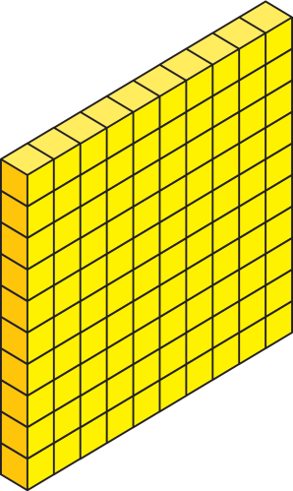
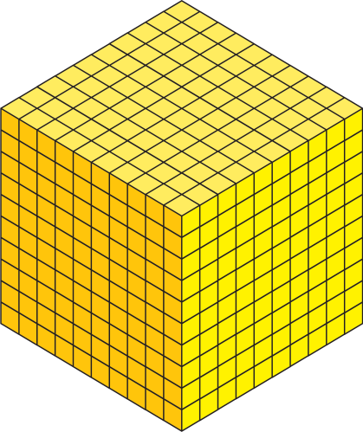


Round 5
Question 1
What is this number?
© Seomra Ranga 2021 www.seomraranga.com

Slide 62
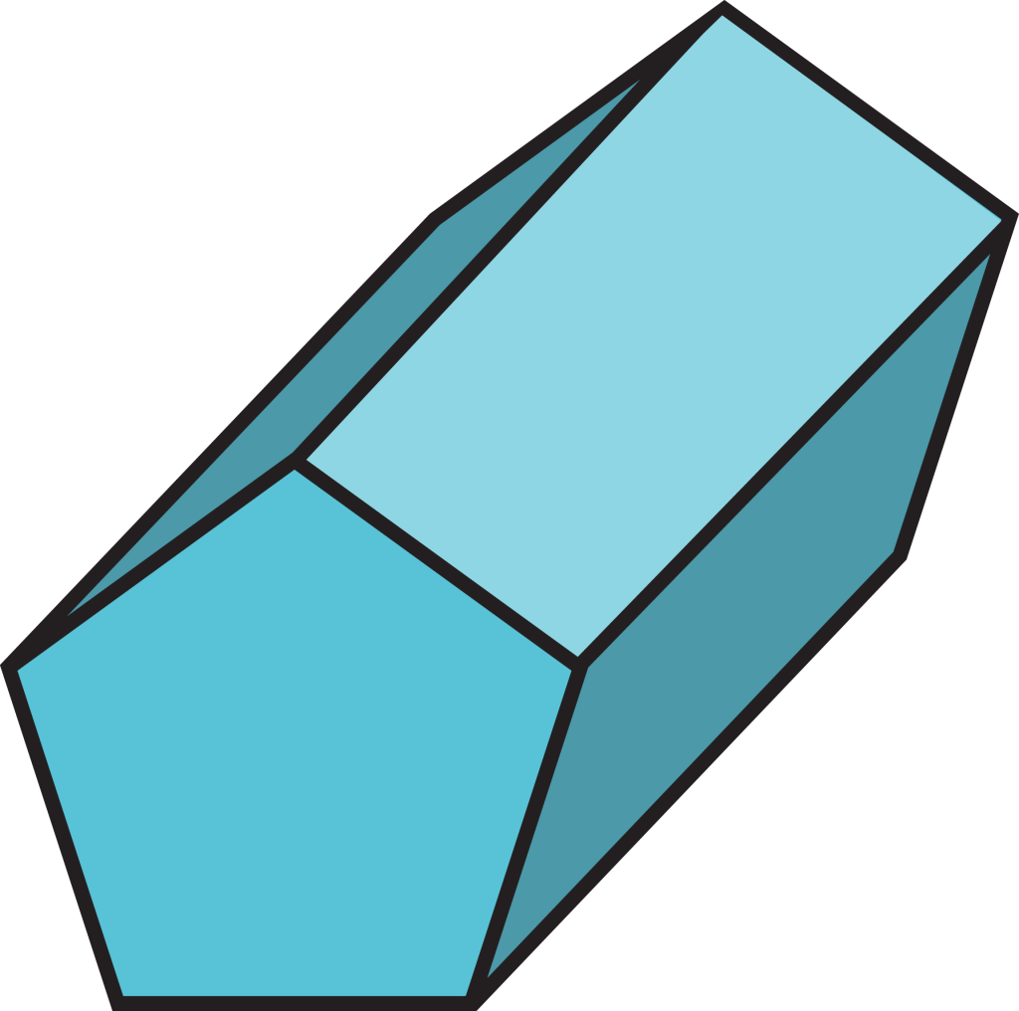
Round 5
Question 2
Name this 3D shape:
© Seomra Ranga 2021 www.seomraranga.com

Slide 63
Round 5
Question 3
What is the next Square Number after 16?
© Seomra Ranga 2021 www.seomraranga.com

Slide 64
Round 5
Question 4
What is the chance of picking a red ball from the box?
© Seomra Ranga 2021 www.seomraranga.com

Slide 65

Round 5
Question 5
What is the maximum score you can get if you throw eight dice?
© Seomra Ranga 2021 www.seomraranga.com

Slide 66

Round 5
Question 6
The perimeter of this regular shape is 72cm. What is the length of one of its sides?
© Seomra Ranga 2021 www.seomraranga.com

Slide 67
Maths Joke No. 8
How does a mathematician plough fields?
Using a pro-tractor!
© Seomra Ranga 2021 www.seomraranga.com

Slide 68
Round 4 Answers
© Seomra Ranga 2021 www.seomraranga.com

Slide 69
Round 4 Answers
Question 1
What fraction of this shape is not coloured?
1/8
© Seomra Ranga 2021 www.seomraranga.com

Slide 70
Round 4 Answers
Question 2
Write the time twenty-five to nine at night in 24-hour time?
20:35
© Seomra Ranga 2021 www.seomraranga.com

Slide 71
Round 4 Answers
Question 3
111111111 X 111111111 = 12345678987654321?
True
© Seomra Ranga 2021 www.seomraranga.com

Slide 72
Round 4 Answers
Question 4
What is 20% of 1000?
200
© Seomra Ranga 2021 www.seomraranga.com

Slide 73
Round 4 Answers
Question 5
In digital storage, how many Megabytes in a Terabyte: (a) 10,000, (b) 100,000 (c) 1,000,000?
1,000,000
© Seomra Ranga 2021 www.seomraranga.com

Slide 74





Round 4 Answers
Question 6
Which of these shapes are congruent?
A
B
C
D
E
F
B and E
© Seomra Ranga 2021 www.seomraranga.com

Slide 75
Maths Joke No. 9
Did you hear about the over-educated circle?
It had 360 degrees!
© Seomra Ranga 2021 www.seomraranga.com

Slide 76
Round 6
© Seomra Ranga 2021 www.seomraranga.com

Slide 77

Round 6
Question 1
Yes or no, is this teddy symmetrical?
© Seomra Ranga 2021 www.seomraranga.com

Slide 78

Round 6
Question 2
Write this Improper Fraction as a Mixed Number in its lowest terms.
© Seomra Ranga 2021 www.seomraranga.com

Slide 79
Round 6
Question 3
A hexagon and a square can tessellate together?
© Seomra Ranga 2021 www.seomraranga.com

Slide 80
Round 6
Question 4
Yes or no, is this a Pentomino?
© Seomra Ranga 2021 www.seomraranga.com

Slide 81


Round 6
Question 5
This mixer is on sale with 25% Off. What is the Sale Price?
€500
© Seomra Ranga 2021 www.seomraranga.com

Slide 82
Round 6
Question 6
If A=1, B=2, C=3 etc. what is the numerical value of the word “RULER”?
© Seomra Ranga 2021 www.seomraranga.com

Slide 83
Maths Joke No. 10
A farmer had a hen that could count her own eggs.
She was a mathemachicken!
© Seomra Ranga 2021 www.seomraranga.com

Slide 84
Round 5 Answers
© Seomra Ranga 2021 www.seomraranga.com

Slide 85
Round 5 Answers
Question 1
What is this number?
2,463
© Seomra Ranga 2021 www.seomraranga.com

Slide 86

Round 5 Answers
Question 2
Name this 3D shape:
Pentagonal Prism
© Seomra Ranga 2021 www.seomraranga.com

Slide 87
Round 5 Answers
Question 3
What is the next Square Number after 16?
25
© Seomra Ranga 2021 www.seomraranga.com

Slide 88
Round 5 Answers
Question 4
What is the chance of picking a red ball from the box?
1:2
© Seomra Ranga 2021 www.seomraranga.com

Slide 89
Round 5 Answers
Question 5
What is the maximum score you can get if you throw eight dice?
48
© Seomra Ranga 2021 www.seomraranga.com

Slide 90
Round 5 Answers
Question 6
The perimeter of this regular shape is 72cm. What is the length of one of its sides?
12cm
© Seomra Ranga 2021 www.seomraranga.com

Slide 91
Maths Joke No. 11
Are monsters good at maths?
Not unless you Count Dracula!
© Seomra Ranga 2021 www.seomraranga.com

Slide 92
Round 7
© Seomra Ranga 2021 www.seomraranga.com

Slide 93
Round 7
Question 1
Is the arrow pointing to the Concave or Convex side?
© Seomra Ranga 2021 www.seomraranga.com

Slide 94
Round 7
Question 2
What is the Place Value of the 2 in this number:
425,367?
© Seomra Ranga 2021 www.seomraranga.com

Slide 95
Round 7
Question 3
How many Prime Numbers are there between 20 and 30?
© Seomra Ranga 2021 www.seomraranga.com

Slide 96
Round 7
Question 4
John worked for 2 hours every afternoon Monday to Friday and earned €25 per day for his part-time job. How much did he earn in one week?
© Seomra Ranga 2021 www.seomraranga.com

Slide 97
Round 7
Question 5
123456789 X 8 + 9 = 987654321?
© Seomra Ranga 2021 www.seomraranga.com

Slide 98
Round 7
Question 6
What is the number in the centre of this Magic Square?
20 |  | 18
 | ? | 23
24 |  | 22
© Seomra Ranga 2021 www.seomraranga.com

Slide 99
Maths Joke No. 12
Why did ⅕ go for a massage?
Because it was two tenths!
© Seomra Ranga 2021 www.seomraranga.com

Slide 100
Round 6 Answers
© Seomra Ranga 2021 www.seomraranga.com

Slide 101
Round 6 Answers
Question 1
Yes or no, is this teddy symmetrical?
Yes
© Seomra Ranga 2021 www.seomraranga.com

Slide 102
Round 6 Answers
Question 2
Write this Improper Fraction as a Mixed Number in its lowest terms.
1⅓
© Seomra Ranga 2021 www.seomraranga.com

Slide 103
Round 6 Answers
Question 3
A hexagon and a square can tessellate together?
Yes
© Seomra Ranga 2021 www.seomraranga.com

Slide 104
Round 6 Answers
Question 4
Yes or no, is this a Pentomino?
Yes
© Seomra Ranga 2021 www.seomraranga.com

Slide 105
Round 6 Answers
Question 5
This mixer is on sale with 25% Off. What is the Sale Price?
€500
€375
© Seomra Ranga 2021 www.seomraranga.com

Slide 106
Round 6 Answers
Question 6
If A=1, B=2, C=3 etc. what is the numerical value of the word “RULER”?
18+21+12+5+18 = 74
© Seomra Ranga 2021 www.seomraranga.com

Slide 107
Maths Joke No. 13
Why can’t a nose be 12 inches long?
Because then it would be a foot!
© Seomra Ranga 2021 www.seomraranga.com

Slide 108
Round 8
© Seomra Ranga 2021 www.seomraranga.com

Slide 109

Round 8
Question 1
Write this time in 12-hour time using am or pm.
21
25
© Seomra Ranga 2021 www.seomraranga.com

Slide 110
Round 8
Question 2
142857 X 7 = 999,999?
© Seomra Ranga 2021 www.seomraranga.com

Slide 111

Round 8
Question 3
Name this 2D shape:
© Seomra Ranga 2021 www.seomraranga.com

Slide 112
Round 8
Question 4
What is the next term in this sequence:
8, 4, 16, 8, 32, ___?
© Seomra Ranga 2021 www.seomraranga.com

Slide 113
Round 8
Question 5
Round off 29.634 to the nearest tenth?
© Seomra Ranga 2021 www.seomraranga.com

Slide 114
Round 8
Question 6
You have €100. You spend €35.53 in one shop and €29.82 in another. How much have you left?
© Seomra Ranga 2021 www.seomraranga.com

Slide 115
Maths Joke No. 14
What do you call a number that can’t sit still?
A Roamin’ Numeral!
© Seomra Ranga 2021 www.seomraranga.com

Slide 116
Round 7 Answers
© Seomra Ranga 2021 www.seomraranga.com

Slide 117
Round 7 Answers
Question 1
Is the arrow pointing to the Concave or Convex side?
Concave
© Seomra Ranga 2021 www.seomraranga.com

Slide 118
Round 7 Answers
Question 2
What is the Place Value of the 2 in this number:
425,367?
200,000
© Seomra Ranga 2021 www.seomraranga.com

Slide 119
Round 7 Answers
Question 3
How many Prime Numbers are there between 20 and 30?
2 (23 and 29)
© Seomra Ranga 2021 www.seomraranga.com

Slide 120
Round 7 Answers
Question 4
John worked for 2 hours every afternoon Monday to Friday and earned €25 per day for his part-time job. How much did he earn in one week?
€125
© Seomra Ranga 2021 www.seomraranga.com

Slide 121
Round 7 Answers
Question 5
123456789 X 8 + 9 = 987654321?
True
© Seomra Ranga 2021 www.seomraranga.com

Slide 122
Round 7 Answers
Question 6
What is the number in the centre of this Magic Square?
20 |  | 18
 | ? | 23
24 |  | 22
21
© Seomra Ranga 2021 www.seomraranga.com

Slide 123
Maths Joke No. 15
What did the Spelling Book say to the Maths Book?
I know I can always count on you!
© Seomra Ranga 2021 www.seomraranga.com

Slide 124
Round 8 Answers
© Seomra Ranga 2021 www.seomraranga.com

Slide 125
Round 8 Answers
Question 1
Write this time in 12-hour time using am or pm.
21
25
9:25pm
© Seomra Ranga 2021 www.seomraranga.com

Slide 126
Round 8 Answers
Question 2
142857 X 7 = 999,999?
True
© Seomra Ranga 2021 www.seomraranga.com

Slide 127
Round 8 Answers
Question 3
Name this 2D shape:
Decagon
© Seomra Ranga 2021 www.seomraranga.com

Slide 128
Round 8 Answers
Question 4
What is the next term in this sequence:
8, 4, 16, 8, 32, ___?
16
© Seomra Ranga 2021 www.seomraranga.com

Slide 129
Round 8 Answers
Question 5
Round off 29.634 to the nearest tenth?
29.6
© Seomra Ranga 2021 www.seomraranga.com

Slide 130
Round 8 Answers
Question 6
You have €100. You spend €35.53 in one shop and €29.82 in another. How much have you left?
€34.65
© Seomra Ranga 2021 www.seomraranga.com

Slide 131
Maths Joke No. 16
What do you call an angle that’s gone through a rubbish disposal machine?
A wrecked-angle!
© Seomra Ranga 2021 www.seomraranga.com

Slide 132
Tie-Break Round
© Seomra Ranga 2021 www.seomraranga.com

Slide 133
Tie-Break Round
Question 1
Ann has her birthday on August 28th. If her sister Jo’s birthday is 5 weeks and 3 days after Ann’s, what is the date of Jo’s birthday?
© Seomra Ranga 2021 www.seomraranga.com

Slide 134
Tie-Break Round
Question 2
These were the temperatures for the week. What was the average temperature?
Mon. | 19⁰
Tues. | 20⁰
Wed. | 30⁰
Thurs. | 22⁰
Fri. | 17⁰
Sat. | 27⁰
Sun. | 26⁰
© Seomra Ranga 2021 www.seomraranga.com

Slide 135
Tie-Break Round
Question 3
There are 86,300 seconds in a day?
© Seomra Ranga 2021 www.seomraranga.com

Slide 136
Tie-Break Round
Question 4
What is the value of this Roman Numeral:
MCMXC
© Seomra Ranga 2021 www.seomraranga.com

Slide 137
Tie-Break Round
Question 5
What percentage of the garden is set in vegetables?
vegetables
flowers
paving
© Seomra Ranga 2021 www.seomraranga.com

Slide 138
Tie-Break Round
Question 6
Put these types of numbers in order starting with the smallest: Giga, Peta, Kilo, Mega, Tera.
© Seomra Ranga 2021 www.seomraranga.com

Slide 139
Maths Joke No. 17
Why did the boy eat his maths homework?
Because the teacher told him it was a piece of cake!
© Seomra Ranga 2021 www.seomraranga.com

Slide 140
Tie-Break Round Answers
© Seomra Ranga 2021 www.seomraranga.com

Slide 141
Tie-Break Answers
Question 1
Ann has her birthday on August 28th. If her sister Jo’s birthday is 5 weeks and 3 days after Ann’s, what is the date of Jo’s birthday?
October 6th
© Seomra Ranga 2021 www.seomraranga.com

Slide 142
Tie-Break Answers
Question 2
These were the temperatures for the week. What was the average temperature?
Mon. | 19⁰
Tues. | 20⁰
Wed. | 30⁰
Thurs. | 22⁰
Fri. | 17⁰
Sat. | 27⁰
Sun. | 26⁰
23⁰
© Seomra Ranga 2021 www.seomraranga.com

Slide 143
Tie-Break Answers
Question 3
There are 86,300 seconds in a day?
False (it’s 86,400)
© Seomra Ranga 2021 www.seomraranga.com

Slide 144
Tie-Break Answers
Question 4
What is the value of this Roman Numeral:
MCMXC
1990
© Seomra Ranga 2021 www.seomraranga.com

Slide 145
Tie-Break Answers
Question 5
What percentage of the garden is set in vegetables?
vegetables
flowers
40%
paving
© Seomra Ranga 2021 www.seomraranga.com

Slide 146
Tie-Break Answers
Question 6
Put these types of numbers in order starting with the smallest: Giga, Peta, Kilo, Mega, Tera.
Kilo, Mega, Giga, Tera, Peta
© Seomra Ranga 2021 www.seomraranga.com

Slide 147
Maths Joke No. 18
What did one decimal say to the other?
Do you get my point?!
© Seomra Ranga 2021 www.seomraranga.com

Slide 148
Hope you all enjoyed the quiz!
© Seomra Ranga 2021 www.seomraranga.com

Slide 149










Resources used in this file from:
© Seomra Ranga 2021 www.seomraranga.com

