Slide 1





© Seomra Ranga 2021 www.seomraranga.com

Slide 2


Scríobh uimhir d’fhoireann ar gach bileog freagartha
Scríobh uimhir gach babhta 1-8 ar gach bileog freagartha
Déan iarracht na freagraí a scríobh as Gaeilge
Ná scread amach na freagraí – bígí ciúin
Bainigí taitneamh as!
© Seomra Ranga 2021 www.seomraranga.com

Slide 3
Bígí réidh anois …..
© Seomra Ranga 2021 www.seomraranga.com

Slide 4
Go n-éirí an t-ádh libh!
© Seomra Ranga 2021 www.seomraranga.com

Slide 5

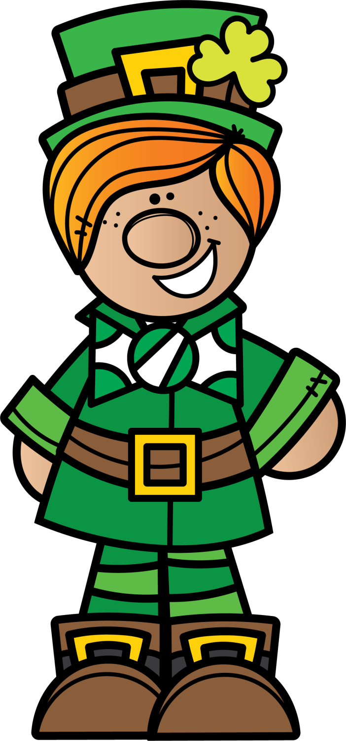

© Seomra Ranga 2021 www.seomraranga.com

Slide 6
Ceist 1
Cén dath atá ar thacsaí i Londain?
© Seomra Ranga 2021 www.seomraranga.com

Slide 7

Ceist 2
Ainmnigh an banna ceoil seo:
© Seomra Ranga 2021 www.seomraranga.com

Slide 8
Ceist 3
Cén sórt ainmhí é “Fozzie” i “The Muppets”?
© Seomra Ranga 2021 www.seomraranga.com

Slide 9

Ceist 4
Cad í seo:
© Seomra Ranga 2021 www.seomraranga.com

Slide 10
Ceist 5
Cé acu seo atá as ionad: stocaí, seaicéad, seampú, sciorta.
© Seomra Ranga 2021 www.seomraranga.com

Slide 11
Ceist 6
Cé a chanann an t-amhrán “Shake It Off”?
© Seomra Ranga 2021 www.seomraranga.com

Slide 12


© Seomra Ranga 2021 www.seomraranga.com

Slide 13

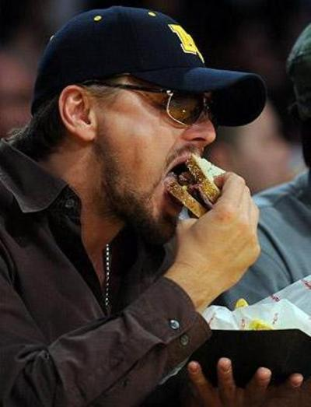
Cé hé seo:
Leonardo D’ith Ceapairí-O
© Seomra Ranga 2021 www.seomraranga.com

Slide 14
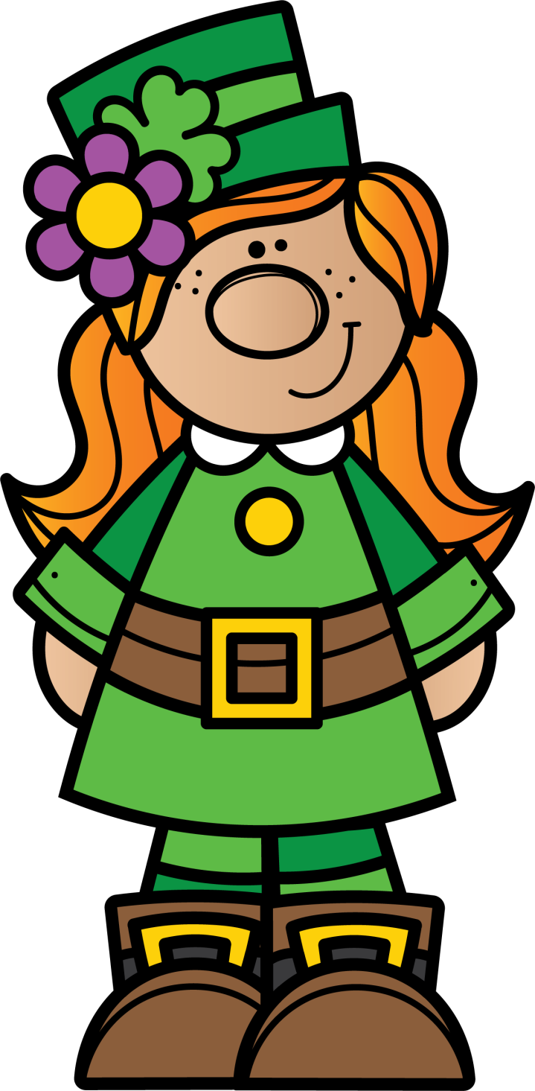

© Seomra Ranga 2021 www.seomraranga.com

Slide 15
Ceist 1
Sa scéal, cén t-ainm a bhí ar dheartháir Gretel?
© Seomra Ranga 2021 www.seomraranga.com

Slide 16
Ceist 2
Cén dath gruaige atá ar an amhránaí Ed Sheeran?
© Seomra Ranga 2021 www.seomraranga.com

Slide 17

Ceist 3
Céard é seo:
© Seomra Ranga 2021 www.seomraranga.com

Slide 18
Ceist 4
Cad iad na dathanna atá ar bhratach na hIodáile?
© Seomra Ranga 2021 www.seomraranga.com

Slide 19
Ceist 5
I mbogha báistí, cén dath a thosaíonn le “O”?
© Seomra Ranga 2021 www.seomraranga.com

Slide 20
Ceist 6
Cé a scríobh an leabhar “The Boy in the Striped Pyjamas”?
© Seomra Ranga 2021 www.seomraranga.com

Slide 21

© Seomra Ranga 2021 www.seomraranga.com

Slide 22


Bualadh
© Seomra Ranga 2021 www.seomraranga.com

Slide 23

© Seomra Ranga 2021 www.seomraranga.com

Slide 24

Ceist 1
Cén dath atá ar thacsaí i Londain?
Dubh
© Seomra Ranga 2021 www.seomraranga.com

Slide 25

Ceist 2
Ainmnigh an banna ceoil seo:
Little Mix
© Seomra Ranga 2021 www.seomraranga.com

Slide 26
Ceist 3
Cén sórt ainmhí é “Fozzie” i “The Muppets”?
Béar
© Seomra Ranga 2021 www.seomraranga.com

Slide 27
Ceist 4
Cad í seo:
Seamróg
© Seomra Ranga 2021 www.seomraranga.com

Slide 28
Ceist 5
Cé acu seo atá as ionad: stocaí, seaicéad, seampú, sciorta.
Seampú
© Seomra Ranga 2021 www.seomraranga.com

Slide 29
Ceist 6
Cé a chanann an t-amhrán “Shake It Off”?
Taylor Swift
© Seomra Ranga 2021 www.seomraranga.com

Slide 30

© Seomra Ranga 2021 www.seomraranga.com

Slide 31

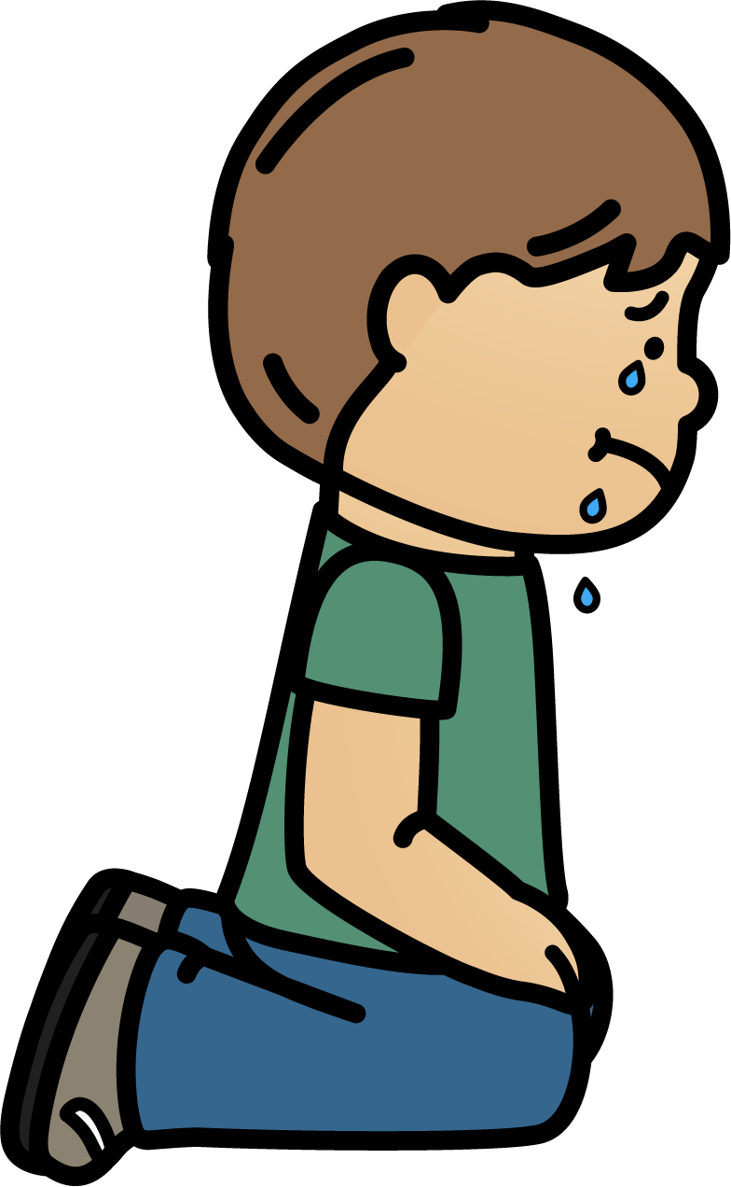
I forgot the Irish for “I Fell” but then it kind of just thit mé.
© Seomra Ranga 2021 www.seomraranga.com

Slide 32

© Seomra Ranga 2021 www.seomraranga.com

Slide 33
Ceist 1
Cé mhéad cos atá ag cearc?
© Seomra Ranga 2021 www.seomraranga.com

Slide 34
Ceist 2
Cad is ainm don mhoncaí sa chlár “Dora the Explorer”?
© Seomra Ranga 2021 www.seomraranga.com

Slide 35
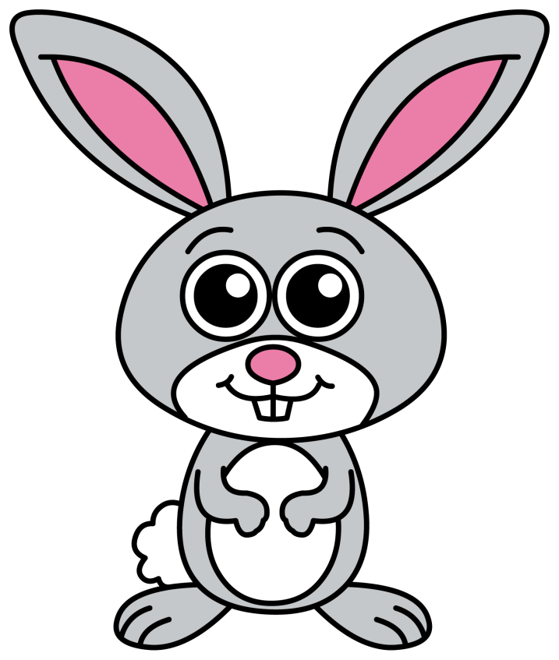
Ceist 3
Cad é seo:
© Seomra Ranga 2021 www.seomraranga.com

Slide 36
Ceist 4
Ard – íseal
Beag – mór
Ramhar - ?
© Seomra Ranga 2021 www.seomraranga.com

Slide 37
Ceist 5
Cad a chuireann tú ar do leaba – braillín nó bratach?
© Seomra Ranga 2021 www.seomraranga.com

Slide 38
Ceist 6
Ainmnigh an fear sneachta i “Frozen”.
© Seomra Ranga 2021 www.seomraranga.com

Slide 39

© Seomra Ranga 2021 www.seomraranga.com

Slide 40


Someone just told me the Irish for “seven”.
SHOCKED!!
© Seomra Ranga 2021 www.seomraranga.com

Slide 41
© Seomra Ranga 2021 www.seomraranga.com

Slide 42
Ceist 1
Sa scéal, cén t-ainm a bhí ar dheartháir Gretel?
Hansel
© Seomra Ranga 2021 www.seomraranga.com

Slide 43
Ceist 2
Cén dath gruaige atá ar an amhránaí Ed Sheeran?
Rua
© Seomra Ranga 2021 www.seomraranga.com

Slide 44
Ceist 3
Céard é seo:
Fear Sneachta
© Seomra Ranga 2021 www.seomraranga.com

Slide 45
Ceist 4
Cad iad na dathanna atá ar bhratach na hIodáile?
Glas / Bán / Dearg
© Seomra Ranga 2021 www.seomraranga.com

Slide 46
Ceist 5
I mbogha báistí, cén dath a thosaíonn le “O”?
Oráiste
© Seomra Ranga 2021 www.seomraranga.com

Slide 47
Ceist 6
Cé a scríobh an leabhar “The Boy in the Striped Pyjamas”?
John Boyne
© Seomra Ranga 2021 www.seomraranga.com

Slide 48

© Seomra Ranga 2021 www.seomraranga.com

Slide 49

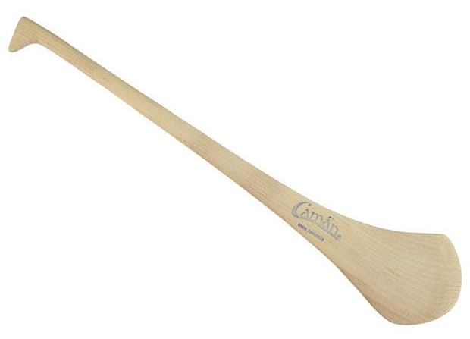
Awww ……
Camán!!
© Seomra Ranga 2021 www.seomraranga.com

Slide 50

© Seomra Ranga 2021 www.seomraranga.com

Slide 51
Ceist 1
Cén sórt bia é Mozzarella?
© Seomra Ranga 2021 www.seomraranga.com

Slide 52

Ceist 2
Ainmnigh an scannán seo:
© Seomra Ranga 2021 www.seomraranga.com

Slide 53

Ceist 3
Cé hí seo:
© Seomra Ranga 2021 www.seomraranga.com

Slide 54

Ceist 4
Cé mhéad spota atá ar dísle go hiomlán?
© Seomra Ranga 2021 www.seomraranga.com

Slide 55
Ceist 5
Bhí imreoir gailf i dtimpiste bhóthair le déanaí. Cé hé?
© Seomra Ranga 2021 www.seomraranga.com

Slide 56
Ceist 6
Niall, Liam, Harry agus Louis. Ainmnigh an banna ceoil.
© Seomra Ranga 2021 www.seomraranga.com

Slide 57

© Seomra Ranga 2021 www.seomraranga.com

Slide 58


So, aon quack?!!
© Seomra Ranga 2021 www.seomraranga.com

Slide 59
© Seomra Ranga 2021 www.seomraranga.com

Slide 60
Ceist 1
Cé mhéad cos atá ag cearc?
2
© Seomra Ranga 2021 www.seomraranga.com

Slide 61
Ceist 2
Cad is ainm don mhoncaí sa chlár “Dora the Explorer”?
Boots
© Seomra Ranga 2021 www.seomraranga.com

Slide 62
Ceist 3
Cad é seo:
Coinín
© Seomra Ranga 2021 www.seomraranga.com

Slide 63
Ceist 4
Ard – íseal
Beag – mór
Ramhar - ?
Tanaí
© Seomra Ranga 2021 www.seomraranga.com

Slide 64
Ceist 5
Cad a chuireann tú ar do leaba – braillín nó bratach?
Braillín
© Seomra Ranga 2021 www.seomraranga.com

Slide 65
Ceist 6
Ainmnigh an fear sneachta i “Frozen”.
Olaf
© Seomra Ranga 2021 www.seomraranga.com

Slide 66

© Seomra Ranga 2021 www.seomraranga.com

Slide 67


Sea
Obair
Bhaile
Ní hea
B’fhéidir
✓
Nah, ye’r grand!
© Seomra Ranga 2021 www.seomraranga.com

Slide 68

© Seomra Ranga 2021 www.seomraranga.com

Slide 69
Ceist 1
Sa scéal “Cinderella”, cé mhéad deirfiúr a bhí aici?
© Seomra Ranga 2021 www.seomraranga.com

Slide 70
Ceist 2
Cén t-ainm atá ar an sioraf sa scannán “Madagascar”?
© Seomra Ranga 2021 www.seomraranga.com

Slide 71

Ceist 3
Cad iad seo:
© Seomra Ranga 2021 www.seomraranga.com

Slide 72
Ceist 4
Cén cathair ina bhfuil an clog “Big Ben”?
© Seomra Ranga 2021 www.seomraranga.com

Slide 73
Ceist 5
Cé a chanann an t-amhrán “Save Your Tears For Another Day”?
© Seomra Ranga 2021 www.seomraranga.com

Slide 74
Ceist 6
Críochnaigh an Seanfhocal: “Is binn ____ ina thost”.
© Seomra Ranga 2021 www.seomraranga.com

Slide 75

© Seomra Ranga 2021 www.seomraranga.com

Slide 76


Cé mhéad duine a bhíonn i mbriogáid dóiteáin?
Naonúr, Naonúr
© Seomra Ranga 2021 www.seomraranga.com

Slide 77
© Seomra Ranga 2021 www.seomraranga.com

Slide 78
Ceist 1
Cén sórt bia é Mozzarella?
Cáis
© Seomra Ranga 2021 www.seomraranga.com

Slide 79
Ceist 2
Ainmnigh an scannán seo:
Instant Family
© Seomra Ranga 2021 www.seomraranga.com

Slide 80
Ceist 3
Cé hí seo:
Norma Foley
© Seomra Ranga 2021 www.seomraranga.com

Slide 81
Ceist 4
Cé mhéad spota atá ar dísle go hiomlán?
21
© Seomra Ranga 2021 www.seomraranga.com

Slide 82
Ceist 5
Bhí imreoir gailf i dtimpiste bhóthair le déanaí. Cé hé?
Tiger Woods
© Seomra Ranga 2021 www.seomraranga.com

Slide 83
Ceist 6
Niall, Liam, Harry agus Louis. Ainmnigh an banna ceoil.
One Direction
© Seomra Ranga 2021 www.seomraranga.com

Slide 84

© Seomra Ranga 2021 www.seomraranga.com

Slide 85


Cad a d’ith Jaws dá dhinnéar?
Duine, duine, duine
© Seomra Ranga 2021 www.seomraranga.com

Slide 86

© Seomra Ranga 2021 www.seomraranga.com

Slide 87
Ceist 1
Cén mhí a thagann díreach tar éis Bealtaine?
© Seomra Ranga 2021 www.seomraranga.com

Slide 88
Ceist 2
Cé mhéad cos atá ar damhán alla?
© Seomra Ranga 2021 www.seomraranga.com

Slide 89

Ceist 3
Cad í seo:
© Seomra Ranga 2021 www.seomraranga.com

Slide 90
Ceist 4
Cé mhéad deirfiúr atá ag Ron Weasley sna leabhair Harry Potter?
© Seomra Ranga 2021 www.seomraranga.com

Slide 91
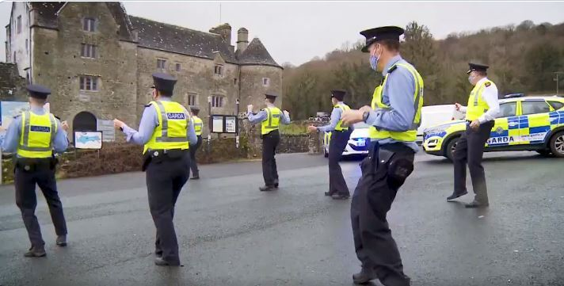
Ceist 5
Ainmnigh an píosa damhsa seo:
© Seomra Ranga 2021 www.seomraranga.com

Slide 92
Ceist 6
Cén tír ina bhfuil Reykjavik mar phríomhchathair?
© Seomra Ranga 2021 www.seomraranga.com

Slide 93

© Seomra Ranga 2021 www.seomraranga.com

Slide 94

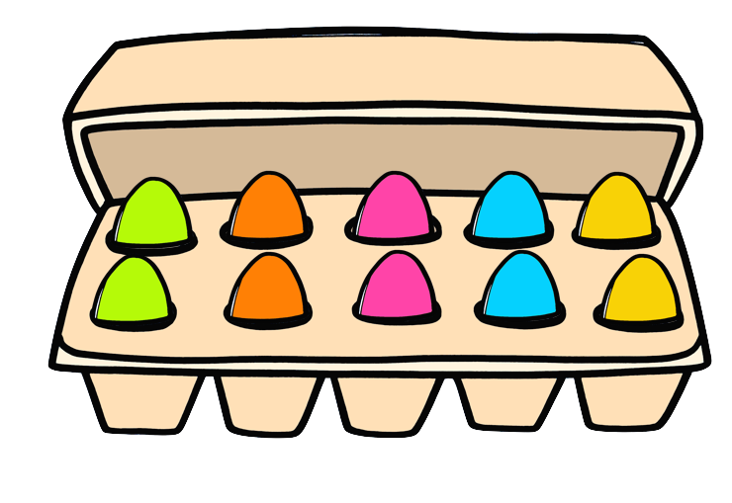
Aon
craic?
© Seomra Ranga 2021 www.seomraranga.com

Slide 95
© Seomra Ranga 2021 www.seomraranga.com

Slide 96
Ceist 1
Sa scéal “Cinderella”, cé mhéad deirfiúr a bhí aici?
Beirt
© Seomra Ranga 2021 www.seomraranga.com

Slide 97
Ceist 2
Cén t-ainm atá ar an sioraf sa scannán “Madagascar”?
Melman
© Seomra Ranga 2021 www.seomraranga.com

Slide 98
Ceist 3
Cad iad seo:
Guaillí
© Seomra Ranga 2021 www.seomraranga.com

Slide 99
Ceist 4
Cén cathair ina bhfuil an clog “Big Ben”?
Londain
© Seomra Ranga 2021 www.seomraranga.com

Slide 100
Ceist 5
Cé a chanann an t-amhrán “Save Your Tears For Another Day”?
The Weeknd
© Seomra Ranga 2021 www.seomraranga.com

Slide 101
Ceist 6
Críochnaigh an Seanfhocal: “Is binn ____ ina thost”.
Béal
© Seomra Ranga 2021 www.seomraranga.com

Slide 102

© Seomra Ranga 2021 www.seomraranga.com

Slide 103

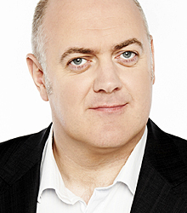
Céad Ó
Briain
Dara Ó
Briain
© Seomra Ranga 2021 www.seomraranga.com

Slide 104

© Seomra Ranga 2021 www.seomraranga.com

Slide 105
Ceist 1
Cén áit a n-oibríonn dochtúir agus altra?
© Seomra Ranga 2021 www.seomraranga.com

Slide 106
Ceist 2
Cén sórt ainmhí é Bambi?
© Seomra Ranga 2021 www.seomraranga.com

Slide 107

Ceist 3
Ainmnigh an spórt seo:
© Seomra Ranga 2021 www.seomraranga.com

Slide 108
Ceist 4
Cén contae ina bhfuil Lios Dúin Bhearna?
© Seomra Ranga 2021 www.seomraranga.com

Slide 109
Ceist 5
Cé mhéad píosa atá ar bhord fichille ag tús an chluiche?
© Seomra Ranga 2021 www.seomraranga.com

Slide 110
Ceist 6
Cé hé Uachtarán nua ‘sna Stáit Aontaithe (USA)?
© Seomra Ranga 2021 www.seomraranga.com

Slide 111

© Seomra Ranga 2021 www.seomraranga.com

Slide 112

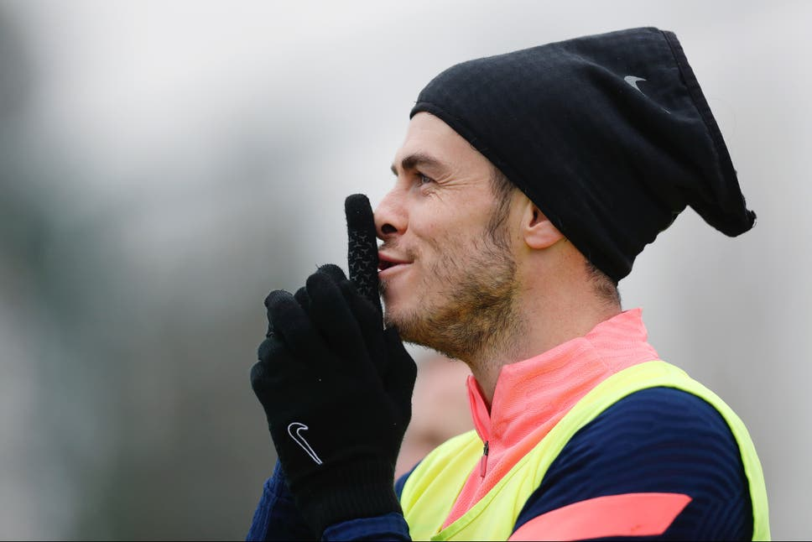
Is binn
BALE
ina
thost
© Seomra Ranga 2021 www.seomraranga.com

Slide 113
© Seomra Ranga 2021 www.seomraranga.com

Slide 114
Ceist 1
Cén mhí a thagann díreach tar éis Bealtaine?
Meitheamh
© Seomra Ranga 2021 www.seomraranga.com

Slide 115
Ceist 2
Cé mhéad cos atá ar damhán alla?
Ocht (8)
© Seomra Ranga 2021 www.seomraranga.com

Slide 116
Ceist 3
Cad í seo:
Sú Talún
© Seomra Ranga 2021 www.seomraranga.com

Slide 117
Ceist 4
Cé mhéad deirfiúr atá ag Ron Weasley sna leabhair Harry Potter?
Deirfiúr Amháin
© Seomra Ranga 2021 www.seomraranga.com

Slide 118
Ceist 5
Ainmnigh an píosa damhsa seo:
Jerusalema
© Seomra Ranga 2021 www.seomraranga.com

Slide 119
Ceist 6
Cén tír ina bhfuil Reykjavik mar phríomhchathair?
An Íoslainn (Iceland)
© Seomra Ranga 2021 www.seomraranga.com

Slide 120

© Seomra Ranga 2021 www.seomraranga.com

Slide 121

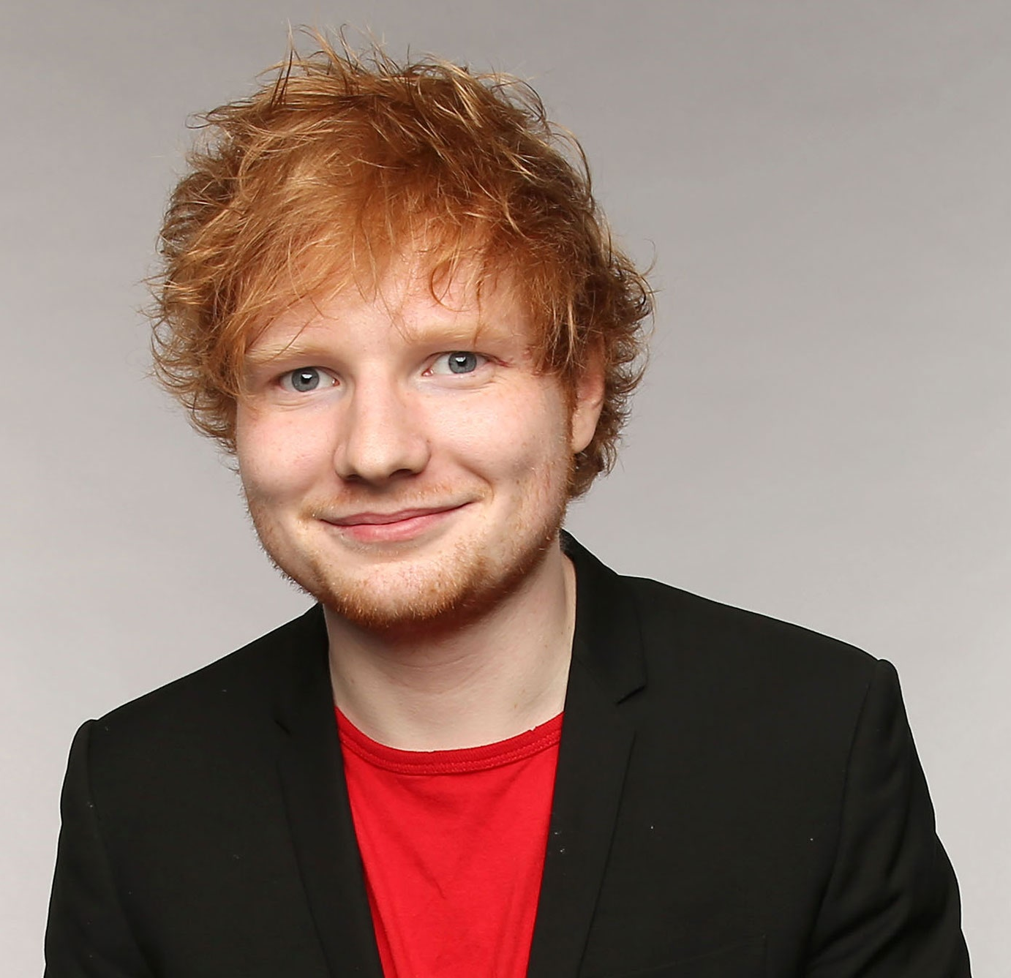
Ed Rith Sí
© Seomra Ranga 2021 www.seomraranga.com

Slide 122

© Seomra Ranga 2021 www.seomraranga.com

Slide 123
Ceist 1
Fíor nó bréagach: Is é Leo Varadkar Taoiseach na hÉireann?
© Seomra Ranga 2021 www.seomraranga.com

Slide 124
Ceist 2
Liom, leat, leis, léi, ____, libh leo.
© Seomra Ranga 2021 www.seomraranga.com

Slide 125

Ceist 3
Cad í seo:
© Seomra Ranga 2021 www.seomraranga.com

Slide 126
Ceist 4
Ainmnigh an cailín atá ina cónaí i Wonderland sa leabhar.
© Seomra Ranga 2021 www.seomraranga.com

Slide 127
Ceist 5
Cén chuid den chorp ar a gcaitear fáinne?
© Seomra Ranga 2021 www.seomraranga.com

Slide 128
Ceist 6
Cé mhéad liathróid a bhíonn ar an mbord ag tús cluiche snúcair?
© Seomra Ranga 2021 www.seomraranga.com

Slide 129

© Seomra Ranga 2021 www.seomraranga.com

Slide 130

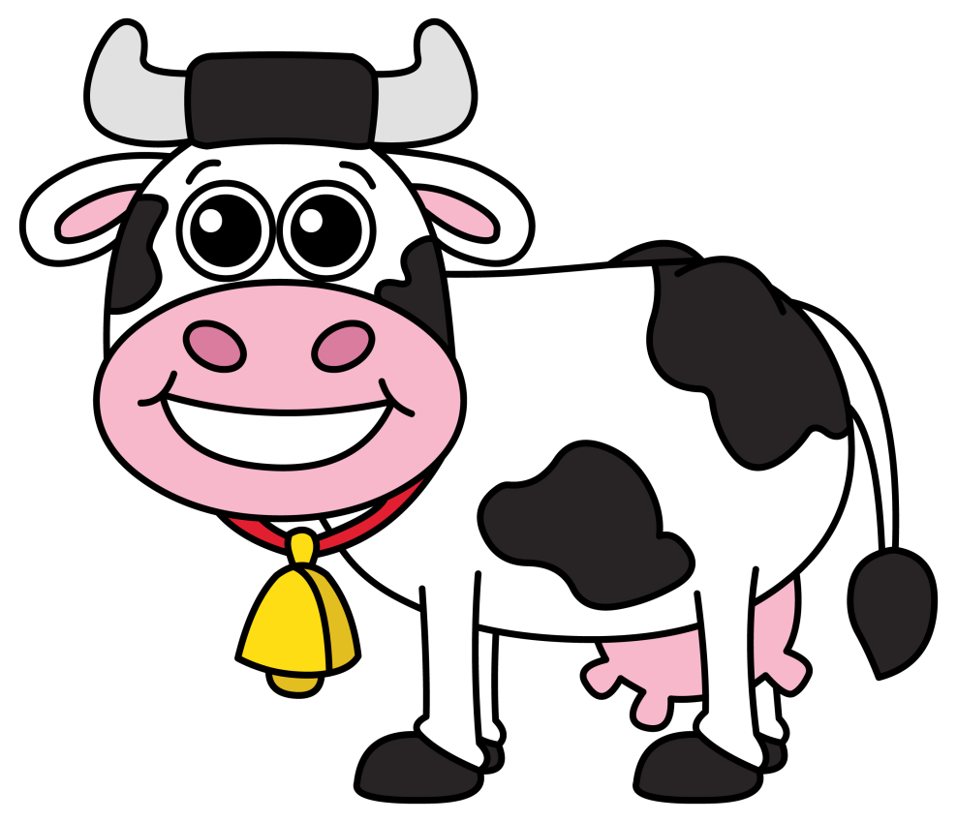

Tommy Bó
© Seomra Ranga 2021 www.seomraranga.com

Slide 131
© Seomra Ranga 2021 www.seomraranga.com

Slide 132
Ceist 1
Cén áit a n-oibríonn dochtúir agus altra?
Ospidéal
© Seomra Ranga 2021 www.seomraranga.com

Slide 133
Ceist 2
Cén sórt ainmhí é Bambi?
Fia
© Seomra Ranga 2021 www.seomraranga.com

Slide 134
Ceist 3
Ainmnigh an spórt seo:
Leadóg
© Seomra Ranga 2021 www.seomraranga.com

Slide 135
Ceist 4
Cén contae ina bhfuil Lios Dúin Bhearna?
Co. an Chláir
© Seomra Ranga 2021 www.seomraranga.com

Slide 136
Ceist 5
Cé mhéad píosa atá ar bhord fichille ag tús an chluiche?
32
© Seomra Ranga 2021 www.seomraranga.com

Slide 137
Ceist 6
Cé hé Uachtarán nua ‘sna Stáit Aontaithe (USA)?
Joe Biden
© Seomra Ranga 2021 www.seomraranga.com

Slide 138

© Seomra Ranga 2021 www.seomraranga.com

Slide 139

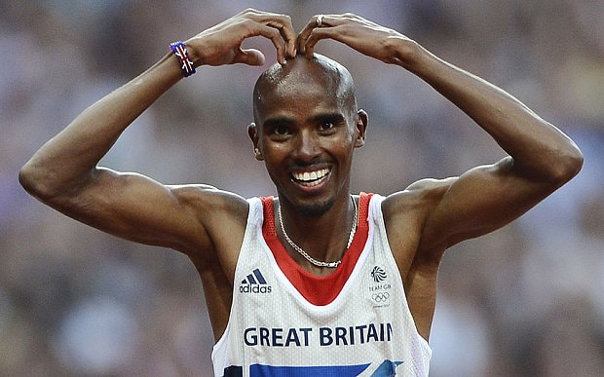
Mo Farah
Níos Mó Farah
© Seomra Ranga 2021 www.seomraranga.com

Slide 140
© Seomra Ranga 2021 www.seomraranga.com

Slide 141
Ceist 1
Fíor nó bréagach: Is é Leo Varadkar Taoiseach na hÉireann?
Bréagach
© Seomra Ranga 2021 www.seomraranga.com

Slide 142
Ceist 2
Liom, leat, leis, léi, ____, libh leo.
Linn
© Seomra Ranga 2021 www.seomraranga.com

Slide 143
Ceist 3
Cad í seo:
Olann
© Seomra Ranga 2021 www.seomraranga.com

Slide 144
Ceist 4
Ainmnigh an cailín atá ina cónaí i Wonderland sa leabhar.
Alice
© Seomra Ranga 2021 www.seomraranga.com

Slide 145
Ceist 5
Cén chuid den chorp ar a gcaitear fáinne?
Méar
© Seomra Ranga 2021 www.seomraranga.com

Slide 146
Ceist 6
Cé mhéad liathróid a bhíonn ar an mbord ag tús cluiche snúcair?
22
© Seomra Ranga 2021 www.seomraranga.com

Slide 147

© Seomra Ranga 2021 www.seomraranga.com

Slide 148

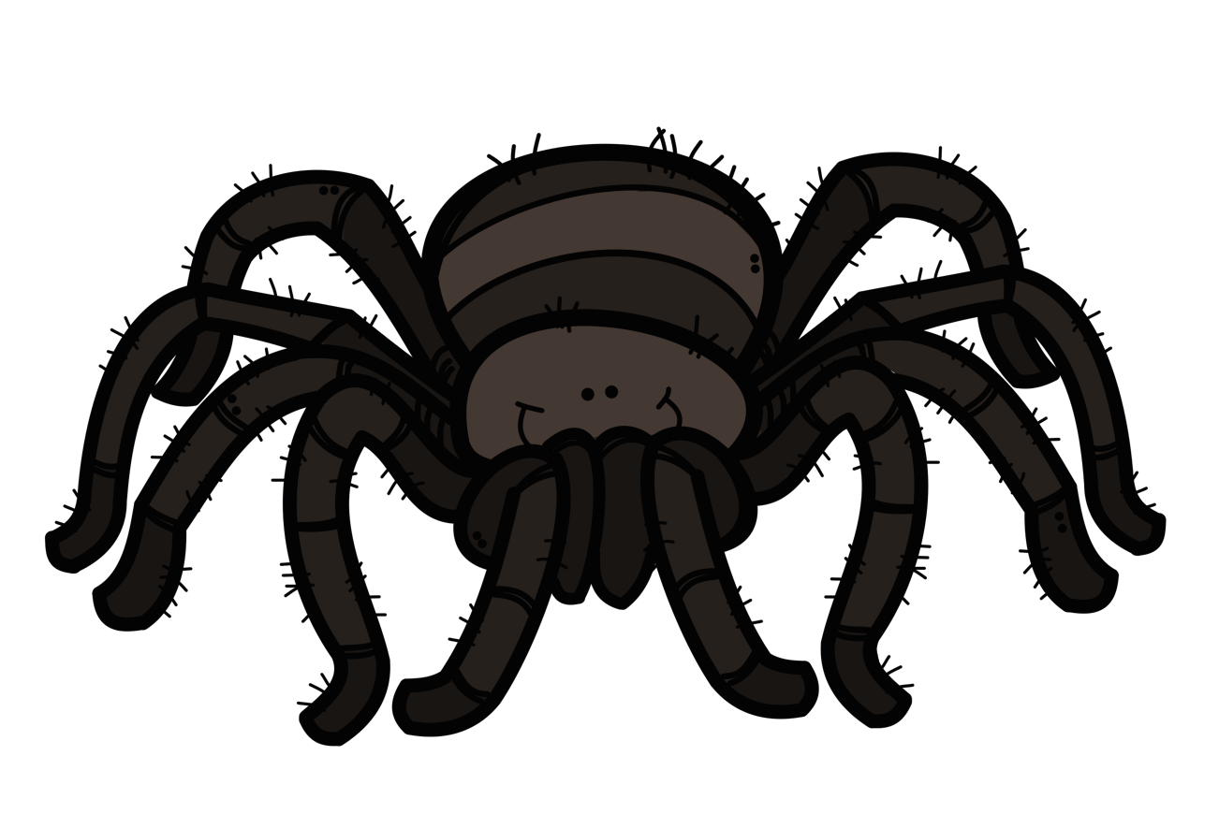
Tóg go BUG é
© Seomra Ranga 2021 www.seomraranga.com

Slide 149

© Seomra Ranga 2021 www.seomraranga.com

Slide 150

Ceist 1
Ainmnigh an fear a sheas ar an ngealach don chéad uair.
© Seomra Ranga 2021 www.seomraranga.com

Slide 151
Ceist 2
Fíor nó bréagach: Chríochnaigh an Dara Cogadh Domhanda i 1946?
© Seomra Ranga 2021 www.seomraranga.com

Slide 152
Ceist 3
Cad í an abhainn is faide san Eoraip?
© Seomra Ranga 2021 www.seomraranga.com

Slide 153
Ceist 4
Críochnaigh an líne ó Amhrán na bhFiann: “Le ___ scréach faoi lámhach na bpiléar”.
© Seomra Ranga 2021 www.seomraranga.com

Slide 154
Ceist 5
Cá ndeachaigh Niamh Cinn Óir le hOisín?
© Seomra Ranga 2021 www.seomraranga.com

Slide 155
Ceist 6
Cén bhliain inár tharla Éirí Amach na Cásca in Éirinn?
© Seomra Ranga 2021 www.seomraranga.com

Slide 156

© Seomra Ranga 2021 www.seomraranga.com

Slide 157

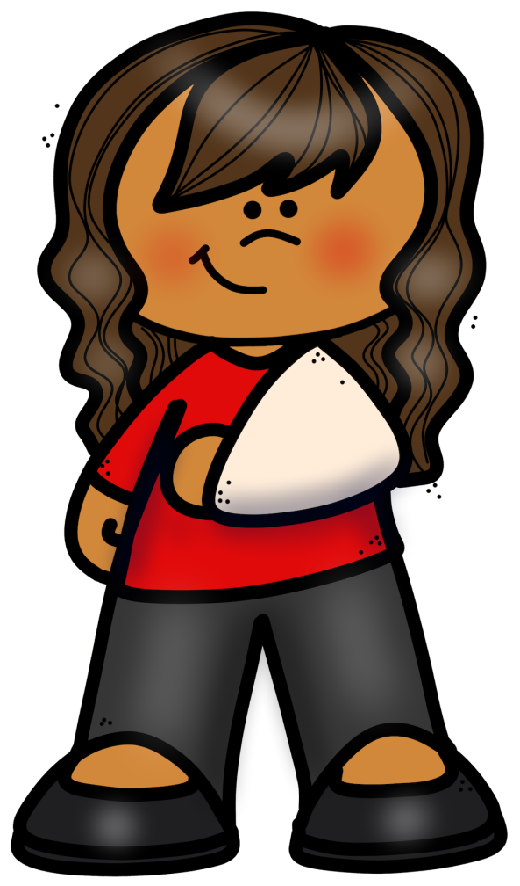
Ar chuala tú faoin gcailín a bhris a láimh chlé?
Tá sí “all-right” anois!
© Seomra Ranga 2021 www.seomraranga.com

Slide 158
© Seomra Ranga 2021 www.seomraranga.com

Slide 159
Ceist 1
Ainmnigh an fear a sheas ar an ngealach don chéad uair.
Neil Armstrong
© Seomra Ranga 2021 www.seomraranga.com

Slide 160
Ceist 2
Fíor nó bréagach: Chríochnaigh an Dara Cogadh Domhanda i 1946?
Bréagach
© Seomra Ranga 2021 www.seomraranga.com

Slide 161
Ceist 3
Cad í an abhainn is faide san Eoraip?
Volga
© Seomra Ranga 2021 www.seomraranga.com

Slide 162
Ceist 4
Críochnaigh an líne ó Amhrán n bhFiann: “Le ___ scréach faoi lámhach na bpiléar”.
Gunna
© Seomra Ranga 2021 www.seomraranga.com

Slide 163
Ceist 5
Cá ndeachaigh Niamh Cinn Óir le hOisín?
Tír na nÓg
© Seomra Ranga 2021 www.seomraranga.com

Slide 164
Ceist 6
Cén bhliain inár tharla Éirí Amach na Cásca in Éirinn?
1916
© Seomra Ranga 2021 www.seomraranga.com

Slide 165

© Seomra Ranga 2021 www.seomraranga.com

Slide 166

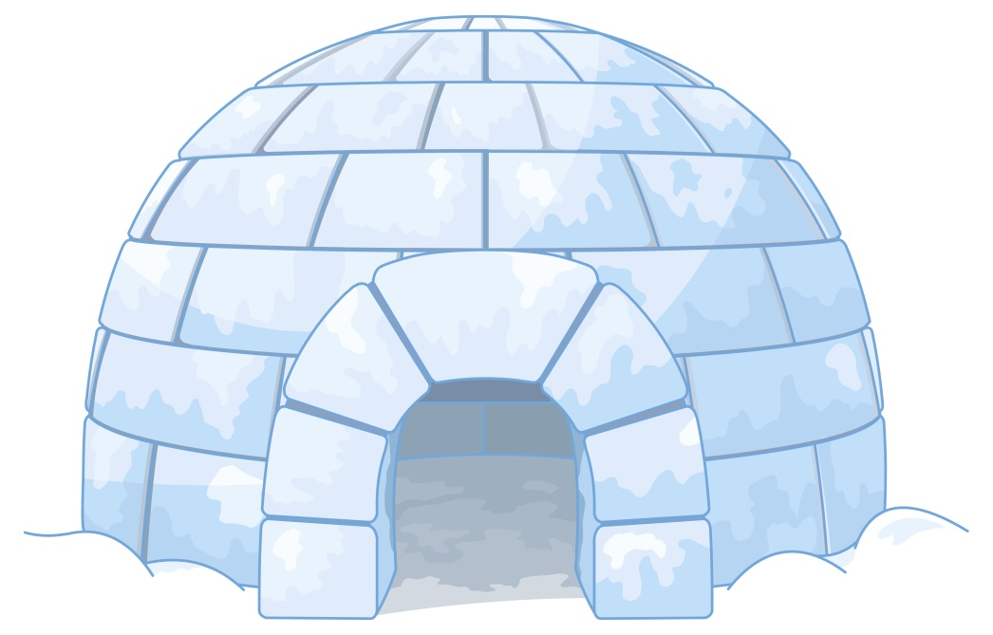
Cén Gaeilge atá ar “igloo?
Choc-Ice!
© Seomra Ranga 2021 www.seomraranga.com

Slide 167
Sin an Deireadh
© Seomra Ranga 2021 www.seomraranga.com

Slide 168
Tá súil agam gur bhain sibh taitneamh as na ceisteanna.
© Seomra Ranga 2021 www.seomraranga.com

Slide 169
Slán agus beannacht
© Seomra Ranga 2021 www.seomraranga.com

Slide 170









Úsáidtear íomhánna sa chomad seo ó:
https://www.teacherspayteachers.com/Store/Creating4-The-Classroom
https://www.teacherspayteachers.com/Store/Photo-Clipz
https://www.teacherspayteachers.com/Store/P4-Clips-Trioriginals
https://www.teacherspayteachers.com/Store/Educlips
https://www.teacherspayteachers.com/Store/Zip-a-dee-doo-dah-Designs
https://www.teacherspayteachers.com/Store/Whimsy-Clips
https://www.textgiraffe.com/
https://www.teacherspayteachers.com/Store/Krista-Wallden-Creative-Clips
https://depositphotos.com/
© Seomra Ranga 2021 www.seomraranga.com

