Slide 1
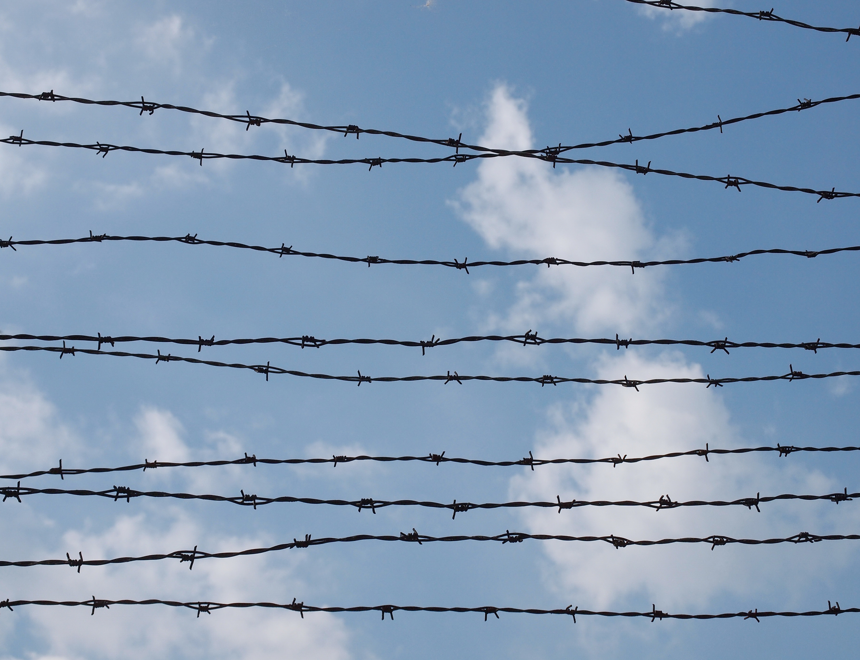

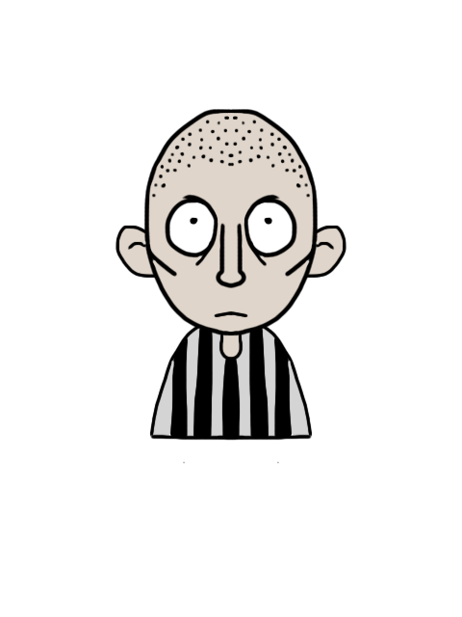



Table Quiz
© Seomra Ranga 2021 www.seomraranga.com

Slide 2
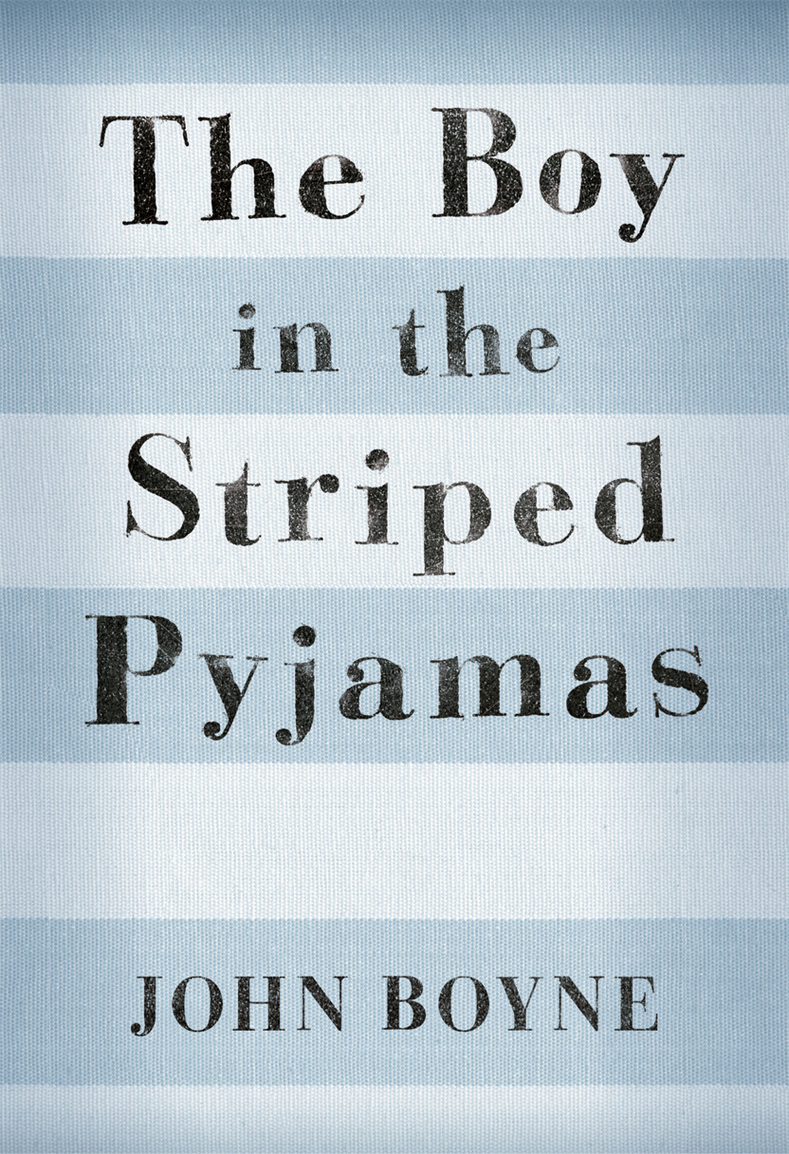
Based on the book by John Boyne
© Seomra Ranga 2021 www.seomraranga.com

Slide 3

Make sure you have written your table/team number/letter on every answer sheet
Write the number of each round 1-8 on every answer sheet
Try not to shout out answers
© Seomra Ranga 2021 www.seomraranga.com

Slide 4
Check with your team mates and agree an answer before you write it down
Don’t worry about spellings – just do your best
If you’re not sure of the answer, make your best possible guess
© Seomra Ranga 2021 www.seomraranga.com

Slide 5
There are eight rounds with six questions in each round
Answer rounds are included
There are facts about Auschwitz Concentration Camp between every round and answer round
© Seomra Ranga 2021 www.seomraranga.com

Slide 6


© Seomra Ranga 2021 www.seomraranga.com

Slide 7

© Seomra Ranga 2021 www.seomraranga.com

Slide 8
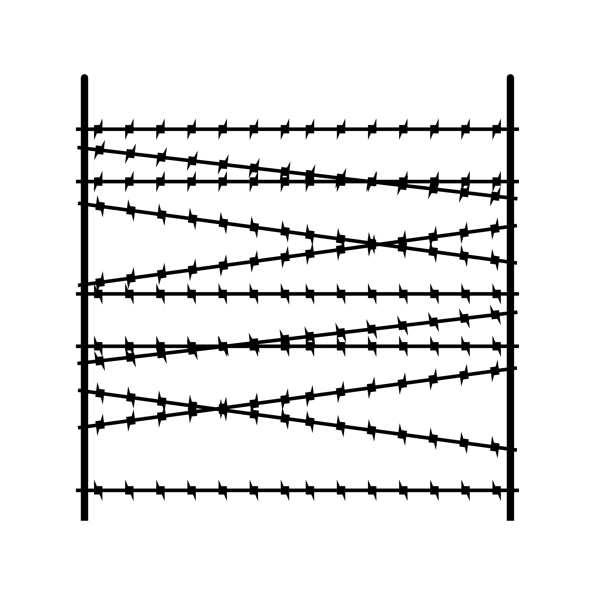

The Boy in the Striped Pyjamas
Question 1
What German city is the setting for the opening of the novel?
© Seomra Ranga 2021 www.seomraranga.com

Slide 9
The Boy in the Striped Pyjamas
Question 2
How many chapters were in the novel?
© Seomra Ranga 2021 www.seomraranga.com

Slide 10
The Boy in the Striped Pyjamas
Question 3
What is the name of the maid we meet in the opening chapter?
© Seomra Ranga 2021 www.seomraranga.com

Slide 11
The Boy in the Striped Pyjamas
Question 4
What was the nickname Bruno had for his sister?
© Seomra Ranga 2021 www.seomraranga.com

Slide 12
The Boy in the Striped Pyjamas
Question 5
Name the author of “The Boy in the Striped Pyjamas”.
© Seomra Ranga 2021 www.seomraranga.com

Slide 13
The Boy in the Striped Pyjamas
Question 6
What age was Bruno at the beginning of the novel?
© Seomra Ranga 2021 www.seomraranga.com

Slide 14
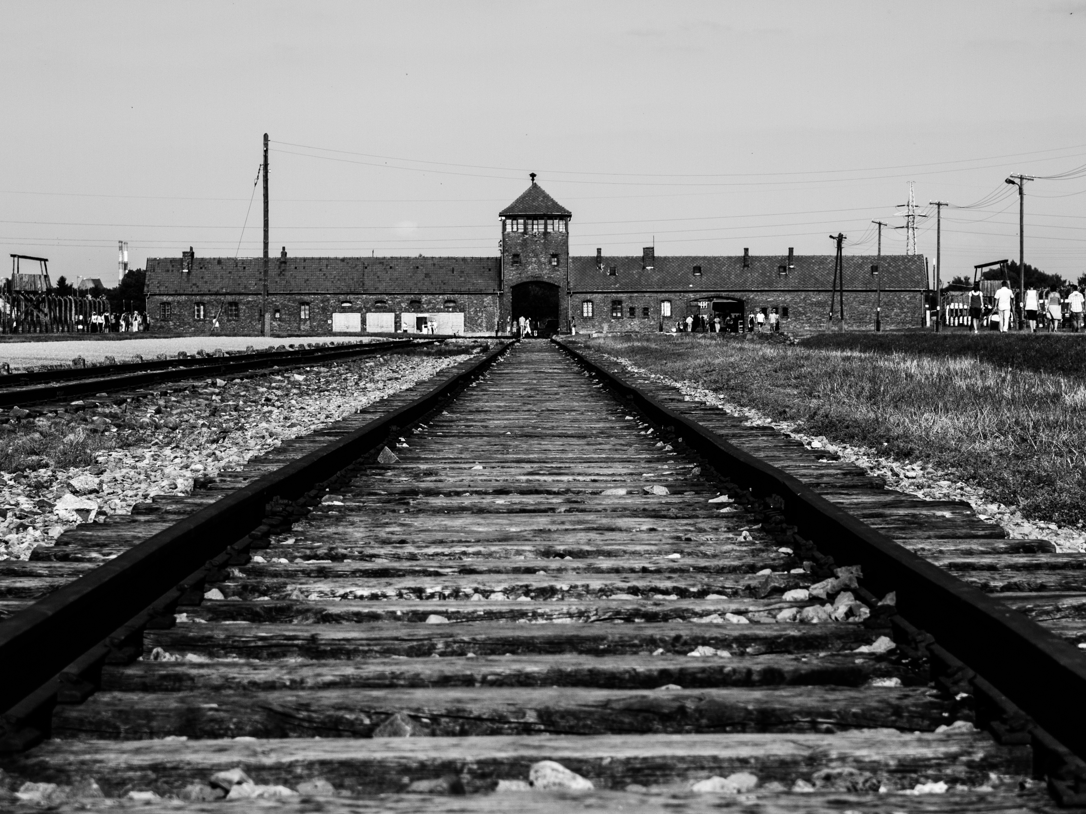


© Seomra Ranga 2021 www.seomraranga.com

Slide 15
Auschwitz was located near the industrial town of Oswiecim in southern Poland.
© Seomra Ranga 2021 www.seomraranga.com

Slide 16

© Seomra Ranga 2021 www.seomraranga.com

Slide 17

The Boy in the Striped Pyjamas
Question 1
What does Bruno tell Shmuel he wants to be when he is older?
© Seomra Ranga 2021 www.seomraranga.com

Slide 18
The Boy in the Striped Pyjamas
Question 2
How many floors were there in Bruno’s house in Berlin?
© Seomra Ranga 2021 www.seomraranga.com

Slide 19
The Boy in the Striped Pyjamas
Question 3
What was the name of the butler to Bruno’s family?
© Seomra Ranga 2021 www.seomraranga.com

Slide 20
The Boy in the Striped Pyjamas
Question 4
What age was Gretel at the beginning of the novel?
© Seomra Ranga 2021 www.seomraranga.com

Slide 21
The Boy in the Striped Pyjamas
Question 5
True or False: the events of the story took place during World War I?
© Seomra Ranga 2021 www.seomraranga.com

Slide 22
The Boy in the Striped Pyjamas
Question 6
Who had “big things in mind” for Bruno’s Father?
© Seomra Ranga 2021 www.seomraranga.com

Slide 23
© Seomra Ranga 2021 www.seomraranga.com

Slide 24
Auschwitz was the largest concentration camp set up by Nazi Germany.
© Seomra Ranga 2021 www.seomraranga.com

Slide 25

© Seomra Ranga 2021 www.seomraranga.com

Slide 26

The Boy in the Striped Pyjamas
Question 1
What German city is the setting for the opening of the novel?
Berlin
© Seomra Ranga 2021 www.seomraranga.com

Slide 27
The Boy in the Striped Pyjamas
Question 2
How many chapters were in the novel?
20
© Seomra Ranga 2021 www.seomraranga.com

Slide 28
The Boy in the Striped Pyjamas
Question 3
What is the name of the maid we meet in the opening chapter?
Maria
© Seomra Ranga 2021 www.seomraranga.com

Slide 29
The Boy in the Striped Pyjamas
Question 4
What was the nickname Bruno had for his sister?
The Hopeless Case
© Seomra Ranga 2021 www.seomraranga.com

Slide 30
The Boy in the Striped Pyjamas
Question 5
Name the author of “The Boy in the Striped Pyjamas”.
John Boyne
© Seomra Ranga 2021 www.seomraranga.com

Slide 31
The Boy in the Striped Pyjamas
Question 6
What age was Bruno at the beginning of the novel?
9
© Seomra Ranga 2021 www.seomraranga.com

Slide 32
© Seomra Ranga 2021 www.seomraranga.com

Slide 33
Auschwitz was actually three camps in one – a prison camp, an extermination camp and a slave labour camp.
© Seomra Ranga 2021 www.seomraranga.com

Slide 34

© Seomra Ranga 2021 www.seomraranga.com

Slide 35

The Boy in the Striped Pyjamas
Question 1
Gretel had a large collection of what?
© Seomra Ranga 2021 www.seomraranga.com

Slide 36
The Boy in the Striped Pyjamas
Question 2
How many pages were in the book: 198, 205, 216, 220?
© Seomra Ranga 2021 www.seomraranga.com

Slide 37
The Boy in the Striped Pyjamas
Question 3
What was Bruno forbidden to do: slouching, interrupting, eavesdropping?
© Seomra Ranga 2021 www.seomraranga.com

Slide 38
The Boy in the Striped Pyjamas
Question 4
What did Bruno like to slide down in the Berlin house?
© Seomra Ranga 2021 www.seomraranga.com

Slide 39
The Boy in the Striped Pyjamas
Question 5
What room was “out of bounds at all times and no exceptions?
© Seomra Ranga 2021 www.seomraranga.com

Slide 40
The Boy in the Striped Pyjamas
Question 6
How many glasses were in the set that Bruno’s grandmother gave mother when she married Father?
© Seomra Ranga 2021 www.seomraranga.com

Slide 41
© Seomra Ranga 2021 www.seomraranga.com

Slide 42
The first transport of Polish political prisoners arrived in Auschwitz on June 14, 1940.
© Seomra Ranga 2021 www.seomraranga.com

Slide 43
© Seomra Ranga 2021 www.seomraranga.com

Slide 44
The Boy in the Striped Pyjamas
Question 1
What does Bruno tell Shmuel he wants to be when he is older?
Explorer
© Seomra Ranga 2021 www.seomraranga.com

Slide 45
The Boy in the Striped Pyjamas
Question 2
How many floors were there in Bruno’s house in Berlin?
Five
© Seomra Ranga 2021 www.seomraranga.com

Slide 46
The Boy in the Striped Pyjamas
Question 3
What was the name of the butler to Bruno’s family?
Lars
© Seomra Ranga 2021 www.seomraranga.com

Slide 47
The Boy in the Striped Pyjamas
Question 4
What age was Gretel at the beginning of the novel?
12
© Seomra Ranga 2021 www.seomraranga.com

Slide 48
The Boy in the Striped Pyjamas
Question 5
True or False: the events of the story took place during World War I?
False
© Seomra Ranga 2021 www.seomraranga.com

Slide 49
The Boy in the Striped Pyjamas
Question 6
Who had “big things in mind” for Bruno’s Father?
The Fury
© Seomra Ranga 2021 www.seomraranga.com

Slide 50
© Seomra Ranga 2021 www.seomraranga.com

Slide 51
Conditions in Auschwitz were harsh with poor shelter and sanitation. Prisoners had to work hard and were given little food.
© Seomra Ranga 2021 www.seomraranga.com

Slide 52

© Seomra Ranga 2021 www.seomraranga.com

Slide 53

The Boy in the Striped Pyjamas
Question 1
How many floors were in Bruno’s house in Out With?
© Seomra Ranga 2021 www.seomraranga.com

Slide 54
The Boy in the Striped Pyjamas
Question 2
In Berlin, Bruno had three best friends – Daniel, Martin and ____?
© Seomra Ranga 2021 www.seomraranga.com

Slide 55
The Boy in the Striped Pyjamas
Question 3
True or false: The Boy in the Striped Pyjamas is John Boyne’s first novel for children?
© Seomra Ranga 2021 www.seomraranga.com

Slide 56
The Boy in the Striped Pyjamas
Question 4
Who referred to Bruno as “Little man”?
© Seomra Ranga 2021 www.seomraranga.com

Slide 57
The Boy in the Striped Pyjamas
Question 5
What was Bruno’s grandmother’s first name: Katrin, Jessica, Nathalie?
© Seomra Ranga 2021 www.seomraranga.com

Slide 58
The Boy in the Striped Pyjamas
Question 6
What was Herr Liszt’s job: cook, teacher, butler?
© Seomra Ranga 2021 www.seomraranga.com

Slide 59
© Seomra Ranga 2021 www.seomraranga.com

Slide 60
7,650 sick or starving prisoners were found by Soviet troops who eventually liberated the camp on January 27, 1945.
© Seomra Ranga 2021 www.seomraranga.com

Slide 61
© Seomra Ranga 2021 www.seomraranga.com

Slide 62
The Boy in the Striped Pyjamas
Question 1
Gretel had a large collection of what?
Dolls
© Seomra Ranga 2021 www.seomraranga.com

Slide 63
The Boy in the Striped Pyjamas
Question 2
How many pages were in the book: 198, 205, 216, 220?
216
© Seomra Ranga 2021 www.seomraranga.com

Slide 64
The Boy in the Striped Pyjamas
Question 3
What was Bruno forbidden to do: slouching, interrupting, eavesdropping?
Interrupting
© Seomra Ranga 2021 www.seomraranga.com

Slide 65
The Boy in the Striped Pyjamas
Question 4
What did Bruno like to slide down in the Berlin house?
Bannister
© Seomra Ranga 2021 www.seomraranga.com

Slide 66
The Boy in the Striped Pyjamas
Question 5
What room was “out of bounds at all times and no exceptions?
Father’s Office
© Seomra Ranga 2021 www.seomraranga.com

Slide 67
The Boy in the Striped Pyjamas
Question 6
How many glasses were in the set that Bruno’s grandmother gave mother when she married Father?
64
© Seomra Ranga 2021 www.seomraranga.com

Slide 68
© Seomra Ranga 2021 www.seomraranga.com

Slide 69
Between 1.1 and 1.5 million people died at Auschwitz - 90 percent of them were Jewish.
© Seomra Ranga 2021 www.seomraranga.com

Slide 70

© Seomra Ranga 2021 www.seomraranga.com

Slide 71

The Boy in the Striped Pyjamas
Question 1
Bruno and his family returned to Berlin for a funeral. Who had died?
© Seomra Ranga 2021 www.seomraranga.com

Slide 72
The Boy in the Striped Pyjamas
Question 2
True or false: Bruno could see some girls when he looked out his bedroom window in the new house?
© Seomra Ranga 2021 www.seomraranga.com

Slide 73
The Boy in the Striped Pyjamas
Question 3
What in the garden was “Presented on the occasion of the opening of Out-With camp”?
© Seomra Ranga 2021 www.seomraranga.com

Slide 74
The Boy in the Striped Pyjamas
Question 4
Bruno’s mother was fond of drinking a “medicinal _____”?
© Seomra Ranga 2021 www.seomraranga.com

Slide 75
The Boy in the Striped Pyjamas
Question 5
Gretel’s three friends in Berlin were named Hilda, Isobel and ____?
© Seomra Ranga 2021 www.seomraranga.com

Slide 76
The Boy in the Striped Pyjamas
Question 6
What did Bruno want Lt. Kotler to find for him to make a swing?
© Seomra Ranga 2021 www.seomraranga.com

Slide 77
© Seomra Ranga 2021 www.seomraranga.com

Slide 78
Approximately 83,000 Polish people died or were killed in the camp.
© Seomra Ranga 2021 www.seomraranga.com

Slide 79
© Seomra Ranga 2021 www.seomraranga.com

Slide 80
The Boy in the Striped Pyjamas
Question 1
How many floors were in Bruno’s house in Out With?
Three
© Seomra Ranga 2021 www.seomraranga.com

Slide 81
The Boy in the Striped Pyjamas
Question 2
In Berlin, Bruno had three best friends – Daniel, Martin and ____?
Karl
© Seomra Ranga 2021 www.seomraranga.com

Slide 82
The Boy in the Striped Pyjamas
Question 3
True or false: The Boy in the Striped Pyjamas is John Boyne’s first novel for children?
True
© Seomra Ranga 2021 www.seomraranga.com

Slide 83
The Boy in the Striped Pyjamas
Question 4
Who referred to Bruno as “Little man”?
Lt. Kotler
© Seomra Ranga 2021 www.seomraranga.com

Slide 84
The Boy in the Striped Pyjamas
Question 5
What was Bruno’s grandmother’s first name: Katrin, Jessica, Nathalie?
Nathalie
© Seomra Ranga 2021 www.seomraranga.com

Slide 85
The Boy in the Striped Pyjamas
Question 6
What was Herr Liszt’s job: cook, teacher, butler?
Teacher
© Seomra Ranga 2021 www.seomraranga.com

Slide 86
© Seomra Ranga 2021 www.seomraranga.com

Slide 87
Prison doctors carried out some medical experiments on prisoners in Auschwitz.
© Seomra Ranga 2021 www.seomraranga.com

Slide 88

© Seomra Ranga 2021 www.seomraranga.com

Slide 89

The Boy in the Striped Pyjamas
Question 1
Shmuel’s family lived in a flat above what kind of shop?
© Seomra Ranga 2021 www.seomraranga.com

Slide 90
The Boy in the Striped Pyjamas
Question 2
True or false: Pavel used to be a doctor before he came to Out-With?
© Seomra Ranga 2021 www.seomraranga.com

Slide 91
The Boy in the Striped Pyjamas
Question 3
How many houses were there in Bruno’s street in Berlin: 4, 6, 8, 10?
© Seomra Ranga 2021 www.seomraranga.com

Slide 92
The Boy in the Striped Pyjamas
Question 4
In what Irish county was John Boyne born?
© Seomra Ranga 2021 www.seomraranga.com

Slide 93
The Boy in the Striped Pyjamas
Question 5
Where did Bruno think Poland was in: Belgium, Holland, Denmark?
© Seomra Ranga 2021 www.seomraranga.com

Slide 94
The Boy in the Striped Pyjamas
Question 6
Who was the only person that Bruno had ever met in Berlin that he considered to be mad?
© Seomra Ranga 2021 www.seomraranga.com

Slide 95
© Seomra Ranga 2021 www.seomraranga.com

Slide 96
Prisoner serial numbers were tattooed onto their bodies in the camp. Prisoners were known by their numbers, not their names.
© Seomra Ranga 2021 www.seomraranga.com

Slide 97
© Seomra Ranga 2021 www.seomraranga.com

Slide 98
The Boy in the Striped Pyjamas
Question 1
Bruno and his family returned to Berlin for a funeral. Who had died?
Grandmother
© Seomra Ranga 2021 www.seomraranga.com

Slide 99
The Boy in the Striped Pyjamas
Question 2
True or false: Bruno could see some girls when he looked out his bedroom window in the new house?
False
© Seomra Ranga 2021 www.seomraranga.com

Slide 100
The Boy in the Striped Pyjamas
Question 3
What in the garden was “Presented on the occasion of the opening of Out-With camp”?
Bench
© Seomra Ranga 2021 www.seomraranga.com

Slide 101
The Boy in the Striped Pyjamas
Question 4
Bruno’s mother was fond of drinking a “medicinal _____”?
Sherry
© Seomra Ranga 2021 www.seomraranga.com

Slide 102
The Boy in the Striped Pyjamas
Question 5
Gretel’s three friends in Berlin were named Hilda, Isobel and ____?
Louise
© Seomra Ranga 2021 www.seomraranga.com

Slide 103
The Boy in the Striped Pyjamas
Question 6
What did Bruno want Lt. Kotler to find for him to make a swing?
Tyre
© Seomra Ranga 2021 www.seomraranga.com

Slide 104
© Seomra Ranga 2021 www.seomraranga.com

Slide 105
Jewish prisoners had to sew two yellow triangles onto their clothes in the shape of a Star of David.
© Seomra Ranga 2021 www.seomraranga.com

Slide 106

© Seomra Ranga 2021 www.seomraranga.com

Slide 107

The Boy in the Striped Pyjamas
Question 1
True or false: Shmuel didn’t wear any shoes or socks?
© Seomra Ranga 2021 www.seomraranga.com

Slide 108
The Boy in the Striped Pyjamas
Question 2
What was Shmuel’s mother’s occupation?
© Seomra Ranga 2021 www.seomraranga.com

Slide 109
The Boy in the Striped Pyjamas
Question 3
What was the name of the symbol that Bruno’s father wore on his armband?
© Seomra Ranga 2021 www.seomraranga.com

Slide 110
The Boy in the Striped Pyjamas
Question 4
How did Shmuel come to Out-With: train, bus, taxi?
© Seomra Ranga 2021 www.seomraranga.com

Slide 111
The Boy in the Striped Pyjamas
Question 5
What was the name of the blonde lady that came to dinner with The Fury?
© Seomra Ranga 2021 www.seomraranga.com

Slide 112
The Boy in the Striped Pyjamas
Question 6
What kind of food had Shmuel only ever tasted once before he met Bruno?
© Seomra Ranga 2021 www.seomraranga.com

Slide 113
© Seomra Ranga 2021 www.seomraranga.com

Slide 114
15% of those who worked at Auschwitz were convicted of war crimes after the war.
© Seomra Ranga 2021 www.seomraranga.com

Slide 115
© Seomra Ranga 2021 www.seomraranga.com

Slide 116
The Boy in the Striped Pyjamas
Question 1
Shmuel’s family lived in a flat above what kind of shop?
Watch Shop
© Seomra Ranga 2021 www.seomraranga.com

Slide 117
The Boy in the Striped Pyjamas
Question 2
True or false: Pavel used to be a doctor before he came to Out-With?
True
© Seomra Ranga 2021 www.seomraranga.com

Slide 118
The Boy in the Striped Pyjamas
Question 3
How many houses were there in Bruno’s street in Berlin: 4, 6, 8, 10?
6
© Seomra Ranga 2021 www.seomraranga.com

Slide 119
The Boy in the Striped Pyjamas
Question 4
In what Irish county was John Boyne born?
Dublin
© Seomra Ranga 2021 www.seomraranga.com

Slide 120
The Boy in the Striped Pyjamas
Question 5
Where did Bruno think Poland was in: Belgium, Holland, Denmark?
Denmark
© Seomra Ranga 2021 www.seomraranga.com

Slide 121
The Boy in the Striped Pyjamas
Question 6
Who was the only person that Bruno had ever met in Berlin that he considered to be mad?
Herr Roller
© Seomra Ranga 2021 www.seomraranga.com

Slide 122
© Seomra Ranga 2021 www.seomraranga.com

Slide 123
Approximately 700 prisoners tried to escape from Auschwitz’s three camps – about 300 were successful.
© Seomra Ranga 2021 www.seomraranga.com

Slide 124

© Seomra Ranga 2021 www.seomraranga.com

Slide 125

The Boy in the Striped Pyjamas
Question 1
Who was Bruno and Shmuel searching for around the camp?
© Seomra Ranga 2021 www.seomraranga.com

Slide 126
The Boy in the Striped Pyjamas
Question 2
True or false: Shmuel was born on the same date as Bruno, but in a different year?
© Seomra Ranga 2021 www.seomraranga.com

Slide 127
The Boy in the Striped Pyjamas
Question 3
What dinner was Bruno looking forward to as he and Shmuel explored the camp?
© Seomra Ranga 2021 www.seomraranga.com

Slide 128
The Boy in the Striped Pyjamas
Question 4
Where did Shmuel say that he would like to work?
© Seomra Ranga 2021 www.seomraranga.com

Slide 129
The Boy in the Striped Pyjamas
Question 5
In what year was “The Boy in the Striped Pyjamas” first published: 2006, 2008, 2009?
© Seomra Ranga 2021 www.seomraranga.com

Slide 130
The Boy in the Striped Pyjamas
Question 6
To what country did Lt. Kotler’s father go when he left Germany?
© Seomra Ranga 2021 www.seomraranga.com

Slide 131
© Seomra Ranga 2021 www.seomraranga.com

Slide 132
Some years after the war, Auschwitz was rebuilt as a museum and is visited by thousands of people every year.
© Seomra Ranga 2021 www.seomraranga.com

Slide 133
© Seomra Ranga 2021 www.seomraranga.com

Slide 134
The Boy in the Striped Pyjamas
Question 1
True or false: Shmuel didn’t wear any shoes or socks?
True
© Seomra Ranga 2021 www.seomraranga.com

Slide 135
The Boy in the Striped Pyjamas
Question 2
What was Shmuel’s mother’s occupation?
Teacher
© Seomra Ranga 2021 www.seomraranga.com

Slide 136
The Boy in the Striped Pyjamas
Question 3
What was the name of the symbol that Bruno’s father wore on his armband?
Swastica
© Seomra Ranga 2021 www.seomraranga.com

Slide 137
The Boy in the Striped Pyjamas
Question 4
How did Shmuel come to Out-With: train, bus, taxi?
Train
© Seomra Ranga 2021 www.seomraranga.com

Slide 138
The Boy in the Striped Pyjamas
Question 5
What was the name of the blonde lady that came to dinner with The Fury?
Eva
© Seomra Ranga 2021 www.seomraranga.com

Slide 139
The Boy in the Striped Pyjamas
Question 6
What kind of food had Shmuel only ever tasted once before he met Bruno?
Chocolate
© Seomra Ranga 2021 www.seomraranga.com

Slide 140
© Seomra Ranga 2021 www.seomraranga.com

Slide 141
In 1979, the Polish Pope John Paul II celebrated mass in Auschwitz.
© Seomra Ranga 2021 www.seomraranga.com

Slide 142
© Seomra Ranga 2021 www.seomraranga.com

Slide 143
The Boy in the Striped Pyjamas
Question 1
Who was Bruno and Shmuel searching for around the camp?
Shmuel’s Father
© Seomra Ranga 2021 www.seomraranga.com

Slide 144
The Boy in the Striped Pyjamas
Question 2
True or false: Shmuel was born on the same date as Bruno, but in a different year?
False
© Seomra Ranga 2021 www.seomraranga.com

Slide 145
The Boy in the Striped Pyjamas
Question 3
What dinner was Bruno looking forward to as he and Shmuel explored the camp?
Roast Beef
© Seomra Ranga 2021 www.seomraranga.com

Slide 146
The Boy in the Striped Pyjamas
Question 4
Where did Shmuel say that he would like to work?
In a Zoo
© Seomra Ranga 2021 www.seomraranga.com

Slide 147
The Boy in the Striped Pyjamas
Question 5
In what year was “The Boy in the Striped Pyjamas” first published: 2006, 2008, 2009?
2006
© Seomra Ranga 2021 www.seomraranga.com

Slide 148
The Boy in the Striped Pyjamas
Question 6
To what country did Lt. Kotler’s father go when he left Germany?
Switzerland
© Seomra Ranga 2021 www.seomraranga.com

Slide 149
© Seomra Ranga 2021 www.seomraranga.com

Slide 150
In the 1980s, Pope John Paul II made two people who were killed in Auschwitz into Catholic Saints.
© Seomra Ranga 2021 www.seomraranga.com

Slide 151


© Seomra Ranga 2021 www.seomraranga.com

Slide 152

The Boy in the Striped Pyjamas
Question 1
What was Lt. Kotler’s first name?
© Seomra Ranga 2021 www.seomraranga.com

Slide 153
The Boy in the Striped Pyjamas
Question 2
In the novel, what book did it mention that Bruno was reading while in Out-With?
© Seomra Ranga 2021 www.seomraranga.com

Slide 154
The Boy in the Striped Pyjamas
Question 3
What was Shmuel doing in Bruno’s kitchen one day?
© Seomra Ranga 2021 www.seomraranga.com

Slide 155
The Boy in the Striped Pyjamas
Question 4
What did Shmuel bring to the fence for Bruno towards the end of the novel?
© Seomra Ranga 2021 www.seomraranga.com

Slide 156
The Boy in the Striped Pyjamas
Question 5
True or false: Bruno’s grandfather’s first name was Matthias?
© Seomra Ranga 2021 www.seomraranga.com

Slide 157
The Boy in the Striped Pyjamas
Question 6
The opening chapter of the book is called “Bruno Makes a _____”?
© Seomra Ranga 2021 www.seomraranga.com

Slide 158
© Seomra Ranga 2021 www.seomraranga.com

Slide 159
In 2005, the United Nations declared January 27th International Holocaust Remembrance day, marking the day the camp was liberated.
© Seomra Ranga 2021 www.seomraranga.com

Slide 160
© Seomra Ranga 2021 www.seomraranga.com

Slide 161
The Boy in the Striped Pyjamas
Question 1
What was Lt. Kotler’s first name?
Kurt
© Seomra Ranga 2021 www.seomraranga.com

Slide 162
The Boy in the Striped Pyjamas
Question 2
In the novel, what book did it mention that Bruno was reading while in Out-With?
Treasure Island
© Seomra Ranga 2021 www.seomraranga.com

Slide 163
The Boy in the Striped Pyjamas
Question 3
What was Shmuel doing in Bruno’s kitchen one day?
Cleaning Glasses
© Seomra Ranga 2021 www.seomraranga.com

Slide 164
The Boy in the Striped Pyjamas
Question 4
What did Shmuel bring to the fence for Bruno towards the end of the novel?
Striped Pyjamas & Hat
© Seomra Ranga 2021 www.seomraranga.com

Slide 165
The Boy in the Striped Pyjamas
Question 5
True or false: Bruno’s grandfather’s first name was Matthias?
True
© Seomra Ranga 2021 www.seomraranga.com

Slide 166
The Boy in the Striped Pyjamas
Question 6
The opening chapter of the book is called “Bruno Makes a _____”?
Discovery
© Seomra Ranga 2021 www.seomraranga.com

Slide 167
© Seomra Ranga 2021 www.seomraranga.com

Slide 168
Auschwitz remains as a reminder to the world of the horrors of war.
© Seomra Ranga 2021 www.seomraranga.com

Slide 169
Hope you all enjoyed the quiz.
© Seomra Ranga 2021 www.seomraranga.com

Slide 170



Resources used in this file from:
https://www.teacherspayteachers.com/Store/Thebookwrangler
https://www.textgiraffe.com/
https://depositphotos.com/
© Seomra Ranga 2021 www.seomraranga.com

