Slide 1

Africa Table Quiz
© Seomra Ranga 2020 www.seomraranga.com

Slide 2
Before You Start
Make sure you have written your table/team number/letter on every answer sheet
Write the number of each round 1-8 on every answer sheet
Try not to shout out answers
Check with your team mates and agree an answer before you write it down
© Seomra Ranga 2020 www.seomraranga.com

Slide 3
Before You Start
Don’t worry about spellings – just do your best
If you’re not sure of the answer, make your best possible guess
Good luck and enjoy the quiz
© Seomra Ranga 2020 www.seomraranga.com

Slide 4
Round 1
© Seomra Ranga 2020 www.seomraranga.com

Slide 5
Round 1
Question 1
Is Africa a country or a continent?
© Seomra Ranga 2020 www.seomraranga.com

Slide 6
Round 1
Question 2
Name two African countries that begin with the letter Z.
© Seomra Ranga 2020 www.seomraranga.com

Slide 7
Round 1
Question 3
Name the line that runs through the centre of Africa?
© Seomra Ranga 2020 www.seomraranga.com

Slide 8
Round 1
Question 4
What is the name given to a tourist expedition to observe animals in their natural habitat in Africa?
© Seomra Ranga 2020 www.seomraranga.com

Slide 9
Round 1
Question 5
True or False: along with lions giraffes and elephants, Africa is also home to penguins.
© Seomra Ranga 2020 www.seomraranga.com

Slide 10
Round 1
Question 6
What is the name of the largest desert in the world, which is located in Africa?
© Seomra Ranga 2020 www.seomraranga.com

Slide 11
Round 2
© Seomra Ranga 2020 www.seomraranga.com

Slide 12
Round 2
Question 1
True or False: The Sphinx had a head of a human and the body of a lion?
© Seomra Ranga 2020 www.seomraranga.com

Slide 13
Round 2
Question 2
In what year was Tutankhamun’s tomb first discovered: 1892, 1922, 1942?
© Seomra Ranga 2020 www.seomraranga.com

Slide 14
Round 2
Question 3
What is the name of the paper that the ancient Egyptians wrote on?
© Seomra Ranga 2020 www.seomraranga.com

Slide 15
Round 2
Question 4
What is the longest river in Africa?
© Seomra Ranga 2020 www.seomraranga.com

Slide 16
Round 2
Question 5
What is the nickname of the South African rugby team, a word which means “jumping antelope”?
© Seomra Ranga 2020 www.seomraranga.com

Slide 17
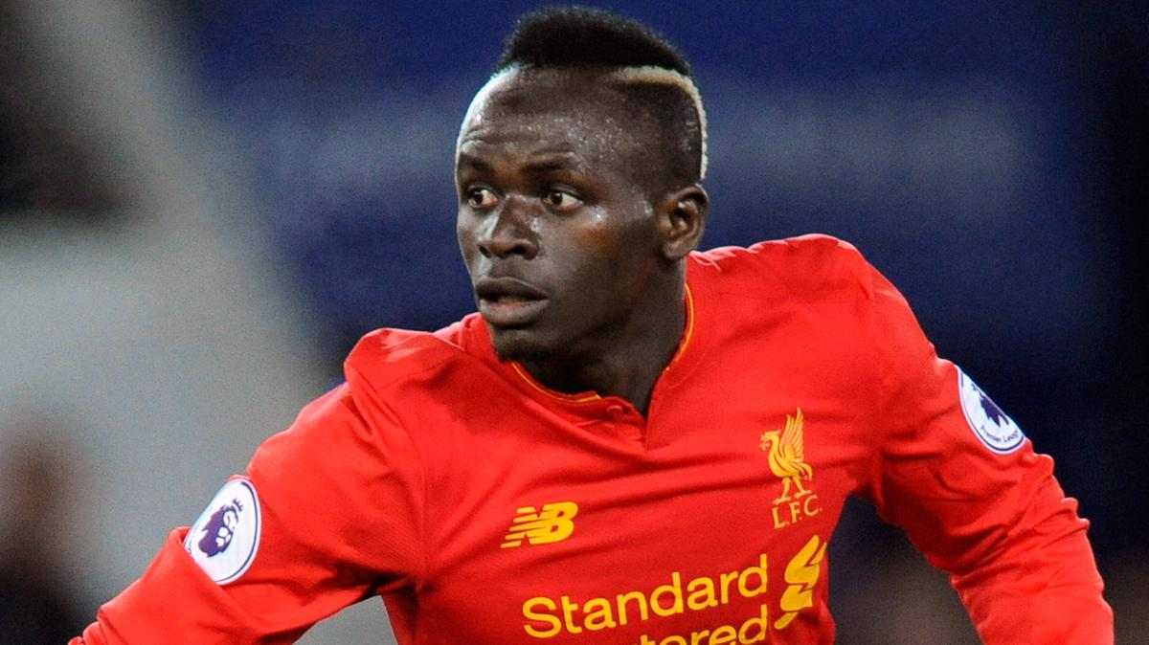
Round 2
Question 6
Sadio Mané, the Liverpool player, comes from which African country?
© Seomra Ranga 2020 www.seomraranga.com

Slide 18
Round 1 Answers
© Seomra Ranga 2020 www.seomraranga.com

Slide 19
Round 1 Answers
Question 1
Is Africa a country or a continent?
A Continent
© Seomra Ranga 2020 www.seomraranga.com

Slide 20
Round 1 Answers
Question 2
Name two African countries that begin with the letter Z.
Zambia & Zimbabwe
© Seomra Ranga 2020 www.seomraranga.com

Slide 21
Round 1 Answers
Question 3
Name the line that runs through the centre of Africa?
The Equator
© Seomra Ranga 2020 www.seomraranga.com

Slide 22
Round 1 Answers
Question 4
What is the name given to a tourist expedition to observe animals in their natural habitat in Africa?
Safari
© Seomra Ranga 2020 www.seomraranga.com

Slide 23
Round 1 Answers
Question 5
True or False: along with lions giraffes and elephants, Africa is also home to penguins.
True
© Seomra Ranga 2020 www.seomraranga.com

Slide 24
Round 1 Answers
Question 6
What is the name of the largest desert in the world, which is located in Africa?
Sahara
© Seomra Ranga 2020 www.seomraranga.com

Slide 25
Round 3
© Seomra Ranga 2020 www.seomraranga.com

Slide 26
Round 3
Question 1
How many recognised countries are there in Africa at present?
© Seomra Ranga 2020 www.seomraranga.com

Slide 27
Round 3
Question 2
What is a group of hyenas called: clan, herd, flock?
© Seomra Ranga 2020 www.seomraranga.com

Slide 28
Round 3
Question 3
What was the name given to an ancient ruler in Egypt: Tzar, Pharaoh, Emperor?
© Seomra Ranga 2020 www.seomraranga.com

Slide 29
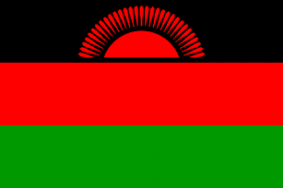
Round 3
Question 4
Of what African country is this the national flag?
© Seomra Ranga 2020 www.seomraranga.com

Slide 30
Round 3
Question 5
What is the highest mountain in Kenya?
© Seomra Ranga 2020 www.seomraranga.com

Slide 31
Round 3
Question 6
Name a famous waterfall in Africa which is one of the 7 Natural Wonders of the World?
© Seomra Ranga 2020 www.seomraranga.com

Slide 32
Round 2 Answers
© Seomra Ranga 2020 www.seomraranga.com

Slide 33
Round 2 Answers
Question 1
True or False: The Sphinx had a head of a human and the body of a lion?
True
© Seomra Ranga 2020 www.seomraranga.com

Slide 34
Round 2 Answers
Question 2
In what year was Tutankhamun’s tomb first discovered: 1892, 1922, 1942?
1922
© Seomra Ranga 2020 www.seomraranga.com

Slide 35
Round 2 Answers
Question 3
What is the name of the paper that the ancient Egyptians wrote on?
Papyrus
© Seomra Ranga 2020 www.seomraranga.com

Slide 36
Round 2 Answers
Question 4
What is the longest river in Africa?
The Nile
© Seomra Ranga 2020 www.seomraranga.com

Slide 37
Round 2 Answers
Question 5
What is the nickname of the South African rugby team, a word which means “jumping antelope”?
Springboks
© Seomra Ranga 2020 www.seomraranga.com

Slide 38
Round 2 Answers
Question 6
Sadio Mané, the Liverpool player, comes from which African country?
Senegal
© Seomra Ranga 2020 www.seomraranga.com

Slide 39
Round 4
© Seomra Ranga 2020 www.seomraranga.com

Slide 40
Round 4
Question 1
What sea separates Africa from Europe?
© Seomra Ranga 2020 www.seomraranga.com

Slide 41
Round 4
Question 2
What was the name of the vessels in which the ancient Egyptians stored human organs?
© Seomra Ranga 2020 www.seomraranga.com

Slide 42
Round 4
Question 3
What European country ruled Kenya until 1963?
© Seomra Ranga 2020 www.seomraranga.com

Slide 43
Round 4
Question 4
What is the word for “Hello” in Swahili?
© Seomra Ranga 2020 www.seomraranga.com

Slide 44
Round 4
Question 5
What is the largest country in Africa: Algeria, Libya, Angola?
© Seomra Ranga 2020 www.seomraranga.com

Slide 45
Round 4
Question 6
The European conquest for land in Africa during the 19th century was known as the “____ for Africa”: Rush, Stampede, Scramble?
© Seomra Ranga 2020 www.seomraranga.com

Slide 46
Round 3 Answers
© Seomra Ranga 2020 www.seomraranga.com

Slide 47
Round 3 Answers
Question 1
How many recognised countries are there in Africa at present?
54
© Seomra Ranga 2020 www.seomraranga.com

Slide 48
Round 3 Answers
Question 2
What is a group of hyenas called: clan, herd, flock?
Clan
© Seomra Ranga 2020 www.seomraranga.com

Slide 49
Round 3 Answers
Question 3
What was the name given to an ancient ruler in Egypt: Tzar, Pharaoh, Emperor?
Pharaoh
© Seomra Ranga 2020 www.seomraranga.com

Slide 50
Round 3 Answers
Question 4
Of what African country is this the national flag?
Malawi
© Seomra Ranga 2020 www.seomraranga.com

Slide 51
Round 3 Answers
Question 5
What is the highest mountain in Kenya?
Mount Kenya
© Seomra Ranga 2020 www.seomraranga.com

Slide 52
Round 3 Answers
Question 6
Name a famous waterfall in Africa which is one of the 7 Natural Wonders of the World?
Victoria Falls
© Seomra Ranga 2020 www.seomraranga.com

Slide 53
Round 5
© Seomra Ranga 2020 www.seomraranga.com

Slide 54
Round 5
Question 1
What is the largest mammal in the world?
© Seomra Ranga 2020 www.seomraranga.com

Slide 55
Round 5
Question 2
Unscramble the letters to find a tribe that lives in Kenya: ANKTAUR
© Seomra Ranga 2020 www.seomraranga.com

Slide 56
Round 5
Question 3
In what African country is the novel “Benny and Omar” set?
© Seomra Ranga 2020 www.seomraranga.com

Slide 57
Round 5
Question 4
What colour does the Masai tribe usually wear: blue, red, green?
© Seomra Ranga 2020 www.seomraranga.com

Slide 58
Round 5
Question 5
What is the most southerly country in Africa?
© Seomra Ranga 2020 www.seomraranga.com

Slide 59
Round 5
Question 6
What is the highest mountain in Africa?
© Seomra Ranga 2020 www.seomraranga.com

Slide 60
Round 4 Answers
© Seomra Ranga 2020 www.seomraranga.com

Slide 61
Round 4 Answers
Question 1
What sea separates Africa from Europe?
Mediterranean Sea
© Seomra Ranga 2020 www.seomraranga.com

Slide 62
Round 4 Answers
Question 2
What was the name of the vessels in which the ancient Egyptians stored human organs?
Canopic Jars
© Seomra Ranga 2020 www.seomraranga.com

Slide 63
Round 4 Answers
Question 3
What European country ruled Kenya until 1963?
United Kingdom
© Seomra Ranga 2020 www.seomraranga.com

Slide 64
Round 4 Answers
Question 4
What is the word for “Hello” in Swahili?
Jambo
© Seomra Ranga 2020 www.seomraranga.com

Slide 65
Round 4 Answers
Question 5
What is the largest country in Africa: Algeria, Libya, Angola?
Algeria
© Seomra Ranga 2020 www.seomraranga.com

Slide 66
Round 4 Answers
Question 6
The European conquest for land in Africa during the 19th century was known as the “____ for Africa”: Rush, Stampede, Scramble?
Scramble
© Seomra Ranga 2020 www.seomraranga.com

Slide 67
Round 6
© Seomra Ranga 2020 www.seomraranga.com

Slide 68
Round 6
Question 1
Zaire, Zambezi and Limpopo are all ______ in Africa: mountains, lakes, rivers?
© Seomra Ranga 2020 www.seomraranga.com

Slide 69
Round 6
Question 2
What is a group of rhinos called: school, pack, gang, trash?
© Seomra Ranga 2020 www.seomraranga.com

Slide 70
Round 6
Question 3
True or False: Africa is the largest of the continents?
© Seomra Ranga 2020 www.seomraranga.com

Slide 71
Round 6
Question 4
Name the largest lake in Africa, through which the equator passes?
© Seomra Ranga 2020 www.seomraranga.com

Slide 72
Round 6
Question 5
What is the capital of Kenya?
© Seomra Ranga 2020 www.seomraranga.com

Slide 73
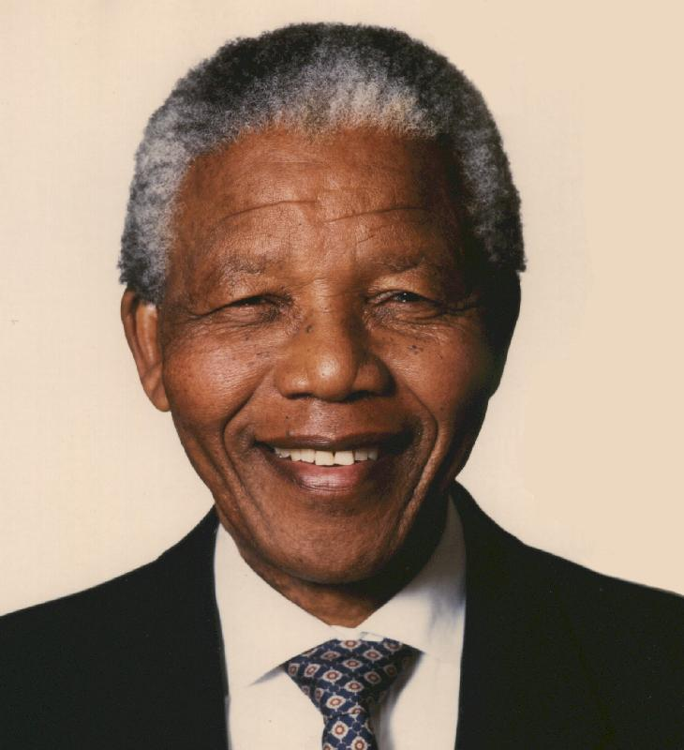
Round 6
Question 6
Name this former president of South Africa who was imprisoned for 27 years due to his opposition to apartheid?
© Seomra Ranga 2020 www.seomraranga.com

Slide 74
Round 5 Answers
© Seomra Ranga 2020 www.seomraranga.com

Slide 75
Round 5 Answers
Question 1
What is the largest mammal in the world?
African Elephant
© Seomra Ranga 2020 www.seomraranga.com

Slide 76
Round 5 Answers
Question 2
Unscramble the letters to find a tribe that lives in Kenya: ANKTAUR
Turkana
© Seomra Ranga 2020 www.seomraranga.com

Slide 77
Round 5 Answers
Question 3
In what African country is the novel “Benny and Omar” set?
Tunisia
© Seomra Ranga 2020 www.seomraranga.com

Slide 78
Round 5 Answers
Question 4
What colour does the Masai tribe usually wear: blue, red, green?
Red
© Seomra Ranga 2020 www.seomraranga.com

Slide 79
Round 5 Answers
Question 5
What is the most southerly country in Africa?
South Africa
© Seomra Ranga 2020 www.seomraranga.com

Slide 80
Round 5 Answers
Question 6
What is the highest mountain in Africa?
Mount Kilimanjaro
© Seomra Ranga 2020 www.seomraranga.com

Slide 81
Round 7
© Seomra Ranga 2020 www.seomraranga.com

Slide 82
Round 7
Question 1
True or False: The Kalahari Desert is located in the north of Africa?
© Seomra Ranga 2020 www.seomraranga.com

Slide 83
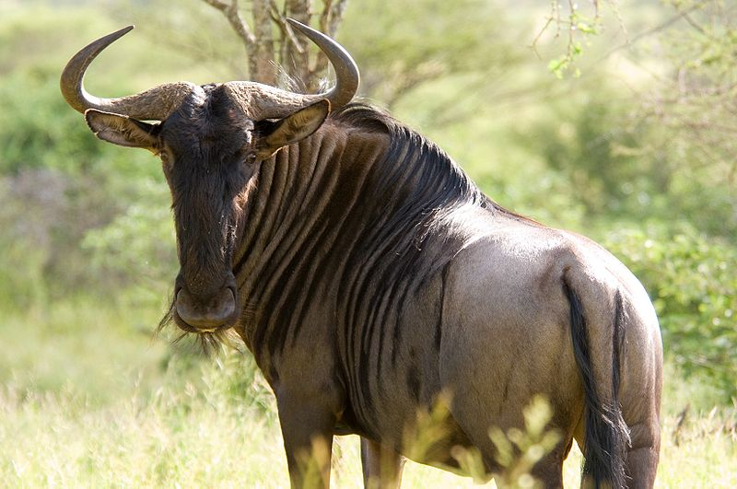
Round 7
Question 2
Name this wild animal found in Africa?
© Seomra Ranga 2020 www.seomraranga.com

Slide 84
Round 7
Question 3
What is the largest city in Africa?
© Seomra Ranga 2020 www.seomraranga.com

Slide 85
Round 7
Question 4
Where was a conference held in 1884 to establish rules for European conquest in Africa?
© Seomra Ranga 2020 www.seomraranga.com

Slide 86
Round 7
Question 5
What ocean lies to the East of Africa?
© Seomra Ranga 2020 www.seomraranga.com

Slide 87
Round 7
Question 6
Name any two African countries through which the equator passes?
© Seomra Ranga 2020 www.seomraranga.com

Slide 88
Round 6 Answers
© Seomra Ranga 2020 www.seomraranga.com

Slide 89
Round 6 Answers
Question 1
Zaire, Zambezi and Limpopo are all ______ in Africa: mountains, lakes, rivers?
Rivers
© Seomra Ranga 2020 www.seomraranga.com

Slide 90
Round 6 Answers
Question 2
What is a group of rhinos called: school, pack, gang, trash?
Trash
© Seomra Ranga 2020 www.seomraranga.com

Slide 91
Round 6 Answers
Question 3
True or False: Africa is the largest of the continents?
False (Asia is the largest)
© Seomra Ranga 2020 www.seomraranga.com

Slide 92
Round 6 Answers
Question 4
Name the largest lake in Africa, through which the equator passes?
Lake Victoria
© Seomra Ranga 2020 www.seomraranga.com

Slide 93
Round 6 Answers
Question 5
What is the capital of Kenya?
Nairobi
© Seomra Ranga 2020 www.seomraranga.com

Slide 94
Round 6 Answers
Question 6
Name this former president of South Africa who was imprisoned for 27 years due to his opposition to apartheid?
Nelson Mandela
© Seomra Ranga 2020 www.seomraranga.com

Slide 95
Round 8
© Seomra Ranga 2020 www.seomraranga.com

Slide 96
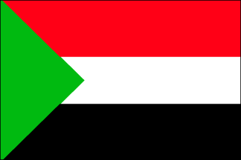
Round 8
Question 1
Of what African country is this the national flag?
© Seomra Ranga 2020 www.seomraranga.com

Slide 97
Round 8
Question 2
What do you call the kind of stone coffin used in ancient Egypt?
© Seomra Ranga 2020 www.seomraranga.com

Slide 98
Round 8
Question 3
What dance do Masai men do to “show off” to women?
© Seomra Ranga 2020 www.seomraranga.com

Slide 99
Round 8
Question 4
What is the capital of Tunisia?
© Seomra Ranga 2020 www.seomraranga.com

Slide 100
Round 8
Question 5
Unscramble the letters to discover a vast area of grassland spreading out from rainforests: HASNAVAN?
© Seomra Ranga 2020 www.seomraranga.com

Slide 101
Round 8
Question 6
What is the largest reptile found in Africa?
© Seomra Ranga 2020 www.seomraranga.com

Slide 102
Round 7 Answers
© Seomra Ranga 2020 www.seomraranga.com

Slide 103
Round 7 Answers
Question 1
True or False: The Kalahari Desert is located in the north of Africa?
False
© Seomra Ranga 2020 www.seomraranga.com

Slide 104
Round 7 Answers
Question 2
Name this wild animal found in Africa?
Wildebeest
© Seomra Ranga 2020 www.seomraranga.com

Slide 105
Round 7 Answers
Question 3
What is the largest city in Africa?
Lagos (in Nigeria)
© Seomra Ranga 2020 www.seomraranga.com

Slide 106
Round 7 Answers
Question 4
Where was a conference held in 1884 to establish rules for European conquest in Africa?
Berlin
© Seomra Ranga 2020 www.seomraranga.com

Slide 107
Round 7 Answers
Question 5
What ocean lies to the East of Africa?
Indian Ocean
© Seomra Ranga 2020 www.seomraranga.com

Slide 108
Round 7 Answers
Question 6
Name any two African countries through which the equator passes?
Rep. of Congo, D.R. of Congo, Uganda, Kenya, Somalia, Gabon, Saõ Tomé & Principé
© Seomra Ranga 2020 www.seomraranga.com

Slide 109
Round 8 Answers
© Seomra Ranga 2020 www.seomraranga.com

Slide 110
Round 8 Answers
Question 1
Of what African country is this the national flag?
Sudan
© Seomra Ranga 2020 www.seomraranga.com

Slide 111
Round 8 Answers
Question 2
What do you call the kind of stone coffin used in ancient Egypt?
Sarcophagus
© Seomra Ranga 2020 www.seomraranga.com

Slide 112
Round 8 Answers
Question 3
What dance do Masai men do to “show off” to women?
Jumping Dance
© Seomra Ranga 2020 www.seomraranga.com

Slide 113
Round 8 Answers
Question 4
What is the capital of Tunisia?
Tunis
© Seomra Ranga 2020 www.seomraranga.com

Slide 114
Round 8 Answers
Question 5
Unscramble the letters to discover a vast area of grassland spreading out from rainforests: HASNAVAN?
Savannah
© Seomra Ranga 2020 www.seomraranga.com

Slide 115
Round 8 Answers
Question 6
What is the largest reptile found in Africa?
Nile Crocodile
© Seomra Ranga 2020 www.seomraranga.com

Slide 116
Tie-Break Round
© Seomra Ranga 2020 www.seomraranga.com

Slide 117
Tie-Break Round
Question 1
What is the smallest country in Africa?
© Seomra Ranga 2020 www.seomraranga.com

Slide 118
Tie-Break Round
Question 2
What was the name of the island on which Nelson Mandela was imprisoned for 27 years?
© Seomra Ranga 2020 www.seomraranga.com

Slide 119
Tie-Break Round
Question 3
What is the most common language spoken in Africa: English, Swahili, Yoruba or Zulu?
© Seomra Ranga 2020 www.seomraranga.com

Slide 120
Tie-Break Round
Question 4
What is the name given to the system of writing used by the ancient Egyptians?
© Seomra Ranga 2020 www.seomraranga.com

Slide 121
Tie-Break Round
Question 5
What is the name of the canal which runs through Africa and links the Mediterranean Sea to the Red Sea?
© Seomra Ranga 2020 www.seomraranga.com

Slide 122
Tie-Break Round
Question 6
South Africa has three capital cities. Name two of them.
© Seomra Ranga 2020 www.seomraranga.com

Slide 123
Tie-Break Round Answers
© Seomra Ranga 2020 www.seomraranga.com

Slide 124
Tie-Break Answers
Question 1
What is the smallest country in Africa?
Seychelles
© Seomra Ranga 2020 www.seomraranga.com

Slide 125
Tie-Break Answers
Question 2
What was the name of the island on which Nelson Mandela was imprisoned for 27 years?
Robben Island
© Seomra Ranga 2020 www.seomraranga.com

Slide 126
Tie-Break Answers
Question 3
What is the most common language spoken in Africa: English, Swahili, Yoruba or Zulu?
Swahili
© Seomra Ranga 2020 www.seomraranga.com

Slide 127
Tie-Break Answers
Question 4
What is the name given to the system of writing used by the ancient Egyptians?
Hieroglyphics
© Seomra Ranga 2020 www.seomraranga.com

Slide 128
Tie-Break Answers
Question 5
What is the name of the canal which runs through Africa and links the Mediterranean Sea to the Red Sea?
Suez Canal
© Seomra Ranga 2020 www.seomraranga.com

Slide 129
Tie-Break Answers
Question 6
South Africa has three capital cities. Name two of them.
Pretoria, Cape Town, Bloemfontein
© Seomra Ranga 2020 www.seomraranga.com

Slide 130
Hope you all enjoyed the quiz!
© Seomra Ranga 2020 www.seomraranga.com

Slide 131
Acknowledgements:
Background Template from : prezentr.com
Thanks to my colleagues for help in compiling questions for this quiz
© Seomra Ranga 2020 www.seomraranga.com

