Slide 1


Seachtain na Gaeilge 2020
Tráth na gCeist
© Seomra Ranga 2020 www.seomraranga.com

Slide 2
Ar dTús ….
Scríobh uimhir d’fhoireann ar gach bileog freagartha
Scríobh uimhir gach babhta 1-8 ar gach bileog freagartha
Déan iarracht na freagraí a scríobh as Gaeilge
Ná scread amach na freagraí – bígí ciúin
Bainigí taitneamh as!
© Seomra Ranga 2020 www.seomraranga.com

Slide 3
Bígí réidh anois …..
© Seomra Ranga 2020 www.seomraranga.com

Slide 4
Go n-éirí an t-ádh libh!
© Seomra Ranga 2020 www.seomraranga.com

Slide 5
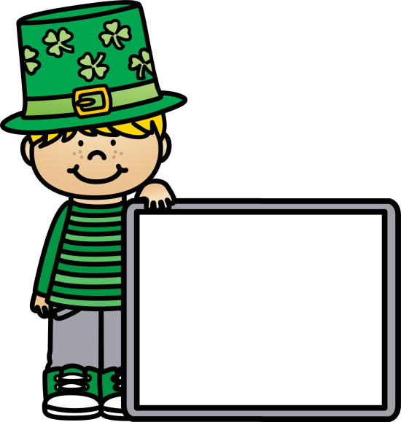
Babhta 1
© Seomra Ranga 2020 www.seomraranga.com

Slide 6
Babhta 1
Ceist 1
Cad a chuireann tú ar Cornflakes, Weetabix nó Coco Pops ag am bricfeasta gach maidin?
© Seomra Ranga 2020 www.seomraranga.com

Slide 7
Babhta 1
Ceist 2
Cén sórt ainmhí í Minnie?
© Seomra Ranga 2020 www.seomraranga.com

Slide 8

Babhta 1
Ceist 3
Tá an cailín ag ______.
© Seomra Ranga 2020 www.seomraranga.com

Slide 9
Babhta 1
Ceist 4
Cén dath atá ar phréachán?
© Seomra Ranga 2020 www.seomraranga.com

Slide 10
Babhta 1
Ceist 5
Cé a chan an t-amhrán “Nice to Meet Ya”?
© Seomra Ranga 2020 www.seomraranga.com

Slide 11
Babhta 1
Ceist 6
Cé mhéad contae atá i gCúige Mumhan?
© Seomra Ranga 2020 www.seomraranga.com

Slide 12
Babhta 2
© Seomra Ranga 2020 www.seomraranga.com

Slide 13
Babhta 2
Ceist 1
Sa scéal Cinderella, cé mhéad deirfiúr a bhí aici?
© Seomra Ranga 2020 www.seomraranga.com

Slide 14
Babhta 2
Ceist 2
An bhfuil sé fuar nó te in oigheann?
© Seomra Ranga 2020 www.seomraranga.com

Slide 15
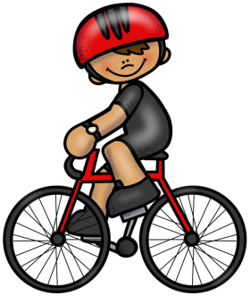
Babhta 2
Ceist 3
Cad atá an buachaill ag déanamh?
© Seomra Ranga 2020 www.seomraranga.com

Slide 16
Babhta 2
Ceist 4
Cén mí a thagann tar éis mí Lúnasa?
© Seomra Ranga 2020 www.seomraranga.com

Slide 17

Babhta 2
Ceist 5
Cad iad seo?
© Seomra Ranga 2020 www.seomraranga.com

Slide 18
Babhta 2
Ceist 6
Tá naoi saol ag cineál ainmhí amháin, cén t-ainmhí?
© Seomra Ranga 2020 www.seomraranga.com

Slide 19
Babhta 1 Freagraí
© Seomra Ranga 2020 www.seomraranga.com

Slide 20
Babhta 1 Freagraí
Ceist 1
Cad a chuireann tú ar Cornflakes, Weetabix nó Coco Pops ag am bricfeasta gach maidin?
Bainne
© Seomra Ranga 2020 www.seomraranga.com

Slide 21
Babhta 1 Freagraí
Ceist 2
Cén sórt ainmhí í Minnie?
Luch
© Seomra Ranga 2020 www.seomraranga.com

Slide 22

Babhta 1 Freagraí
Ceist 3
Tá an cailín ag ______.
Ag Snámh
© Seomra Ranga 2020 www.seomraranga.com

Slide 23
Babhta 1 Freagraí
Ceist 4
Cén dath atá ar phréachán?
Dubh
© Seomra Ranga 2020 www.seomraranga.com

Slide 24
Babhta 1 Freagraí
Ceist 5
Cé a chan an t-amhrán “Nice to Meet Ya”?
Niall Ó Hóráin
© Seomra Ranga 2020 www.seomraranga.com

Slide 25
Babhta 1 Freagraí
Ceist 6
Cé mhéad contae atá i gCúige Mumhan?
Sé (6)
© Seomra Ranga 2020 www.seomraranga.com

Slide 26
Babhta 3
© Seomra Ranga 2020 www.seomraranga.com

Slide 27
Babhta 3
Ceist 1
Cé mhéad cos atá ag capall?
© Seomra Ranga 2020 www.seomraranga.com

Slide 28
Babhta 3
Ceist 2
Cén chuid den chorp ar a gcaitear slipéir?
© Seomra Ranga 2020 www.seomraranga.com

Slide 29
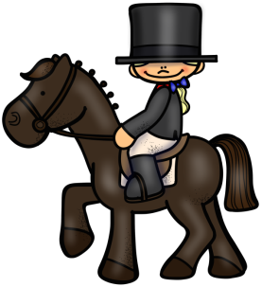
Babhta 3
Ceist 3
Cad atá á dhéanamh ag an gcailín?
© Seomra Ranga 2020 www.seomraranga.com

Slide 30
Babhta 3
Ceist 4
Shane, Kian, Mark, Nicky – ainmnigh an grúpa ceoil.
© Seomra Ranga 2020 www.seomraranga.com

Slide 31
Babhta 3
Ceist 5
Cad iad na dathanna atá ar bhrat na Fraince?
© Seomra Ranga 2020 www.seomraranga.com

Slide 32
Babhta 3
Ceist 6
Cén spórt a imríonn Shane Lowry?
© Seomra Ranga 2020 www.seomraranga.com

Slide 33
Babhta 2 Freagraí
© Seomra Ranga 2020 www.seomraranga.com

Slide 34
Babhta 2 Freagraí
Ceist 1
Sa scéal Cinderella, cé mhéad deirfiúr a bhí aici?
Beirt
© Seomra Ranga 2020 www.seomraranga.com

Slide 35
Babhta 2 Freagraí
Ceist 2
An bhfuil sé fuar nó te in oigheann?
Te
© Seomra Ranga 2020 www.seomraranga.com

Slide 36
Babhta 2 Freagraí
Ceist 3
Cad atá an buachaill ag déanamh?
Ag Rothaíocht
© Seomra Ranga 2020 www.seomraranga.com

Slide 37
Babhta 2 Freagraí
Ceist 4
Cén mí a thagann tar éis mí Lúnasa?
Meán Fómhair
© Seomra Ranga 2020 www.seomraranga.com

Slide 38

Babhta 2 Freagraí
Ceist 5
Cad iad seo?
Spéaclaí Gréine
© Seomra Ranga 2020 www.seomraranga.com

Slide 39
Babhta 2 Freagraí
Ceist 6
Tá naoi saol ag cineál ainmhí amháin, cén t-ainmhí?
Cat
© Seomra Ranga 2020 www.seomraranga.com

Slide 40
Babhta 4
© Seomra Ranga 2020 www.seomraranga.com

Slide 41
Babhta 4
Ceist 1
Cén spórt a imríonn Venus Williams agus a deirfiúr Serena?
© Seomra Ranga 2020 www.seomraranga.com

Slide 42
Babhta 4
Ceist 2
Cad a chuir eagla ar Little Miss Muffet?
© Seomra Ranga 2020 www.seomraranga.com

Slide 43

Babhta 4
Ceist 3
Cad atá á dhéanamh ag an mbuachaill?
© Seomra Ranga 2020 www.seomraranga.com

Slide 44
Babhta 4
Ceist 4
Muc – banbh
Bó – lao
Capall - ?
© Seomra Ranga 2020 www.seomraranga.com

Slide 45
Babhta 4
Ceist 5
Scríobh an uimhir seo: dhá mhíle, seacht gcéad, caoga a trí.
© Seomra Ranga 2020 www.seomraranga.com

Slide 46
Babhta 4
Ceist 6
Cé hí láithreoir “Operation Transformation” ar RTÉ 1?
© Seomra Ranga 2020 www.seomraranga.com

Slide 47
Babhta 3 Freagraí
© Seomra Ranga 2020 www.seomraranga.com

Slide 48
Babhta 3 Freagraí
Ceist 1
Cé mhéad cos atá ag capall?
Ceithre (4)
© Seomra Ranga 2020 www.seomraranga.com

Slide 49
Babhta 3 Freagraí
Ceist 2
Cén chuid den chorp ar a gcaitear slipéir?
Cosa
© Seomra Ranga 2020 www.seomraranga.com

Slide 50
Babhta 3 Freagraí
Ceist 3
Cad atá á dhéanamh ag an gcailín?
Ag Marcaíocht
© Seomra Ranga 2020 www.seomraranga.com

Slide 51
Babhta 3 Freagraí
Ceist 4
Shane, Kian, Mark, Nicky – ainmnigh an grúpa ceoil.
Westlife
© Seomra Ranga 2020 www.seomraranga.com

Slide 52
Babhta 3 Freagraí
Ceist 5
Cad iad na dathanna atá ar bhrat na Fraince?
Gorm, Bán, Dearg
© Seomra Ranga 2020 www.seomraranga.com

Slide 53
Babhta 3 Freagraí
Ceist 6
Cén spórt a imríonn Shane Lowry?
Galf
© Seomra Ranga 2020 www.seomraranga.com

Slide 54
Babhta 5
© Seomra Ranga 2020 www.seomraranga.com

Slide 55
Babhta 5
Ceist 1
Cén mhí ina mbíonn Lá Fhéile Bríde?
© Seomra Ranga 2020 www.seomraranga.com

Slide 56
Babhta 5
Ceist 2
Cén cathair ina bhfuil an Empire State Building?
© Seomra Ranga 2020 www.seomraranga.com

Slide 57
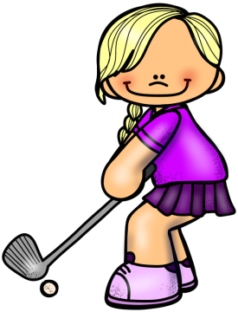
Babhta 5
Ceist 3
Cad atá á dhéanamh ag an gcailín?
© Seomra Ranga 2020 www.seomraranga.com

Slide 58
Babhta 5
Ceist 4
Mamaí – Daidí
Mamó - ?
© Seomra Ranga 2020 www.seomraranga.com

Slide 59
Babhta 5
Ceist 5
Ainmnigh an sobaldráma ar RTÉ 1 atá suite in An Charraig (Carrigstown)?
© Seomra Ranga 2020 www.seomraranga.com

Slide 60
Babhta 5
Ceist 6
Cé hé príomhcheannaire (Taoiseach) an UK?
© Seomra Ranga 2020 www.seomraranga.com

Slide 61
Babhta 4 Freagraí
© Seomra Ranga 2020 www.seomraranga.com

Slide 62
Babhta 4 Freagraí
Ceist 1
Cén spórt a imríonn Venus Williams agus a deirfiúr Serena?
Leadóg
© Seomra Ranga 2020 www.seomraranga.com

Slide 63
Babhta 4 Freagraí
Ceist 2
Cad a chuir eagla ar Little Miss Muffet?
Damhán Alla
© Seomra Ranga 2020 www.seomraranga.com

Slide 64
Babhta 4 Freagraí
Ceist 3
Cad atá á dhéanamh ag an mbuachaill?
Ag bádóireacht /
Ag seoltóireacht
© Seomra Ranga 2020 www.seomraranga.com

Slide 65
Babhta 4 Freagraí
Ceist 4
Muc – banbh
Bó – lao
Capall - ?
Searrach
© Seomra Ranga 2020 www.seomraranga.com

Slide 66
Babhta 4 Freagraí
Ceist 5
Scríobh an uimhir seo: dhá mhíle, seacht gcéad, caoga a trí.
2,753
© Seomra Ranga 2020 www.seomraranga.com

Slide 67
Babhta 4 Freagraí
Ceist 6
Cé hí láithreoir “Operation Transformation” ar RTÉ 1?
Kathryn Thomas
© Seomra Ranga 2020 www.seomraranga.com

Slide 68
Babhta 6
© Seomra Ranga 2020 www.seomraranga.com

Slide 69
Babhta 6
Ceist 1
Ainmnigh an clár teilifíse “Young ____” atá bunaithe ar carachtar ón “Big Bang Theory”?
© Seomra Ranga 2020 www.seomraranga.com

Slide 70
Babhta 6
Ceist 2
Sa Scannán “Paddington”, cén sórt ainmhí é Paddington?
© Seomra Ranga 2020 www.seomraranga.com

Slide 71
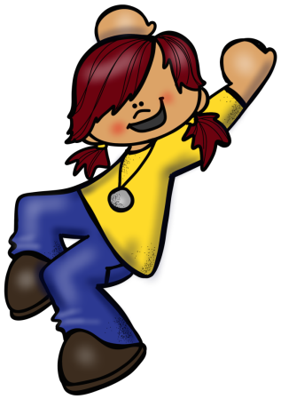
Babhta 6
Ceist 3
Cad atá an cailín ag déanamh?
© Seomra Ranga 2020 www.seomraranga.com

Slide 72
Babhta 6
Ceist 4
Is é Jay-Z m’fhear céile. Tá cúpla againn darb ainm Rumi agus Sir. Cé mise?
© Seomra Ranga 2020 www.seomraranga.com

Slide 73
Babhta 6
Ceist 5
Críochnaigh an seanfhocal: “Aithníonn ciaróg ______ eile”.
© Seomra Ranga 2020 www.seomraranga.com

Slide 74
Babhta 6
Ceist 6
An bhfuil eireaball ar na cait ar Oileán Mhanann?
© Seomra Ranga 2020 www.seomraranga.com

Slide 75
Babhta 5 Freagraí
© Seomra Ranga 2020 www.seomraranga.com

Slide 76
Babhta 5 Freagraí
Ceist 1
Cén mhí ina mbíonn Lá Fhéile Bríde?
Feabhra
© Seomra Ranga 2020 www.seomraranga.com

Slide 77
Babhta 5 Freagraí
Ceist 2
Cén cathair ina bhfuil an Empire State Building?
Nua-Eabhrac
© Seomra Ranga 2020 www.seomraranga.com

Slide 78
Babhta 5 Freagraí
Ceist 3
Cad atá á dhéanamh ag an gcailín?
Ag imirt gailf
© Seomra Ranga 2020 www.seomraranga.com

Slide 79
Babhta 5 Freagraí
Ceist 4
Mamaí – Daidí
Mamó - ?
Daideo
© Seomra Ranga 2020 www.seomraranga.com

Slide 80
Babhta 5 Freagraí
Ceist 5
Ainmnigh an sobaldráma ar RTÉ atá suite in An Charraig (Carrigstown)?
Fair City
© Seomra Ranga 2020 www.seomraranga.com

Slide 81
Babhta 5 Freagraí
Ceist 6
Cé hé príomhcheannaire (Taoiseach) an UK?
Boris Johnson
© Seomra Ranga 2020 www.seomraranga.com

Slide 82
Babhta 7
© Seomra Ranga 2020 www.seomraranga.com

Slide 83
Babhta 7
Ceist 1
Cén dath atá ar seamróg?
© Seomra Ranga 2020 www.seomraranga.com

Slide 84
Babhta 7
Ceist 2
Fúm, fút, ____, fúithi, fúinn, fúibh, fúthu.
© Seomra Ranga 2020 www.seomraranga.com

Slide 85
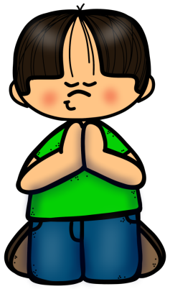
Babhta 7
Ceist 3
Cad atá an buachaill ag déanamh?
© Seomra Ranga 2020 www.seomraranga.com

Slide 86
Babhta 7
Ceist 4
Cén seomra sa teach ina mbíonn cithfholcadán, de ghnáth?
© Seomra Ranga 2020 www.seomraranga.com

Slide 87
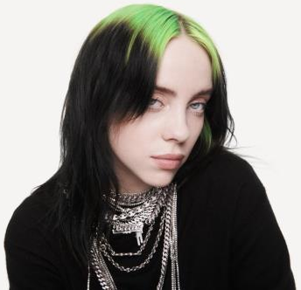
Babhta 7
Ceist 5
Cé hí seo?
© Seomra Ranga 2020 www.seomraranga.com

Slide 88
Babhta 7
Ceist 6
Ainmnigh an víreas a thosaigh sa tSín i mbliana?
© Seomra Ranga 2020 www.seomraranga.com

Slide 89
Babhta 6 Freagraí
© Seomra Ranga 2020 www.seomraranga.com

Slide 90
Babhta 6 Freagraí
Ceist 1
Ainmnigh an clár teilifíse “Young ____” atá bunaithe ar carachtar ón “Big Bang Theory”?
Sheldon
© Seomra Ranga 2020 www.seomraranga.com

Slide 91
Babhta 6 Freagraí
Ceist 2
Sa Scannán “Paddington”, cén sórt ainmhí é Paddington?
Béar
© Seomra Ranga 2020 www.seomraranga.com

Slide 92

Babhta 6 Freagraí
Ceist 3
Cad atá an cailín ag déanamh?
Ag Damhsa
© Seomra Ranga 2020 www.seomraranga.com

Slide 93
Babhta 6 Freagraí
Ceist 4
Is é Jay-Z m’fhear céile. Tá cúpla againn darb ainm Rumi agus Sir. Cé mise?
Beyonce
© Seomra Ranga 2020 www.seomraranga.com

Slide 94
Babhta 6 Freagraí
Ceist 5
Críochnaigh an seanfhocal: “Aithníonn ciaróg ______ eile”.
Ciaróg
© Seomra Ranga 2020 www.seomraranga.com

Slide 95
Babhta 6 Freagraí
Ceist 6
An bhfuil eireaball ar na cait ar Oileán Mhanann?
Níl
© Seomra Ranga 2020 www.seomraranga.com

Slide 96
Babhta 8
© Seomra Ranga 2020 www.seomraranga.com

Slide 97
Babhta 8
Ceist 1
Cén dath atá ar thacsaí i Londain?
© Seomra Ranga 2020 www.seomraranga.com

Slide 98
Babhta 8
Ceist 2
Cad is gnáthainm ar an siombal H₂O?
© Seomra Ranga 2020 www.seomraranga.com

Slide 99
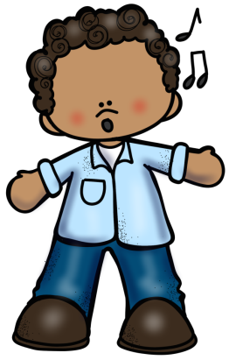
Babhta 8
Ceist 3
Cad atá á dhéanamh ag an mbuachaill?
© Seomra Ranga 2020 www.seomraranga.com

Slide 100
Babhta 8
Ceist 4
Nuair a meascann tú an dath dearg leis an ndath buí, cén dath a fhaigheann tú?
© Seomra Ranga 2020 www.seomraranga.com

Slide 101

Babhta 8
Ceist 5
Cad é seo?
© Seomra Ranga 2020 www.seomraranga.com

Slide 102
Babhta 8
Ceist 6
Cé a scríobh na leabhair “Diary of a Wimpy Kid”?
© Seomra Ranga 2020 www.seomraranga.com

Slide 103
Babhta 7 Freagraí
© Seomra Ranga 2020 www.seomraranga.com

Slide 104
Babhta 7 Freagraí
Ceist 1
Cén dath atá ar seamróg?
Glas
© Seomra Ranga 2020 www.seomraranga.com

Slide 105
Babhta 7 Freagraí
Ceist 2
Fúm, fút, ____, fúithi, fúinn, fúibh, fúthu.
Faoi
© Seomra Ranga 2020 www.seomraranga.com

Slide 106
Babhta 7 Freagraí
Ceist 3
Cad atá an buachaill ag déanamh?
Ag Guí
© Seomra Ranga 2020 www.seomraranga.com

Slide 107
Babhta 7 Freagraí
Ceist 4
Cén seomra sa teach ina mbíonn cithfholcadán, de ghnáth?
Seomra Folctha
© Seomra Ranga 2020 www.seomraranga.com

Slide 108
Babhta 7 Freagraí
Ceist 5
Cé hí seo?
Billie Eilish
© Seomra Ranga 2020 www.seomraranga.com

Slide 109
Babhta 7 Freagraí
Ceist 6
Ainmnigh an víreas a thosaigh sa tSín i mbliana?
Coronavirus (Covid 19)
© Seomra Ranga 2020 www.seomraranga.com

Slide 110
Babhta 8 Freagraí
© Seomra Ranga 2020 www.seomraranga.com

Slide 111
Babhta 8 Freagraí
Ceist 1
Cén dath atá ar thacsaí i Londain?
Dubh
© Seomra Ranga 2020 www.seomraranga.com

Slide 112
Babhta 8 Freagraí
Ceist 2
Cad is gnáthainm ar an siombal H₂O?
Uisce
© Seomra Ranga 2020 www.seomraranga.com

Slide 113
Babhta 8 Freagraí
Ceist 3
Cad atá á dhéanamh ag an mbuachaill?
Ag canadh
© Seomra Ranga 2020 www.seomraranga.com

Slide 114
Babhta 8 Freagraí
Ceist 4
Nuair a meascann tú an dath dearg leis an dath buí, cén dath a fhaigheann tú?
Oráiste
© Seomra Ranga 2020 www.seomraranga.com

Slide 115
Babhta 8 Freagraí
Ceist 5
Cad é seo?
Fón Póca
© Seomra Ranga 2020 www.seomraranga.com

Slide 116
Babhta 8 Freagraí
Ceist 6
Cé a scríobh na leabhair “Diary of a Wimpy Kid”?
Jeff Kinney
© Seomra Ranga 2020 www.seomraranga.com

Slide 117
Babhta Réitigh
© Seomra Ranga 2020 www.seomraranga.com

Slide 118
Babhta Réitigh
Ceist 1
Cé a chónaíonn in Áras an Uachtaráin?
© Seomra Ranga 2020 www.seomraranga.com

Slide 119
Babhta Réitigh
Ceist 2
Cé a cheap an teileafón?
© Seomra Ranga 2020 www.seomraranga.com

Slide 120

Babhta Réitigh
Ceist 3
Cad atá á dhéanamh ag an gcailín?
© Seomra Ranga 2020 www.seomraranga.com

Slide 121
Babhta Réitigh
Ceist 4
Cé mhéad lá atá i mbliain bhisigh?
© Seomra Ranga 2020 www.seomraranga.com

Slide 122
Babhta Réitigh
Ceist 5
Cén tír ina bhfásann an méid is mó caife ar domhain?
© Seomra Ranga 2020 www.seomraranga.com

Slide 123
Babhta Réitigh
Ceist 6
Cén t-aigéan atá idir an Aifric agus an Meiriceá Theas?
© Seomra Ranga 2020 www.seomraranga.com

Slide 124
Babhta Réitigh Freagraí
© Seomra Ranga 2020 www.seomraranga.com

Slide 125
Babhta Réitigh Freagraí
Ceist 1
Cé a chónaíonn in Áras an Uachtaráin?
Micheál D. Ó hUigín
© Seomra Ranga 2020 www.seomraranga.com

Slide 126
Babhta Réitigh Freagraí
Ceist 2
Cé a cheap an teileafón?
Alexander Graham Bell
© Seomra Ranga 2020 www.seomraranga.com

Slide 127
Babhta Réitigh Freagraí
Ceist 3
Cad atá á dhéanamh ag an gcailín?
Ag dornálaíocht
© Seomra Ranga 2020 www.seomraranga.com

Slide 128
Babhta Réitigh Freagraí
Ceist 4
Cé mhéad lá atá i mbliain bhisigh?
366
© Seomra Ranga 2020 www.seomraranga.com

Slide 129
Babhta Réitigh Freagraí
Ceist 5
Cén tír ina bhfásann an méid is mó caife ar domhain?
An Bhrasaíl
© Seomra Ranga 2020 www.seomraranga.com

Slide 130
Babhta Réitigh Freagraí
Ceist 6
Cén t-aigéan atá idir an Aifric agus an Meiriceá Theas?
An tAtlantach
© Seomra Ranga 2020 www.seomraranga.com

Slide 131
Tá súil againn gur bhain sibh taitneamh as na ceisteanna.
© Seomra Ranga 2020 www.seomraranga.com

Slide 132
Slán agus beannacht
© Seomra Ranga 2020 www.seomraranga.com

Slide 133




Úsáidtear íomhánna sa chomad seo ó:
https://www.teacherspayteachers.com/Store/Whimsy-Clips
https://www.teacherspayteachers.com/Store/Educlips
https://www.teacherspayteachers.com/Store/Krista-Wallden-Creative-Clips
https://depositphotos.com/
© Seomra Ranga 2020 www.seomraranga.com

