Slide 1
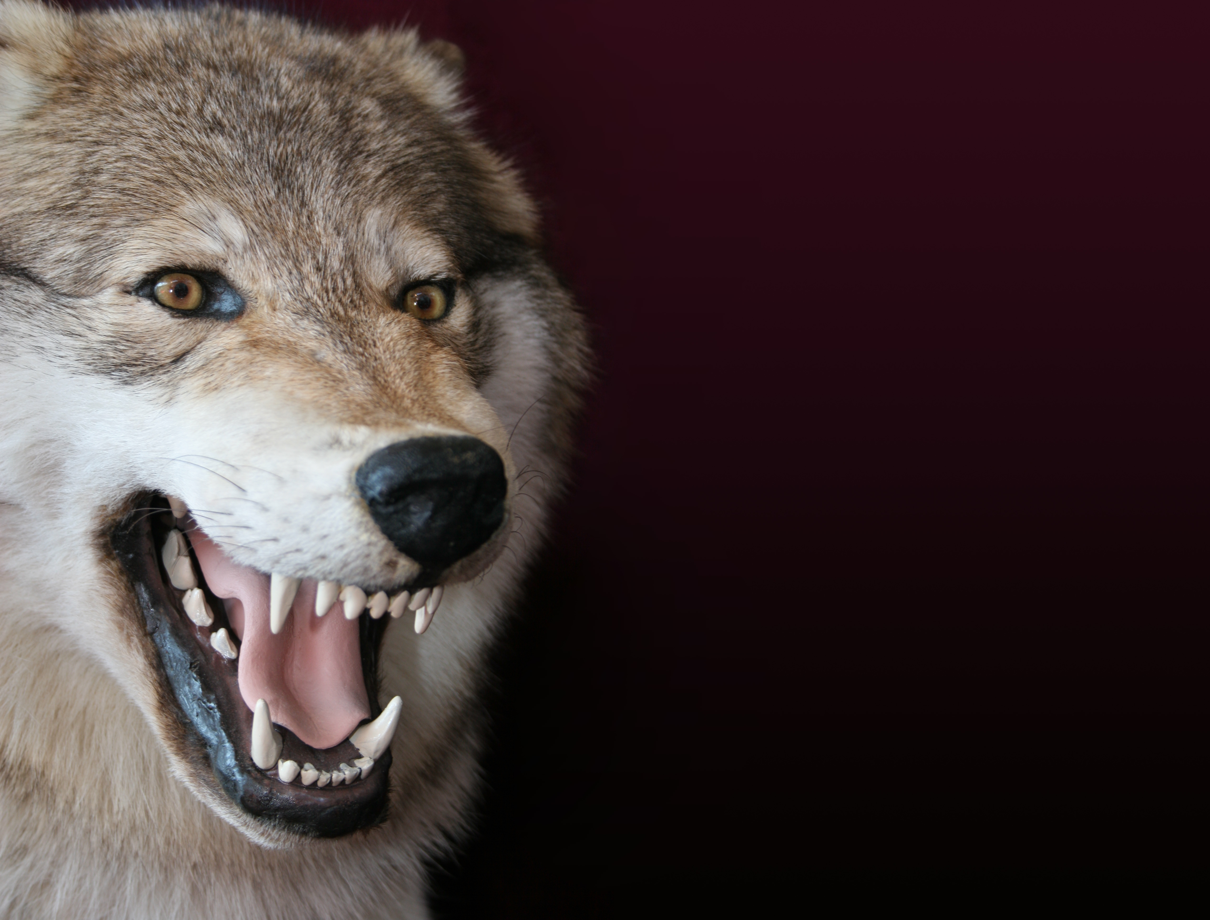

The Wolf
© Seomra Ranga 2019 www.seomraranga.com

Slide 2
The Wolf
A wolf is a member of the dog family. It looks a bit like a German Shepherd dog. Wolves can be found in Asia, Europe and North America, although they are now extinct in Ireland and England.
2
© Seomra Ranga 2019 www.seomraranga.com

Slide 3
The Wolf
Adult male wolves can grow up to 35-55Kg in weight and up to two metres in length (including the tail). Female wolves are usually smaller than this.
3
© Seomra Ranga 2019 www.seomraranga.com

Slide 4
The Wolf
Wolves are excellent hunters – their sense of sight, hearing and smell help them when they are hunting. Wolves will hunt for almost any animal that they can find.
4
© Seomra Ranga 2019 www.seomraranga.com

Slide 5
The Wolf
Wolves live and hunt in groups called packs. Most packs have about eight members but some have more than that. They hunt at any time for food, but they usually hunt at night.
5
© Seomra Ranga 2019 www.seomraranga.com

Slide 6
The Wolf
Wolves are territorial which means that they like to stay in a particular area. They will not allow other animals in their area and will fight away any intruders.
6
© Seomra Ranga 2019 www.seomraranga.com

Slide 7
The Wolf
Wolves live in a sheltered area called a den. The female wolf gives birth to one to eleven pups in the den. The pups leave the den when they are about two months old.
7
© Seomra Ranga 2019 www.seomraranga.com

Slide 8
The Wolf
Wolves are known to howl loudly, usually to scare away other animals. Although people fear wolves, they will rarely approach human beings.
8
© Seomra Ranga 2019 www.seomraranga.com

Slide 9


Resources used in this file from:
https://www.teacherspayteachers.com/Store/Hello-Literacy
https://depositphotos.com/
Information sourced from:
"Wolf." World Book Kids, World Book, 2020, www.worldbookonline.com/kids/home#article/ar832203. Accessed 05 Jan. 2020.

