Slide 1
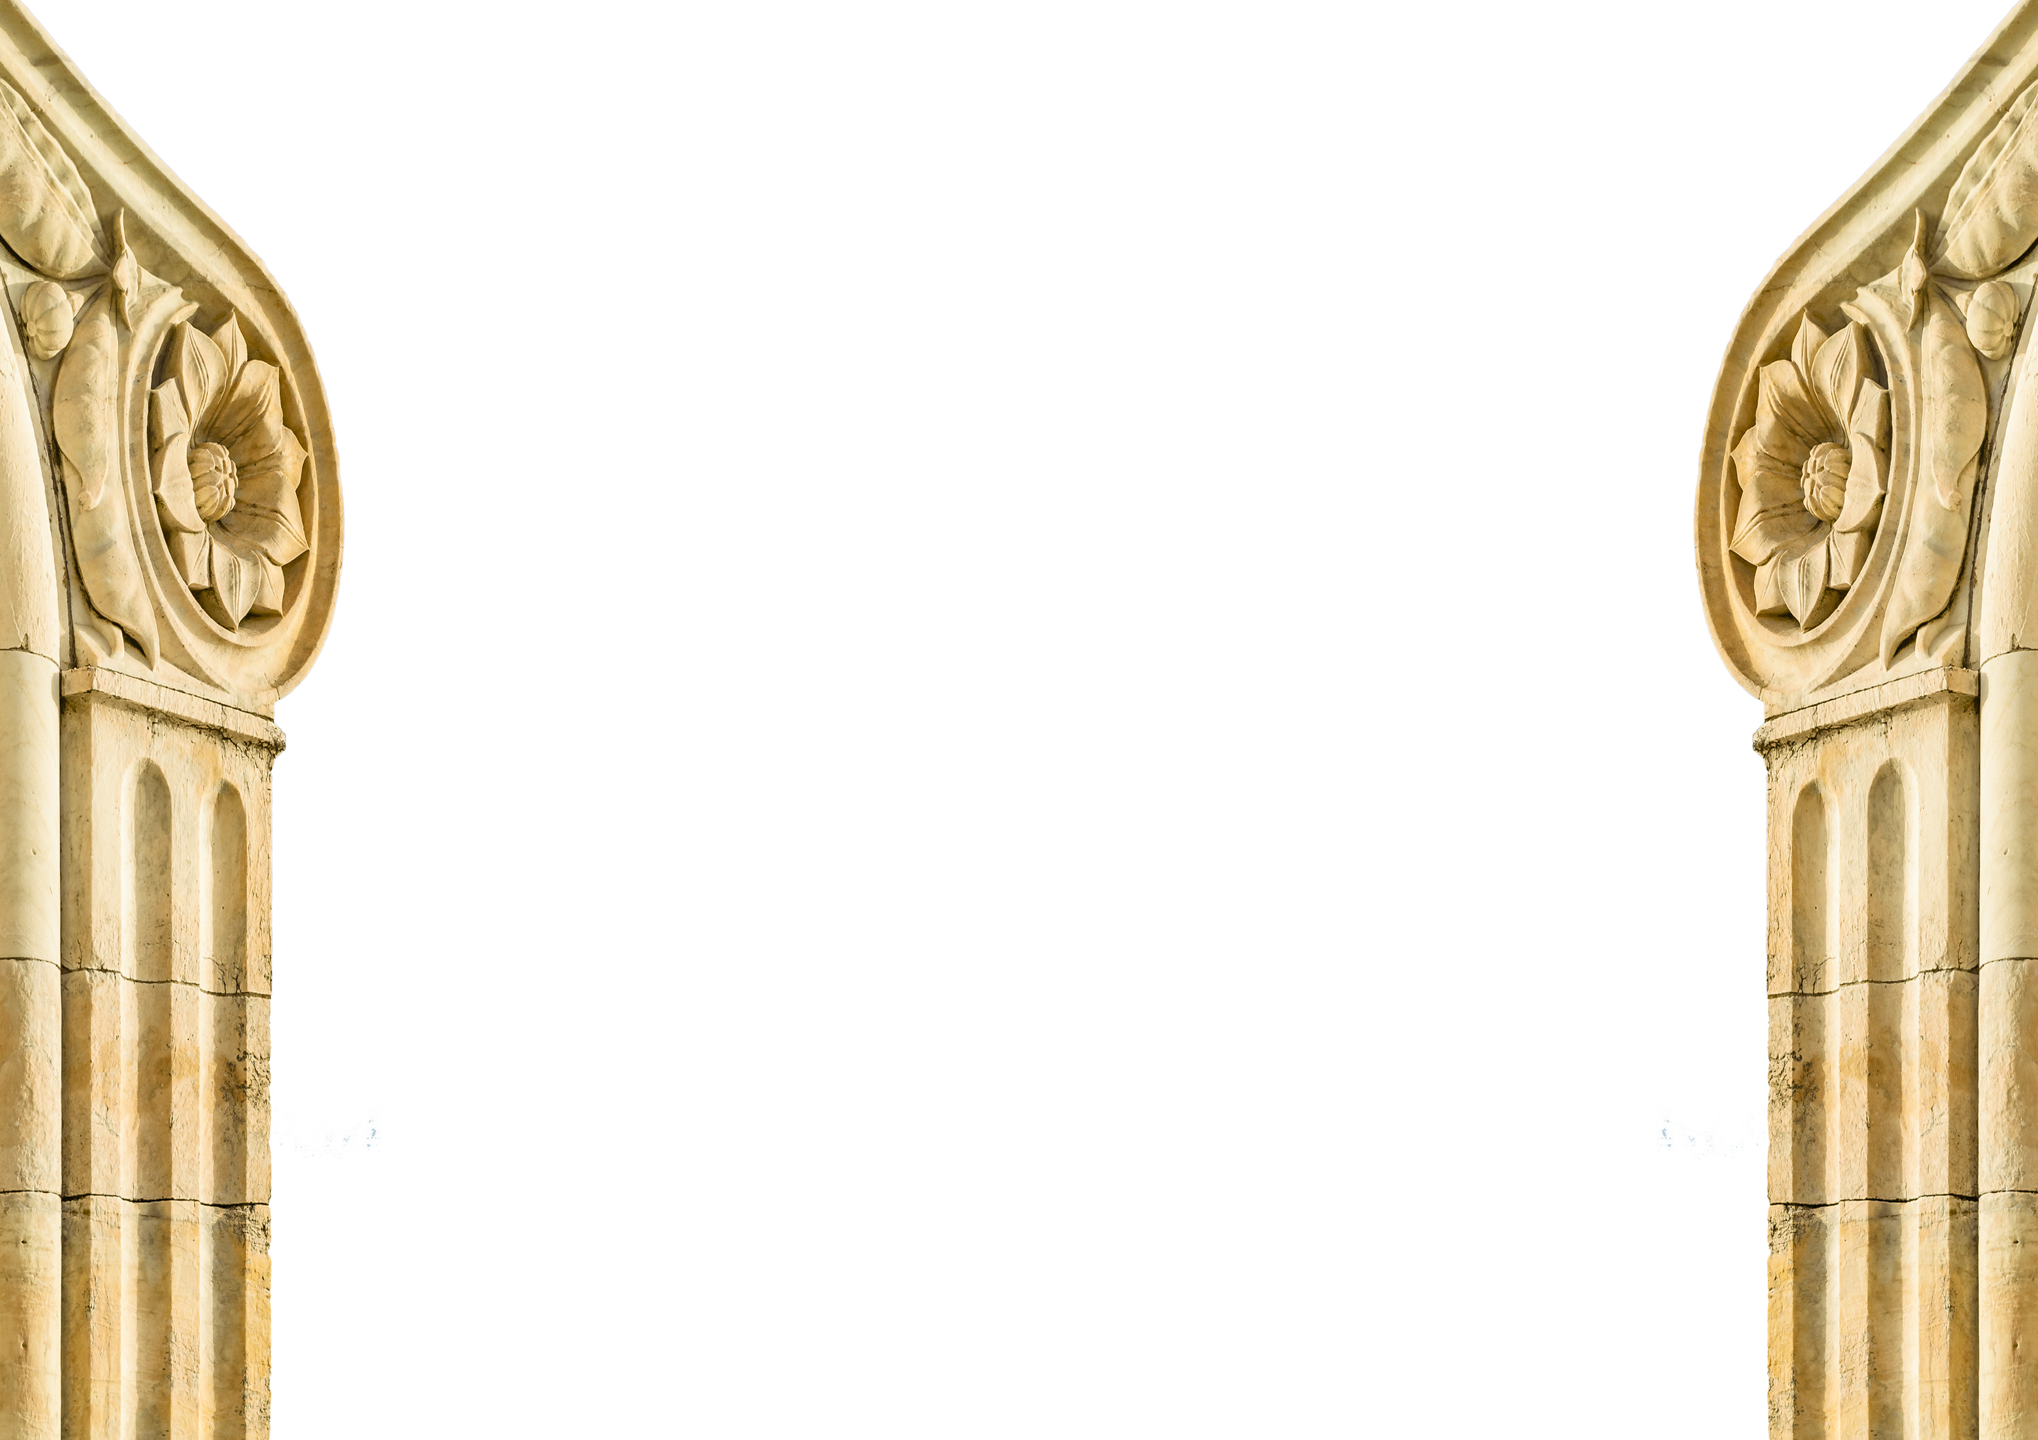
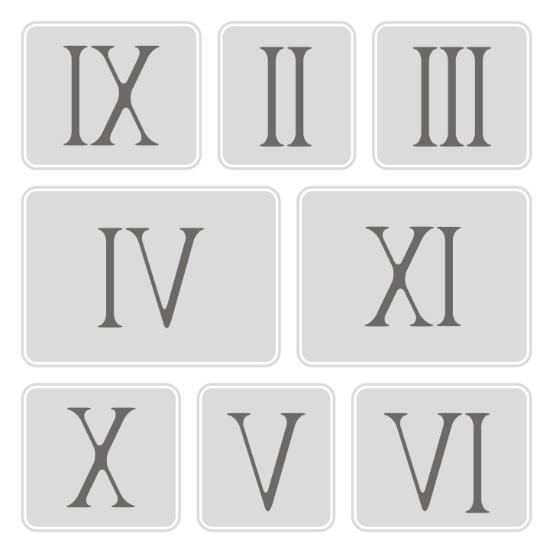

History of
Roman Numerals
© Seomra Ranga 2020 www.seomraranga.com

Slide 2
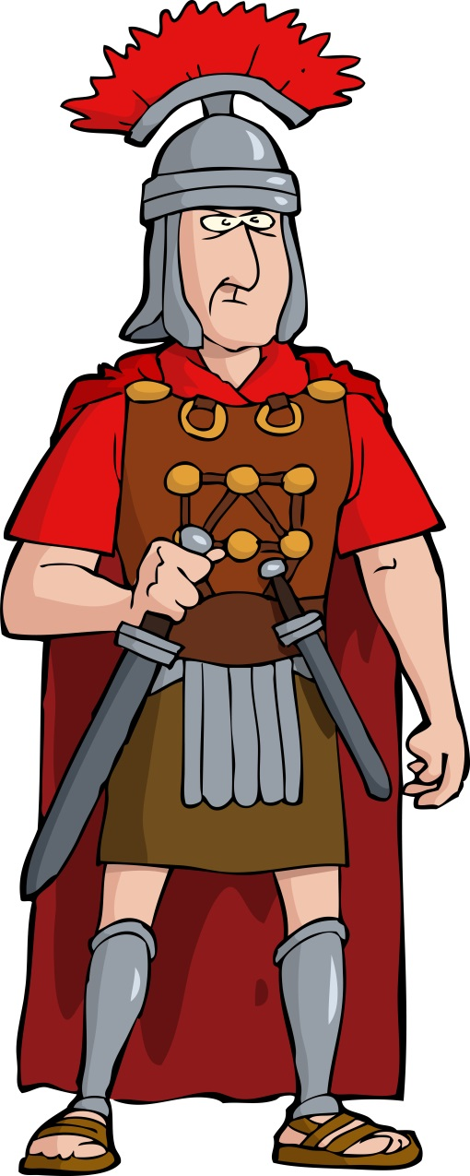
History of Roman Numerals
Roman Numerals originated in ancient Rome. They are a set of symbols that represent numbers as we know them today. It is believed that their usage began sometime between 900 and 800 BC.
© Seomra Ranga 2020 www.seomraranga.com

Slide 3
History of Roman Numerals
Roman Numerals were developed out of a need to find a common method of counting. Basic ways of counting using just hands and fingers were only useful up to 10, so another way of counting was needed.
© Seomra Ranga 2020 www.seomraranga.com

Slide 4
History of Roman Numerals
The new Roman Numerals were loosely based on using a person’s hand. The I was similar to one finger; the V represented five fingers; the X represented two hands.
© Seomra Ranga 2020 www.seomraranga.com

Slide 5
History of Roman Numerals
The early system of Roman Numerals was slightly different than that used today. For example 4 was represented by IIII and 9 was represented by VIIII. Over time, the system was developed more.
© Seomra Ranga 2020 www.seomraranga.com

Slide 6
History of Roman Numerals
Roman Numerals were used up to the 1500s throughout Europe. People found it easy to add and subtract using Roman Numerals but found that other calculations were more difficult.
© Seomra Ranga 2020 www.seomraranga.com

Slide 7
History of Roman Numerals
Eventually, towards the end of the 1500s, it became more common to use Arabic numbers for most calculations. However, Roman Numerals are still used today in various ways.
© Seomra Ranga 2020 www.seomraranga.com

Slide 8
Uses of
Roman Numerals
© Seomra Ranga 2020 www.seomraranga.com

Slide 9

Uses of Roman Numerals
Lots of clocks use Roman numerals for their figures on the clock face.
© Seomra Ranga 2020 www.seomraranga.com

Slide 10
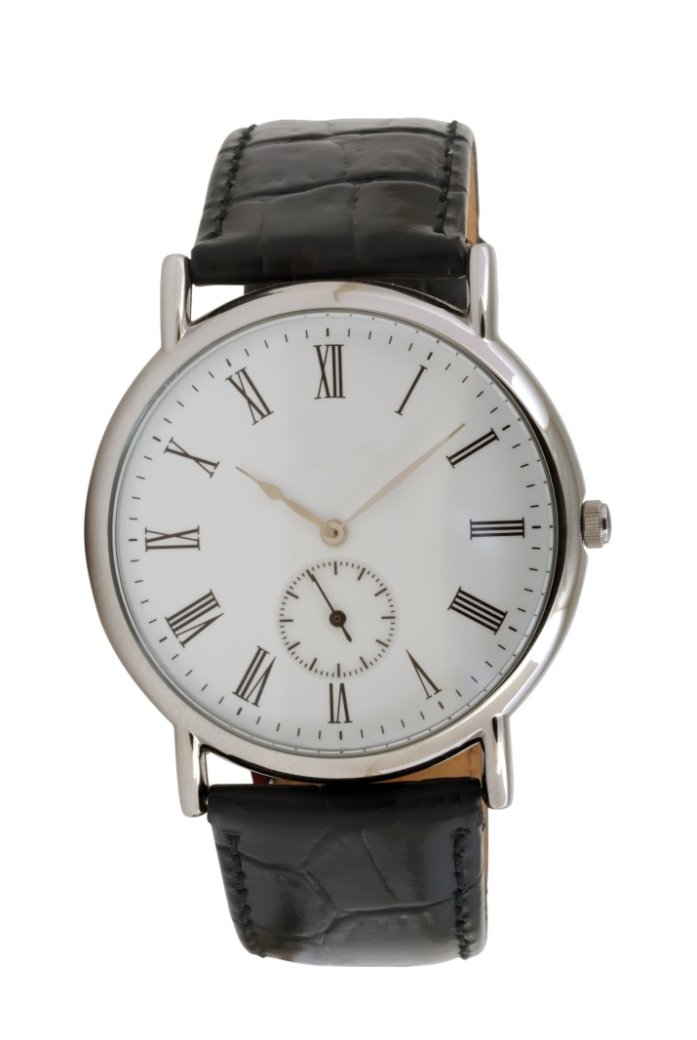
Uses of Roman Numerals
Some analogue wrist watches use Roman Numerals for their figures.
© Seomra Ranga 2020 www.seomraranga.com

Slide 11
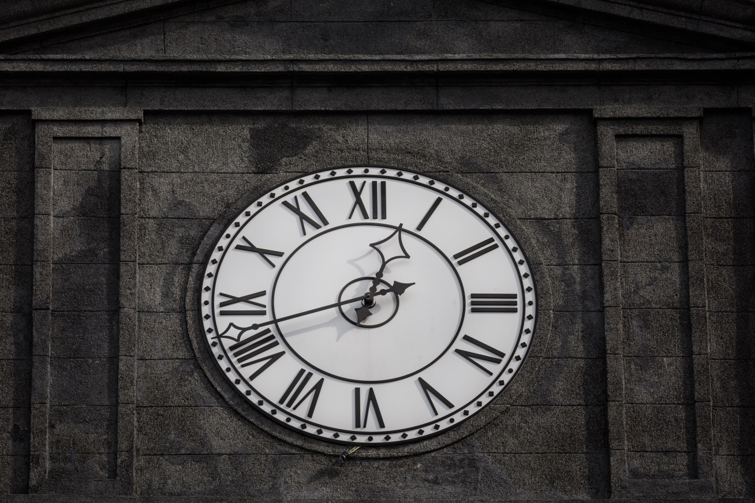
Uses of Roman Numerals
Clocks on many public buildings use Roman Numerals for their figures.
© Seomra Ranga 2020 www.seomraranga.com

Slide 12
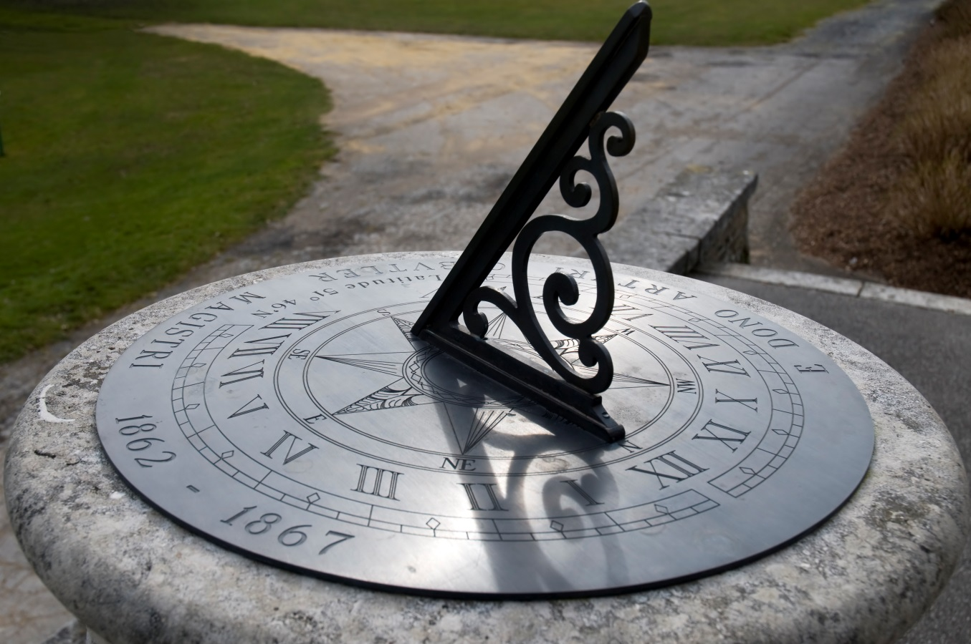
Uses of Roman Numerals
Roman Numerals are sometimes used as part of a sundial.
© Seomra Ranga 2020 www.seomraranga.com

Slide 13
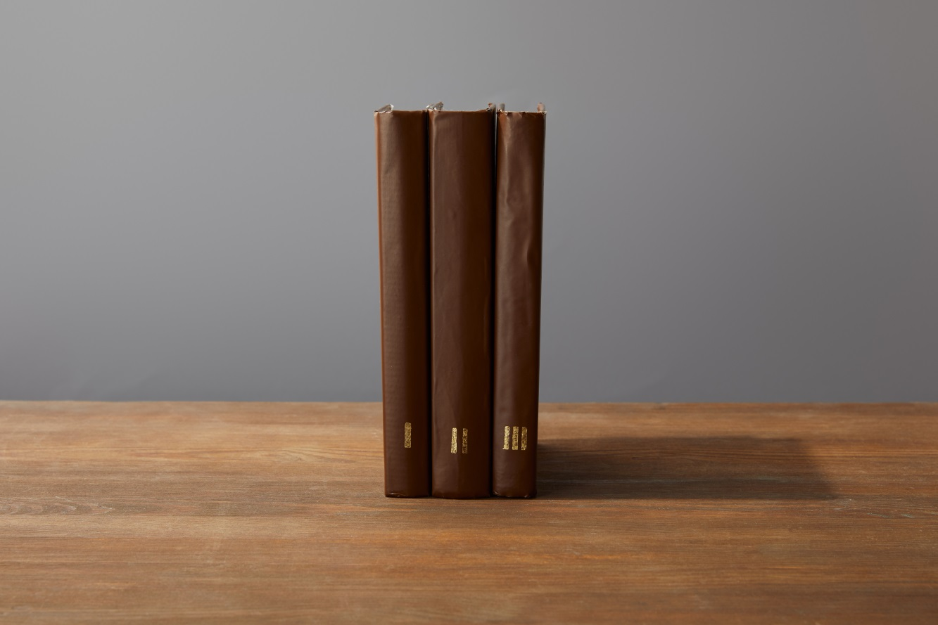
Uses of Roman Numerals
Roman Numerals are sometimes used to number volumes of books.
© Seomra Ranga 2020 www.seomraranga.com

Slide 14
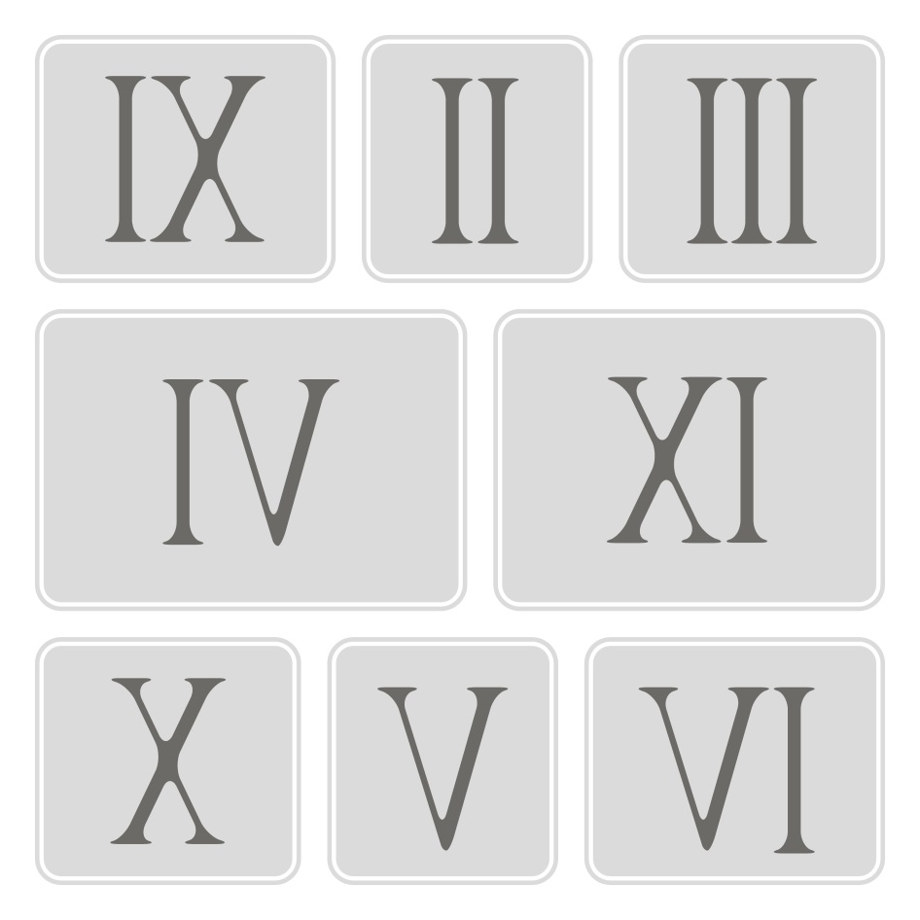
Uses of Roman Numerals
Roman Numerals are sometimes used for inscriptions on stones.
© Seomra Ranga 2020 www.seomraranga.com

Slide 15

Uses of Roman Numerals
Roman Numerals are sometimes used on presentation medals.
© Seomra Ranga 2020 www.seomraranga.com

Slide 16

Uses of Roman Numerals
Sometimes, years are written using Roman Numerals.
© Seomra Ranga 2020 www.seomraranga.com

Slide 17
Uses of Roman Numerals
Other uses for Roman Numerals in modern times include: names of monarchs, popes, ships and sporting events like the Olympics; they appear in movie credits and titles; they sometimes appear on building cornerstones; they are used in astronomy to designate moons; they are used in chemistry to denote groups of the Periodic Table; they are used in notation symbols for Music Theory.
© Seomra Ranga 2020 www.seomraranga.com

Slide 18

Resources used in this file from:
https://depositphotos.com/
Information sourced from:
https://www.livescience.com/32052-roman-numerals.html
D'Ambrosio, BS 2020, 'Roman numerals' , World Book Student, World Book, Chicago, viewed 9 January 2020,<https://www.worldbookonline.com/student-new/#/article/home/ar474040>
© Seomra Ranga 2020 www.seomraranga.com

