Slide 1

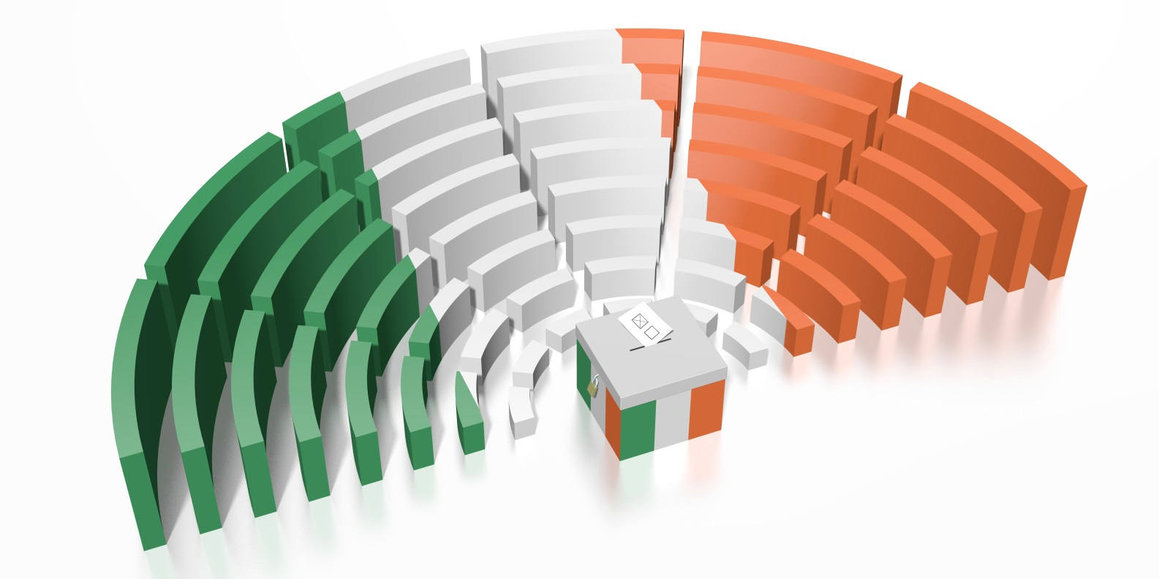

General Elections
In Ireland
© Seomra Ranga 2020 www.seomraranga.com

Slide 2
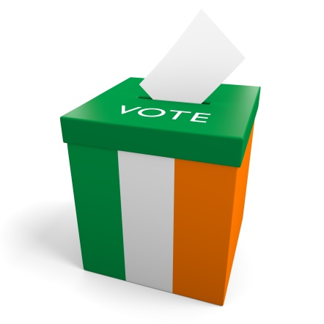
General Elections in Ireland
What is a General Election?
A General Election is when people living in a country vote on who they want to represent them in the national parliament.
The national parliament in Ireland is called Dáil Éireann
© Seomra Ranga 2020 www.seomraranga.com

Slide 3
General Elections in Ireland
When is a General Election Held?
A General Election is held at least every five years – this rule is laid out in the Irish Constitution
Sometimes elections are held more often
In 1982, there were two general elections in the same year, February and November
© Seomra Ranga 2020 www.seomraranga.com

Slide 4
General Elections in Ireland
Voting for a Teachta Dála (TD)
160 TDs are elected by people in different areas around the country
Each of these areas is called a Constituency and there are currently 39 of these throughout the country
Constituencies can elect 3, 4 or 5 TDs, depending on the size of its population
© Seomra Ranga 2020 www.seomraranga.com

Slide 5
General Elections in Ireland
Voting in a General Election
TDs are elected by the direct vote of the people
Voting is by secret ballot on the Single Transferable Vote system – this means voters indicate their preference by indicating 1, 2, 3 on the ballot paper
The names of the candidates appear in alphabetical order on the Ballot Paper along with the name of their political party
© Seomra Ranga 2020 www.seomraranga.com

Slide 6
General Elections in Ireland
Who Can Stand for Election?
Every citizen of Ireland over 21 years of age who is not disqualified by the Constitution or by law is eligible to stand for election to Dáil Éireann
Usually candidates seek a nomination from a Political Party to stand for election
Those not belonging to a political party can stand for election as an Independent
© Seomra Ranga 2020 www.seomraranga.com

Slide 7
General Elections in Ireland
Who Can Vote?
Every citizen over 18 years of age is eligible to vote for TDs in a General Election
If you wish to exercise your vote, you have to make sure that your name is on the Electoral Register
The register comes into force on February 15th each year
© Seomra Ranga 2020 www.seomraranga.com

Slide 8
General Elections in Ireland
Why Should You Vote?
If you are over 18 years of age, it is your democratic right to vote
If you don’t vote, then you don’t have a say in what TDs are elected
Consequently, you don’t have a say in how the country is run
© Seomra Ranga 2020 www.seomraranga.com

Slide 9
General Elections in Ireland
How to Vote in an Election?
If you are on the Electoral Register, a Polling Card will be posted to your home prior to the election
The Polling Card tells you the date of the election, where your Polling Station is and at what time it is open
You bring the Polling Card, as well as ID, with you to the Polling Station
© Seomra Ranga 2020 www.seomraranga.com

Slide 10
General Elections in Ireland
How to Vote in an Election?
The Polling Station is usually in a local school or hall
When you arrive at the Polling Station, you give the Polling Clerk your Polling Card
The Polling Clerk will give you a Ballot Paper – this has the names of all the Candidates standing for election in your constituency
© Seomra Ranga 2020 www.seomraranga.com

Slide 11
General Elections in Ireland
How to Vote in an Election?
You take your Ballot Paper to a Polling Booth, where you can vote by Secret Ballot
You number the Ballot Paper in order of your preference, giving your favourite No. 1, your second favourite No. 2 etc.
You can choose to mark as many boxes as you wish
You then place your Ballot Paper in the locked Ballot Box
© Seomra Ranga 2020 www.seomraranga.com

Slide 12
General Elections in Ireland
Counting of Votes
The counting of votes commences at 9am on the day after the election
The Quota (the number of votes necessary for election) is calculated by the Presiding Officer in each constituency
The quota is calculated by dividing the number of valid votes by the number of seats + 1 and then add 1
© Seomra Ranga 2020 www.seomraranga.com

Slide 13
General Elections in Ireland
Electing of TDs
If a candidate exceeds the quota, the Presiding Officer announces publicly that they have been elected as a TD for the constituency
TDs are currently paid €96,189 per year and they attend meetings of Dáil Éireann that are held on about 90 days of the year
They discuss the problems of the country and pass laws to try to solve these problems.
© Seomra Ranga 2020 www.seomraranga.com

Slide 14
General Elections in Ireland
After the Election
When all TDs have been elected, they gather in Dáil Éireann
The political party with the most TDs will try to form a Government
If they do not have enough TDs, they will try to join with another party or parties to form a Coalition Government
© Seomra Ranga 2020 www.seomraranga.com

Slide 15
General Elections in Ireland
After the Election
The leader of the government becomes the new Taoiseach
S/he will appoint the Tánaiste who is the deputy leader of the government
The Taoiseach will also appoint between seven and fifteen Ministers who will be responsible for different areas eg. Education, Health etc.
© Seomra Ranga 2020 www.seomraranga.com

Slide 16
General Elections in Ireland
After the Election
The new government will try to pass laws to enact policies that they promised during the election campaign
The new government will attempt to stay in power for the next five years
© Seomra Ranga 2020 www.seomraranga.com

Slide 17

Resources used in this file:
https://depositphotos.com/
© Seomra Ranga 2020 www.seomraranga.com

