Slide 1
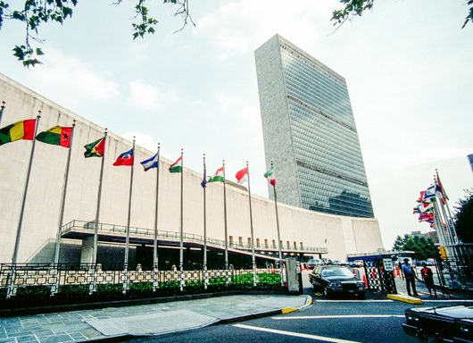
World Homeless Day
October 10th 2019
© Seomra Ranga 2019 www.seomraranga.com
Notes:
Sometimes we have holidays or “international days” to celebrate something. Other times, such as with World Homeless Day, we have put aside this day to educate and raise awareness about important and urgent issues affecting our societies! Notice that it is “world,” because homelessness affects all countries/societies in the world!

Slide 2
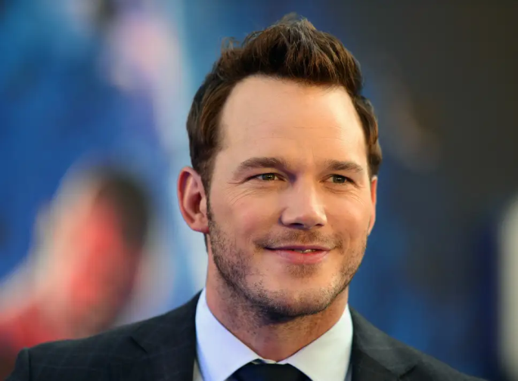
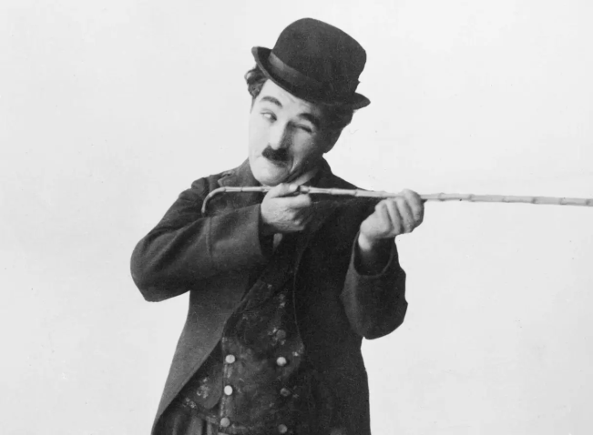
What do they all have in common?
Notes:
Ask: show of hands - do you know who these people are?Can you tell me what they all have in common? They’re very famous artists… some actors, some singers… that’s true. But also, all of them have experienced homelessness. Homelessness does not have a race or gender. Homelessness can look very different.
Source for 1. Jennifer Lopez, Chris Pratt, Charlie Chaplin https://www.independent.co.uk/news/people/17-rich-and-famous-people-who-were-once-homeless-a7350941.html

Slide 3
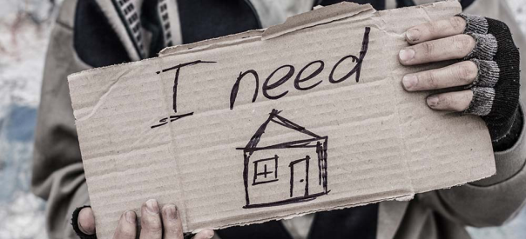
WHO ARE THE HOMELESS?
© Seomra Ranga 2019 www.seomraranga.com
Notes:
Anyone from celebrities, to someone you go to church with, to your friend and their family. It is possible that people in this room have been or are homeless. Us learning more about homelessness, can help solve homlessness and make sure that everyone understands that the right to safe and secure housing is something we all have.
Being homeless doesn’t mean you aren’t loved and it doesn’t have to mean that you don’t have friends or community.
Picture source: http://olympiawa.gov/community/homelessness.aspx

Slide 4
What is Homelessness?
"Homelessness is a condition where a person or household lacks habitable space with security of tenure, rights and ability to enjoy social relations, including safety. Homelessness is a manifestation of extreme poverty and a failure of multiple systems and human rights"
- Definition agreed upon by the thematic experts that convened in Nairobi Kenya, 2019
???
© Seomra Ranga 2019 www.seomraranga.com
Notes:
It’s really hard to say what homelessness is, because different cultures understand it differently. Also, because some homelessness is INVISIBLE - and you might not think of it as homelessness. Why do you think there’s homelessness that is “visible” and “invisible”?
Great. It is true that sometimes you may see people on the street who are asking for money, or maybe just there seeking shelter or a place to be. But there are also people whose houses are not safe. Or they sleep at houses that are not their own, that have too many people inside.
This is the definition of homelessness agreed upon by United Nations experts in 2019. *READ DEFINITION*
This might be hard to understand if you don’t know some other information. Do you know what are human rights???
Break down -what is security of tenure?
What does safety look like???
How would you describe homelessness?
Human rights videos options:
https://www.youtube.com/watch?v=pRGhrYmUjU4
https://www.youtube.com/watch?v=nDgIVseTkuE

Slide 5
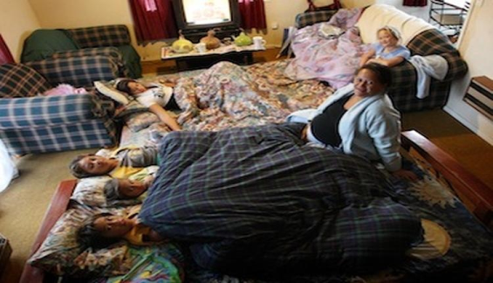
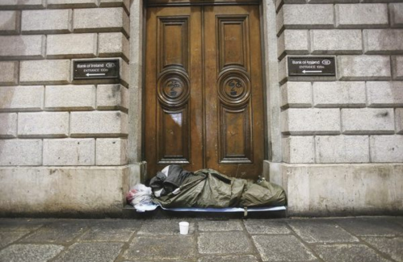
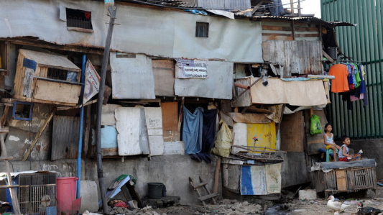
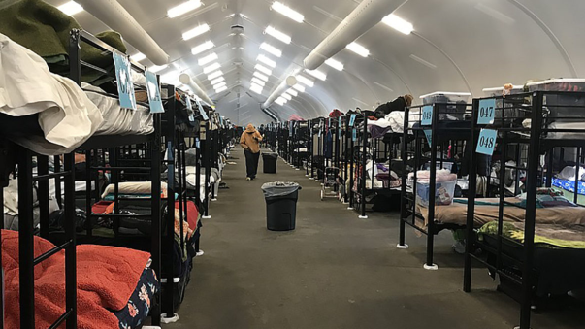
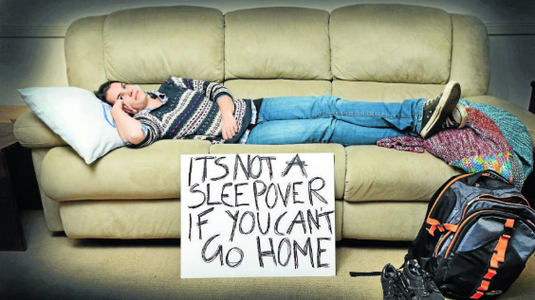
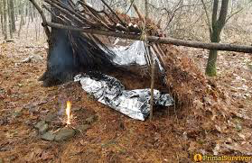
What Does Homelessness Look Like?
© Seomra Ranga 2019 www.seomraranga.com
Notes:
Shelter beds photo credit: SUSAN MURPHY, KPBS
No a sleep over, photo credit: Homes 4 hearts, https://twitter.com/_homes4hearts/status/981555934400000001
Lean to
Street homeless, Photo credit: photocall Ireland
overcrowding , photo credit: Kartya Walker
Slum, Photo Credit: Filipino children sit in front of their slum homes in Manila, Philippines. Activists are trying to organize slum dwellers in order to provide them with a political voice.
Jay Directo/AFP/Getty Images

Slide 6
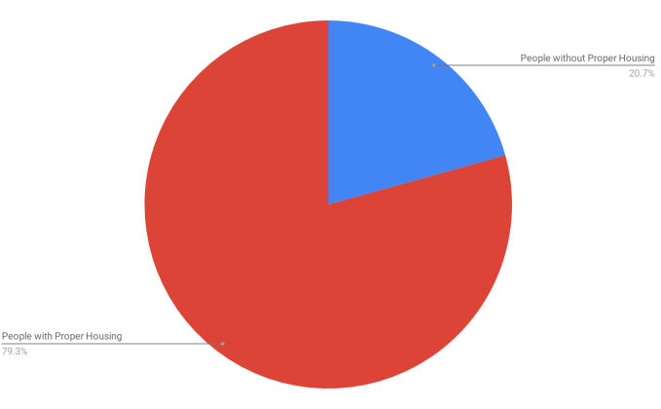
How Many People Don’t Have Proper Housing/ are Considered Homeless?
© Seomra Ranga 2019 www.seomraranga.com
Notes:
World statistics source: https://www.worldometers.info/world-population/
“An estimated 1.8 bil people lack proper housing”
Human Rights Council Resolution 40/61
Class activity: divide the class in two, 20% in one group 80% in the other to demonstrate the graphic

Slide 7
What Causes Homelessness?
The causes of Homelessness across the globe are different and complicated, though some consistently stand out, including:
Finding it hard or not being able to access affordable or secure housing,
Lack of social protection systems, like welfare payments, pensions, etc
Poverty
Not being able to find a job or losing a job
Family breakdown
Lack of help and support experiencing mental illness, substance abuse and displacement caused by conflicts and natural disasters
© Seomra Ranga 2019 www.seomraranga.com
Notes:
FROM UI Research The causes of homelessness across the globe are different and complicated, though some consistently stand out, including:
inability to access affordable or secure housing,
lack of social protection systems
poverty,
unemployment
family breakdown.
Lack of services and access to facilities for those experiencing mental illness,
substance abuse and displacement caused by conflicts and natural disasters are also contributing factors.
Class activity: Brain storm as a class and think of things that might cause homelessness in your community

Slide 8
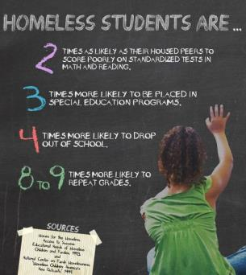
What Does it Feel Like to be Homeless?
Click here to listen to an interview with Irish Girl “Amanda” telling a local radio station how she felt when she was experiencing Homelessness
https://www.rte.ie/news/newslens/2018/1005/1001127-amanda-homelessness/
© Seomra Ranga 2019 www.seomraranga.com
Notes:
https://www.driveplayer.com/#fileIds=1GT1x4iuf_hQByYx5l3f9jGdqXNpWJuDn&userId={userId} Link to an interview with 18 year old Amanda
Class activity discuss how you would feel if you didn’t have a home.

Slide 9
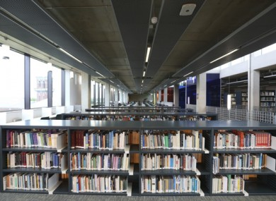
Creative Responses to Homelessness
© Seomra Ranga 2019 www.seomraranga.com
Notes:
Image source: https://www.thejournal.ie/book-sellers-ireland-3195886-Jan2017/
How many of you go to the library?
Well, in some countries, and especially the United States, libraries provide a very important space for helping the homeless. First of all, they provide a safe and comfortable environment to spend freetime in that keeps you safe from bad weather and entertained. They also often have information or resources that can help struggling families. Remember, you never know who may have experienced homelessness - this is just one more reason to be kind to the people around you!

Slide 10
Activity: Draw
Draw a house that has everything a family needs
Think about: safety, and what you need and use every day!
If you wish, you may label your drawing
© Seomra Ranga 2019 www.seomraranga.com
Notes:
Explain the activity, and then discuss what was included. Did they include a toilet/sink/clearning materials/hygiene materials? Did they leave enough space for multiple people? Did they remember a roof? A floor? Somewhere to sleep? A lock on the door? Etc.

Slide 11
UNANIMA International
This presentation was developed in association with UNANIMA International. UNANIMA International is a non-governmental organisation (NGO) advocating on behalf of women and children (particularly those living in poverty), immigrants, homeless, refugees, and the environment. Their work takes place primarily at the United Nations headquarters in New York, where they and other members of civil society aim to educate and influence policymakers at the global level.
For more information, see the UNANIMA website https://www.unanima-international.org/
© Seomra Ranga 2019 www.seomraranga.com
Notes:
Picture source: http://olympiawa.gov/community/homelessness.aspx

