Slide 1
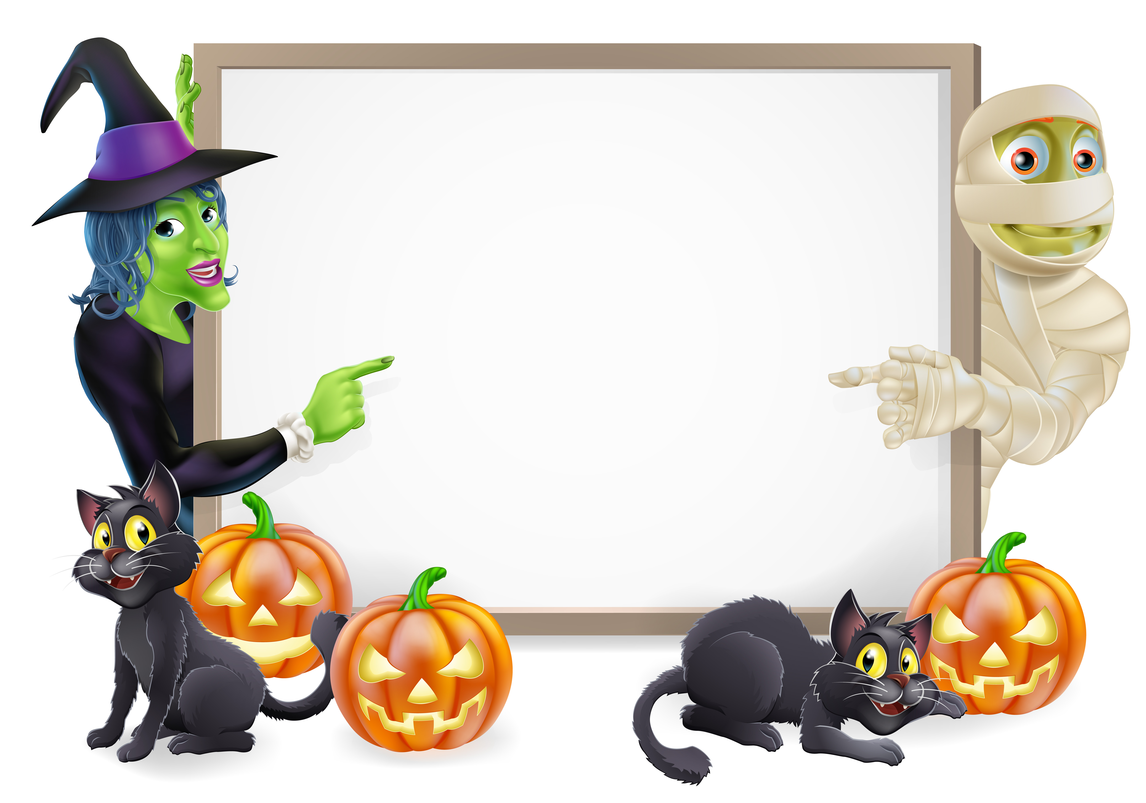

Hallowe’en Customs and Traditions
© Seomra Ranga 2019 www.seomraranga.com

Slide 2
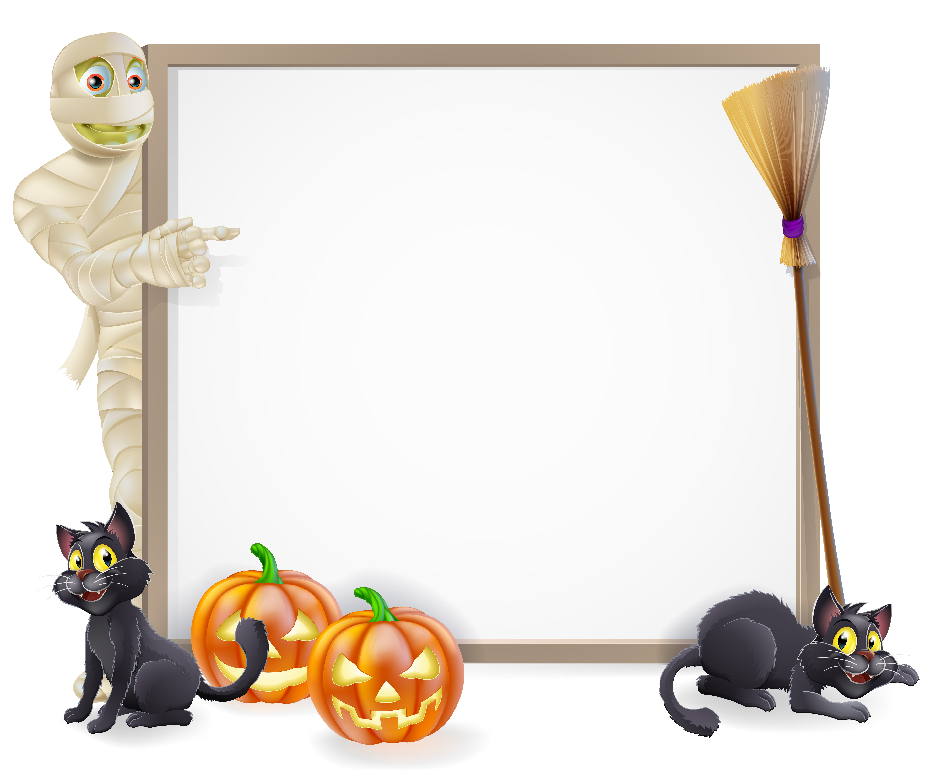
Hallowe’en
Once upon a time (about 2,000 years ago), the Celtic New Year began on the first of November. But October 31st was when the great festival of Samhain began. It celebrated the end of the old year and the start of the new; the return of the herds from pasture and the renewal of laws and land tenure. It was also the night that the gates of the underworld opened to let loose witches, demons and the spirits of the dead!
© Seomra Ranga 2019 www.seomraranga.com

Slide 3
Trick or Treat
After Ireland became a Christian country, the people still celebrated Samhain. November 2nd was All Souls Day and on this day, people would go around collecting gifts of food or money. Sometimes people would make special sweet “Soul Cakes” for them.
© Seomra Ranga 2019 www.seomraranga.com

Slide 4
Trick or Treat
In return, they would sing songs and say prayers for the people. This is why children go from door to door at Hallowe’en. Anyone who didn’t give anything would have a trick played on them. Some of these tricks were not so nice!
© Seomra Ranga 2019 www.seomraranga.com

Slide 5
Trick or Treat
At the end of the harvest, there is a lot of fruit and nuts to be gathered. When it is all gathered, children go around “trick-or-treating”. They are given the fruit or nuts or they will play tricks on the people.
© Seomra Ranga 2019 www.seomraranga.com

Slide 6
Hallowe’en Food
Kurly Kale – White cabbage served with mashed potatoes
Colcannon – mashed potatoes with fried onions
Toffee Apples – apples coated with toffee/chocolate and covered with sprinkles
Nuts – monkey nuts/peanuts, hazelnuts, brazil nuts, walnuts
Fruit – apples, grapes, pears
Barm Brack – a fruit cake
© Seomra Ranga 2019 www.seomraranga.com

Slide 7
Barm Brack
The ancient Celts believed that if they were nice to the demons, the demons would be nice in return. So they decided to give them nice things to eat. Sometimes, they left Barm Brack (Báirín Breac) out for the demons.
© Seomra Ranga 2019 www.seomraranga.com

Slide 8
Barm Brack Surprises
A Barm Brack sometimes has some or all of the following surprises:
Ring – means you will be married
Money – means you will be rich
Cloth – means you will turn to rags
Stick – means you will be beaten
Pea (or button) – means you will be a bachelor/spinster
© Seomra Ranga 2019 www.seomraranga.com

Slide 9
Jack O’ Lantern
A Jack O’ Lantern is a pumpkin (or turnip) which the centre has been scooped out of. Eyes, a nose and a mouth are carved out. A torch or candle is placed inside and the Jack O’ Lantern shines!
© Seomra Ranga 2019 www.seomraranga.com

Slide 10
Witches
Witches are believed to be old women who can work magic and make potions. The two main things that a witch has is a black cat and a broom. She is also known for her black clothes and a cauldron in which she mixes her potions. The witch wears a black pointed hat, a black dress and cloak and black shoes. She is a very powerful woman!
© Seomra Ranga 2019 www.seomraranga.com

Slide 11
Banshee (Bean Sí)
Ireland is famous for her ghosts and the banshee (“bean sí” or “fairy woman”) is the greatest Irish ghost of all. People who claim to have seen the banshee describe her as being a small, wrinkled old woman who slowly combs her hair as she wails and cries in a most sorrowful way. She is usually dressed in a long white cloak and is only seen late at night. It is said that the cry of the banshee is a cry of the death of certain old Irish families.
© Seomra Ranga 2019 www.seomraranga.com

Slide 12
Saman
Saman was the feared “Lord of Death” and it was believed that he called forth evil spirits and demons on Hallowe’en night to wreak havoc and mischief on the living. To ward off evil spirits, our ancestors lit huge bonfires on hilltops at nightfall. They called this night “Oíche Shamhna” – the Vigil of Saman.
© Seomra Ranga 2019 www.seomraranga.com

Slide 13
Bonfires
In olden times, bonfires were sometimes lit on Hallowe’en night to frighten away all the demons.
© Seomra Ranga 2019 www.seomraranga.com

Slide 14
Masks and Costumes
Food
Bonfires
Fireworks
Hallowe’en
Customs
Jack O’ Lanterns
Games
Trick or Treat
Ghost Stories
Barm Brack
© Seomra Ranga 2019 www.seomraranga.com

Slide 15
Scavenger Hunt
Blind Man’s Buff
Snap Apple
Bobbing for Apples
Hallowe’en
Games
Carve the Pumpkin
Ghost Stories
Wrap the Mummy
Balloon Sweep
Ghost in the Graveyard
© Seomra Ranga 2019 www.seomraranga.com

Slide 16
Dracula
Witches
Goblins
Ghosts
Hallowe’en
Creatures
Poltergeists
Ghouls
Monsters
Wizards
Spectres
© Seomra Ranga 2019 www.seomraranga.com

Slide 17

Resources used in this file from:
https://depositphotos.com/
© Seomra Ranga 2019 www.seomraranga.com

