Slide 1


© Seomra Ranga 2019 www.seomraranga.com

Slide 2

Rugby World Cup 2019
Background
The Rugby World Cup is held every four years
The 2019 event is the 9th Rugby World Cup
This is the first time that the tournament will be held in Asia
Japan won the bid to host the Rugby World Cup 2019 at a special meeting in Dublin, Ireland in July 2009
© Seomra Ranga 2019 www.seomraranga.com

Slide 3
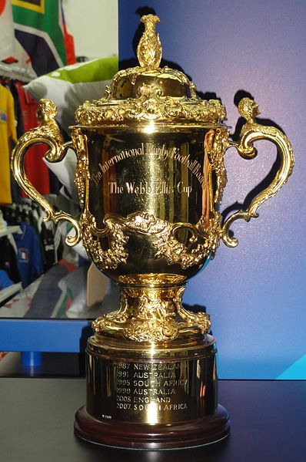
Rugby World Cup 2019
Cup
The winning team in the Rugby World Cup receives the Webb Ellis Cup
The cup is named after William Webb Ellis, reputed to be the inventor of the game of rugby
The current holder of the Webb Ellis Cup is New Zealand who won the 2015 Rugby World Cup in England
© Seomra Ranga 2019 www.seomraranga.com

Slide 4
Rugby World Cup 2019
Stats
Host Nation:
Japan
Dates:
Sept. 20th - Nov.2nd
No. of Nations:
20
No. of Venues:
12
© Seomra Ranga 2019 www.seomraranga.com

Slide 5

Rugby World Cup 2019
Logo
The logo for the Rugby World Cup 2019 features two of Japan’s most recognisable symbols – the Rising Sun and Mount Fuji.
© Seomra Ranga 2019 www.seomraranga.com

Slide 6
Rugby World Cup 2019
Structure
Twenty teams will compete for the Rugby World Cup 2019
All teams have played at a previous Rugby World Cup at least once
The 20 teams are divided into four pools of five teams
© Seomra Ranga 2019 www.seomraranga.com

Slide 7
Rugby World Cup 2019
Pools
Pool A
Ireland
Scotland
Japan
Russia
Samoa
Pool B
New Zealand
South Africa
Italy
Namibia
Canada
Pool C
England
France
Argentina
USA
Tonga
Pool D
Australia
Wales
Georgia
Fiji
Uruguay
© Seomra Ranga 2019 www.seomraranga.com

Slide 8
Rugby World Cup 2019
Scoring
In each pool, each team plays each of the other teams, meaning there will be ten games played in each pool
Win = 4 points
Draw = 2 points
Loss (by 8 or more points) = 0 points
Loss (by less than 8 points) = 1 point
Team that scores 4+ tries = 1 bonus point
© Seomra Ranga 2019 www.seomraranga.com

Slide 9
Rugby World Cup 2019
Qualification
The top two teams in each pool advance to the Quarter Final stage
The top three teams in each pool automatically qualify for the 2023 Rugby World Cup, to be held in France
© Seomra Ranga 2019 www.seomraranga.com

