Slide 1
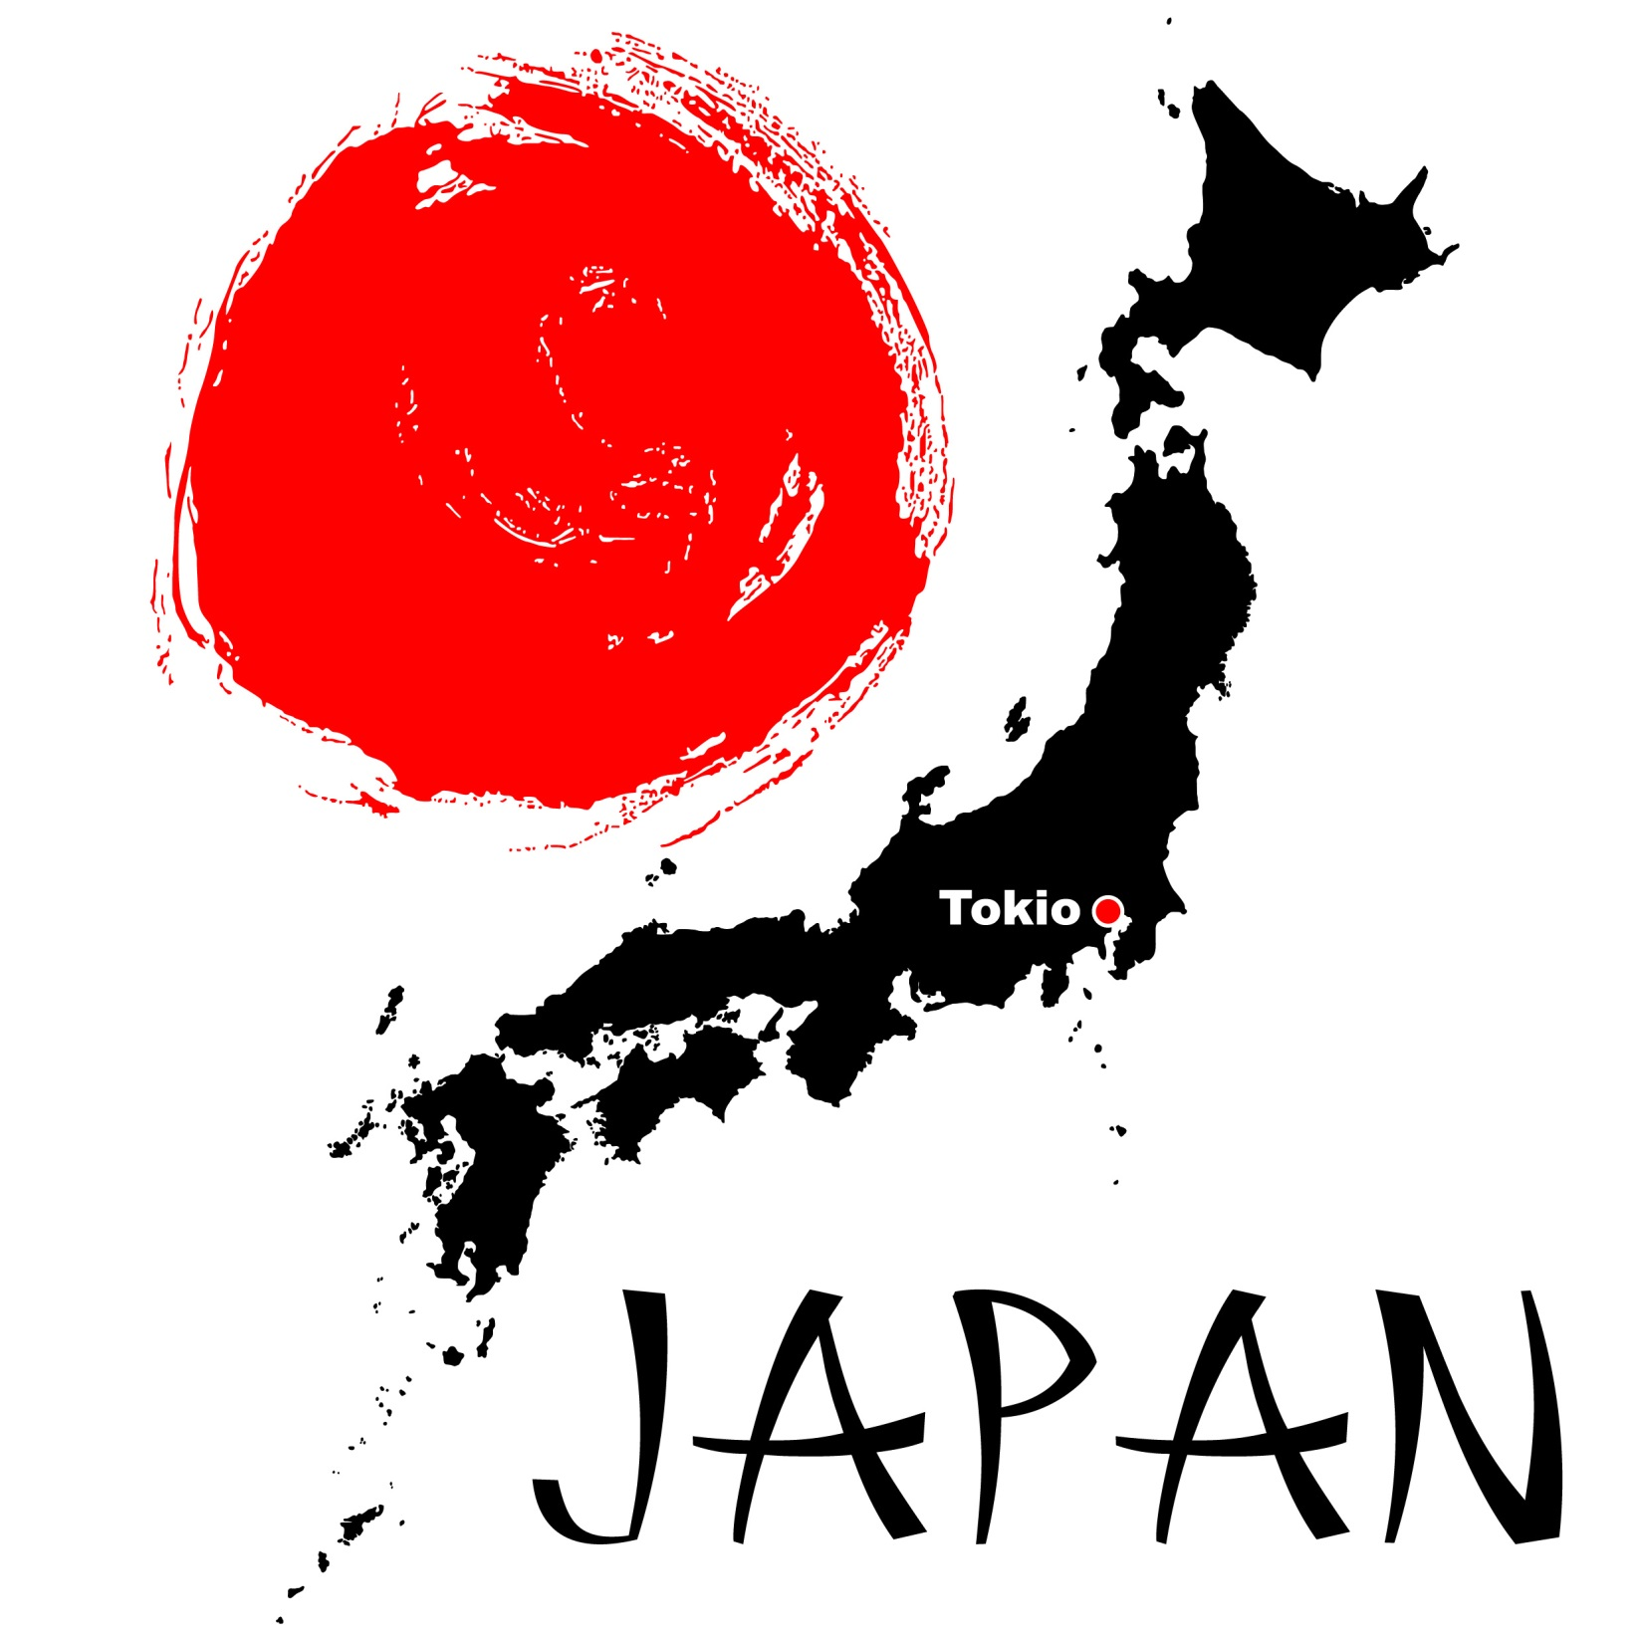

© Seomra Ranga 2019 www.seomraranga.com

Slide 2
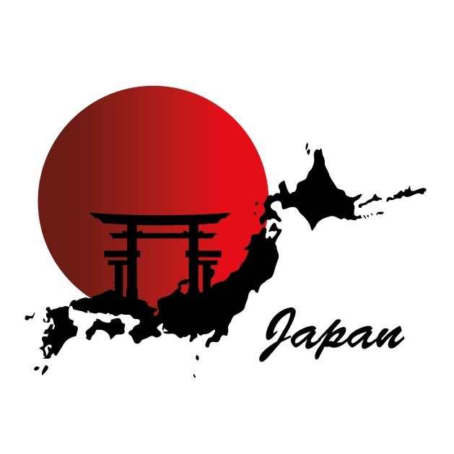
Location
Japan is an island state in the Pacific Ocean off the east coast of Asia. It is made up of the four large islands of Hokkaido, Honshu, Kyushu and Shikoku as well as many other small islands.
© Seomra Ranga 2019 www.seomraranga.com

Slide 3
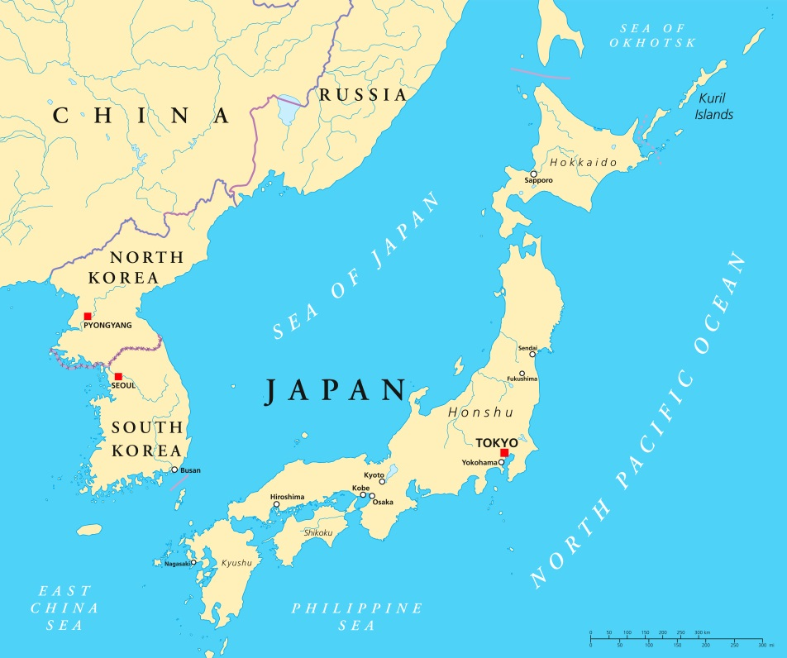
Location
Japan’s nearest neighbours are North and South Korea, China and Russia.
© Seomra Ranga 2019 www.seomraranga.com

Slide 4
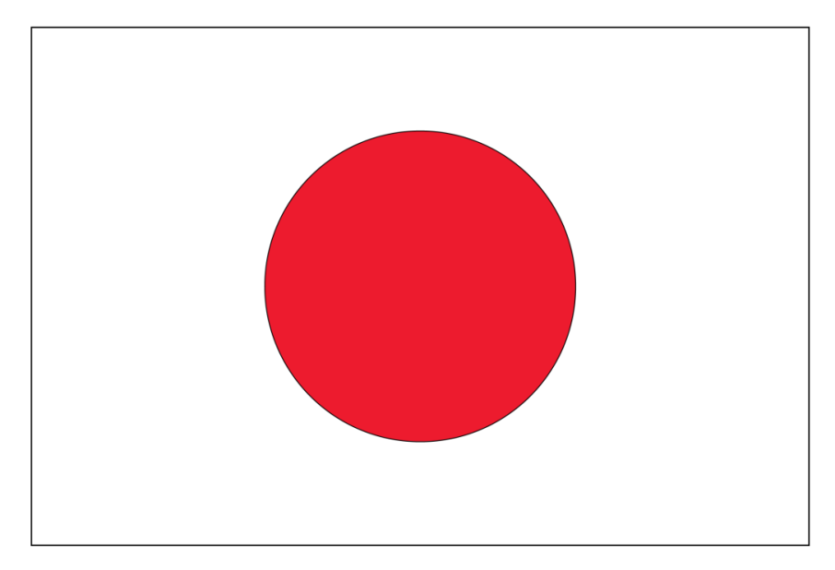
Flag
The Japanese flag is a white rectangle with a solid red circle in the centre. The red circle represents the sun. Japanese people refer to the flag as the “Hinomaru” which means “sun disc”.
© Seomra Ranga 2019 www.seomraranga.com

Slide 5
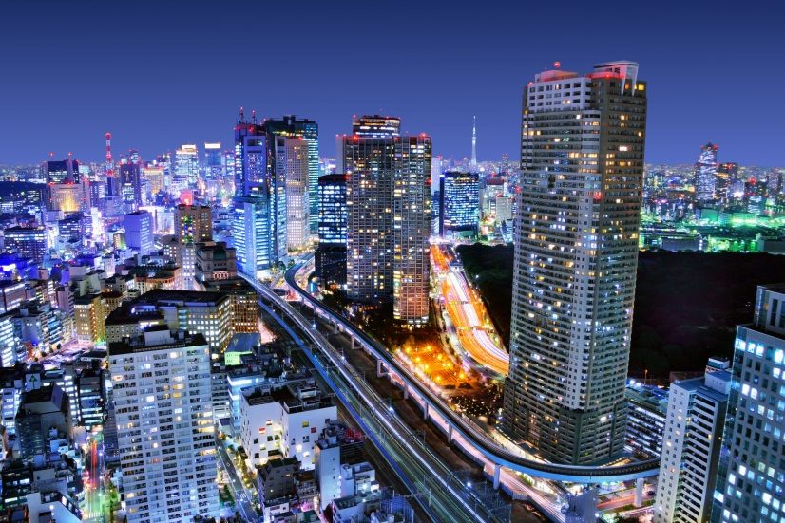
Cities
Japan’s capital, Tokyo, is situated on the island of Honshu. Other main cities are Yokohama, Fukuoka, Osaka, Sapporo, Kyoto, Nagoya and Kobe.
Tokyo
© Seomra Ranga 2019 www.seomraranga.com

Slide 6
Name & Language
Japan’s local name is “Nippon” or “Nihon” and it is sometimes referred to as “The Land of the Rising Sun”.
The official language is Japanese which is spoken by 99% of the population
© Seomra Ranga 2019 www.seomraranga.com

Slide 7
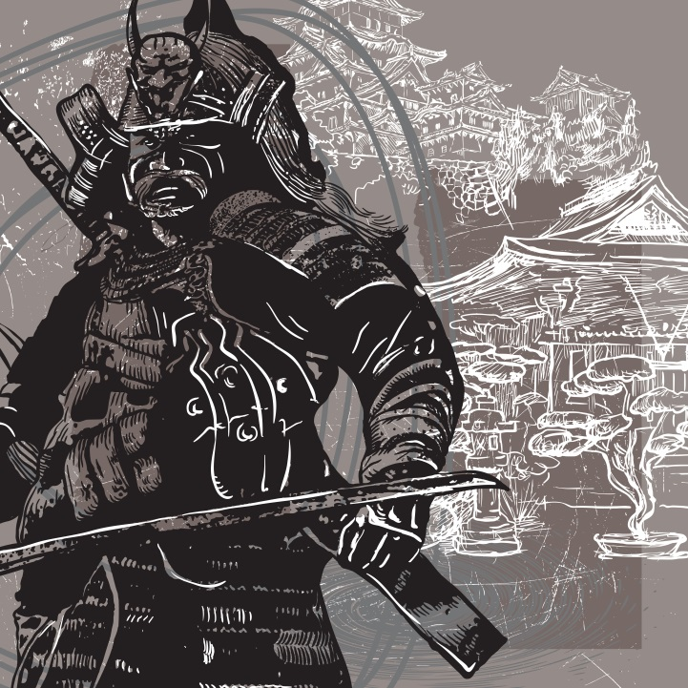
History
Japan’s history is heavily influenced by China. More than 1000 years ago warriors called Samurai became important in Japan. Years later, the real power lay in the hand of a military leader known as a Shogun.
© Seomra Ranga 2019 www.seomraranga.com

Slide 8
History
The first Europeans arrived in Japan in the mid 1500s. However, in the early 1600s, Japan’s rulers decided to cut the country off from the rest of the world. This lasted until the mid-1800s when Japan began to trade with the US.
© Seomra Ranga 2019 www.seomraranga.com

Slide 9
History
Japan’s history also includes wars against China over control of Korea (1894-1995), Russia over both country’s expansion interests (1904-1905), China over Japan wishing to extend power into China (1937-1945).
© Seomra Ranga 2019 www.seomraranga.com

Slide 10
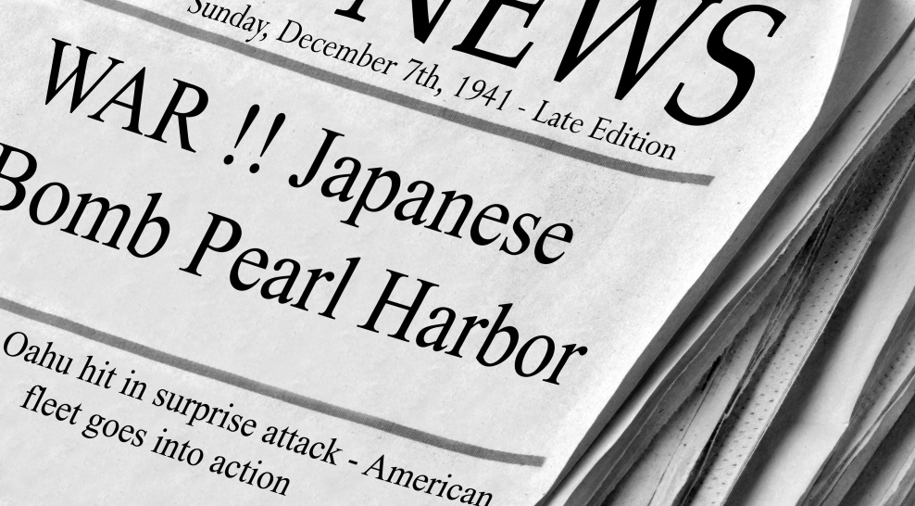
World War II
Japan entered World War II with its surprise attack on the US Naval Fleet at Pearl Harbour in Hawaii on December 7th 1941. Two days later Britain and the US declared war on Japan.
© Seomra Ranga 2019 www.seomraranga.com

Slide 11
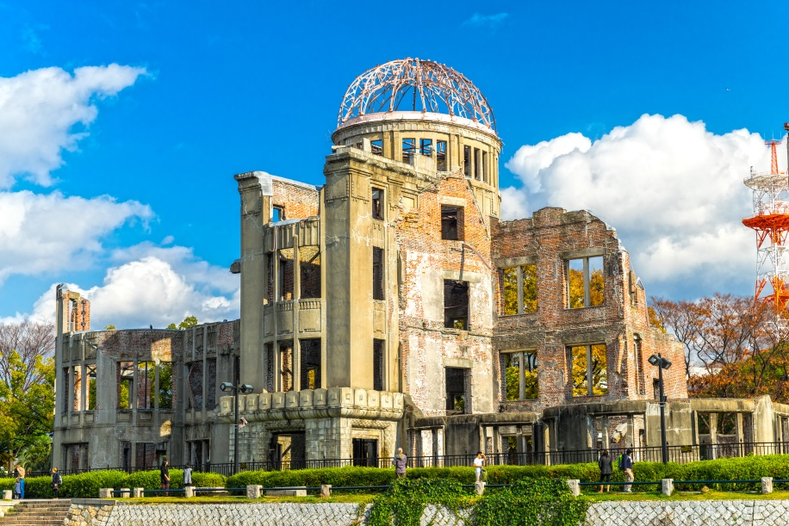
Atomic Bombs
On August 6th 1945, the US dropped the first atomic bomb on the Japanese city of Hiroshima. 100,000 Japanese people were killed.
Atomic Bomb Dome, Hiroshima
© Seomra Ranga 2019 www.seomraranga.com

Slide 12
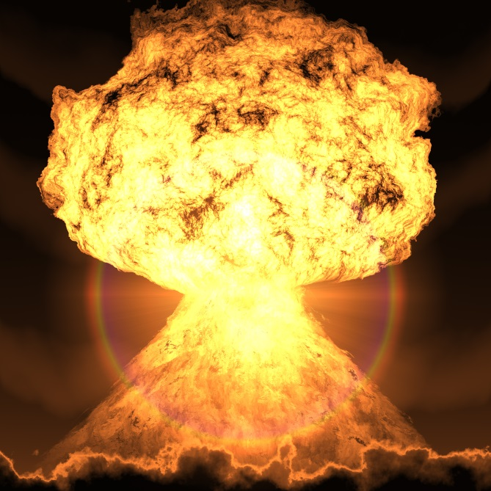
Atomic Bombs
Three days later, on August 9th 1945, a second atomic bomb was dropped on the Japanese city of Nagasaki. 40,000 Japanese were killed. This event marked the end of World War II and Japan surrendered.
© Seomra Ranga 2019 www.seomraranga.com

Slide 13
World War II
After the war, Japan was left in a state of destruction with many Japanese cities in ruins. However, after a period of hard work, by the 1970s Japan had become an industrial nation and its economy grew.
© Seomra Ranga 2019 www.seomraranga.com

Slide 14
Geography
The islands of Japan consist mainly of steep mountains with many volcanoes. Honshu, the largest island includes the sacred Mount Fuji which is 3,776m high.
© Seomra Ranga 2019 www.seomraranga.com

Slide 15
Earthquakes
Earthquakes frequently occur in Japan with about 1,500 occurring each year. Most are just minor tremors. Undersea quakes can sometimes cause huge waves called tsunamis. These can cause great destruction.
© Seomra Ranga 2019 www.seomraranga.com

Slide 16
Climate
Climates in Japan vary greatly from island to island. It varies from short warm summers and severe winters with heavy snow in the north to hot summers and almost subtropical winters further south.
© Seomra Ranga 2019 www.seomraranga.com

Slide 17
Climate
Seasonal winds called monsoons also affects the Japanese climate. These can occur in both winter and summer. Most areas of Japan get lots of rain. Japan has two main rainy seasons: mid-June to mid-July and September/October.
© Seomra Ranga 2019 www.seomraranga.com

Slide 18
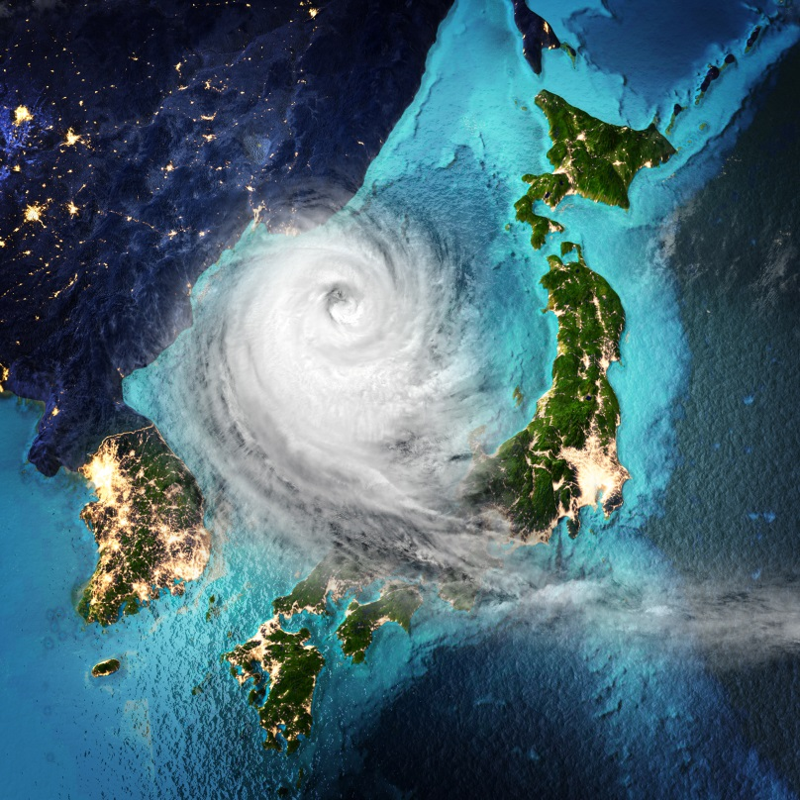
Climate
Several typhoons strike Japan each year, chiefly in late summer and early autumn. They bring heavy rain, violent winds and stormy conditions.
© Seomra Ranga 2019 www.seomraranga.com

Slide 19
Population
Latest figures show that Japan has a population of about 126.8million, the 11th largest in the world. The vast majority of the population live in cities with a very small rural population.
© Seomra Ranga 2019 www.seomraranga.com

Slide 20
Time Zone
Japan Standard Time (JST) is nine hours ahead of Greenwich Mean Time (GMT). This means that when it is midday in Ireland, it is 9pm in Japan.
© Seomra Ranga 2019 www.seomraranga.com

Slide 21
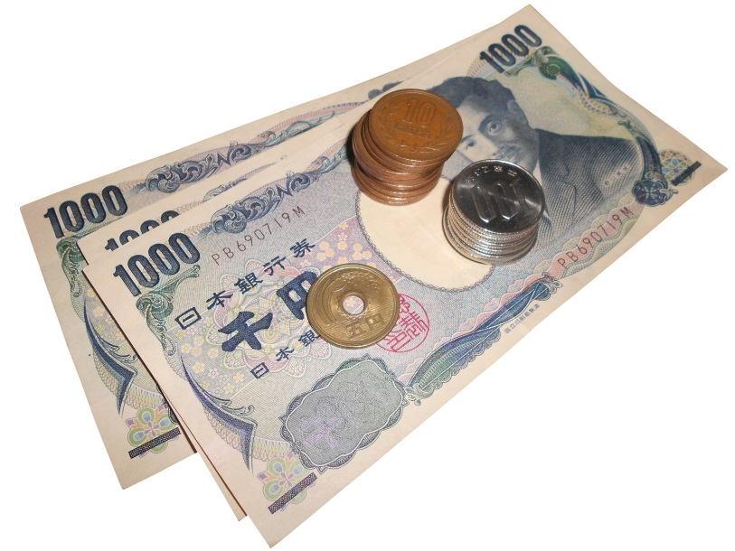
Currency
Japan’s currency is called the Yen. The symbol for the Yen is ¥ Currently €1 = ¥118.62
© Seomra Ranga 2019 www.seomraranga.com

Slide 22
Religion
Many people in Japan claim that they do not have strong religious beliefs. However, most people engage in some religious practices or rituals based on the religions of Shinto and Buddhism.
© Seomra Ranga 2019 www.seomraranga.com

Slide 23
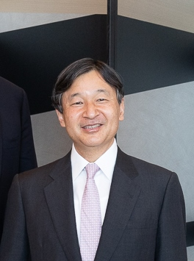
Government
Japan is a constitutional monarchy with an Emperor as head of State. Naruhito is the current Emperor of Japan. He succeeded his father Akihito in May 2019
Image © https://commons.wikimedia.org/wiki/File:Emperor_Naruhito_(may_2019).jpg
© Seomra Ranga 2019 www.seomraranga.com

Slide 24
Government
The Diet (Hokkai) is the national legislature consisting of a 465 member House of Representatives (Shugiin) elected at least every four years and a 245 member House of Councillors (Sangiin) elected every six years.
© Seomra Ranga 2019 www.seomraranga.com

Slide 25
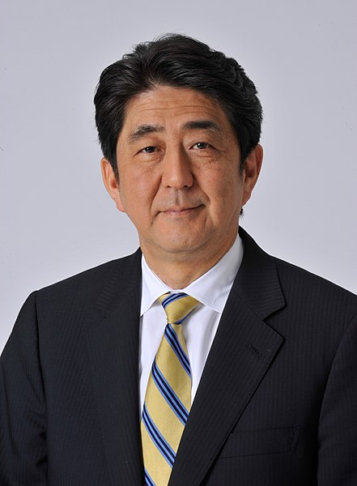
Government
A Prime Minister leads the government and appoints members of the government to run the country. Shinzō Abe is the current Prime Minister.
Image © https://commons.wikimedia.org/wiki/File:Shinz%C5%8D_Abe_Official.jpg
© Seomra Ranga 2019 www.seomraranga.com

Slide 26
Economy
Japan is one of the world’s leading countries in the value of its exports and imports. Japanese people enjoy one of the highest standards of living in the world.
© Seomra Ranga 2019 www.seomraranga.com

Slide 27
Economy
Natural resources are limited in Japan so it must buy many of its necessities like coal, copper, iron and petroleum. Less than 20% of the land is under cultivation.
© Seomra Ranga 2019 www.seomraranga.com

Slide 28
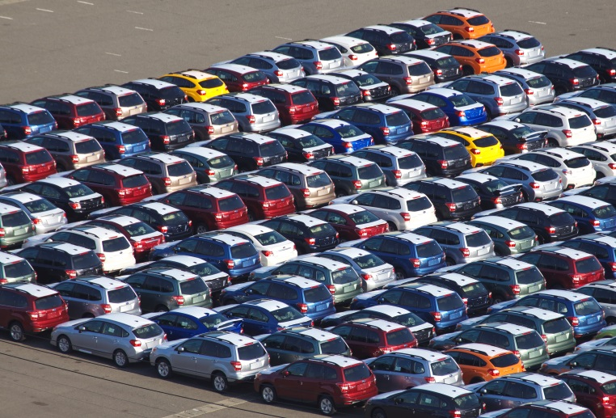
Manufacturing
Manufacturing is very important to the Japanese economy. Well known Japanese manufacturers include Honda, Nissan, Sony and Toyota.
© Seomra Ranga 2019 www.seomraranga.com

Slide 29
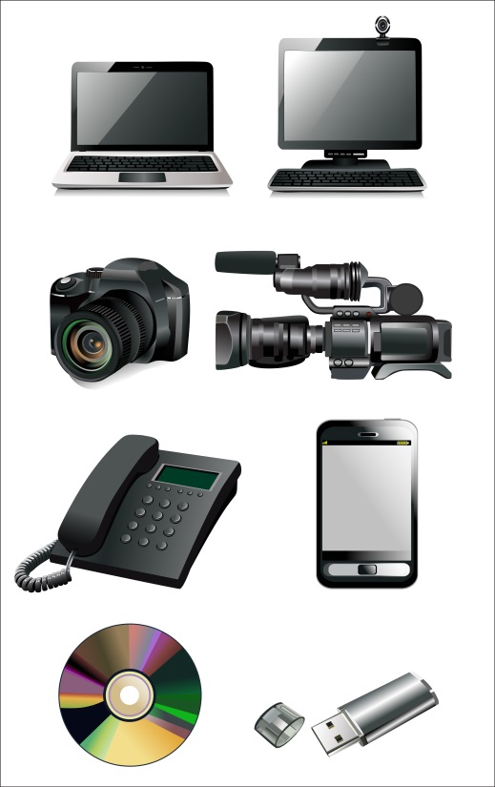
Manufacturing
Other goods manufactured in Japan include cars, trucks, watches, TVs, computers and peripherals, steel, mobile phones, electrical goods, chemicals and textiles.
© Seomra Ranga 2019 www.seomraranga.com

Slide 30
Agriculture
Rice is Japan's leading crop. Japanese farmers also grow apples, cabbage, onions, potatoes, sugar beets, and tomatoes. The country raises beef and dairy cattle, chickens for eggs and meat, and hogs. Much of Japan's agricultural output comes from the island of Hokkaido.
© Seomra Ranga 2019 www.seomraranga.com

Slide 31
Fishing
Fishing is a very important industry in Japan. Japanese fishermen catch anchovies, pollock, mackerel, salmon, squid, tuna as well as crabs and other shellfish.
© Seomra Ranga 2019 www.seomraranga.com

Slide 32
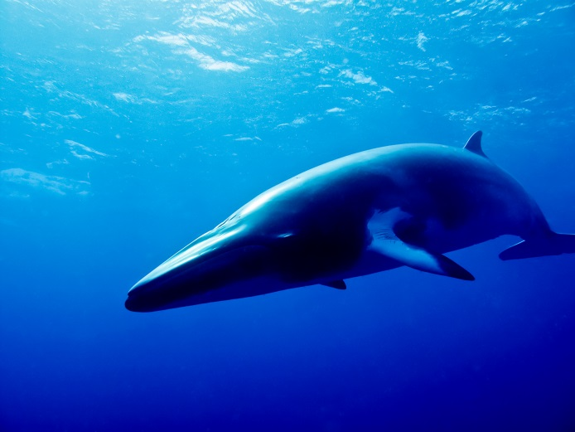
Whaling
Controversially, Japan is one of the few nations in the world that hunt whales. In July 2019, Japanese fishermen resumed commercial whale hunting for the first time in 30 years.
© Seomra Ranga 2019 www.seomraranga.com

Slide 33
Education
Japanese children between the ages of 6 and 14 spend six years in Elementary School followed by three years at a Junior High School. These nine years of education at public schools is free. Most Japanese children wear uniforms to school.
© Seomra Ranga 2019 www.seomraranga.com

Slide 34
Education
Japanese children study subjects such as science, art, the Japanese language, mathematics, music, PE, social studies, homemaking and moral education. Many Junior High School students also study English or another foreign language.
© Seomra Ranga 2019 www.seomraranga.com

Slide 35
Education
After Junior High School, most students attend Senior High School for three years. Many of these are fee-paying private schools. Many students then progress onto third level colleges.
© Seomra Ranga 2019 www.seomraranga.com

Slide 36
Education
Public school students attend classes from Monday to Friday as well as a half a day on Saturday, except for two weeks each month when they have Saturdays off.
© Seomra Ranga 2019 www.seomraranga.com

Slide 37
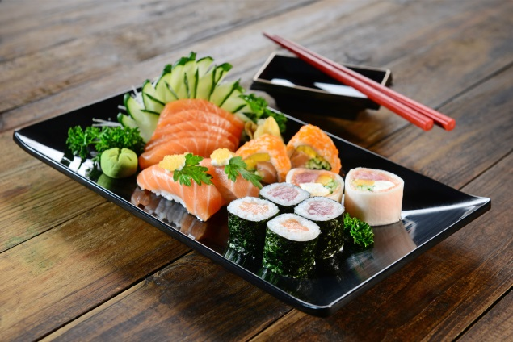
Food
Japan is well known for its distinctive food. Traditional Japanese dishes includes sushi (cured raw fish), sashimi (thinly sliced raw food), tempura (battered and fried fish), ramen (noodles in broth), yakitori (chicken on a skewer) and miso (soup).
© Seomra Ranga 2019 www.seomraranga.com

Slide 38
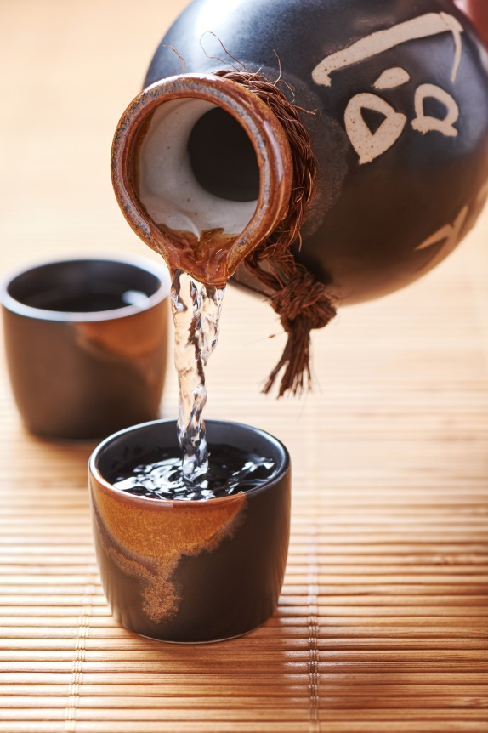
Drink
Japanese people drink soft drinks, wine and Japanese beer. Teas, such as matcha (green tea) and sakura tea (made from cherry blossoms) are traditional. Sake, a traditional Japanese-style rice wine, is also popular.
Sake
© Seomra Ranga 2019 www.seomraranga.com

Slide 39
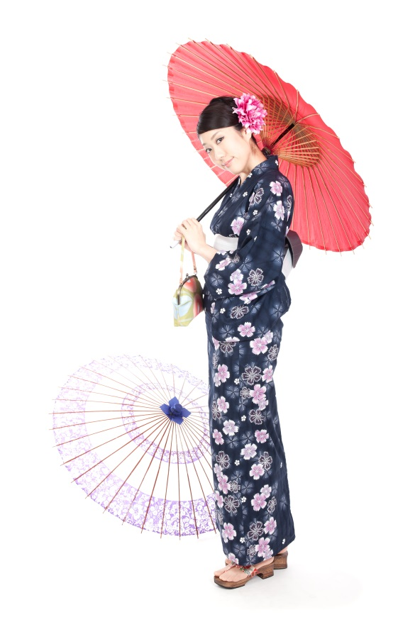
Clothing
Most Japanese people wear clothes similar to those worn in Europe and the US. On special occasions, women and girls may wear the traditional long dress called a kimono. This is tied around the waist with a sash called an obi and worn with sandals known as zori.
© Seomra Ranga 2019 www.seomraranga.com

Slide 40
Homes
People in Japan live in high rise apartments as well as traditional Japanese houses. These houses tend to be small with rooms separated by sliding paper screens. Straw mats called tatami cover the floors. People sit on cushions and sleep on a type of padded quilt called a futon.
© Seomra Ranga 2019 www.seomraranga.com

Slide 41
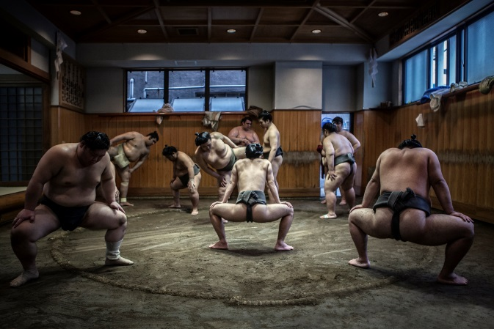
Sport
Kendo, a Japanese form of fencing in which bamboo or wooden sticks are used instead of swords, is popular in Japan. Traditional martial arts like judo, aikido and karate are also popular. Sumo wrestling is a popular spectator sport.
Sumo wrestlers in training
© Seomra Ranga 2019 www.seomraranga.com

Slide 42
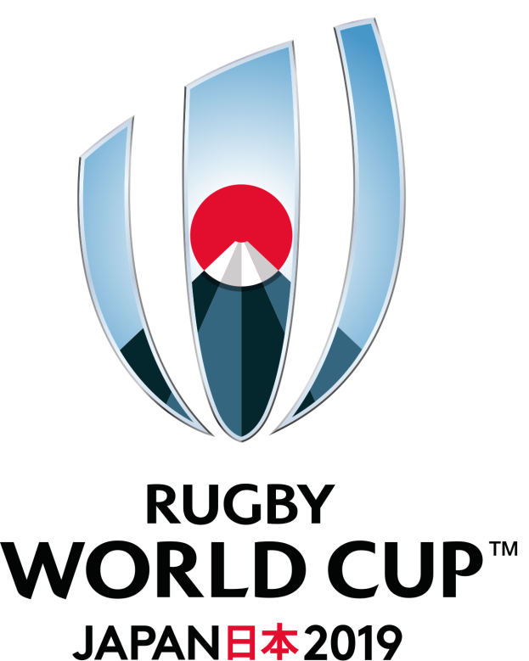
Sport
Baseball, horse racing, soccer and rugby are all popular spectator sports in Japan. The 9th Rugby World Cup will be held in Japan in 2019. This is the first time that the tournament will be held in Asia.
© Seomra Ranga 2019 www.seomraranga.com

Slide 43
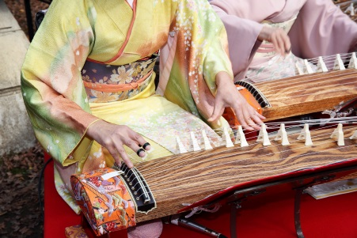
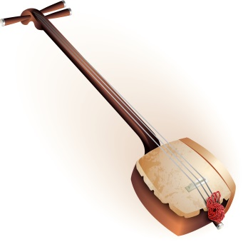
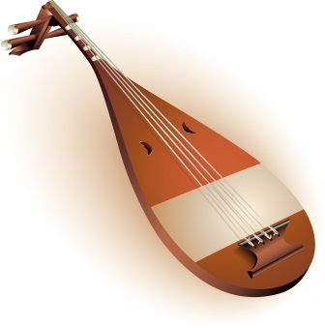
Music
Traditional Japanese music includes music played on a biwa, koto and a samisen or shamisen.
Koto
Shamisen
Biwa
© Seomra Ranga 2019 www.seomraranga.com

Slide 44
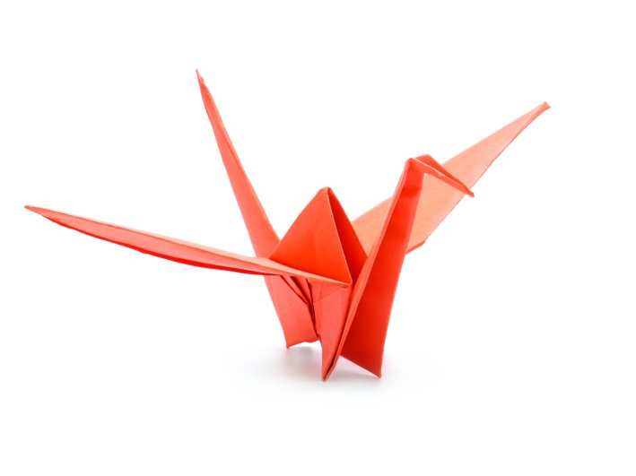
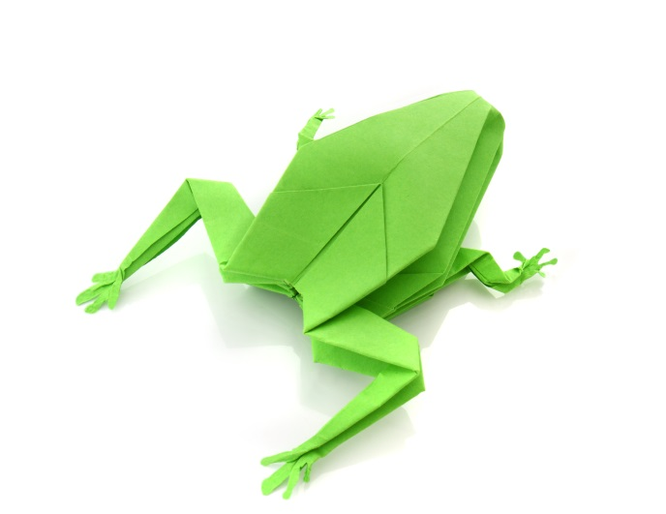
Origami
Origami, the art of paper folding, is often associated with Japanese culture. The word comes from the words ori (meaning folding) and kami (meaning paper).
© Seomra Ranga 2019 www.seomraranga.com

Slide 45
Pupil Task
Write what you have learned about Japan. Think about including some of the following: Location, Climate, Population, Cities, Currency, Religion, Flag, Government, Culture, Food etc.
© Seomra Ranga 2019 www.seomraranga.com

Slide 46


Resources used in this file from:
https://depositphotos.com/
https://www.teacherspayteachers.com/Store/Dancing-Crayon-Designs
Information sourced from:
Allinson, GD 2019, 'Japan' , World Book Student, World Book, Chicago, viewed 3 August 2019 https://www.worldbookonline.com/student-new/#/article/home/ar285600
'Japan' 2019, World Book Kids, World Book, Chicago, viewed 05 Aug 2019, https://www.worldbookonline.com/kids/home#article/ar831063
The Chambers Encyclopaedia
Wikipedia
© Seomra Ranga 2019 www.seomraranga.com

