Slide 1
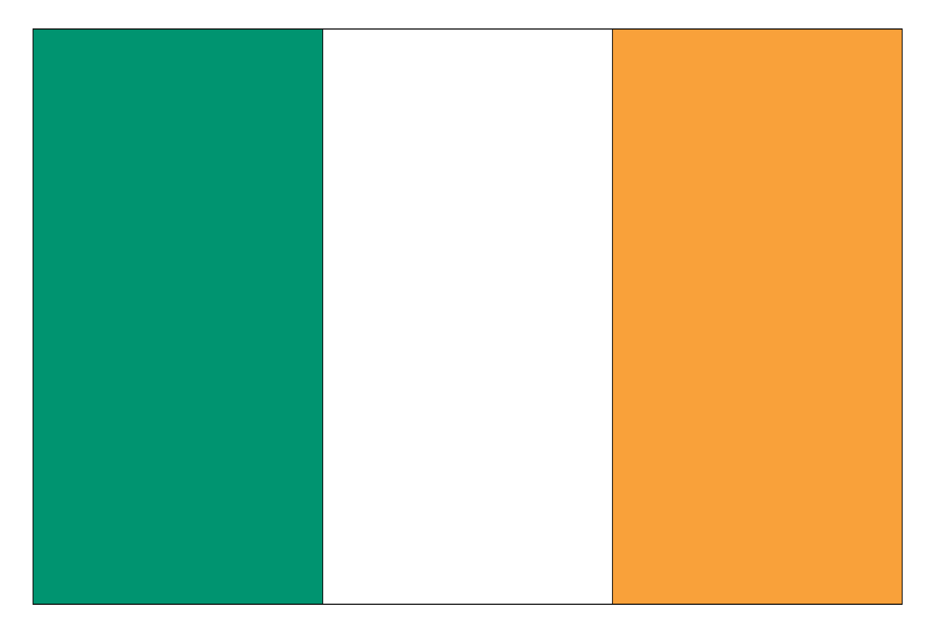

Ireland’s
Call
© Seomra Ranga 2019 www.seomraranga.com

Slide 2
Ireland’s Call
History:
Rugby is one of the few sports where members of the national team are drawn from both Northern Ireland and the Republic of Ireland.
© Seomra Ranga 2019 www.seomraranga.com

Slide 3
Ireland’s Call
History:
It was felt that some players from Northern Ireland might not be comfortable singing Amhrán na bhFiann before rugby matches because of their background. So, a new anthem was needed.
© Seomra Ranga 2019 www.seomraranga.com

Slide 4
Ireland’s Call
History:
The Irish Rugby Football Union (IRFU) commissioned the well-known Irish composer and musician Phil Coulter to write a new rugby anthem for the team playing in the 1995 Rugby World Cup.
© Seomra Ranga 2019 www.seomraranga.com

Slide 5
Ireland’s Call
History:
Coulter composed “Ireland’s Call” and it has since become one of the most recognisable songs in the country.
© Seomra Ranga 2019 www.seomraranga.com

Slide 6
Ireland’s Call
Practice:
At most games, only the first verse is sung followed by the Chorus sung twice.
© Seomra Ranga 2019 www.seomraranga.com

Slide 7
Ireland’s Call
Practice:
At home International rugby games, both Ireland’s Call and Amhrán na bhFiann are sung.
© Seomra Ranga 2019 www.seomraranga.com

Slide 8
Ireland’s Call
Practice:
At away International rugby games, only Ireland’s Call is sung.
© Seomra Ranga 2019 www.seomraranga.com

Slide 9
Ireland’s
Call
© Seomra Ranga 2019 www.seomraranga.com

Slide 10
Ireland’s Call
Come the day
and come the hour,
Come the power
and the glory,
We have come to answer
Our Country's call,
From the four proud
Provinces of Ireland.
© Seomra Ranga 2019 www.seomraranga.com

Slide 11
Ireland’s Call
CHORUS
Ireland, Ireland
Together standing tall
Shoulder to shoulder
We'll answer Ireland's call
© Seomra Ranga 2019 www.seomraranga.com

Slide 12
Ireland’s Call
From the mighty
Glens of Antrim,
From the rugged hills of Galway,
From the walls of Limerick
And Dublin Bay,
From the four proud
Provinces of Ireland.
© Seomra Ranga 2019 www.seomraranga.com

Slide 13
Ireland’s Call
CHORUS
Ireland, Ireland
Together standing tall
Shoulder to shoulder
We'll answer Ireland's call
© Seomra Ranga 2019 www.seomraranga.com

Slide 14
Ireland’s Call
Hearts of steel
And heads unbowing,
Vowing never to be broken,
We will fight until
We can fight no more,
From the four proud
Provinces of Ireland.
© Seomra Ranga 2019 www.seomraranga.com

Slide 15
Ireland’s Call
CHORUS
Ireland, Ireland
Together standing tall
Shoulder to shoulder
We'll answer Ireland's call
© Seomra Ranga 2019 www.seomraranga.com

Slide 16

Resources used in this file from:
https://www.teacherspayteachers.com/Store/Dancing-Crayon-Designs

