Slide 1
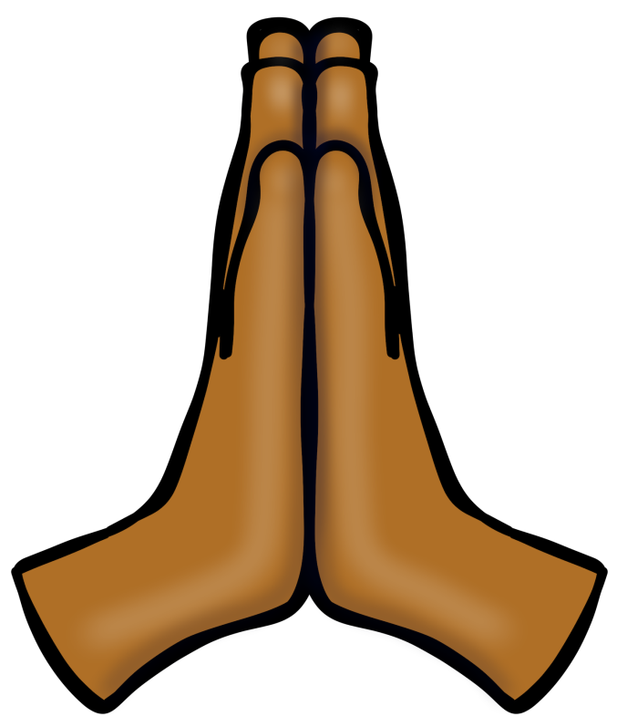

The Beatitudes
© Seomra Ranga 2019 www.seomraranga.com

Slide 2
What are the Beatitudes?
The Beatitudes
The Beatitudes are eight blessings taught by Jesus during his Sermon on the Mount, recounted in the Gospel of St. Matthew. Each Beatitude is almost like a proverb. They all follow a simple pattern - Jesus names a group of people normally thought to be unfortunate and pronounces them blessed.
One of the meanings of “Blessed” is “happy” or “joyful”. Each of the Beatitudes describes a person who puts God and others’ interests above their own.
In the Beatitudes, Jesus is telling us that we cannot be “Blessed” if we live selfishly.
© Seomra Ranga 2019 www.seomraranga.com

Slide 3


What are the Beatitudes?
The Beatitudes
The Ten Commandments taught by Jesus tell us what we shouldn’t do on Earth. The Beatitudes tell us what we should do. They are positive. They are the eight virtues or traits that Jesus said we should show in our daily lives.
Those that show these virtues will be blessed with rewards, both here on earth and in heaven.
© Seomra Ranga 2019 www.seomraranga.com

Slide 4
The Beatitudes
The Beatitudes
1. Blessed are the poor in spirit, for theirs is the kingdom of heaven. 2. Blessed are those who mourn, for they will be comforted. 3. Blessed are the meek, for they will inherit the earth. 4. Blessed are those who hunger and thirst for righteousness,
for they will be filled. 5. Blessed are the merciful, for they will be shown mercy. 6. Blessed are the pure in heart, for they will see God. 7. Blessed are the peacemakers, for they will be called children of God. 8 Blessed are those who are persecuted for righteousness’ sake, for theirs is the kingdom of heaven.
© Seomra Ranga 2019 www.seomraranga.com

Slide 5

The Beatitudes
Resources used in this file from:
https://www.teacherspayteachers.com/Store/Educlips
© Seomra Ranga 2019 www.seomraranga.com

