Slide 1
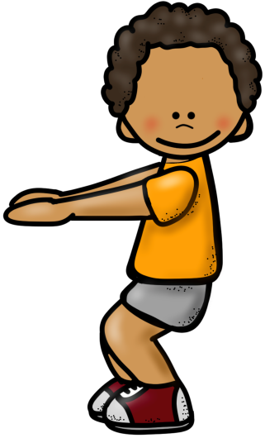
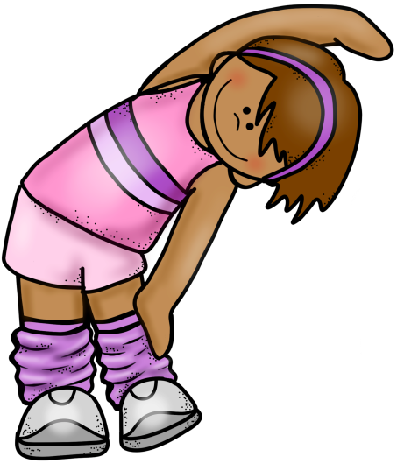
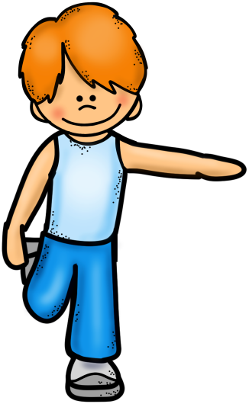
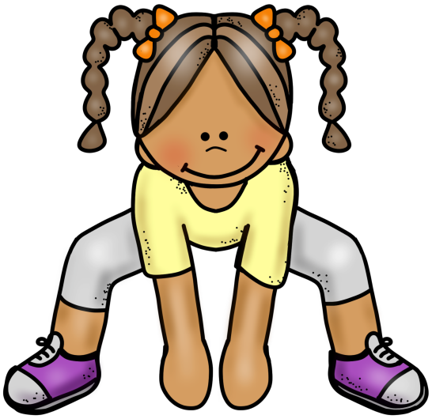

10 @ 10
10 simple exercises to do in the classroom at 10am every morning
© Seomra Ranga 2018 www.seomraranga.com

Slide 2

10 @ 10
10
Repeat
#1
Quad Stretch
© Seomra Ranga 2018 www.seomraranga.com

Slide 3

10 @ 10
10
Repeat
#2
Side Stretch
© Seomra Ranga 2018 www.seomraranga.com

Slide 4
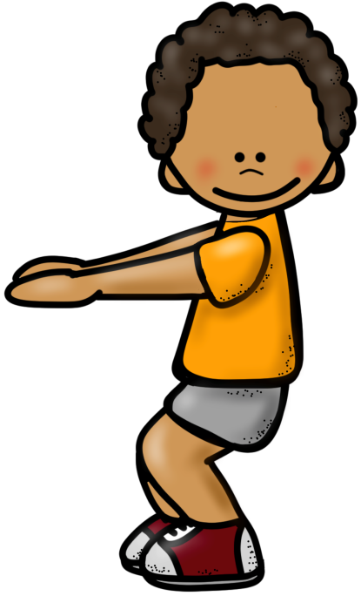
10 @ 10
10
Repeat
#3
Knee Bends
© Seomra Ranga 2018 www.seomraranga.com

Slide 5
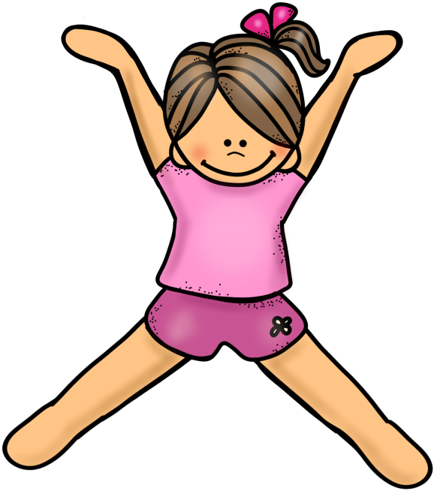
10 @ 10
10
Repeat
#4
Star Jumps
© Seomra Ranga 2018 www.seomraranga.com

Slide 6

10 @ 10
10
Repeat
#5
Sumo Squats
© Seomra Ranga 2018 www.seomraranga.com

Slide 7
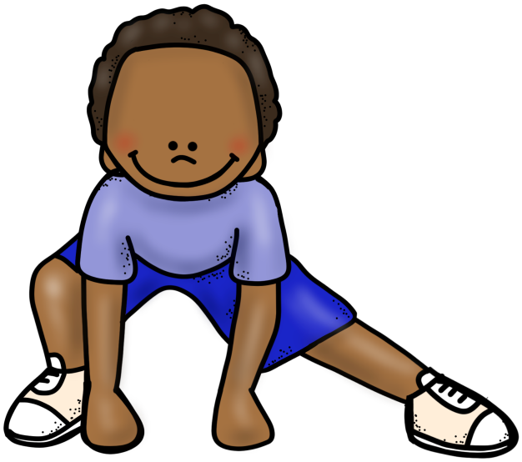
10 @ 10
10
Repeat
#6
Side Lunges
© Seomra Ranga 2018 www.seomraranga.com

Slide 8
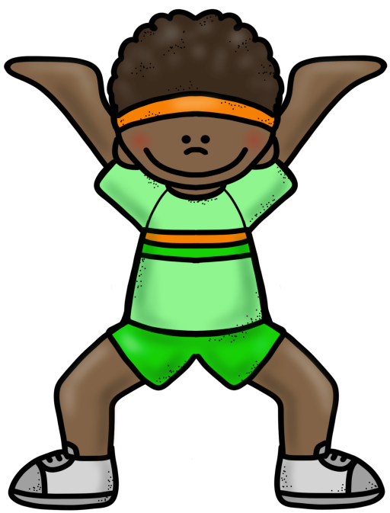
10 @ 10
10
Repeat
#7
Overhead Squats
© Seomra Ranga 2018 www.seomraranga.com

Slide 9
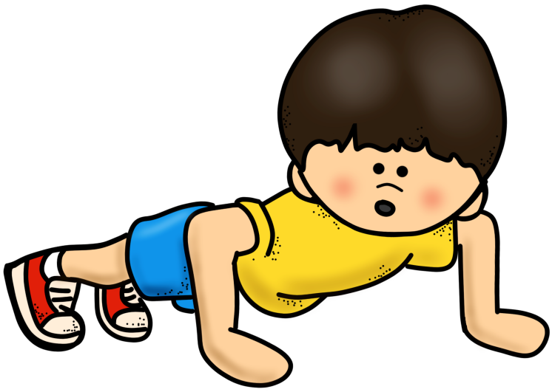
10 @ 10
10
Repeat
#8
Push Ups
© Seomra Ranga 2018 www.seomraranga.com

Slide 10
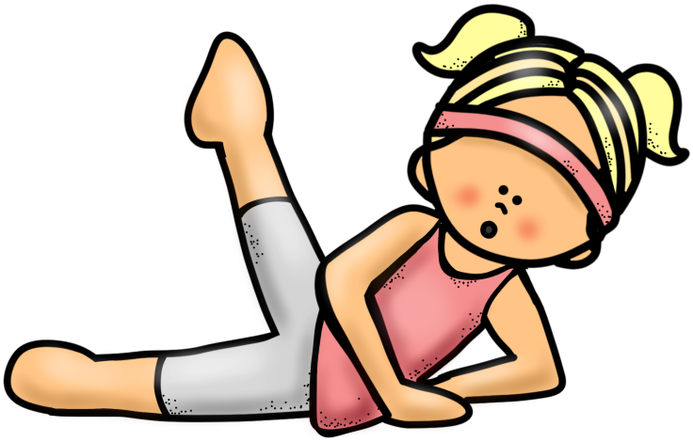
10 @ 10
10
Repeat
#9
Leg Stretches
© Seomra Ranga 2018 www.seomraranga.com

Slide 11
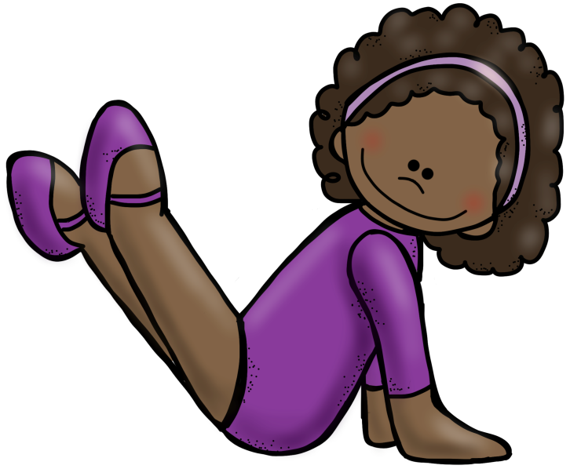
10 @ 10
10
Repeat
#10
Leg Lifts
© Seomra Ranga 2018 www.seomraranga.com

Slide 12

10 @ 10
Resources used in this file from:
https://www.teacherspayteachers.com/Store/Educlips
© Seomra Ranga 2018 www.seomraranga.com

