Slide 1
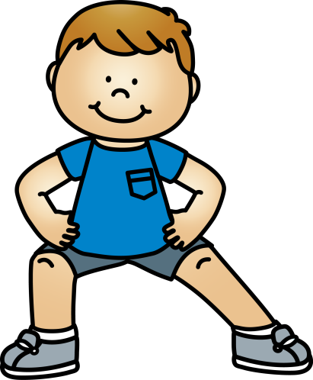
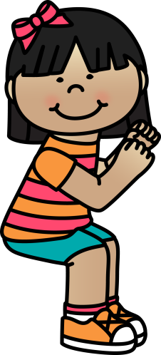
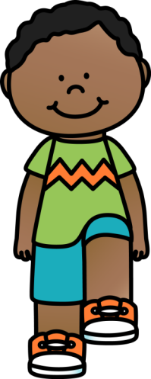
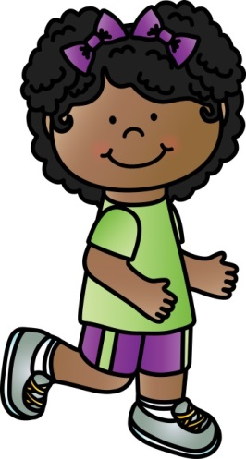

10 @ 10
10 simple exercises to do in the classroom at 10am every morning
© Seomra Ranga 2018 www.seomraranga.com

Slide 2
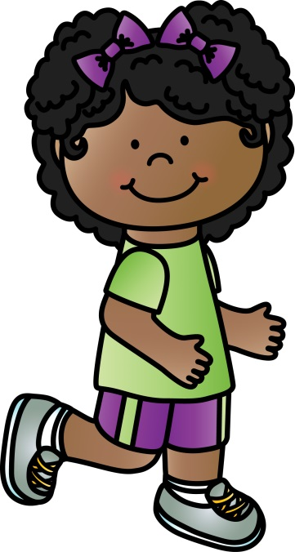
10 @ 10
10
Repeat
#1
Running on the Spot
© Seomra Ranga 2018 www.seomraranga.com

Slide 3
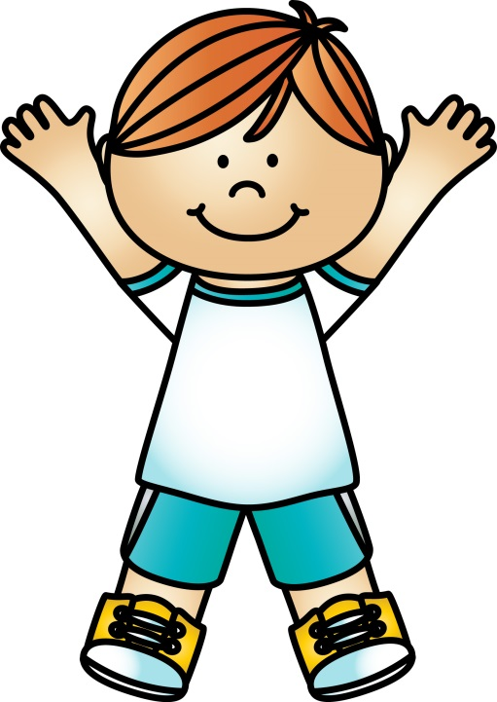
10 @ 10
10
Repeat
#2
Jumping Jacks
© Seomra Ranga 2018 www.seomraranga.com

Slide 4
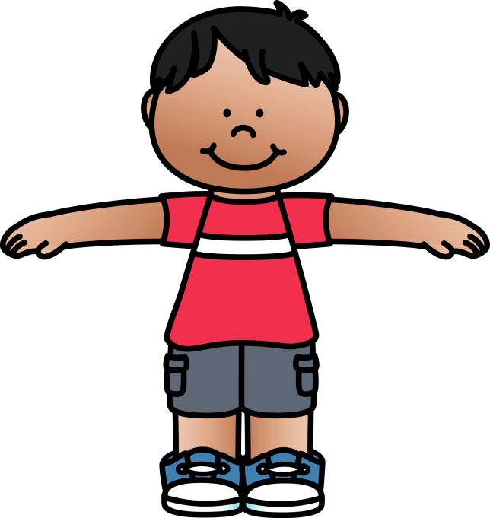
10 @ 10
10
Repeat
#3
Arm Circles
© Seomra Ranga 2018 www.seomraranga.com

Slide 5

10 @ 10
10
Repeat
#4
Side Lunges
© Seomra Ranga 2018 www.seomraranga.com

Slide 6
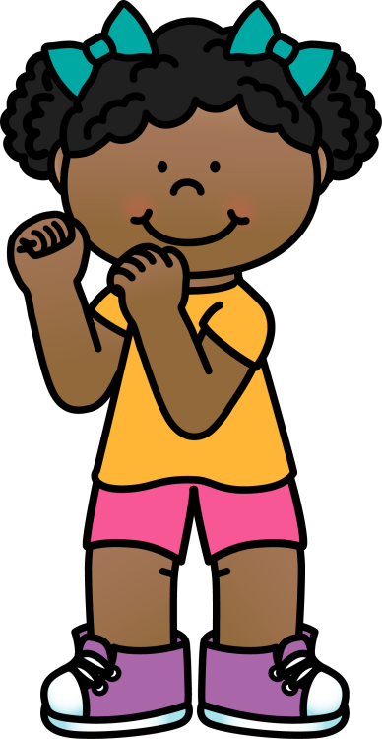
10 @ 10
10
Repeat
#5
Trunk Twists
© Seomra Ranga 2018 www.seomraranga.com

Slide 7
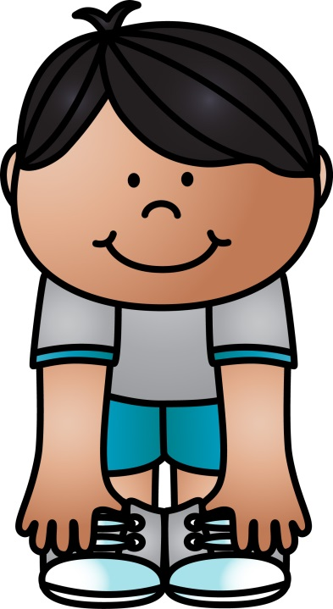
10 @ 10
10
Repeat
#6
Touch Toes
© Seomra Ranga 2018 www.seomraranga.com

Slide 8

10 @ 10
10
Repeat
#7
March on the Spot
© Seomra Ranga 2018 www.seomraranga.com

Slide 9

10 @ 10
10
Repeat
#8
Squats
© Seomra Ranga 2018 www.seomraranga.com

Slide 10
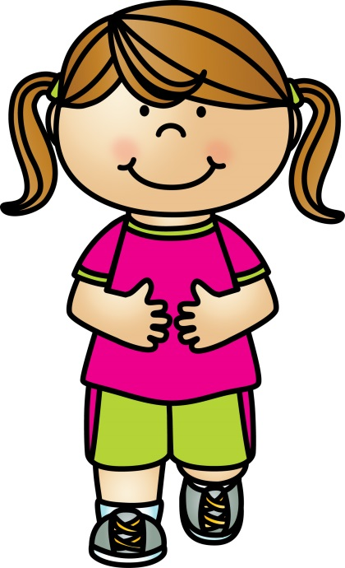
10 @ 10
10
Repeat
#9
Hopping on One Foot
© Seomra Ranga 2018 www.seomraranga.com

Slide 11
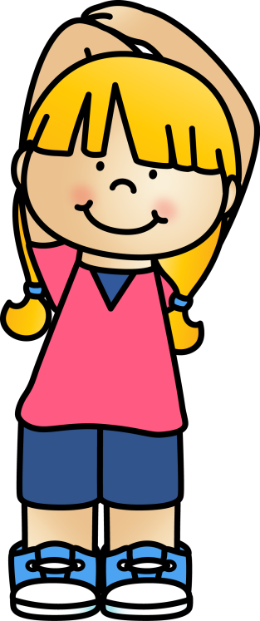
10 @ 10
10
Repeat
#10
Tricep Stretches
© Seomra Ranga 2018 www.seomraranga.com

Slide 12

10 @ 10
Resources used in this file from:
https://www.teacherspayteachers.com/Store/Whimsy-Clips
© Seomra Ranga 2018 www.seomraranga.com

