Slide 1

PRIME NUMBERS
© Seomra Ranga 2018 www.seomraranga.com

Slide 2
PRIME NUMBERS
2
A Prime Number is a number greater than 1 that has no other factors except itself and 1.
(A factor is a number that divides evenly into another number)
© Seomra Ranga 2018 www.seomraranga.com

Slide 3
PRIME NUMBERS
3
Examples of Prime Numbers are:
7 (7 x 1); 11 (11 x 1);
17 (17 x 1); 41 (41 x 1)
© Seomra Ranga 2018 www.seomraranga.com

Slide 4
PRIME NUMBERS
4
Number 1 is not considered prime as it has only one factor – 1. The first Prime Number is 2.
© Seomra Ranga 2018 www.seomraranga.com

Slide 5
PRIME NUMBERS
5
If a number is not a Prime Number, it is said to be Composite.
© Seomra Ranga 2018 www.seomraranga.com

Slide 6
PRIME NUMBERS
6
Examples of Composite Numbers are:
9 (9 x 1 and 3 x 3);
12 (12 x 1 and 4 x 3 and 6 x 2); 20 (20 x 1 and 10 x 2 and 4 x 5)
© Seomra Ranga 2018 www.seomraranga.com

Slide 7
PRIME NUMBERS
7
Sieve of Eratosthenes
Eratosthenes (275-194 BC, Greece) devised a “sieve” to discover Prime Numbers. Eratosthenes’s sieve gets rid of the Composite Numbers and leaves you with the Prime Numbers.
© Seomra Ranga 2018 www.seomraranga.com

Slide 8
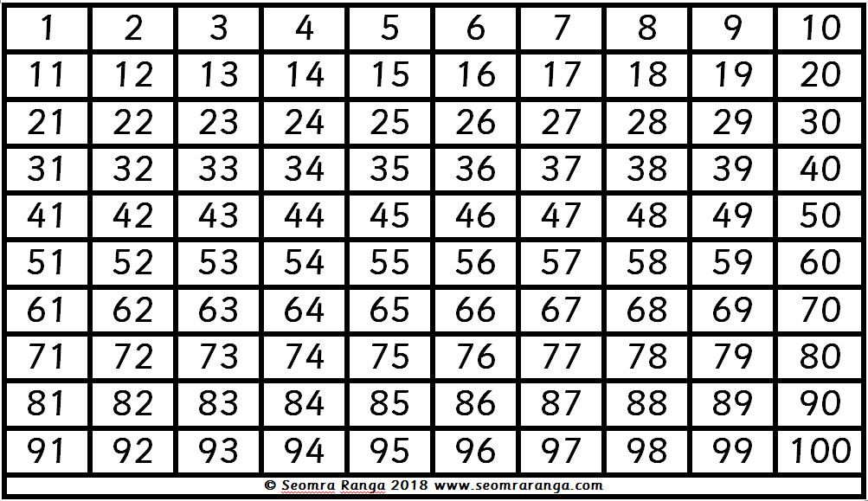
PRIME NUMBERS
8
Use your 100 Square to find out how many Prime Numbers there are between 1 and 100, using Eratosthenes’s sieve:
© Seomra Ranga 2018 www.seomraranga.com

Slide 9
PRIME NUMBERS
9
Cross out 1 as it’s not prime
Circle 2 and then cross out every multiple of 2 (ie every second number)
Circle 3 and then cross out every multiple of 3 (ie every third number)
Circle 5 and then cross out every multiple of 5
Continue doing this until all the numbers have either been circled or crossed out.
You should now have circled all the prime numbers from 1 to 100
© Seomra Ranga 2018 www.seomraranga.com

Slide 10
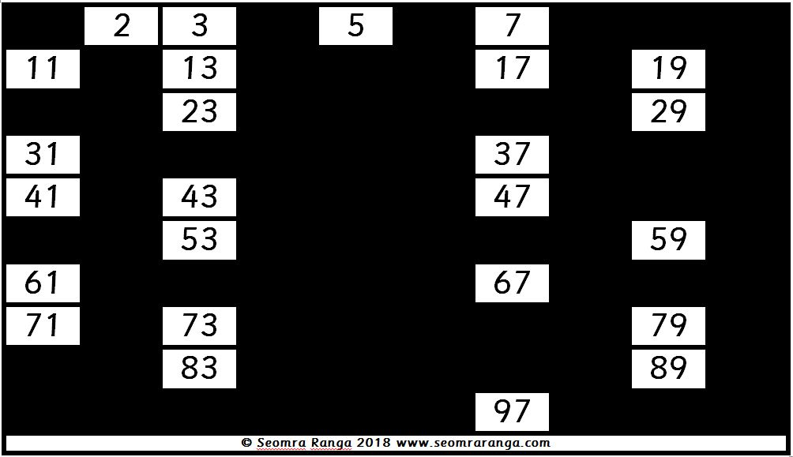
PRIME NUMBERS
10
You should have found 25 Prime Numbers between 1 and 100
© Seomra Ranga 2018 www.seomraranga.com

Slide 11
PRIME NUMBERS
11
Use your completed 100 Square to find out:
What is the 8th Prime Number
What is the 13th Prime Number
What is the 24th Prime Number
© Seomra Ranga 2018 www.seomraranga.com

Slide 12
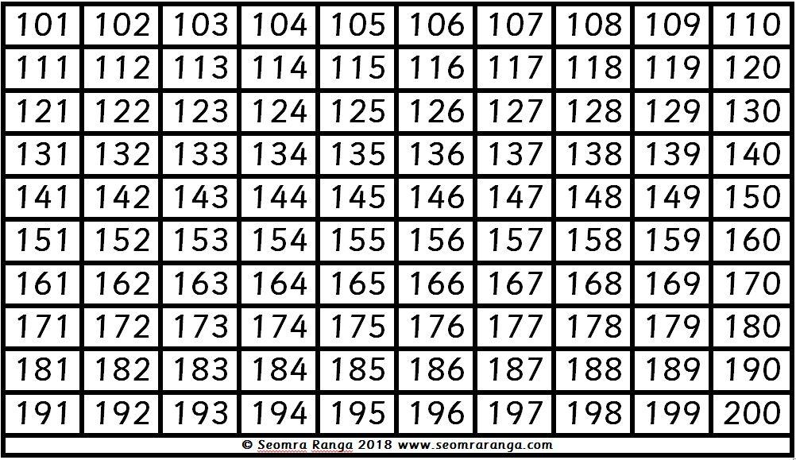
PRIME NUMBERS
12
Now use your 200 Square to find out how many Prime Numbers there are between 101 and 200, using Eratosthenes’s sieve:
© Seomra Ranga 2018 www.seomraranga.com

Slide 13
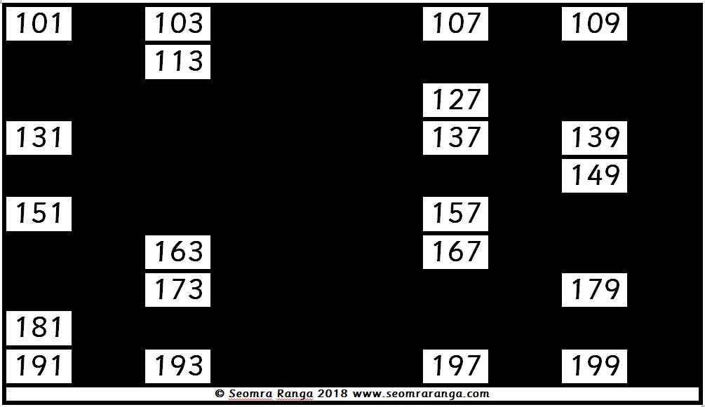
PRIME NUMBERS
13
You should have found 21 Prime Numbers between 101 and 200
© Seomra Ranga 2018 www.seomraranga.com

Slide 14
PRIME NUMBERS
14
Prime Twins
This is where (P, P + 2) are both prime numbers.
Eg. (3, 5); (5, 7); (11, 13)
Can you find any more Twin Primes?
© Seomra Ranga 2018 www.seomraranga.com

Slide 15
PRIME NUMBERS
15
Prime Triplets
This is where (P, P + 2, P + 6) or (P, P + 4, P + 6) are all prime numbers.
Eg. (5, 7, 11); (7, 11, 13)
Can you find any more Prime Triplets?
© Seomra Ranga 2018 www.seomraranga.com

Slide 16
PRIME NUMBERS
16
Prime Quadruplets
This is where (P, P + 2, P + 6, P + 8) are all prime numbers.
Eg. (5, 7, 11, 13); (11, 13, 17, 19)
Can you find any more Prime Quadruplets?
© Seomra Ranga 2018 www.seomraranga.com

Slide 17
PRIME NUMBERS
17
Cousin Primes
This is where (P, P + 4) are both prime numbers.
Eg. (3, 7); (7, 11); (13, 17)
Can you find any more Cousin Primes?
© Seomra Ranga 2018 www.seomraranga.com

Slide 18
PRIME NUMBERS
18
Additive Primes
These are prime numbers whose sum of digits is also prime.
Eg. 11, 23, 29, 41
Can you find any more Additive Primes?
© Seomra Ranga 2018 www.seomraranga.com

Slide 19
PRIME NUMBERS
19
Safe Primes
These are where P and (P – 1) ÷ 2 are both prime numbers.
Eg. 5, 7, 11, 23
Can you find any more Safe Primes?
© Seomra Ranga 2018 www.seomraranga.com

Slide 20
PRIME NUMBERS
20
Can you find out:
What is the 50th Prime Number?
What is the 100th Prime Number
What is the 1000th Prime Number
How many Prime Numbers are there?
© Seomra Ranga 2018 www.seomraranga.com

Slide 21
PRIME NUMBERS
21
Did you know:
The largest known Prime Number was discovered in December 2017. It is:
2^{77,232,917}
© Seomra Ranga 2018 www.seomraranga.com

