Slide 1
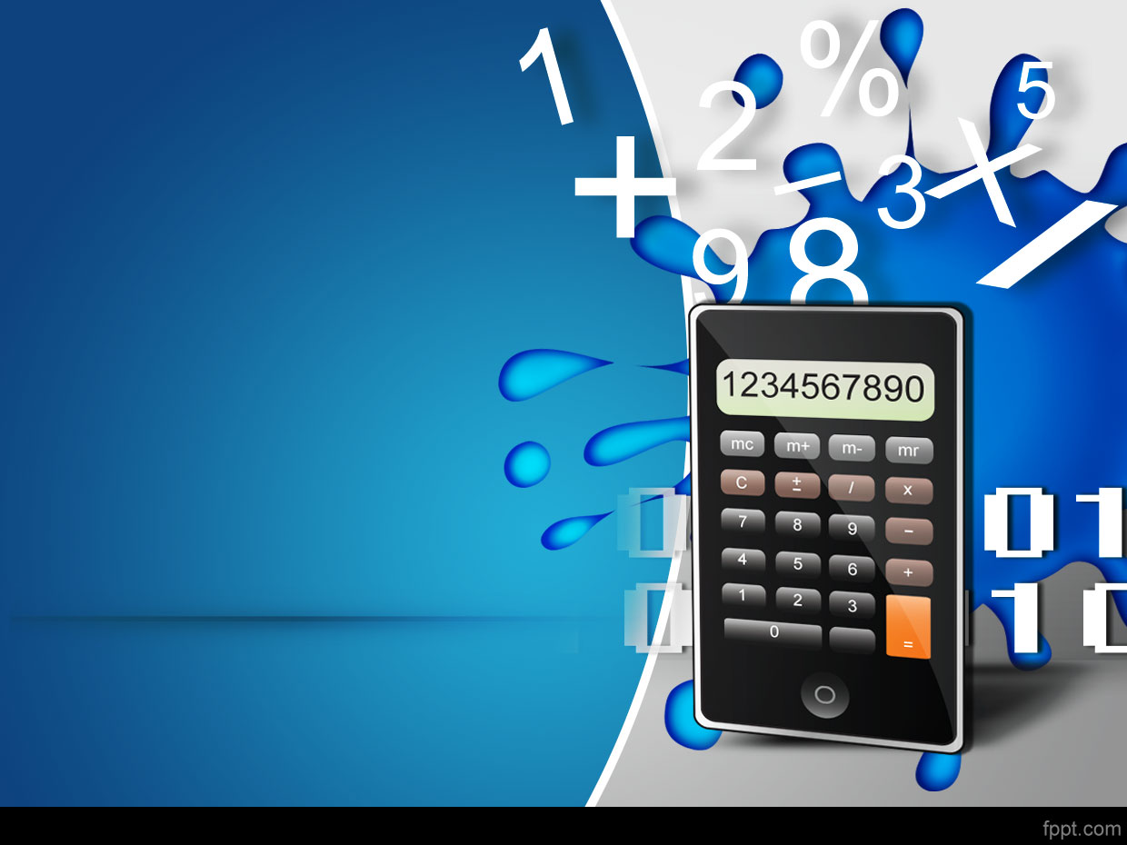

Maths Week 2017
Table Quiz
© Seomra Ranga 2017 www.seomraranga.com

Slide 2
Before You Start
Make sure you have written your table/team number/letter on every answer sheet
Write the number of each round 1-8 on every answer sheet
Try not to shout out answers
Check with your team mates and agree an answer before you write it down
© Seomra Ranga 2017 www.seomraranga.com

Slide 3
Before You Start
Don’t worry about spellings – just do your best
If you’re not sure of the answer, make your best possible guess
It might be a good idea to have a piece of paper to do some rough calculations for some questions
Good luck and enjoy the quiz
© Seomra Ranga 2017 www.seomraranga.com

Slide 4
ROUND 1
© Seomra Ranga 2017 www.seomraranga.com

Slide 5
Round 1
Question 1
What is the sum of 12 and 34?
© Seomra Ranga 2017 www.seomraranga.com

Slide 6
Round 1
Question 2
How many buns in a baker’s dozen?
© Seomra Ranga 2017 www.seomraranga.com

Slide 7
Round 1
Question 3
How many hours are there in four days?
© Seomra Ranga 2017 www.seomraranga.com

Slide 8
Round 1
Question 4
Round off 4,355 to the nearest 10
© Seomra Ranga 2017 www.seomraranga.com

Slide 9
Round 1
Question 5
What is the total of these circles:
4
6
2
3
© Seomra Ranga 2017 www.seomraranga.com

Slide 10
Round 1
Question 6
Which number on a clock face is ½ of another number on the clock, ⅔ of another number and ¾ of another number?
© Seomra Ranga 2017 www.seomraranga.com

Slide 11
Maths Joke #1
Why did the girl wear glasses during maths class?
Because it improves di-vision!
© Seomra Ranga 2017 www.seomraranga.com

Slide 12
ROUND 2
© Seomra Ranga 2017 www.seomraranga.com

Slide 13
Round 2
Question 1
If you face West and turn clockwise 180º, in what direction are you facing?
© Seomra Ranga 2017 www.seomraranga.com

Slide 14
Round 2
Question 2
My tens number is three; my thousands number is one; my units number is nine; my hundreds number is zero. What number am I?
© Seomra Ranga 2017 www.seomraranga.com

Slide 15
Round 2
Question 3
True or false: a ‘CENTILLION’ is the number 1 followed by 404 zeroes?
© Seomra Ranga 2017 www.seomraranga.com

Slide 16
Round 2
Question 4
Write the number ten thousand and five
© Seomra Ranga 2017 www.seomraranga.com

Slide 17
Round 2
Question 5
What is the total number of degrees in a triangle?
© Seomra Ranga 2017 www.seomraranga.com

Slide 18
Round 2
Question 6
If A=1, B=2, C=3…… Z=26, what is the value of the word ‘SQUARE’?
© Seomra Ranga 2017 www.seomraranga.com

Slide 19
Maths Joke #2
Why did the maths book look so sad?
It had so many problems!
© Seomra Ranga 2017 www.seomraranga.com

Slide 20
ROUND 1 ANSWERS
© Seomra Ranga 2017 www.seomraranga.com

Slide 21
Round 1 Answers
Question 1
What is the sum of 12 and 34?
46
© Seomra Ranga 2017 www.seomraranga.com

Slide 22
Round 1 Answers
Question 2
How many buns in a baker’s dozen?
13
© Seomra Ranga 2017 www.seomraranga.com

Slide 23
Round 1 Answers
Question 3
How many hours are there in four days?
96
© Seomra Ranga 2017 www.seomraranga.com

Slide 24
Round 1 Answers
Question 4
Round off 4,355 to the nearest 10
4360
© Seomra Ranga 2017 www.seomraranga.com

Slide 25
Round 1 Answers
Question 5
What is the total of these circles:
49
4
6
2
3
© Seomra Ranga 2017 www.seomraranga.com

Slide 26
Round 1 Answers
Question 6
Which number on a clock face is ½ of another number on the clock, ⅔ of another number and ¾ of another number?
6 (it’s ½ of 12; ⅔ of 9; ¾ of 8)
© Seomra Ranga 2017 www.seomraranga.com

Slide 27
Maths Joke #3
What geometric shape is like a lost parrot?
Polygon!
© Seomra Ranga 2017 www.seomraranga.com

Slide 28
ROUND 3
© Seomra Ranga 2017 www.seomraranga.com

Slide 29
Round 3
Question 1
The perimeter of a circle is known as (a) arc (b) circumference (c) diameter (d) radius
© Seomra Ranga 2017 www.seomraranga.com

Slide 30
Round 3
Question 2
What do the numbers on the opposite side of a dice add up to?
© Seomra Ranga 2017 www.seomraranga.com

Slide 31
Round 3
Question 3
How many sides are there on a heptagon?
© Seomra Ranga 2017 www.seomraranga.com

Slide 32
Round 3
Question 4
What is 8.2 X 100?
© Seomra Ranga 2017 www.seomraranga.com

Slide 33
Round 3
Question 5
If eight chocolate bars cost €10, how much does two cost?
© Seomra Ranga 2017 www.seomraranga.com

Slide 34
Round 3
Question 6
What is the value of the Roman Numeral LVIII?
© Seomra Ranga 2017 www.seomraranga.com

Slide 35
Maths Joke #4
What did the zero say to the 8?
Nice belt!
© Seomra Ranga 2017 www.seomraranga.com

Slide 36
ROUND 2 ANSWERS
© Seomra Ranga 2017 www.seomraranga.com

Slide 37
Round 2 Answers
Question 1
If you face West and turn clockwise 180º, in what direction are you facing?
East
© Seomra Ranga 2017 www.seomraranga.com

Slide 38
Round 2 Answers
Question 2
My tens number is three; my thousands number is one; my units number is nine; my hundreds number is zero. What number am I?
1039
© Seomra Ranga 2017 www.seomraranga.com

Slide 39
Round 2 Answers
Question 3
True or false: a ‘CENTILLION’ is the number 1 followed by 404 zeroes?
False (it’s 1 followed by 303 zeroes)
© Seomra Ranga 2017 www.seomraranga.com

Slide 40
Round 2 Answers
Question 4
Write the number ten thousand and five
10,005
© Seomra Ranga 2017 www.seomraranga.com

Slide 41
Round 2 Answers
Question 5
What is the total number of degrees in a triangle?
180⁰
© Seomra Ranga 2017 www.seomraranga.com

Slide 42
Round 2 Answers
Question 6
If A=1, B=2, C=3…… Z=26, what is the value of the word ‘SQUARE’?
81 (19+17+21+1+18+5)
© Seomra Ranga 2017 www.seomraranga.com

Slide 43
Maths Joke #5
Why did the boy eat his maths homework?
Because the teacher told him it was a piece of cake!
© Seomra Ranga 2017 www.seomraranga.com

Slide 44
ROUND 4
© Seomra Ranga 2017 www.seomraranga.com

Slide 45
Round 4
Question 1
What is 10:04pm on a 24 hour clock?
© Seomra Ranga 2017 www.seomraranga.com

Slide 46
Round 4
Question 2
How many straight edges on a cube?
© Seomra Ranga 2017 www.seomraranga.com

Slide 47
Round 4
Question 3
What is a fear of numbers called: (a) mathematicophobia (b) arithmophobia (c) hundredsophobia
© Seomra Ranga 2017 www.seomraranga.com

Slide 48
Round 4
Question 4
What is the square root of 64? (√64)
© Seomra Ranga 2017 www.seomraranga.com

Slide 49
Round 4
Question 5
How many days are there altogether in May, September, July and February (in a Leap Year)?
© Seomra Ranga 2017 www.seomraranga.com

Slide 50
Round 4
Question 6
Which number is bigger: a billion or a googol?
© Seomra Ranga 2017 www.seomraranga.com

Slide 51
Maths Joke #6
How can you make time fly?
Throw a clock out the window!
© Seomra Ranga 2017 www.seomraranga.com

Slide 52
ROUND 3 ANSWERS
© Seomra Ranga 2017 www.seomraranga.com

Slide 53
Round 3 Answers
Question 1
The perimeter of a circle is known as (a) arc (b) circumference (c) diameter (d) radius
Circumference
© Seomra Ranga 2017 www.seomraranga.com

Slide 54
Round 3 Answers
Question 2
What do the numbers on the opposite side of a dice add up to?
7
© Seomra Ranga 2017 www.seomraranga.com

Slide 55
Round 3 Answers
Question 3
How many sides are there on a heptagon?
7
© Seomra Ranga 2017 www.seomraranga.com

Slide 56
Round 3 Answers
Question 4
What is 8.2 X 100?
820
© Seomra Ranga 2017 www.seomraranga.com

Slide 57
Round 3 Answers
Question 5
If eight chocolate bars cost €10, how much does two cost?
€2.50
© Seomra Ranga 2017 www.seomraranga.com

Slide 58
Round 3 Answers
Question 6
What is the value of the Roman Numeral LVIII?
58
© Seomra Ranga 2017 www.seomraranga.com

Slide 59
Maths Joke #7
Why did the two 4s skip lunch?
They already 8!
© Seomra Ranga 2017 www.seomraranga.com

Slide 60
ROUND 5
© Seomra Ranga 2017 www.seomraranga.com

Slide 61
Round 5
Question 1
True or False:
(6 x 9) + 1 ≠ (9 x 6) -1
© Seomra Ranga 2017 www.seomraranga.com

Slide 62
Round 5
Question 2
How many grammes in 7½Kg?
© Seomra Ranga 2017 www.seomraranga.com

Slide 63
Round 5
Question 3
What is 8.1 ÷ 1000?
© Seomra Ranga 2017 www.seomraranga.com

Slide 64
Round 5
Question 4
How many spots are there on two dice altogether?
© Seomra Ranga 2017 www.seomraranga.com

Slide 65
Round 5
Question 5
Add: the number of legs on a crab; the number of notes in an octave; the number of days in a fortnight
© Seomra Ranga 2017 www.seomraranga.com

Slide 66
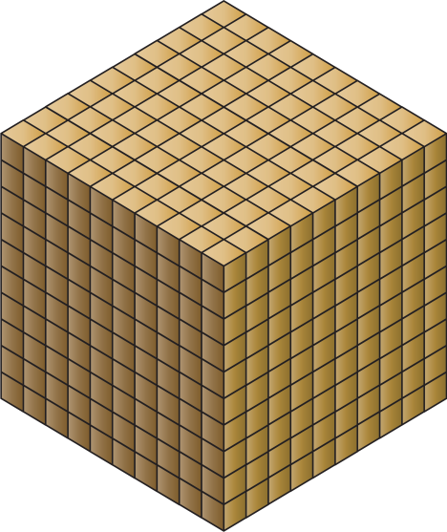
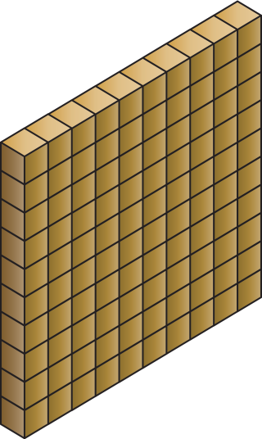

Round 5
Question 6
What number is this?
© Seomra Ranga 2017 www.seomraranga.com

Slide 67
Maths Joke #8
Why did the teacher write the maths problem on the window?
She wanted it to be very clear!
© Seomra Ranga 2017 www.seomraranga.com

Slide 68
ROUND 4 ANSWERS
© Seomra Ranga 2017 www.seomraranga.com

Slide 69
Round 4 Answers
Question 1
What is 10:04pm on a 24 hour clock?
22:04
© Seomra Ranga 2017 www.seomraranga.com

Slide 70
Round 4 Answers
Question 2
How many straight edges on a cube?
12
© Seomra Ranga 2017 www.seomraranga.com

Slide 71
Round 4 Answers
Question 3
What is a fear of numbers called: (a) mathematicophobia (b) arithmophobia (c) hundredsophobia
arithmophobia
© Seomra Ranga 2017 www.seomraranga.com

Slide 72
Round 4 Answers
Question 4
What is the square root of 64? (√64)
8 (8 x 8 =64)
© Seomra Ranga 2017 www.seomraranga.com

Slide 73
Round 4 Answers
Question 5
How many days are there altogether in May, September, July and February (in a Leap Year)?
121 (31+30+31+29)
© Seomra Ranga 2017 www.seomraranga.com

Slide 74
Round 4 Answers
Question 6
Which number is bigger: a billion or a googol?
Googol
(Billion = 10⁹; Googol = 10¹⁰⁰)
© Seomra Ranga 2017 www.seomraranga.com

Slide 75
Maths Joke #9
What is the king of the pencil case?
The ruler!
© Seomra Ranga 2017 www.seomraranga.com

Slide 76
ROUND 6
© Seomra Ranga 2017 www.seomraranga.com

Slide 77
Round 6
Question 1
What is an angle of 90⁰ called?
© Seomra Ranga 2017 www.seomraranga.com

Slide 78
Round 6
Question 2
True or false: There are 31,622,400 seconds in a leap year?
© Seomra Ranga 2017 www.seomraranga.com

Slide 79
Round 6
Question 3
I am an odd number. Take away one letter and I become even. What number am I?
© Seomra Ranga 2017 www.seomraranga.com

Slide 80
Round 6
Question 4
If 2 is the first Prime Number, what is the 7th?
© Seomra Ranga 2017 www.seomraranga.com

Slide 81
Round 6
Question 5
How many sides are there on a quadrilateral?
© Seomra Ranga 2017 www.seomraranga.com

Slide 82
Round 6
Question 6
In a 25m swimming pool, how many lengths does a 4x100m relay team have to swim?
© Seomra Ranga 2017 www.seomraranga.com

Slide 83
Maths Joke #10
Why was 6 afraid of 7?
Because 7 8 9!
© Seomra Ranga 2017 www.seomraranga.com

Slide 84
ROUND 5 ANSWERS
© Seomra Ranga 2017 www.seomraranga.com

Slide 85
Round 5 Answers
Question 1
True or False:
(6 x 9) + 1 ≠ (9 x 6) -1
True (they are not equal)
© Seomra Ranga 2017 www.seomraranga.com

Slide 86
Round 5 Answers
Question 2
How many grammes in 7½Kg?
7,500g
© Seomra Ranga 2017 www.seomraranga.com

Slide 87
Round 5 Answers
Question 3
What is 8.1 ÷ 1000?
0.0081
© Seomra Ranga 2017 www.seomraranga.com

Slide 88
Round 5 Answers
Question 4
How many spots are there on two dice altogether?
42
© Seomra Ranga 2017 www.seomraranga.com

Slide 89
Round 5 Answers
Question 5
Add: the number of legs on a crab; the number of notes in an octave; the number of days in a fortnight
32 (10+8+14)
© Seomra Ranga 2017 www.seomraranga.com

Slide 90



Round 5 Answers
Question 6
What number is this?
1308
© Seomra Ranga 2017 www.seomraranga.com

Slide 91
Maths Joke #11
Why did the pupil do multiplication problems on the floor?
Because the teacher told her not to use tables!
© Seomra Ranga 2017 www.seomraranga.com

Slide 92
ROUND 7
© Seomra Ranga 2017 www.seomraranga.com

Slide 93
Round 7
Question 1
What number is represented by this tally:
© Seomra Ranga 2017 www.seomraranga.com

Slide 94
Round 7
Question 2
How many keys on most modern pianos? (a) 68 (b) 78 (c) 88 (d) 98
© Seomra Ranga 2017 www.seomraranga.com

Slide 95
Round 7
Question 3
A hoodie costs €65. There’s 10% off in a sale. What is the sale price?
© Seomra Ranga 2017 www.seomraranga.com

Slide 96
Round 7
Question 4
What mathematic instrument do you use to measure and construct angles?
© Seomra Ranga 2017 www.seomraranga.com

Slide 97
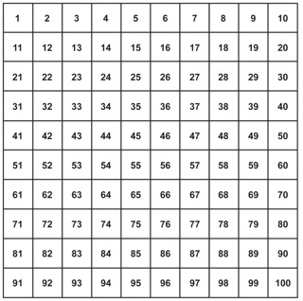
Round 7
Question 5
How many digits in a 100 Square? (a) 105 (b) 181 (c) 192 (d) 199
© Seomra Ranga 2017 www.seomraranga.com

Slide 98
Round 7
Question 6
Name this shape:
© Seomra Ranga 2017 www.seomraranga.com

Slide 99
Maths Joke #12
What did one decimal say to the other?
Do you get my point!
© Seomra Ranga 2017 www.seomraranga.com

Slide 100
ROUND 6 ANSWERS
© Seomra Ranga 2017 www.seomraranga.com

Slide 101
Round 6 Answers
Question 1
What is an angle of 90⁰ called?
A Right Angle
© Seomra Ranga 2017 www.seomraranga.com

Slide 102
Round 6 Answers
Question 2
True or false: There are 31,622,400 seconds in a leap year?
True
© Seomra Ranga 2017 www.seomraranga.com

Slide 103
Round 6 Answers
Question 3
I am an odd number. Take away one letter and I become even. What number am I?
(S)even (7)
© Seomra Ranga 2017 www.seomraranga.com

Slide 104
Round 6 Answers
Question 4
If 2 is the first Prime Number, what is the 7th?
17
© Seomra Ranga 2017 www.seomraranga.com

Slide 105
Round 6 Answers
Question 5
How many sides are there on a quadrilateral?
4
© Seomra Ranga 2017 www.seomraranga.com

Slide 106
Round 6 Answers
Question 6
In a 25m swimming pool, how many lengths does a 4x100m relay team have to swim?
16 (4 x 4)
© Seomra Ranga 2017 www.seomraranga.com

Slide 107
Maths Joke #13
Why is the obtuse angle always upset?
Because it is never right!
© Seomra Ranga 2017 www.seomraranga.com

Slide 108
ROUND 8
© Seomra Ranga 2017 www.seomraranga.com

Slide 109
Round 8
Question 1
What kind of an angle is an angle of 55⁰?
© Seomra Ranga 2017 www.seomraranga.com

Slide 110
Round 8
Question 2
What is the name of a straight line from the centre of the circle to the edge?
© Seomra Ranga 2017 www.seomraranga.com

Slide 111
Round 8
Question 3
Put these in order starting with the smallest: 0.3, 3, 0.003, 0.03, 30
© Seomra Ranga 2017 www.seomraranga.com

Slide 112
Round 8
Question 4
If you score a hat trick in a match, you score 3 goals. How many goals do you score if you get a ‘brace’?
© Seomra Ranga 2017 www.seomraranga.com

Slide 113
Round 8
Question 5
True or false: 111111111 x 111111111 =12345678987654321
© Seomra Ranga 2017 www.seomraranga.com

Slide 114
Round 8
Question 6
What is the missing term in the sequence: 27, 36, __, 54, 63, 72
© Seomra Ranga 2017 www.seomraranga.com

Slide 115
Maths Joke #14
Which king loved fractions?
Henry the ⅛!
© Seomra Ranga 2017 www.seomraranga.com

Slide 116
ROUND 7 ANSWERS
© Seomra Ranga 2017 www.seomraranga.com

Slide 117
Round 7 Answers
Question 1
What number is represented by this tally:
37
© Seomra Ranga 2017 www.seomraranga.com

Slide 118
Round 7 Answers
Question 2
How many keys on most modern pianos? (a) 68 (b) 78 (c) 88 (d) 98
88
© Seomra Ranga 2017 www.seomraranga.com

Slide 119
Round 7 Answers
Question 3
A hoodie costs €65. There’s 10% off in a sale. What is the sale price?
€58.50 (€65 - €6.50)
© Seomra Ranga 2017 www.seomraranga.com

Slide 120
Round 7 Answers
Question 4
What mathematic instrument do you use to measure and construct angles?
Protractor
© Seomra Ranga 2017 www.seomraranga.com

Slide 121
Round 7 Answers
Question 5
How many digits in a 100 Square? (a) 105 (b) 181 (c) 192 (d) 199
192
© Seomra Ranga 2017 www.seomraranga.com

Slide 122
Round 7 Answers
Question 6
Name this shape:
Dodecagon
© Seomra Ranga 2017 www.seomraranga.com

Slide 123
Maths Joke #15
I hired a man to do 8 odd-jobs for me.
He only did jobs 1, 3, 5 and 7!
© Seomra Ranga 2017 www.seomraranga.com

Slide 124
ROUND 8 ANSWERS
© Seomra Ranga 2017 www.seomraranga.com

Slide 125
Round 8
Question 1
What kind of an angle is an angle of 55⁰?
Acute
© Seomra Ranga 2017 www.seomraranga.com

Slide 126
Round 8
Question 2
What is the name of a straight line from the centre of the circle to the edge?
Radius
© Seomra Ranga 2017 www.seomraranga.com

Slide 127
Round 8
Question 3
Put these in order starting with the smallest: 0.3, 3, 0.003, 0.03, 30
0.003, 0.03, 0.3, 3, 30
© Seomra Ranga 2017 www.seomraranga.com

Slide 128
Round 8
Question 4
If you score a hat trick in a match, you score 3 goals. How many goals do you score if you get a ‘brace’?
2
© Seomra Ranga 2017 www.seomraranga.com

Slide 129
Round 8
Question 5
True or false: 111111111 x 111111111 =12345678987654321
True
© Seomra Ranga 2017 www.seomraranga.com

Slide 130
Round 8
Question 6
What is the missing term in the sequence: 27, 36, __, 54, 63, 72
45
© Seomra Ranga 2017 www.seomraranga.com

Slide 131
Maths Joke #16
What did one maths book say to the other?
I don’t know about you, but I’ve got a lot of problems!
© Seomra Ranga 2017 www.seomraranga.com

Slide 132
TIE BREAK ROUND
© Seomra Ranga 2017 www.seomraranga.com

Slide 133
Tie-Break Round
Question 1
What number between 1 and 50 is the only number that has all its letters in alphabetical order?
© Seomra Ranga 2017 www.seomraranga.com

Slide 134
Tie-Break Round
Question 2
How many sides on a pentadecagon?
© Seomra Ranga 2017 www.seomraranga.com

Slide 135
Tie-Break Round
Question 3
How many millimeters are there in 2½ metres?
© Seomra Ranga 2017 www.seomraranga.com

Slide 136
Tie-Break Round
Question 4
Which scale of map would show more detail: 1:500 or 1:50,000?
© Seomra Ranga 2017 www.seomraranga.com

Slide 137
Tie-Break Round
Question 5
What number comes next: million, billion, trillion, _______?
© Seomra Ranga 2017 www.seomraranga.com

Slide 138
Tie-Break Round
Question 6
What number did Buzz Lightyear speak about in the Toy Story movies, represented by this symbol: ∞
© Seomra Ranga 2017 www.seomraranga.com

Slide 139
TIE BREAK ROUND ANSWERS
© Seomra Ranga 2017 www.seomraranga.com

Slide 140
Tie-Break Round Answers
Question 1
What number between 1 and 50 is the only number that has all its letters in alphabetical order?
Forty
© Seomra Ranga 2017 www.seomraranga.com

Slide 141
Tie-Break Round Answers
Question 2
How many sides on a pentadecagon?
15
© Seomra Ranga 2017 www.seomraranga.com

Slide 142
Tie-Break Round Answers
Question 3
How many millimeters are there in 2½ metres?
2,500
© Seomra Ranga 2017 www.seomraranga.com

Slide 143
Tie-Break Round Answers
Question 4
Which scale of map would show more detail: 1:500 or 1:50,000?
1:500
© Seomra Ranga 2017 www.seomraranga.com

Slide 144
Tie-Break Round Answers
Question 5
What number comes next: million, billion, trillion, _______?
Quadrillion
© Seomra Ranga 2017 www.seomraranga.com

Slide 145
Tie-Break Round Answers
Question 6
What number did Buzz Lightyear speak about in the Toy Story movies, represented by this symbol: ∞
Infinity
(‘To infinity and beyond!’)
© Seomra Ranga 2017 www.seomraranga.com

Slide 146
Hope you all enjoyed the quiz!
© Seomra Ranga 2017 www.seomraranga.com

