Slide 1
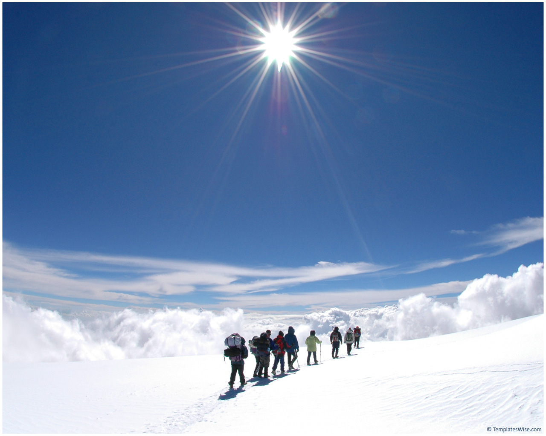
POLAR REGIONS TABLE QUIZ
© Seomra Ranga 2017 www.seomraranga.com

Slide 2
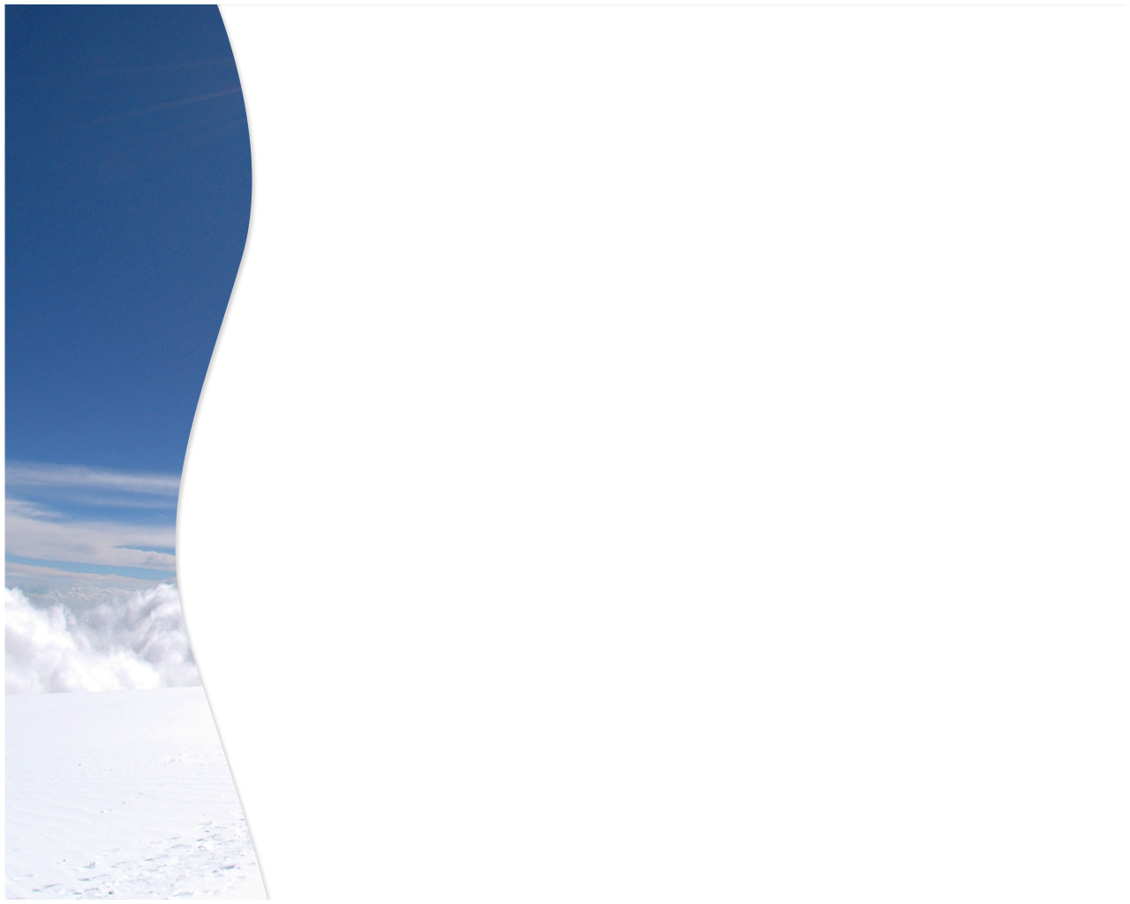
Before You Start
Make sure you have written your table/group number on every answer sheet
Write the number of each round 1-8 on every answer sheet
Try not to shout out answers
Don’t worry about spellings – do your best
Good luck and enjoy the quiz
© Seomra Ranga 2017 www.seomraranga.com

Slide 3
ROUND 1
© Seomra Ranga 2017 www.seomraranga.com

Slide 4
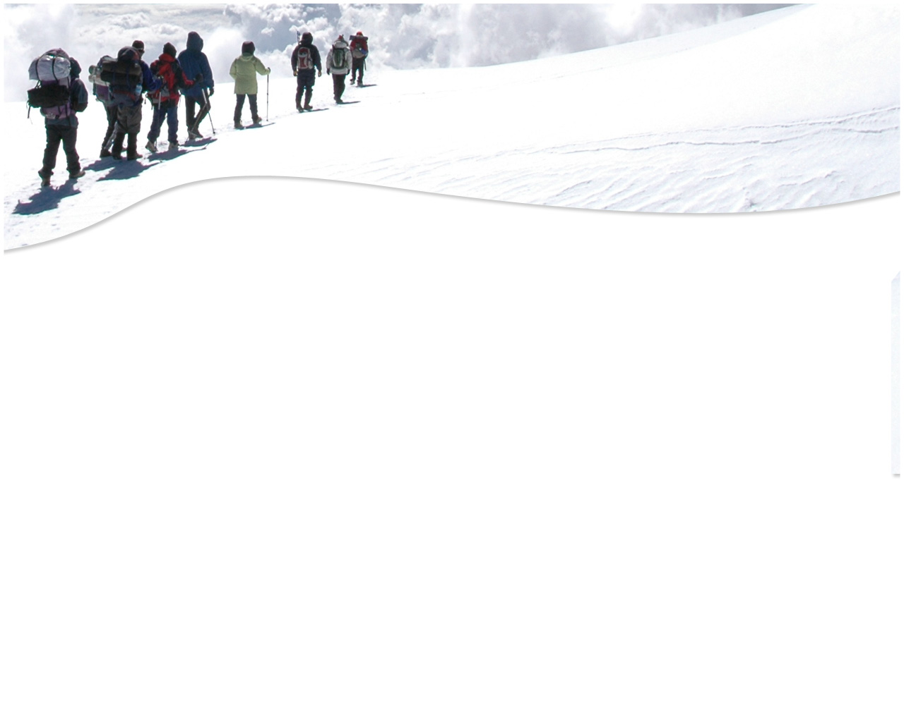
Round 1
Question 1
True or False: The Arctic is in the Northern Hemisphere?
© Seomra Ranga 2017 www.seomraranga.com

Slide 5
Round 1
Question 2
What word means a journey undertaken to Antarctica:
exhibition
expedition
exhaustion
© Seomra Ranga 2017 www.seomraranga.com

Slide 6
Round 1
Question 3
In what county Kerry village was Tom Crean born?
© Seomra Ranga 2017 www.seomraranga.com

Slide 7
Round 1
Question 4
What is a large group of penguins called?
© Seomra Ranga 2017 www.seomraranga.com

Slide 8
Round 1
Question 5
In which year was the South Pole first reached?
© Seomra Ranga 2017 www.seomraranga.com

Slide 9
Round 1
Question 6
In which Irish county was Ernest Shackleton born?
© Seomra Ranga 2017 www.seomraranga.com

Slide 10
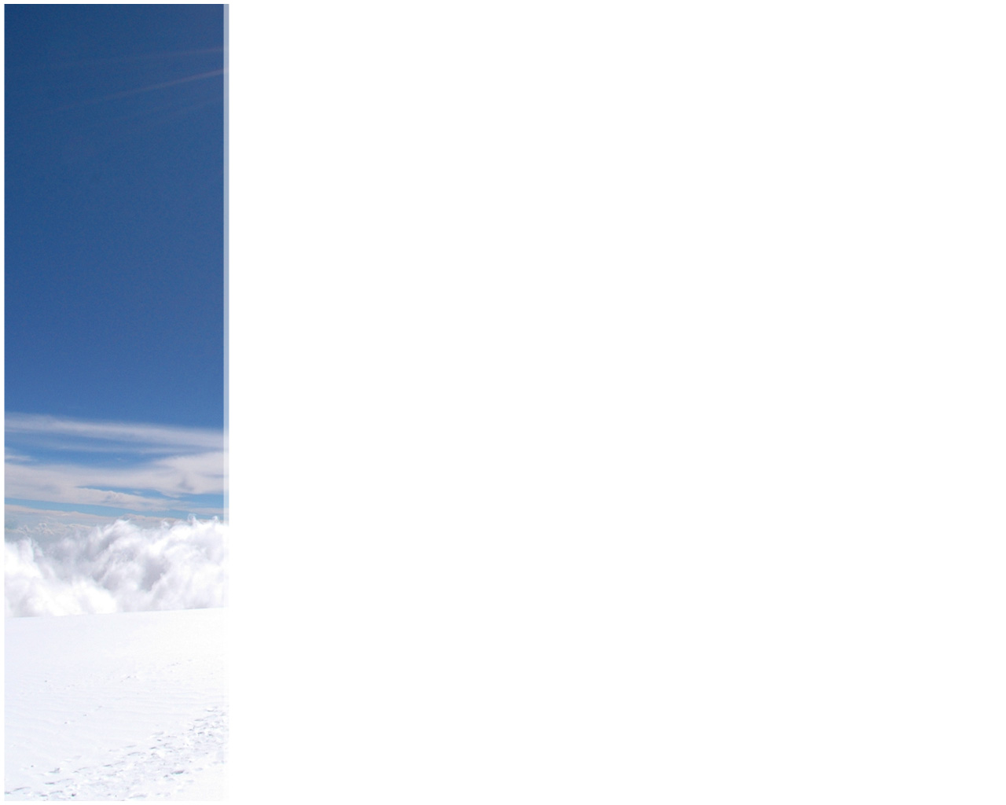
Polar Bear Joke #1
What do polar bears eat for lunch?
Ice berg-ers!
© Seomra Ranga 2017 www.seomraranga.com

Slide 11
ROUND 2
© Seomra Ranga 2017 www.seomraranga.com

Slide 12
Round 2
Question 1
True or False: Polar Bears live in Antarctica?
© Seomra Ranga 2017 www.seomraranga.com

Slide 13
Round 2
Question 2
Unscramble the letters to discover a form of Arctic transport:
BLOMWONISE
© Seomra Ranga 2017 www.seomraranga.com

Slide 14
Round 2
Question 3
What is the largest carnivore that lives on land?
© Seomra Ranga 2017 www.seomraranga.com

Slide 15
Round 2
Question 4
What is the fat of a seal called?
© Seomra Ranga 2017 www.seomraranga.com

Slide 16
Round 2
Question 5
True or False: A penguin is prey for a Polar Bear?
© Seomra Ranga 2017 www.seomraranga.com

Slide 17
Round 2
Question 6
What is the degree of latitude of the South Pole?
© Seomra Ranga 2017 www.seomraranga.com

Slide 18
Polar Bear Joke #2
What’s a balanced diet for a polar bear?
A seal in each paw!
© Seomra Ranga 2017 www.seomraranga.com

Slide 19
ROUND 1 ANSWERS
© Seomra Ranga 2017 www.seomraranga.com

Slide 20
Round 1 Answers
Question 1
True or False: The Arctic is in the Northern Hemisphere?
True
© Seomra Ranga 2017 www.seomraranga.com

Slide 21
Round 1 Answers
Question 2
What word means a journey undertaken to Antarctica:
exhibition
expedition
exhaustion
Expedition
© Seomra Ranga 2017 www.seomraranga.com

Slide 22
Round 1 Answers
Question 3
In what county Kerry village was Tom Crean born?
Anascaul
© Seomra Ranga 2017 www.seomraranga.com

Slide 23
Round 1 Answers
Question 4
What is a large group of penguins called?
Colony
© Seomra Ranga 2017 www.seomraranga.com

Slide 24
Round 1 Answers
Question 5
In which year was the South Pole first reached?
1911
© Seomra Ranga 2017 www.seomraranga.com

Slide 25
Round 1 Answers
Question 6
In which Irish county was Ernest Shackleton born?
Kildare
© Seomra Ranga 2017 www.seomraranga.com

Slide 26
Polar Bear Joke #3
What did the polar bear eat after the dentist fixed its tooth?
The dentist!
© Seomra Ranga 2017 www.seomraranga.com

Slide 27
ROUND 3
© Seomra Ranga 2017 www.seomraranga.com

Slide 28
Round 3
Question 1
True or False: Penguins live in Antarctica?
© Seomra Ranga 2017 www.seomraranga.com

Slide 29
Round 3
Question 2
Unscramble the letters to make an Arctic animal:
WARHLAN
© Seomra Ranga 2017 www.seomraranga.com

Slide 30
Round 3
Question 3
Where do Snowy Owls perch?
© Seomra Ranga 2017 www.seomraranga.com

Slide 31
Round 3
Question 4
What was the name of the cat on board the ‘Endurance’ ship?
© Seomra Ranga 2017 www.seomraranga.com

Slide 32
Round 3
Question 5
How many men were in Shackleton’s crew on the ‘Endurance’?
© Seomra Ranga 2017 www.seomraranga.com

Slide 33
Round 3
Question 6
‘Nanook’ is another name for which animal?
© Seomra Ranga 2017 www.seomraranga.com

Slide 34
Polar Bear Joke #4
What do polar bears like to eat?
Brrrrrr-itos!
© Seomra Ranga 2017 www.seomraranga.com

Slide 35
ROUND 2 ANSWERS
© Seomra Ranga 2017 www.seomraranga.com

Slide 36
Round 2 Answers
Question 1
True or False: Polar Bears live in Antarctica?
False
© Seomra Ranga 2017 www.seomraranga.com

Slide 37
Round 2 Answers
Question 2
Unscramble the letters to discover a form of Arctic transport:
BLOMWONISE
Snowmobile
© Seomra Ranga 2017 www.seomraranga.com

Slide 38
Round 2 Answers
Question 3
What is the largest carnivore that lives on land?
Polar Bears
© Seomra Ranga 2017 www.seomraranga.com

Slide 39
Round 2 Answers
Question 4
What is the fat of a seal called?
Blubber
© Seomra Ranga 2017 www.seomraranga.com

Slide 40
Round 2 Answers
Question 5
True or False: A penguin is prey for a Polar Bear?
False (they live in different parts of the world)
© Seomra Ranga 2017 www.seomraranga.com

Slide 41
Round 2 Answers
Question 6
What is the degree of latitude of the South Pole?
90⁰ S
© Seomra Ranga 2017 www.seomraranga.com

Slide 42
Polar Bear Joke #5
Why don’t polar bears like fast food?
Because they can’t catch it!
© Seomra Ranga 2017 www.seomraranga.com

Slide 43
ROUND 4
© Seomra Ranga 2017 www.seomraranga.com

Slide 44
Round 4
Question 1
Name the native group of people who live in the Arctic?
© Seomra Ranga 2017 www.seomraranga.com

Slide 45
Round 4
Question 2
What is the name of the largest type of penguin?
© Seomra Ranga 2017 www.seomraranga.com

Slide 46
Round 4
Question 3
Which of these is an island off the coast of Antarctica:
Tiger Island
Monkey Island
Elephant Island
© Seomra Ranga 2017 www.seomraranga.com

Slide 47
Round 4
Question 4
Villa Las Estrellas is an Antarctic town owned by which country?
© Seomra Ranga 2017 www.seomraranga.com

Slide 48
Round 4
Question 5
What type of coats do Inuits wear?
© Seomra Ranga 2017 www.seomraranga.com

Slide 49
Round 4
Question 6
Who captained the ‘Endurance’ ship?
© Seomra Ranga 2017 www.seomraranga.com

Slide 50
Polar Bear Joke #6
How does a polar bear stop a DVD?
By pressing the ‘paws’ button!
© Seomra Ranga 2017 www.seomraranga.com

Slide 51
ROUND 3 ANSWERS
© Seomra Ranga 2017 www.seomraranga.com

Slide 52
Round 3 Answers
Question 1
True or False: Penguins live in Antarctica?
True
© Seomra Ranga 2017 www.seomraranga.com

Slide 53
Round 3 Answers
Question 2
Unscramble the letters to make an Arctic animal:
WARHLAN
Narwhal
© Seomra Ranga 2017 www.seomraranga.com

Slide 54
Round 3 Answers
Question 3
Where do Snowy Owls perch?
Rocks
© Seomra Ranga 2017 www.seomraranga.com

Slide 55
Round 3 Answers
Question 4
What was the name of the cat on board the ‘Endurance’ ship?
Mrs. Chippy
© Seomra Ranga 2017 www.seomraranga.com

Slide 56
Round 3 Answers
Question 5
How many men were in Shackleton’s crew on the ‘Endurance’?
28
© Seomra Ranga 2017 www.seomraranga.com

Slide 57
Round 3 answers
Question 6
‘Nanook’ is another name for which animal?
Polar Bear
© Seomra Ranga 2017 www.seomraranga.com

Slide 58
Polar Bear Joke #7
What do you call a dream in which polar bears are chasing you?
A bite-mare!
© Seomra Ranga 2017 www.seomraranga.com

Slide 59
ROUND 5
© Seomra Ranga 2017 www.seomraranga.com

Slide 60
Round 5
Question 1
What animal did Tom Crean sneak on board on his second Antarctic expedition on the Terra Nova?
© Seomra Ranga 2017 www.seomraranga.com

Slide 61
Round 5
Question 2
True or false: Captain Scott died on his return journey from the South Pole?
© Seomra Ranga 2017 www.seomraranga.com

Slide 62
Round 5
Question 3
What type of dog drives an Inuit’s sled?
© Seomra Ranga 2017 www.seomraranga.com

Slide 63
Round 5
Question 4
What animal has the warmest fur on the planet?
© Seomra Ranga 2017 www.seomraranga.com

Slide 64
Round 5
Question 5
True or False: Killer whales live in the Arctic?
© Seomra Ranga 2017 www.seomraranga.com

Slide 65
Round 5
Question 6
What animal is at the top of the Arctic food chain?
© Seomra Ranga 2017 www.seomraranga.com

Slide 66
Polar Bear Joke #8
What did the polar bear say when it saw a seal on a bike?
Meals on Wheels!
© Seomra Ranga 2017 www.seomraranga.com

Slide 67
ROUND 4 ANSWERS
© Seomra Ranga 2017 www.seomraranga.com

Slide 68
Round 4 Answers
Question 1
Name the native group of people who live in the Arctic?
Inuits
© Seomra Ranga 2017 www.seomraranga.com

Slide 69
Round 4 Answers
Question 2
What is the name of the largest type of penguin?
Emperor
© Seomra Ranga 2017 www.seomraranga.com

Slide 70
Round 4 Answers
Question 3
Which of these is an island off the coast of Antarctica:
Tiger Island
Monkey Island
Elephant Island
Elephant Island
© Seomra Ranga 2017 www.seomraranga.com

Slide 71
Round 4 Answers
Question 4
Villa Las Estrellas is an Antarctic town owned by which country?
Chile
© Seomra Ranga 2017 www.seomraranga.com

Slide 72
Round 4 Answers
Question 5
What type of coats do Inuits wear?
Parka
© Seomra Ranga 2017 www.seomraranga.com

Slide 73
Round 4 Answers
Question 6
Who captained the ‘Endurance’ ship?
Frank Worsley
© Seomra Ranga 2017 www.seomraranga.com

Slide 74
Polar Bear Joke #9
What do you call a big mean polar bear heading your way?
Don’t call it anything, just run!
© Seomra Ranga 2017 www.seomraranga.com

Slide 75
ROUND 6
© Seomra Ranga 2017 www.seomraranga.com

Slide 76
Round 6
Question 1
A polar bear’s fur is white (or appears to be white). What colour is its skin?
© Seomra Ranga 2017 www.seomraranga.com

Slide 77
Round 6
Question 2
In what year was Tom Crean born?
© Seomra Ranga 2017 www.seomraranga.com

Slide 78
Round 6
Question 3
The fur of an Arctic hare is white in winter. What colour is it in the summer?
© Seomra Ranga 2017 www.seomraranga.com

Slide 79
Round 6
Question 4
Who was the first explorer to reach the South Pole?
© Seomra Ranga 2017 www.seomraranga.com

Slide 80
Round 6
Question 5
True or False: Arctic Hares hibernate?
© Seomra Ranga 2017 www.seomraranga.com

Slide 81
Round 6
Question 6
Antarctica is:
Sea surrounded by land
Land surrounded by sea
© Seomra Ranga 2017 www.seomraranga.com

Slide 82
Polar Bear Joke #10
Why would polar bears be cheap to keep as pets?
They live on ice!
© Seomra Ranga 2017 www.seomraranga.com

Slide 83
ROUND 5 ANSWERS
© Seomra Ranga 2017 www.seomraranga.com

Slide 84
Round 5 Answers
Question 1
What animal did Tom Crean sneak on board on his second Antarctic expedition on the Terra Nova?
Rabbit
© Seomra Ranga 2017 www.seomraranga.com

Slide 85
Round 5 Answers
Question 2
True or false: Captain Scott died on his return journey from the South Pole?
True
© Seomra Ranga 2017 www.seomraranga.com

Slide 86
Round 5 Answers
Question 3
What type of dog drives an Inuit’s sled?
Husky
© Seomra Ranga 2017 www.seomraranga.com

Slide 87
Round 5 Answers
Question 4
What animal has the warmest fur on the planet?
Arctic Fox
© Seomra Ranga 2017 www.seomraranga.com

Slide 88
Round 5 Answers
Question 5
True or False: Killer whales live in the Arctic?
True
© Seomra Ranga 2017 www.seomraranga.com

Slide 89
Round 5 Answers
Question 6
What animal is at the top of the Arctic food chain?
Polar Bear
© Seomra Ranga 2017 www.seomraranga.com

Slide 90
Polar Bear Joke #11
Where do you find polar bears?
Wherever you lost them!
© Seomra Ranga 2017 www.seomraranga.com

Slide 91
ROUND 7
© Seomra Ranga 2017 www.seomraranga.com

Slide 92
Round 7
Question 1
What is a baby Arctic Fox called?
© Seomra Ranga 2017 www.seomraranga.com

Slide 93
Round 7
Question 2
In 1913, Tom Crean was awarded a medal for bravery for saving his fellow Terra Nova crew members. Was it the
Albert Medal
George Medal
Edward Medal
© Seomra Ranga 2017 www.seomraranga.com

Slide 94
Round 7
Question 3
Antarctica is surrounded by which ocean?
© Seomra Ranga 2017 www.seomraranga.com

Slide 95
Round 7
Question 4
What type of light show can you see in the Arctic?
© Seomra Ranga 2017 www.seomraranga.com

Slide 96
Round 7
Question 5
From which country did Shackleton acquire the ship ‘Endurance’?
© Seomra Ranga 2017 www.seomraranga.com

Slide 97
Round 7
Question 6
Which animal would you not see in Antarctica: penguin, whale, polar bear, seal?
© Seomra Ranga 2017 www.seomraranga.com

Slide 98
Polar Bear Joke #12
What do you get when you cross a polar bear with a rose?
I don’t know but I wouldn’t try to smell it!
© Seomra Ranga 2017 www.seomraranga.com

Slide 99
ROUND 6 ANSWERS
© Seomra Ranga 2017 www.seomraranga.com

Slide 100
Round 6 Answers
Question 1
A polar bear’s fur is white (or appears to be white). What colour is its skin?
Black
© Seomra Ranga 2017 www.seomraranga.com

Slide 101
Round 6 Answers
Question 2
In what year was Tom Crean born?
1877
© Seomra Ranga 2017 www.seomraranga.com

Slide 102
Round 6 Answers
Question 3
The fur of an Arctic hare is white in winter. What colour is it in the summer?
Blue/Grey
© Seomra Ranga 2017 www.seomraranga.com

Slide 103
Round 6 Answers
Question 4
Who was the first explorer to reach the South Pole?
Roald Amundsen
© Seomra Ranga 2017 www.seomraranga.com

Slide 104
Round 6 Answers
Question 5
True or False: Arctic Hares hibernate?
False
© Seomra Ranga 2017 www.seomraranga.com

Slide 105
Round 6 Answers
Question 6
Antarctica is:
Sea surrounded by land
Land surrounded by sea
(b) Land Surrounded by Sea
© Seomra Ranga 2017 www.seomraranga.com

Slide 106
Polar Bear Joke #13
What do polar bears like to eat in the cold?
Brrrrrr-gers!
© Seomra Ranga 2017 www.seomraranga.com

Slide 107
ROUND 8
© Seomra Ranga 2017 www.seomraranga.com

Slide 108
Round 8
Question 1
What are igloos made from?
© Seomra Ranga 2017 www.seomraranga.com

Slide 109
Round 8
Question 2
Who was the leader of the second expedition to reach the South Pole?
© Seomra Ranga 2017 www.seomraranga.com

Slide 110
Round 8
Question 3
How many degrees south of the Equator is the Antarctic Circle?
© Seomra Ranga 2017 www.seomraranga.com

Slide 111
Round 8
Question 4
What animal’s Latin name is ‘Ursus Maritimus’?
© Seomra Ranga 2017 www.seomraranga.com

Slide 112
Round 8
Question 5
What was the name of the sea in which the ‘Endurance’ became stuck in the ice pack?
© Seomra Ranga 2017 www.seomraranga.com

Slide 113
Round 8
Question 6
Antarctica has the largest:
Desert
Mountains
Volcano
© Seomra Ranga 2017 www.seomraranga.com

Slide 114
Polar Bear Joke #14
What do you call a polar bear on thin ice?
An ice breaker!
© Seomra Ranga 2017 www.seomraranga.com

Slide 115
ROUND 7 ANSWERS
© Seomra Ranga 2017 www.seomraranga.com

Slide 116
Round 7 Answers
Question 1
What is a baby Arctic Fox called?
Kit/Pup
© Seomra Ranga 2017 www.seomraranga.com

Slide 117
Round 7 Answers
Question 2
In 1913, Tom Crean was awarded a medal for bravery for saving his fellow Terra Nova crew members. Was it the
Albert Medal
George Medal
Edward Medal
Albert Medal
© Seomra Ranga 2017 www.seomraranga.com

Slide 118
Round 7 Answers
Question 3
Antarctica is surrounded by which ocean?
Southern Ocean
© Seomra Ranga 2017 www.seomraranga.com

Slide 119
Round 7 Answers
Question 4
What type of light show can you see in the Arctic?
Northern Lights
© Seomra Ranga 2017 www.seomraranga.com

Slide 120
Round 7 Answers
Question 5
From which country did Shackleton acquire the ship ‘Endurance’?
Norway
© Seomra Ranga 2017 www.seomraranga.com

Slide 121
Round 7 Answers
Question 6
Which animal would you not see in Antarctica: penguin, whale, polar bear, seal?
Polar Bear
© Seomra Ranga 2017 www.seomraranga.com

Slide 122
Polar Bear Joke #15
What do you call a polar bear outside in the rain?
A drizzly bear!
© Seomra Ranga 2017 www.seomraranga.com

Slide 123
ROUND 8 ANSWERS
© Seomra Ranga 2017 www.seomraranga.com

Slide 124
Round 8 Answers
Question 1
What are igloos made from?
Snow
© Seomra Ranga 2017 www.seomraranga.com

Slide 125
Round 8 Answers
Question 2
Who was the leader of the second expedition to reach the South Pole?
Robert Scott
© Seomra Ranga 2017 www.seomraranga.com

Slide 126
Round 8 Answers
Question 3
How many degrees south of the Equator is the Antarctic Circle?
66⁰
© Seomra Ranga 2017 www.seomraranga.com

Slide 127
Round 8 Answers
Question 4
What animal’s Latin name is ‘Ursus Maritimus’?
Polar Bear
© Seomra Ranga 2017 www.seomraranga.com

Slide 128
Round 8 Answers
Question 5
What was the name of the sea in which the ‘Endurance’ became stuck in the ice pack?
Weddell Sea
© Seomra Ranga 2017 www.seomraranga.com

Slide 129
Round 8 Answers
Question 6
Antarctica has the largest:
Desert
Mountains
Volcano
Desert
© Seomra Ranga 2017 www.seomraranga.com

Slide 130
Polar Bear Joke #16
What do you get when you cross a polar bear with a seal?
A polar bear!
© Seomra Ranga 2017 www.seomraranga.com

Slide 131
TIE-BREAK ROUND
© Seomra Ranga 2017 www.seomraranga.com

Slide 132
Tie-Break Round
Question 1
Antarctica is the world’s coldest continent. It is also the world’s:
furthest away continent
windiest continent
foggiest continent
© Seomra Ranga 2017 www.seomraranga.com

Slide 133
Tie-Break Round
Question 2
True or false: Antarctica is a cold continent now, but it used to be tropical?
© Seomra Ranga 2017 www.seomraranga.com

Slide 134
Tie-Break Round
Question 3
What was the name of the stowaway on the ‘Endurance’ expedition?
© Seomra Ranga 2017 www.seomraranga.com

Slide 135
Tie-Break Round
Question 4
Of the seven continents, where does Antarctica rank in terms of size?
© Seomra Ranga 2017 www.seomraranga.com

Slide 136
Tie-Break Round
Question 5
Where did the ‘Endurance’ first dock after leaving South America?
© Seomra Ranga 2017 www.seomraranga.com

Slide 137
Tie-Break Round
Question 6
What are native people of Antarctica called?
Antarcticans
South Polians
There are no native people of Antarctica
© Seomra Ranga 2017 www.seomraranga.com

Slide 138
Polar Bear Joke #17
What do polar bears sing on a birthday?
Freeze a jolly good fellow!
© Seomra Ranga 2017 www.seomraranga.com

Slide 139
TIE-BREAK ROUND ANSWERS
© Seomra Ranga 2017 www.seomraranga.com

Slide 140
Tie-Break Answers
Question 1
Antarctica is the world’s coldest continent. It is also the world’s:
furthest away continent
windiest continent
foggiest continent
Windiest
© Seomra Ranga 2017 www.seomraranga.com

Slide 141
Tie-Break Answers
Question 2
True or false: Antarctica is a cold continent now, but it used to be tropical?
True
© Seomra Ranga 2017 www.seomraranga.com

Slide 142
Tie-Break Answers
Question 3
What was the name of the stowaway on the ‘Endurance’ expedition?
Perce Blackborrow
© Seomra Ranga 2017 www.seomraranga.com

Slide 143
Tie-Break Answers
Question 4
Of the seven continents, where does Antarctica rank in terms of size?
5th
© Seomra Ranga 2017 www.seomraranga.com

Slide 144
Tie-Break Answers
Question 5
Where did the ‘Endurance’ first dock after leaving South America?
South Georgia Island
© Seomra Ranga 2017 www.seomraranga.com

Slide 145
Tie-Break Answers
Question 6
What are native people of Antarctica called?
Antarcticans
South Polians
There are no native people of Antarctica
There are no native people of Antarctica
© Seomra Ranga 2017 www.seomraranga.com

Slide 146
Polar Bear Joke #18
What did the polar bear say when it saw an igloo?
Ooo, I LOVE these things. Crunchy on the outside, with a nice chewy centre!
© Seomra Ranga 2017 www.seomraranga.com

Slide 147
HOPE YOU ALL ENJOYED THE POLAR REGIONS TABLE QUIZ
© Seomra Ranga 2017 www.seomraranga.com

