Slide 1
Don’t Mention It!
A fun language game where certain key words cannot be mentioned
© Seomra Ranga 2014 www.seomraranga.com

Slide 2
Don’t Mention It!
Don’t Mention:
Chalk
School
Teacher
Chalk
© Seomra Ranga 2014 www.seomraranga.com

Slide 3
Don’t Mention It!
Don’t Mention:
Swimsuit
Swimming
Girl
Swimsuit
© Seomra Ranga 2014 www.seomraranga.com

Slide 4

Don’t Mention It!
Don’t Mention:
Balloons
Air
Blow
Balloons
© Seomra Ranga 2014 www.seomraranga.com

Slide 5

Don’t Mention It!
Don’t Mention:
Bulb
Light
Switch
Bulb
© Seomra Ranga 2014 www.seomraranga.com

Slide 6

Don’t Mention It!
Don’t Mention:
Wheelbarrow
Garden
Weeds
Wheelbarrow
© Seomra Ranga 2014 www.seomraranga.com

Slide 7

Don’t Mention It!
Don’t Mention:
Hoover
Dust
Carpet
Hoover
© Seomra Ranga 2014 www.seomraranga.com

Slide 8

Don’t Mention It!
Don’t Mention:
Candle
Flame
Light
Candle
© Seomra Ranga 2014 www.seomraranga.com

Slide 9

Don’t Mention It!
Don’t Mention:
Bricks
Builder
Wall
Bricks
© Seomra Ranga 2014 www.seomraranga.com

Slide 10
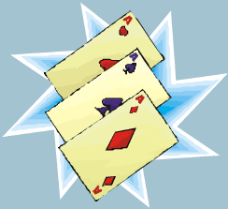
Don’t Mention It!
Don’t Mention:
Cards
Poker
Hearts
Playing Cards
© Seomra Ranga 2014 www.seomraranga.com

Slide 11
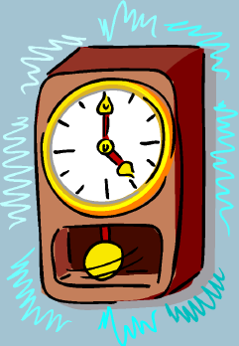
Don’t Mention It!
Don’t Mention:
Clock
Time
Hands
Clock
© Seomra Ranga 2014 www.seomraranga.com

Slide 12

Don’t Mention It!
Don’t Mention:
Hanger
Trousers
Wardrobe
Hanger
© Seomra Ranga 2014 www.seomraranga.com

Slide 13

Don’t Mention It!
Don’t Mention:
Umbrella
Rain
Winter
Umbrella
© Seomra Ranga 2014 www.seomraranga.com

Slide 14
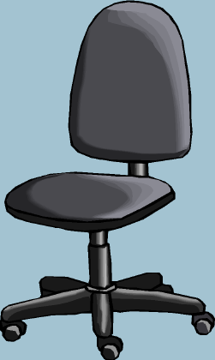
Don’t Mention It!
Don’t Mention:
Chair
Sit
Computer
Chair
© Seomra Ranga 2014 www.seomraranga.com

Slide 15

Don’t Mention It!
Don’t Mention:
Keys
Lock
Open
Keys
© Seomra Ranga 2014 www.seomraranga.com

Slide 16

Don’t Mention It!
Don’t Mention:
Tablets
Sick
Doctor
Tablets
© Seomra Ranga 2014 www.seomraranga.com

Slide 17

Don’t Mention It!
Don’t Mention:
Present
Birthday
Gift
Present
© Seomra Ranga 2014 www.seomraranga.com

Slide 18

Don’t Mention It!
Don’t Mention:
Cereal
Breakfast
Porridge
Cereal
© Seomra Ranga 2014 www.seomraranga.com

Slide 19

Don’t Mention It!
Don’t Mention:
Chips
Burger
Take Away
Chips
© Seomra Ranga 2014 www.seomraranga.com

Slide 20
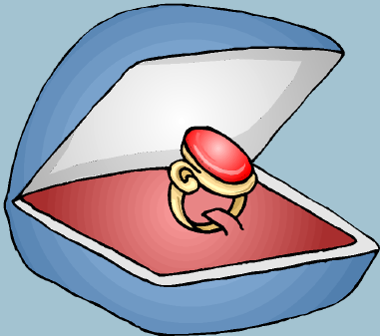
Don’t Mention It!
Don’t Mention:
Ring
Finger
Engaged
Ring
© Seomra Ranga 2014 www.seomraranga.com

Slide 21

Don’t Mention It!
Don’t Mention:
Matches
Fire
Dangerous
Matches
© Seomra Ranga 2014 www.seomraranga.com

Slide 22
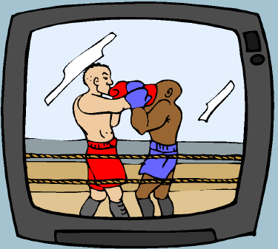
Don’t Mention It!
Don’t Mention:
Television
Sitting Room
Film/Movie
Television
© Seomra Ranga 2014 www.seomraranga.com

Slide 23

Don’t Mention It!
Don’t Mention:
Hammer
Nail
Carpenter
Hammer
© Seomra Ranga 2014 www.seomraranga.com

Slide 24

Don’t Mention It!
Don’t Mention:
Teddy
Bear
Bed
Teddy Bear
© Seomra Ranga 2014 www.seomraranga.com

Slide 25
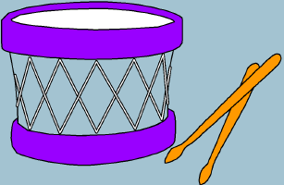
Don’t Mention It!
Don’t Mention:
Drum
Band
Sticks
Drum
© Seomra Ranga 2014 www.seomraranga.com

Slide 26

Don’t Mention It!
Don’t Mention:
Jigsaw
Puzzle
Pieces
Jigsaw
© Seomra Ranga 2014 www.seomraranga.com

Slide 27

Don’t Mention It!
Don’t Mention:
Shower
Bathroom
Water
Shower
© Seomra Ranga 2014 www.seomraranga.com

Slide 28
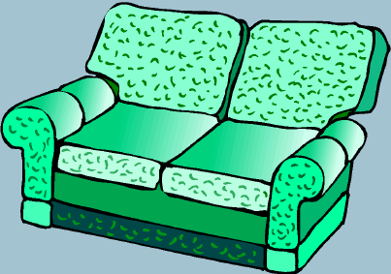
Don’t Mention It!
Don’t Mention:
Couch
Sofa
Sitting-Room
Couch
© Seomra Ranga 2014 www.seomraranga.com

Slide 29
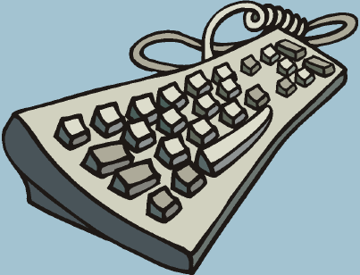
Don’t Mention It!
Don’t Mention:
Keyboard
Computer
Type
Keyboard
© Seomra Ranga 2014 www.seomraranga.com

Slide 30

Don’t Mention It!
Don’t Mention:
Piano
Keys
Music
Piano
© Seomra Ranga 2014 www.seomraranga.com

Slide 31
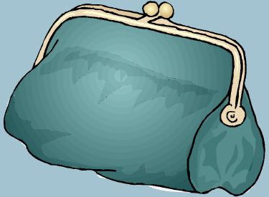
Don’t Mention It!
Don’t Mention:
Purse
Money
Mummy
Purse
© Seomra Ranga 2014 www.seomraranga.com

