Slide 1
My Friend With Autism
© Seomra Ranga 2014 www.seomraranga.com

Slide 2
We are all different!
We are all unique!
© Seomra Ranga 2014 www.seomraranga.com

Slide 3
We all have lots of things the same and a few things different. But …
We all want others to understand us
© Seomra Ranga 2014 www.seomraranga.com

Slide 4
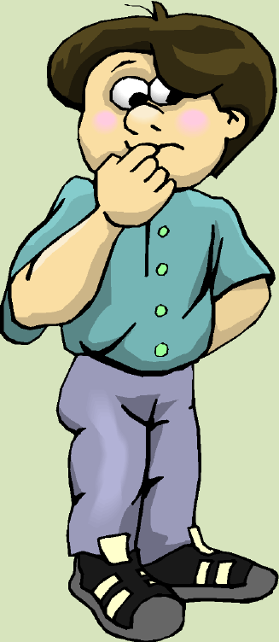
I have a friend with autism
I like him because he’s different, and he’s my friend
© Seomra Ranga 2014 www.seomraranga.com

Slide 5
Just like me, my friend does many things very well, but some things are hard for him
© Seomra Ranga 2014 www.seomraranga.com

Slide 6
Sometimes ……..
He doesn’t like bright lights
He doesn’t like loud or unexpected noises
He doesn’t like having his hair brushed
He doesn’t always feel pain like I do
He doesn’t always like being cuddled
He sits awkwardly and fidgets
And he’s my friend!
© Seomra Ranga 2014 www.seomraranga.com

Slide 7
Sometimes ……..
He finds it hard to take turns
He hates writing and cutting with scissors
He’s a fussy eater and eats the same things
He may shout out in class (but he doesn’t mean to)
He likes to wander in the classroom
He hates being barefoot
And he’s my friend!
©Seomra Ranga 2014 www.seomraranga.com

Slide 8
I have to remember that I have habits that annoy him too!
© Seomra Ranga 2014 www.seomraranga.com

Slide 9
Most of all, I know that my friend likes to have friends too
© Seomra Ranga 2014 www.seomraranga.com

Slide 10
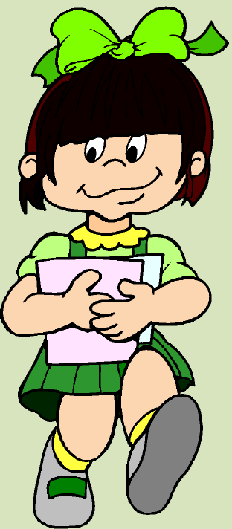
I have a friend with autism
I like her because she’s different, and she’s my friend
© Seomra Ranga 2014 www.seomraranga.com

Slide 11
Just like me, my friend does many things very well, but some things are hard for her
© Seomra Ranga 2014 www.seomraranga.com

Slide 12
Sometimes …..
She finds it hard to concentrate
She has difficulty listening to what others say
She likes to smell things
She chews on everything!
She doesn’t like being tickled
She likes to walk on tiptoes
And she’s my friend!
© Seomra Ranga 2014 www.seomraranga.com

Slide 13
Sometimes …..
She hates the tags in her clothes
She not great at throwing and catching games
Her desk and bag are very untidy
Some fabrics make her uncomfortable
She gets tired very quickly
She is easily distracted in class
And she’s my friend!
© Seomra Ranga 2014 www.seomraranga.com

Slide 14
I have to remember that I have habits that annoy her too!
© Seomra Ranga 2014 www.seomraranga.com

Slide 15
Most of all, I know that my friend likes to have friends too
© Seomra Ranga 2014 www.seomraranga.com

Slide 16
We hope that our friends can be your friends too
© Seomra Ranga 2014 www.seomraranga.com

