Slide 1
Spark the Imagination
A Digital Response to the Class Novel
© Seomra Ranga 2014 www.seomraranga.com

Slide 2
Make Connections
#cesicon
#edchatie
#bunscoile
@cesitweets
@seomraranga
© Seomra Ranga 2014 www.seomraranga.com

Slide 3
Curriculum Goals
experience a shared response to fiction
build up a character profile
encourage children to write reviews
write or tell further adventures of a particular character
making ‘spider plans’ and webs
children need opportunities to exchange and share responses
children will write for different audiences
having their writing praised, receiving constructive criticism and seeing their efforts valued
© Seomra Ranga 2014 www.seomraranga.com

Slide 4
Curriculum Goals
children should be encouraged to write for a real audience and a real purpose
it is important that the teacher establish a sense of purpose for the writing
learn to use language in ways that are appropriate to different audiences
recognise that different registers of language are needed for different purposes
The sharing of writing enhances children’s feelings of success and accomplishment and will inspire and motivate them to further writing
© Seomra Ranga 2014 www.seomraranga.com

Slide 5
Kidblog
Kidblog.org
© Seomra Ranga 2014 www.seomraranga.com

Slide 6
Kidblog
“We get to read other people’s work and write a message/comment saying how good or how much you liked their work. It helps to build people’s vocal and conversational confidence”.
© Seomra Ranga 2014 www.seomraranga.com

Slide 7
Kidblog
“Kidblog has helped me so much over the year. I have improved on my English work and my literacy”
© Seomra Ranga 2014 www.seomraranga.com

Slide 8
Kidblog
“We learned about making comments on a blog so that we don’t just write “Well done” and “Good job” and Cool!” Now we know the steps for making a comment and this has improved the blog immensely”.
© Seomra Ranga 2014 www.seomraranga.com

Slide 9
Kidblog
“Without deviation from normality, progress would be impossible. In the classroom, this blog is nowhere near normal!”
More pupils opinions on blogging in this Video
© Seomra Ranga 2014 www.seomraranga.com

Slide 10
Kidblog
“I love homework this year because we can do some of it on the blog”.
© Seomra Ranga 2014 www.seomraranga.com

Slide 11
Novel Work
Make Connections between two characters from different novels
Get one character to write a letter to another character
Book Reports
Character Analysis
Character Comparison
“What If” Poem based on a character
List of questions in a character’s mind
© Seomra Ranga 2014 www.seomraranga.com

Slide 12
Novel Work
Write a letter from yourself to one of the characters
Write a Diary entry for a character
Decisions – what would you do if you were one of the characters?
Comparison of two novels
Write a Newspaper Article based on an event/incident in the novel
© Seomra Ranga 2014 www.seomraranga.com

Slide 13
Posting Comments
Using Videoscribe App
© Seomra Ranga 2014 www.seomraranga.com

Slide 14
Compare Video and Novel
Under the Hawthorn Tree Video
© Seomra Ranga 2014 www.seomraranga.com

Slide 15
Novel Quiz on Blog
© Seomra Ranga 2014 www.seomraranga.com

Slide 16
Embedding Video Content on Blog
How to write a Book Review
Dancing the Hora
Interview With Author Marita Conlon Mc Kenna
Child Labour in the 19th Century
© Seomra Ranga 2014 www.seomraranga.com

Slide 17
Wordle
http://www.wordle.net/
© Seomra Ranga 2014 www.seomraranga.com

Slide 18
Tagxedo
Language Observation
http://www.tagxedo.com/
© Seomra Ranga 2014 www.seomraranga.com

Slide 19
Tagxedo
Character Analysis
© Seomra Ranga 2014 www.seomraranga.com

Slide 20
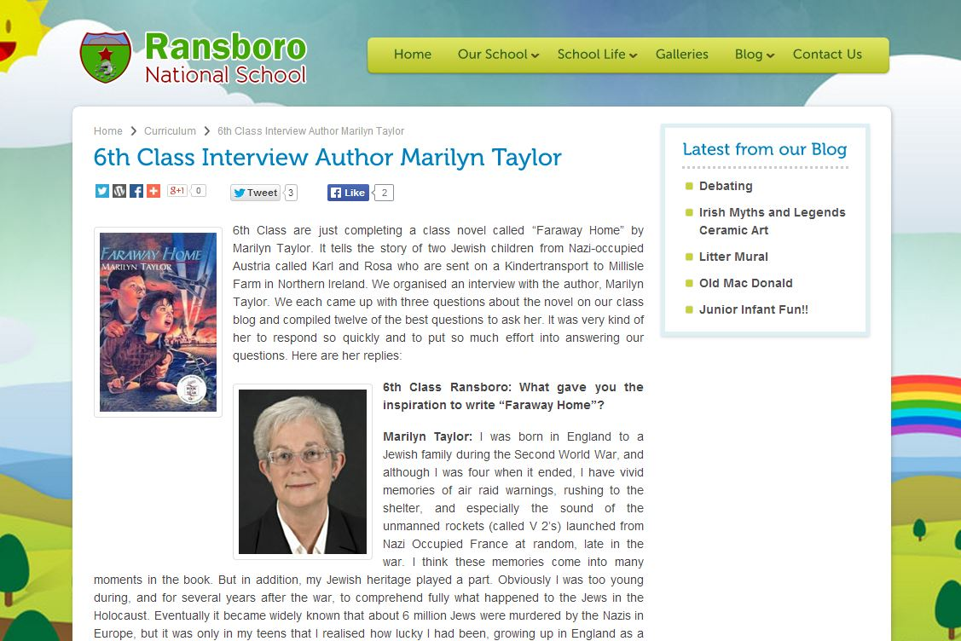
Author Interview
Don’t forget an author visit (Writers in Schools Scheme) through Poetry Ireland www.poetryireland.ie
© Seomra Ranga 2014 www.seomraranga.com

Slide 21
News Booth App
© Seomra Ranga 2014 www.seomraranga.com

Slide 22
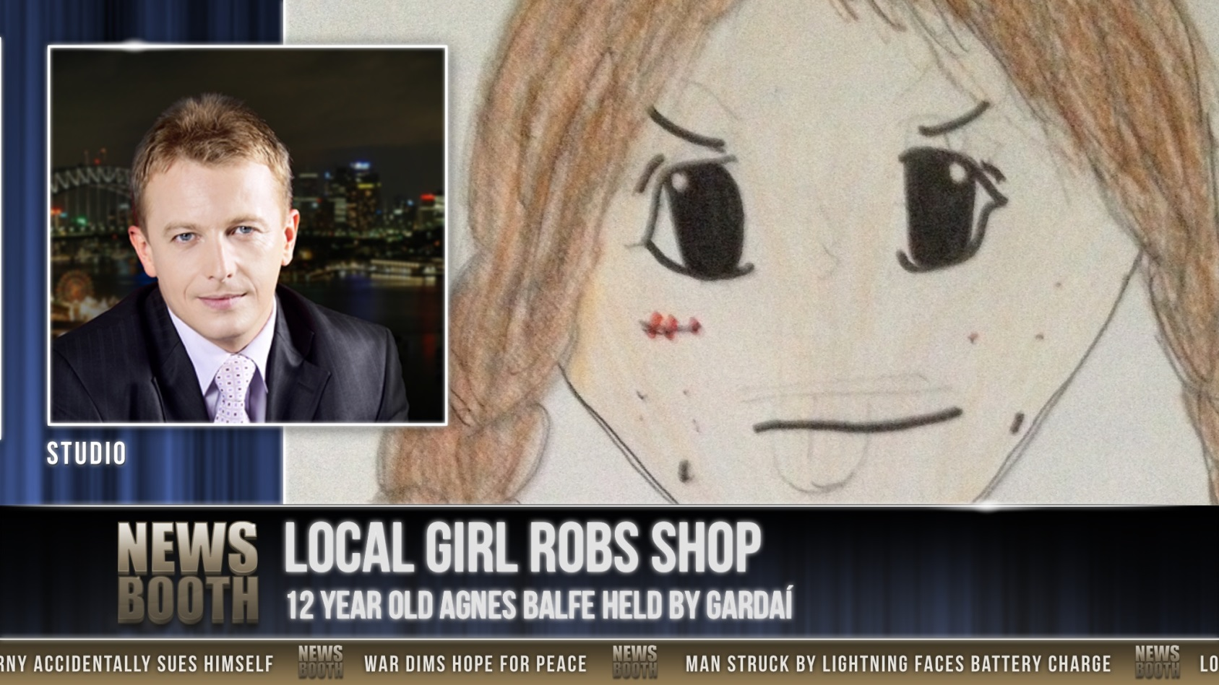
News Booth App
© Seomra Ranga 2014 www.seomraranga.com

Slide 23
News Booth App
© Seomra Ranga 2014 www.seomraranga.com

Slide 24
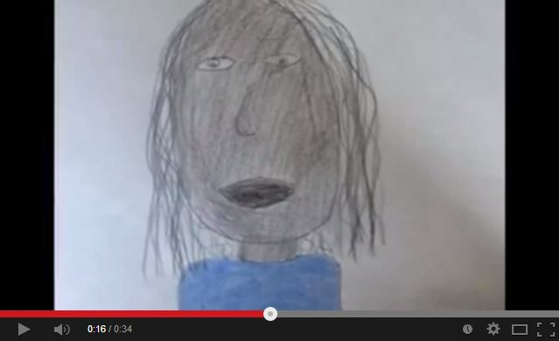
In A World … Drama App
© Seomra Ranga 2014 www.seomraranga.com

Slide 25
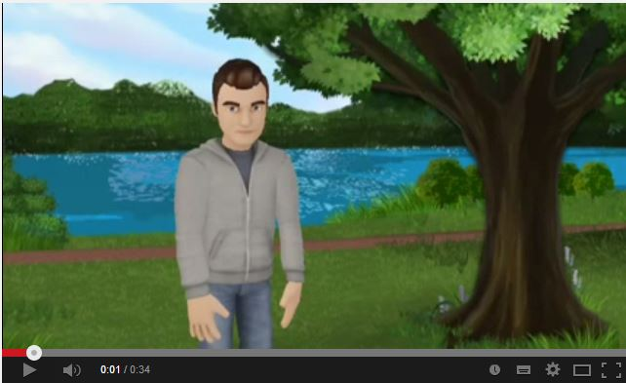
Tellagami App
© Seomra Ranga 2014 www.seomraranga.com

Slide 26
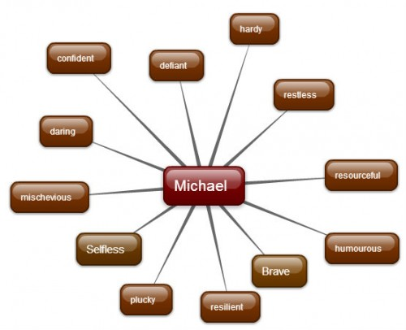
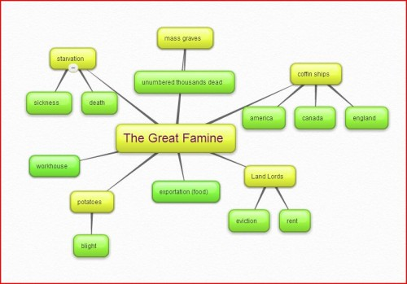
Bubbl.us
https://bubbl.us/
© Seomra Ranga 2014 www.seomraranga.com

Slide 27
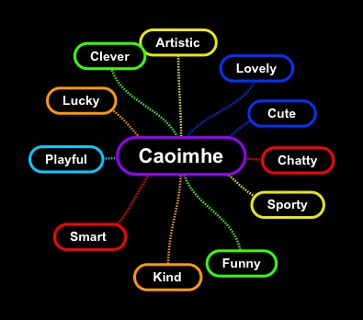
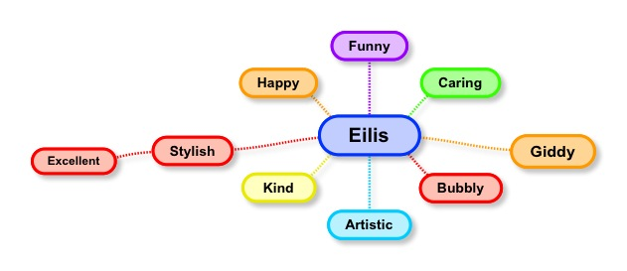
Simple Mind App
Available on iTunes
© Seomra Ranga 2014 www.seomraranga.com

Slide 28
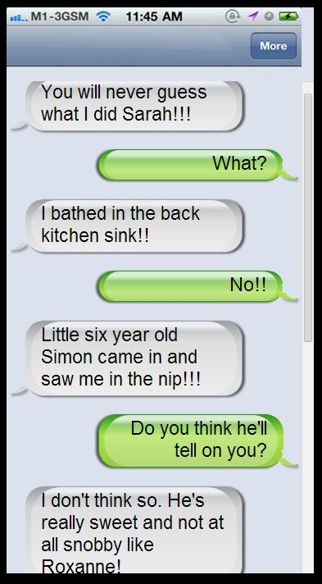
SMS Generator
Classtools.net
© Seomra Ranga 2014 www.seomraranga.com

Slide 29
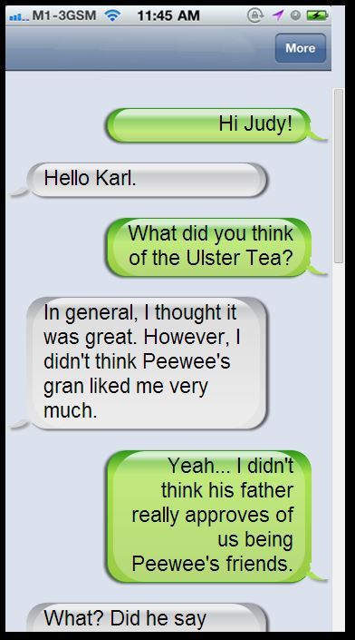
SMS Generator
Classtools.net
© Seomra Ranga 2014 www.seomraranga.com

Slide 30
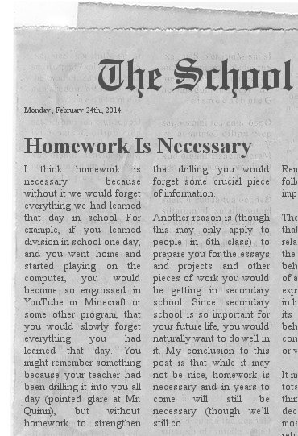
Newspaper Clipping Generator
http://www.fodey.com/generators/newspaper/snippet.asp
© Seomra Ranga 2014 www.seomraranga.com
Saves as an image file

Slide 31
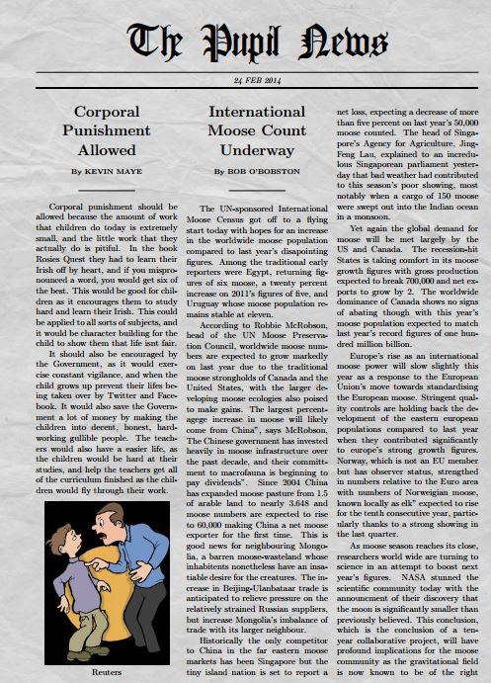
Newspaper Clipping Generator
http://www.homemade-gifts-made-easy.com/newspaper-generator.html
© Seomra Ranga 2014 www.seomraranga.com
Saves as a PDF

Slide 32
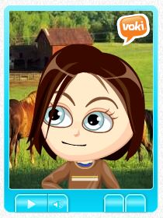
Voki
http://www.voki.com/
© Seomra Ranga 2014 www.seomraranga.com

Slide 33
Novel Ideas
© Seomra Ranga 2014 www.seomraranga.com

Slide 34
Other Ideas
Strip Design App – make a comic strip (iTunes)
Animoto – make a video (animoto.com)
Storybird – create a digital story (storybird.com)
Audacity – create a podcast (audacity.sourceforge.net)
QR Code – embed a video/resource in a QR Code, print and stick into pupils’ novels (qrstuff.com)
QR Code Talking Story (qrvoice.net)
Literacy Shed – great motivator to write (literacyshed.com)
© Seomra Ranga 2014 www.seomraranga.com

Slide 35
Seomra Ranga
www.seomraranga.com/.ie
@seomraranga on Twitter
facebook.com/SeomraRanga
slideshare.com/seomraranga
pinterest.com/seomraranga
info@seomraranga.com
© Seomra Ranga 2014 www.seomraranga.com

