Slide 1
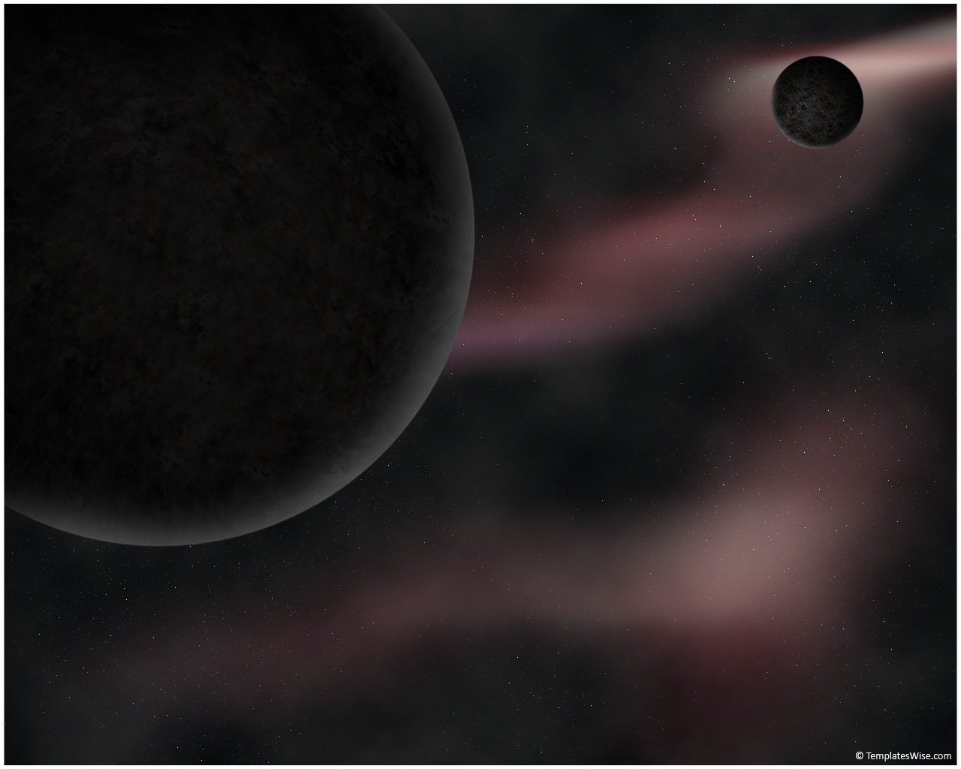

Science Week 2013
Table Quiz
© Seomra Ranga 2013 www.seomraranga.com

Slide 2

Food For Thought …
Science is a way of thinking much more than it is a body of knowledge.
Carl Sagan
© Seomra Ranga 2013 www.seomraranga.com

Slide 3
Before You Start
Make sure you have written your table/group number on every answer sheet
Write the number of each round 1-8 on every answer sheet
Try not to shout out answers
Good luck and enjoy the quiz
© Seomra Ranga 2013 www.seomraranga.com

Slide 4
Round 1
© Seomra Ranga 2013 www.seomraranga.com

Slide 5

Round 1
Question 1
How many legs does a spider have?
© Seomra Ranga 2013 www.seomraranga.com

Slide 6
Round 1
Question 2
True or false: an adult body has over 500 bones?
© Seomra Ranga 2013 www.seomraranga.com

Slide 7
Round 1
Question 3
Global ? is the term used to describe the rise in Earth’s temperature due to human activity.
© Seomra Ranga 2013 www.seomraranga.com

Slide 8
Round 1
Question 4
Bronze is made from copper and what other metal?
© Seomra Ranga 2013 www.seomraranga.com

Slide 9
Round 1
Question 5
What tree does the acorn seed come from?
© Seomra Ranga 2013 www.seomraranga.com

Slide 10
Round 1
Question 6
Name the Commander who earlier this year became famous for taking pictures of earth from space and Tweeting them?
© Seomra Ranga 2013 www.seomraranga.com

Slide 11
Science Joke #1
What’s the first thing you should learn in chemistry?
Never lick the spoon!
© Seomra Ranga 2013 www.seomraranga.com

Slide 12
Round 2
© Seomra Ranga 2013 www.seomraranga.com

Slide 13
Round 2
Question 1
True or False: a dolphin is a mammal?
© Seomra Ranga 2013 www.seomraranga.com

Slide 14
Round 2
Question 2
What are the two holes in your nose called?
© Seomra Ranga 2013 www.seomraranga.com

Slide 15
Round 2
Question 3
What food is used as the base for ‘guacamole’?
© Seomra Ranga 2013 www.seomraranga.com

Slide 16
Round 2
Question 4
What does a Meteorologist study?
© Seomra Ranga 2013 www.seomraranga.com

Slide 17
Round 2
Question 5
How many horns did a triceratops have?
© Seomra Ranga 2013 www.seomraranga.com

Slide 18
Round 2
Question 6
What kind of creatures would you expect to see in an apiary?
© Seomra Ranga 2013 www.seomraranga.com

Slide 19
Science Joke #2
Why is electricity so dangerous?
Because it doesn’t conduct itself!
© Seomra Ranga 2013 www.seomraranga.com

Slide 20
Round 1 Answers
© Seomra Ranga 2013 www.seomraranga.com

Slide 21
Round 1 Answers
Question 1
How many legs does a spider have?
8
© Seomra Ranga 2013 www.seomraranga.com

Slide 22
Round 1 Answers
Question 2
True or false: an adult body has over 500 bones?
False (it has 206)
© Seomra Ranga 2013 www.seomraranga.com

Slide 23
Round 1 Answers
Question 3
Global ? is the term used to describe the rise in Earth’s temperature due to human activity.
Warming
© Seomra Ranga 2013 www.seomraranga.com

Slide 24
Round 1 Answers
Question 4
Bronze is made from copper and what other metal?
Tin
© Seomra Ranga 2013 www.seomraranga.com

Slide 25
Round 1 Answers
Question 5
What tree does the acorn seed come from?
Oak
© Seomra Ranga 2013 www.seomraranga.com

Slide 26
Round 1 Answers
Question 6
Name the Commander who earlier this year became famous for taking pictures of earth from space and Tweeting them?
Commander Hadfield
© Seomra Ranga 2013 www.seomraranga.com

Slide 27
Science Joke #3
Why do chemists prefer nitrates?
Because they’re cheaper than day rates!
© Seomra Ranga 2013 www.seomraranga.com

Slide 28
Round 3
© Seomra Ranga 2013 www.seomraranga.com

Slide 29
Round 3
Question 1
What food makes up 99% of a Giant Panda’s diet?
© Seomra Ranga 2013 www.seomraranga.com

Slide 30
Round 3
Question 2
In what part of the human body would you find the Iris?
© Seomra Ranga 2013 www.seomraranga.com

Slide 31
Round 3
Question 3
True or False: India is the world’s largest producer of bananas?
© Seomra Ranga 2013 www.seomraranga.com

Slide 32
Round 3
Question 4
Which is the slowest of the four swimming strokes?
© Seomra Ranga 2013 www.seomraranga.com

Slide 33
Round 3
Question 5
What does a Seismologist study: earthquakes, volcanoes or storms?
© Seomra Ranga 2013 www.seomraranga.com

Slide 34
Round 3
Question 6
What is the only mammal that can truly fly?
© Seomra Ranga 2013 www.seomraranga.com

Slide 35
Science Joke #4
What was the name of the first electricity detective?
Sherlock Ohms!
© Seomra Ranga 2013 www.seomraranga.com

Slide 36
Round 2 Answers
© Seomra Ranga 2013 www.seomraranga.com

Slide 37
Round 2 Answers
Question 1
True or False: a dolphin is a mammal?
True
© Seomra Ranga 2013 www.seomraranga.com

Slide 38
Round 2 Answers
Question 2
What are the two holes in your nose called?
Nostrils
© Seomra Ranga 2013 www.seomraranga.com

Slide 39
Round 2 Answers
Question 3
What food is used as the base for ‘guacamole’?
Avacado
© Seomra Ranga 2013 www.seomraranga.com

Slide 40
Round 2 Answers
Question 4
What does a Meteorologist study?
Weather
© Seomra Ranga 2013 www.seomraranga.com

Slide 41
Round 2 Answers
Question 5
How many horns did a triceratops have?
Three
© Seomra Ranga 2013 www.seomraranga.com

Slide 42
Round 2 Answers
Question 6
What kind of creatures would you expect to see in an apiary?
Bees
© Seomra Ranga 2013 www.seomraranga.com

Slide 43
Science Joke #5
What did one mountain say to another mountain after an earthquake?
It was not my fault!
© Seomra Ranga 2013 www.seomraranga.com

Slide 44
Round 4
© Seomra Ranga 2013 www.seomraranga.com

Slide 45
Round 4
Question 1
What are female elephants called?
© Seomra Ranga 2013 www.seomraranga.com

Slide 46
Round 4
Question 2
Which planet is closest to the sun?
© Seomra Ranga 2013 www.seomraranga.com

Slide 47
Round 4
Question 3
What is the name given to foods rich in starch such as pasta and bread? (Hint: begins with C!)
© Seomra Ranga 2013 www.seomraranga.com

Slide 48
Round 4
Question 4
True or False: Olympic Gold Medals contain more silver than gold?
© Seomra Ranga 2013 www.seomraranga.com

Slide 49
Round 4
Question 5
Do Stalactites rise from the floor or hang from the ceiling of limestone caves?
© Seomra Ranga 2013 www.seomraranga.com

Slide 50
Round 4
Question 6
What is a rapid fall of snow on a mountain called?
© Seomra Ranga 2013 www.seomraranga.com

Slide 51
Science Joke #6
What kind of shorts do clouds like?
Thunderwear!
© Seomra Ranga 2013 www.seomraranga.com

Slide 52
Round 3 Answers
© Seomra Ranga 2013 www.seomraranga.com

Slide 53
Round 3 Answers
Question 1
What food makes up 99% of a Giant Panda’s diet?
Bamboo
© Seomra Ranga 2013 www.seomraranga.com

Slide 54
Round 3 Answers
Question 2
In what part of the human body would you find the Iris?
The Eye
© Seomra Ranga 2013 www.seomraranga.com

Slide 55
Round 3 Answers
Question 3
True or False: India is the world’s largest producer of bananas?
True
© Seomra Ranga 2013 www.seomraranga.com

Slide 56
Round 3 Answers
Question 4
Which is the slowest of the four swimming strokes?
Breaststroke
© Seomra Ranga 2013 www.seomraranga.com

Slide 57
Round 3 Answers
Question 5
What does a Seismologist study: earthquakes, volcanoes or storms?
Earthquakes
© Seomra Ranga 2013 www.seomraranga.com

Slide 58
Round 3 Answers
Question 6
What is the only mammal that can truly fly?
The Bat
© Seomra Ranga 2013 www.seomraranga.com

Slide 59
Science Joke #7
What does the Pacific Ocean say to the Atlantic Ocean every day?
Nothing, they just wave at each other!
© Seomra Ranga 2013 www.seomraranga.com

Slide 60
Round 5
© Seomra Ranga 2013 www.seomraranga.com

Slide 61
Round 5
Question 1
True or False: Rabbits are born blind?
© Seomra Ranga 2013 www.seomraranga.com

Slide 62
Round 5
Question 2
Is the sun a star or a planet?
© Seomra Ranga 2013 www.seomraranga.com

Slide 63
Round 5
Question 3
What technology company did Bill Gates and Paul Allen found?
© Seomra Ranga 2013 www.seomraranga.com

Slide 64
Round 5
Question 4
What is the only metal that is liquid at room temperature?
© Seomra Ranga 2013 www.seomraranga.com

Slide 65
Round 5
Question 5
Which vitamin is commonly found in oranges: A, B or C?
© Seomra Ranga 2013 www.seomraranga.com

Slide 66
Round 5
Question 6
What part of the human skeleton protects the brain?
© Seomra Ranga 2013 www.seomraranga.com

Slide 67
Science Joke #8
Teacher: "What is the spinal column?"
Pupil: "A long bunch of bones. The head sits on the top and you sit on the bottom."
© Seomra Ranga 2013 www.seomraranga.com

Slide 68
Round 4 Answers
© Seomra Ranga 2013 www.seomraranga.com

Slide 69
Round 4 Answers
Question 1
What are female elephants called?
Cows
© Seomra Ranga 2013 www.seomraranga.com

Slide 70
Round 4 Answers
Question 2
Which planet is closest to the sun?
Mercury
© Seomra Ranga 2013 www.seomraranga.com

Slide 71
Round 4 Answers
Question 3
What is the name given to foods rich in starch such as pasta and bread? (Hint: begins with C !)
Carbohydrates
© Seomra Ranga 2013 www.seomraranga.com

Slide 72
Round 4 Answers
Question 4
True or False: Olympic Gold Medals contain more silver than gold?
True
© Seomra Ranga 2013 www.seomraranga.com

Slide 73
Round 4 Answers
Question 5
Do Stalactites rise from the floor or hang from the ceiling of limestone caves?
Hang From Ceiling
© Seomra Ranga 2013 www.seomraranga.com

Slide 74
Round 4 Answers
Question 6
What is a rapid fall of snow on a mountain called?
Avalanche
© Seomra Ranga 2013 www.seomraranga.com

Slide 75
Science Joke #9
What is the name of the molecule CH₂O?
Sea Water!
© Seomra Ranga 2013 www.seomraranga.com

Slide 76
Round 6
© Seomra Ranga 2013 www.seomraranga.com

Slide 77
Round 6
Question 1
What is a baby goat called?
© Seomra Ranga 2013 www.seomraranga.com

Slide 78
Round 6
Question 2
What planet is known as the ‘Red Planet’?
© Seomra Ranga 2013 www.seomraranga.com

Slide 79
Round 6
Question 3
True or False: ‘Beefsteak’ is a variety of tomato?
© Seomra Ranga 2013 www.seomraranga.com

Slide 80
Round 6
Question 4
Nano, Shuffle, Classic and Touch are all types of what?
© Seomra Ranga 2013 www.seomraranga.com

Slide 81
Round 6
Question 5
Which squirrel is native to Ireland, the red or the grey?
© Seomra Ranga 2013 www.seomraranga.com

Slide 82
Round 6
Question 6
Which chemical element, whose symbol is is also the name of a David Guetta song?
Ti
© Seomra Ranga 2013 www.seomraranga.com

Slide 83
Science Joke #10
What happened the boy who was reading a book on anti-gravity?
He couldn’t put it down!
© Seomra Ranga 2013 www.seomraranga.com

Slide 84
Round 5 Answers
© Seomra Ranga 2013 www.seomraranga.com

Slide 85
Round 5 Answers
Question 1
True or False: Rabbits are born blind?
True
© Seomra Ranga 2013 www.seomraranga.com

Slide 86
Round 5 Answers
Question 2
Is the sun a star or a planet?
Star
© Seomra Ranga 2013 www.seomraranga.com

Slide 87
Round 5 Answers
Question 3
What technology company did Bill Gates and Paul Allen found?
Microsoft
© Seomra Ranga 2013 www.seomraranga.com

Slide 88
Round 5 Answers
Question 4
What is the only metal that is liquid at room temperature?
Mercury
© Seomra Ranga 2013 www.seomraranga.com

Slide 89
Round 5 Answers
Question 5
Which vitamin is commonly found in oranges: A, B or C?
Vitamin C
© Seomra Ranga 2013 www.seomraranga.com

Slide 90
Round 5 Answers
Question 6
What part of the human skeleton protects the brain?
Skull
© Seomra Ranga 2013 www.seomraranga.com

Slide 91
Science Joke #11
What do you call a fish without an eye?
Fsh!
© Seomra Ranga 2013 www.seomraranga.com

Slide 92
Round 7
© Seomra Ranga 2013 www.seomraranga.com

Slide 93
Round 7
Question 1
What kind of animal is a doe?
© Seomra Ranga 2013 www.seomraranga.com

Slide 94
Round 7
Question 2
With what country would you associate the dish ‘paella’?
© Seomra Ranga 2013 www.seomraranga.com

Slide 95
Round 7
Question 3
True or false: Kelvin, Celcius and Fahrenheit are all measures of temperature?
© Seomra Ranga 2013 www.seomraranga.com

Slide 96
Round 7
Question 4
Firefox, Opera, Chrome, Safari and Explorer are all types of what?
© Seomra Ranga 2013 www.seomraranga.com

Slide 97
Round 7
Question 5
What does a geologist study?
© Seomra Ranga 2013 www.seomraranga.com

Slide 98
Round 7
Question 6
If every member of a particular species is dead, it is said to be ______.
© Seomra Ranga 2013 www.seomraranga.com

Slide 99
Science Joke #11
How does a dog stop a DVD?
It presses the paws button!
© Seomra Ranga 2013 www.seomraranga.com

Slide 100
Round 6 Answers
© Seomra Ranga 2013 www.seomraranga.com

Slide 101
Round 6 Answers
Question 1
What is a baby goat called?
Kid
© Seomra Ranga 2013 www.seomraranga.com

Slide 102
Round 6 Answers
Question 2
What planet is known as the ‘Red Planet’?
Mars
© Seomra Ranga 2013 www.seomraranga.com

Slide 103
Round 6 Answers
Question 3
True or False: ‘Beefsteak’ is a variety of tomato?
True
© Seomra Ranga 2013 www.seomraranga.com

Slide 104
Round 6 Answers
Question 4
Nano, Shuffle, Classic and Touch are all types of what?
Apple iPod
© Seomra Ranga 2013 www.seomraranga.com

Slide 105
Round 6 Answers
Question 5
Which squirrel is native to Ireland, the red or the grey?
Red
© Seomra Ranga 2013 www.seomraranga.com

Slide 106
Round 6 Answers
Question 6
Which chemical element, whose symbol is is also the name of a David Guetta song?
Titanium
Ti
© Seomra Ranga 2013 www.seomraranga.com

Slide 107
Science Joke #12
How do you know when the moon has enough to eat?
When it’s full!
© Seomra Ranga 2013 www.seomraranga.com

Slide 108
Round 8
© Seomra Ranga 2013 www.seomraranga.com

Slide 109
Round 8
Question 1
Is a shark a fish or a mammal?
© Seomra Ranga 2013 www.seomraranga.com

Slide 110
Round 8
Question 2
What is the name of the force which holds us down to earth?
© Seomra Ranga 2013 www.seomraranga.com

Slide 111
Round 8
Question 3
Stratus, Cirrus, Cumulus and Nimbus are all types of what?
© Seomra Ranga 2013 www.seomraranga.com

Slide 112
Round 8
Question 4
True or false: heat is a form of energy?
© Seomra Ranga 2013 www.seomraranga.com

Slide 113
Round 8
Question 5
A filament is a wire inside what electrical item?
© Seomra Ranga 2013 www.seomraranga.com

Slide 114
Round 8
Question 6
What is a group of dog offspring known as?
© Seomra Ranga 2013 www.seomraranga.com

Slide 115
Science Joke #13
Why did Mickey Mouse go to Outer Space?
He was looking for Pluto!
© Seomra Ranga 2013 www.seomraranga.com

Slide 116
Round 7 Answers
© Seomra Ranga 2013 www.seomraranga.com

Slide 117
Round 7 Answers
Question 1
What kind of animal is a doe?
Deer
© Seomra Ranga 2013 www.seomraranga.com

Slide 118
Round 7 Answers
Question 2
With what country would you associate the dish ‘paella’?
Spain
© Seomra Ranga 2013 www.seomraranga.com

Slide 119
Round 7 Answers
Question 3
True or false: Kelvin, Celcius and Fahrenheit are all measures of temperature?
True
© Seomra Ranga 2013 www.seomraranga.com

Slide 120
Round 7 Answers
Question 4
Firefox, Opera, Chrome, Safari and Explorer are all types of what?
Web Browsers
© Seomra Ranga 2013 www.seomraranga.com

Slide 121
Round 7 Answers
Question 5
What does a geologist study?
Rocks
© Seomra Ranga 2013 www.seomraranga.com

Slide 122
Round 7 Answers
Question 6
If every member of a particular species is dead, it is said to be ______.
Extinct
© Seomra Ranga 2013 www.seomraranga.com

Slide 123
Science Joke #14
Why did the people not like the restaurant on the moon?
Because there was no atmosphere!
© Seomra Ranga 2013 www.seomraranga.com

Slide 124
Round 8 Answers
© Seomra Ranga 2013 www.seomraranga.com

Slide 125
Round 8 Answers
Question 1
Is a shark a fish or a mammal?
Fish
© Seomra Ranga 2013 www.seomraranga.com

Slide 126
Round 8 Answers
Question 2
What is the name of the force which holds us down to earth?
Gravity
© Seomra Ranga 2013 www.seomraranga.com

Slide 127
Round 8 Answers
Question 3
Stratus, Cirrus, Cumulus and Nimbus are all types of what?
Clouds
© Seomra Ranga 2013 www.seomraranga.com

Slide 128
Round 8 Answers
Question 4
True or false: heat is a form of energy?
True
© Seomra Ranga 2013 www.seomraranga.com

Slide 129
Round 8 Answers
Question 5
A filament is a wire inside what electrical item?
Light Bulb
© Seomra Ranga 2013 www.seomraranga.com

Slide 130
Round 8 Answers
Question 6
What is a group of dog offspring known as?
A Litter
© Seomra Ranga 2013 www.seomraranga.com

Slide 131
Science Joke #15
Why was the ant so confused?
Because his uncles were all ants!
© Seomra Ranga 2013 www.seomraranga.com

Slide 132
Tie-Break Round
© Seomra Ranga 2013 www.seomraranga.com

Slide 133
Tie-Break
Question 1
Bees are found on every continent except one, which one?
© Seomra Ranga 2013 www.seomraranga.com

Slide 134
Tie-Break
Question 2
What do you call the bones that make up your spine?
© Seomra Ranga 2013 www.seomraranga.com

Slide 135
Tie-Break
Question 3
Who was the first person to walk on the moon?
© Seomra Ranga 2013 www.seomraranga.com

Slide 136
Tie-Break
Question 4
Deer meat is known by what name?
© Seomra Ranga 2013 www.seomraranga.com

Slide 137
Tie-Break
Question 5
What does an anemometer measure?
© Seomra Ranga 2013 www.seomraranga.com

Slide 138
Tie-Break
Question 6
What is the scientific study of plant life known as?
© Seomra Ranga 2013 www.seomraranga.com

Slide 139
Science Joke #16
What do you call a crate of ducks?
A box of quackers!
© Seomra Ranga 2013 www.seomraranga.com

Slide 140
Tie-Break Answers
© Seomra Ranga 2013 www.seomraranga.com

Slide 141
Tie-Break Answers
Question 1
Bees are found on every continent except one, which one?
Antarctica
© Seomra Ranga 2013 www.seomraranga.com

Slide 142
Tie-Break Answers
Question 2
What do you call the bones that make up your spine?
Vertebrae
© Seomra Ranga 2013 www.seomraranga.com

Slide 143
Tie-Break Answers
Question 3
Who was the first person to walk on the moon?
Neil Armstrong
© Seomra Ranga 2013 www.seomraranga.com

Slide 144
Tie-Break Answers
Question 4
Deer meat is known by what name?
Venison
© Seomra Ranga 2013 www.seomraranga.com

Slide 145
Tie-Break Answers
Question 5
What does an anemometer measure?
Wind Speed
© Seomra Ranga 2013 www.seomraranga.com

Slide 146
Tie-Break Answers
Question 6
What is the scientific study of plant life known as?
Botany
© Seomra Ranga 2013 www.seomraranga.com

Slide 147
Science Joke #16
What do you call a parrot that flew away?
Polygon!
© Seomra Ranga 2013 www.seomraranga.com

Slide 148
Food For Thought …
The best scientist is open to experience and begins with romance - the idea that anything is possible.
Ray Bradbury
© Seomra Ranga 2013 www.seomraranga.com

Slide 149
And Finally …
The average cost of a GB of computer memory over time:
1980: $6,328,125
1985: $859,375
1990: $103,880
1995: $30,875
2000: $1,107
2005: $189
2010: $12.37
2013: $5.50
Source: John C. McCallum (jcmit.com)
So …..
© Seomra Ranga 2013 www.seomraranga.com

Slide 150
So …………
Science Matters!
© Seomra Ranga 2013 www.seomraranga.com

