Slide 1
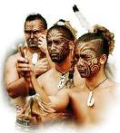
The Maori culture of New Zealand

Slide 2
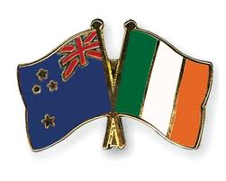
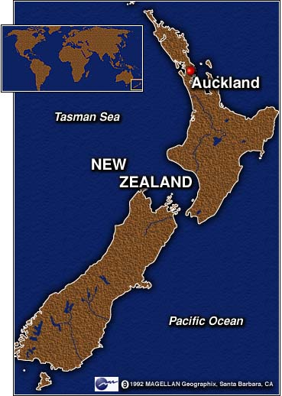
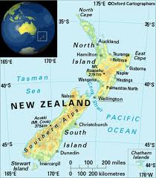
Maori Location

Slide 3
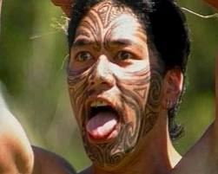
Maori
The Maori community are the indigenous Polynesian people of New Zealand
The Maori developed a unique language, rich mythology, distinctive crafts and performing arts. All of which are based on Polynesian social customs.

Slide 4
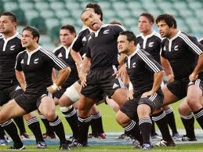
Maori
The arrival of Europeans to New Zealand from the 17th century onwards brought change to the Maori way of life.
The Treaty of Waitangi in 1840 meant the two cultures coexisted as part of a new British colony.
Social upheaval, decades of conflict and epidemics of disease too their toll on the Maori population but from 1960s onwards, a Maori cultural revival has been taking place.

Slide 5
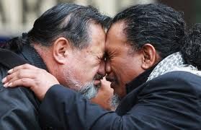
Maori
In 2010, there were an estimated 660,000 Maori in New Zealand, making up 15% of the national population. (Population of New Zealand is 4.4 million)
There are 100,000 Maori living in Australia. (Population of Australia is 22,697,577 million)
A Maori welcome >>>>>>>>>

Slide 6
Maori Language
New Zealand has three official languages, English, Maori and New Zealand Sign Language.
Most Government departments & agencies have bilingual names, e.g., the Dept of Internal Affairs is Te Tari Taiwhenua.
An interpreter is in Parliament in case a MP wants to speak Maori.

Slide 7
Maori Language
A 1994 ruling by the Privy Council in the UK held the New Zealand Government responsible under the Treaty of Waitangi (1840) to preserve the language.
There is a state funded Maori Television station (similar to TG4 in Ireland)

Slide 8
Maori Language
The modern Māori alphabet has 20 letters, two of which are digraphs: A Ā E Ē H I Ī K M N O Ō P R T U Ū W NG and WH
ata 'morning', āta 'carefully'
mana 'prestige', māna 'for him/her'
manu 'bird', mānu 'to float'
o 'of', ō 'provisions for a journey'
wahine 'woman', wāhine 'women'

Slide 9
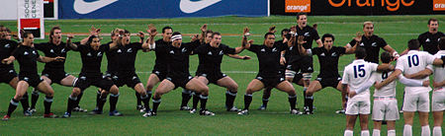
The Haka is a traditional Maori war dance from New Zealand. There are thousands of Haka that are performed by various tribes and cultural groups throughout New Zealand. The best known Haka of them all is called "KA MATE". It has been performed by countless New Zealand teams both locally and internationally. It is normally performed immediately prior to the event that is to take place: e.g. sports matches, conferences, VIP functions, hui, etc

